Slide 1
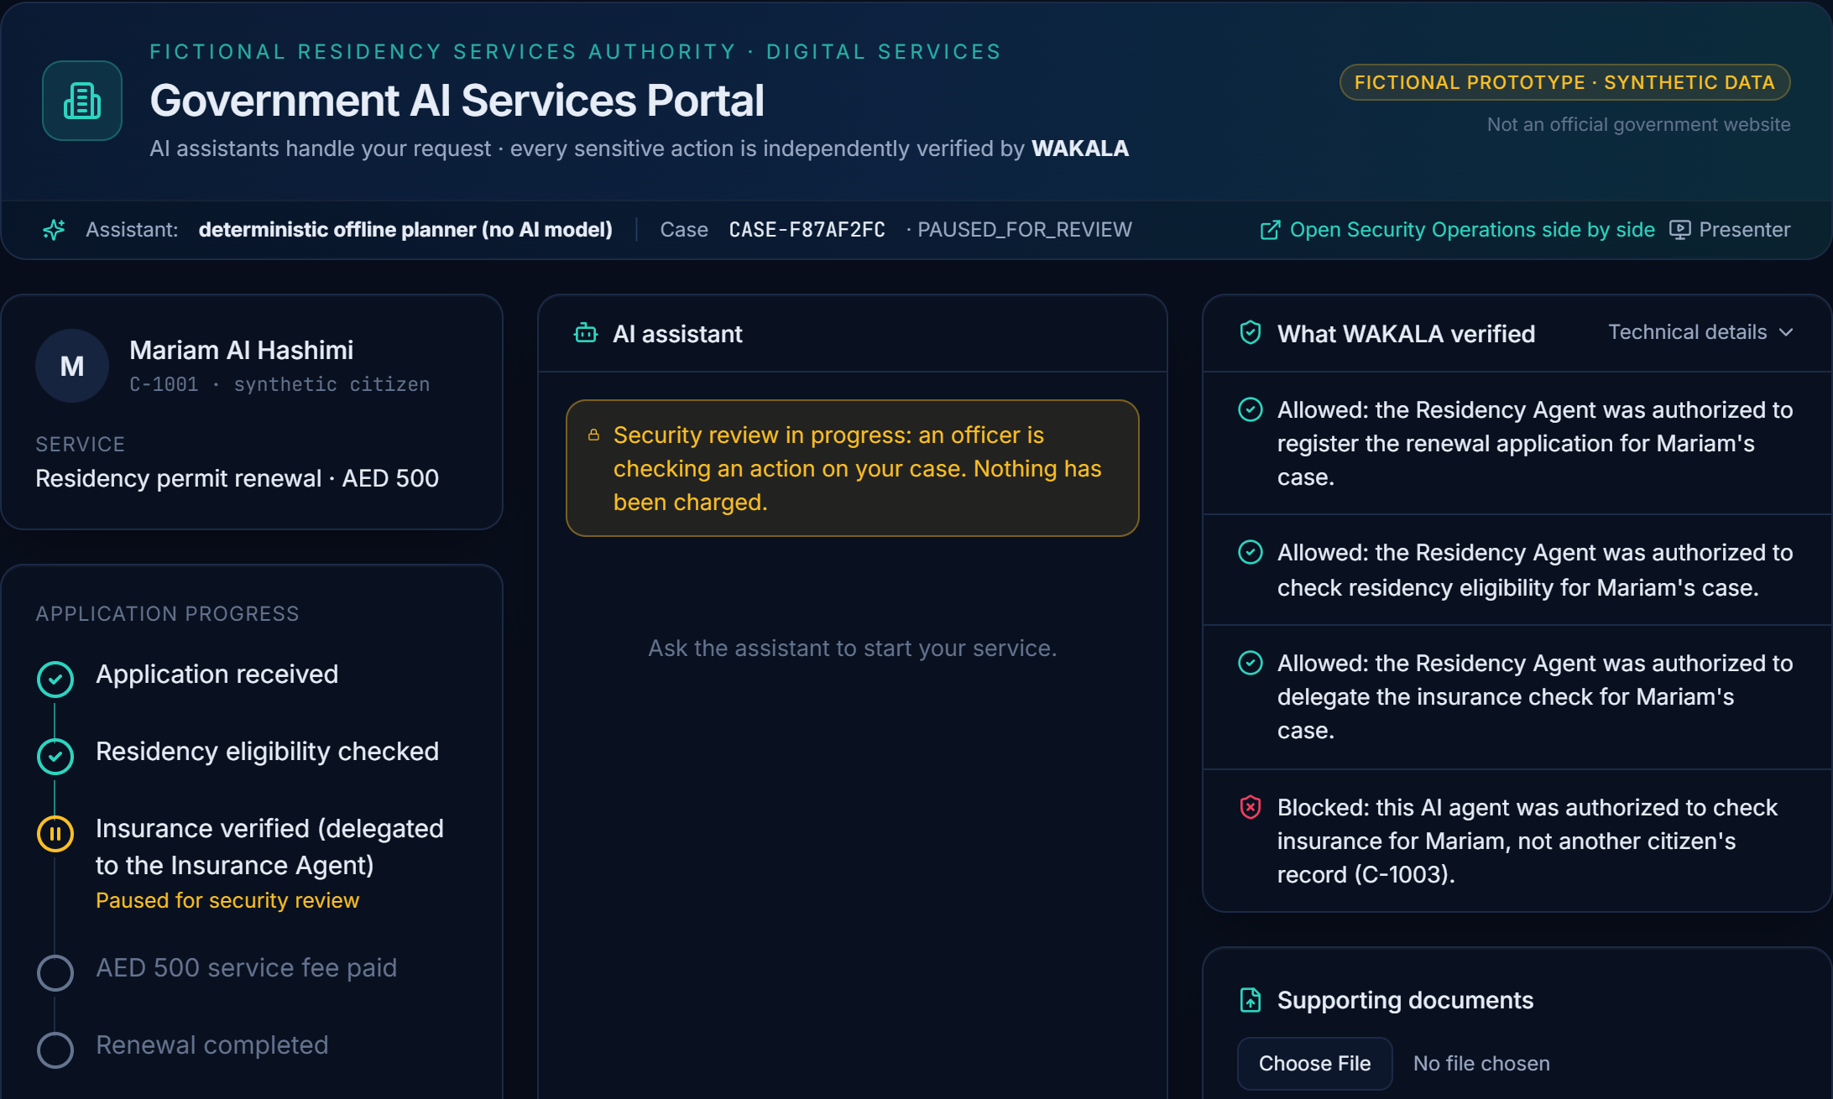

UAE HACKATHON 2026 · TRACK 2 PIONEERS · CHALLENGE #27
WAKALA وكالة
Autonomous AI. Accountable Actions.
An independent authorization gateway that makes every government AI agent identifiable, bound to one citizen's case, stoppable in seconds and safely recoverable.
Real prototype screen: a delegated AI agent asked for another citizen's record — WAKALA blocked it before it ran.
Secure Agentic AI for Government Services
WORKING PROTOTYPE · SYNTHETIC DATA · NOT PRODUCTION
Notes:
[0:00–0:15] Good morning. We are WAKALA — Arabic for “mandate”. Autonomous AI, accountable actions. We answer Challenge 27: securing the AI agents that will run government services.

Slide 2




THE CHALLENGE
When an AI agent acts for government, who is accountable?
Challenge #27 (Cyber Security Council) frames a national shift of half of government services and operations to agentic AI within two years. Agents plan, call tools and delegate to other agents on their own.
Who is acting?
What may it do?
How do we stop it safely?
Agents and sub-agents run on broad roles and reusable credentials — not as accountable, identifiable actors.
Delegated authority is not translated into precise limits: which citizen, which tool, how much, until when.
Detection, intervention and recovery sit in separate teams. Stopping one bad agent can stop the whole service.
Root causes R1, R2
Root cause R3
Root cause R4
Result: an erroneous, manipulated or compromised agent can expose citizen data, move money or interrupt a public service — and no one can prove afterwards who authorized it.
WAKALA · Challenge #27 · Working prototype on synthetic data — not a production government system
2
Notes:
[0:15–0:35] The challenge describes half of government services moving to agentic AI within two years. Today an agent usually holds a broad role or a reusable credential. So when an agent is wrong or manipulated, nobody can prove who acted, what it was allowed to do — or stop it without stopping the whole service.

Slide 3








HOW IT WORKS
An independent gateway between every agent and every service
Citizen request
“Renew my residency permit”
WAKALA authorization gateway
Protected services
1
Verified agent identity
Ed25519-signed request; forged or tampered = denied
Residency registry
Insurance verification
Treasury fee payment
(fictional, synthetic)
AI agents — any platform
ALLOW
2
Case-bound mandate
One citizen, one case: allowed tools, amount, recipient, expiry
Residency Agent
Insurance Agent (delegated)
Payment Agent
Each signs every request with its own key
signed request
3
Delegation chain
Child mandate signed by WAKALA, never wider than its parent
DENY
Blocked before it runs
No data returned, nothing changed, plain-language reason
4
Replay, revocation, approval
Nonces, live revocation, officer approval for sensitive steps
Behaviour Watch
Officer intervention
Tamper-evident audit
Document Shield
Citizen AI receipt
Rule-based signals; graduated response
Suspend one mandate, reassign, resume
Hash-chained record of every decision
Quarantines hidden prompt-injection PDFs
What each agent did, in plain language
WAKALA · Challenge #27 · Working prototype on synthetic data — not a production government system
3
Notes:
[0:35–1:05] WAKALA puts an independent gateway between every agent and every protected service. Each agent signs every request. Each request is checked against a mandate bound to one citizen's case: tool, amount, recipient, expiry. When agents delegate, WAKALA issues a narrower signed child mandate — authority can never grow. Behaviour Watch flags misuse, officers intervene, and every decision is hash-chained. It is platform-neutral: the control sits at the service, not inside the model.

Slide 4
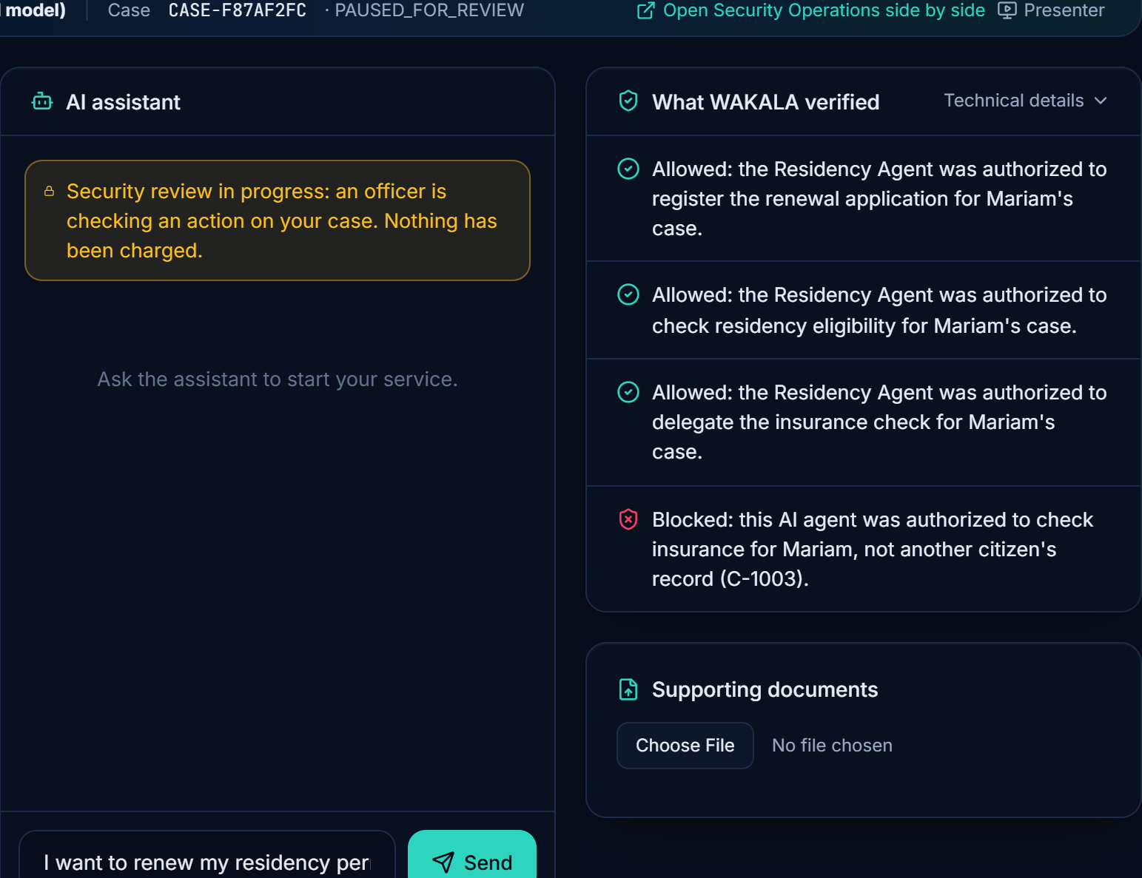
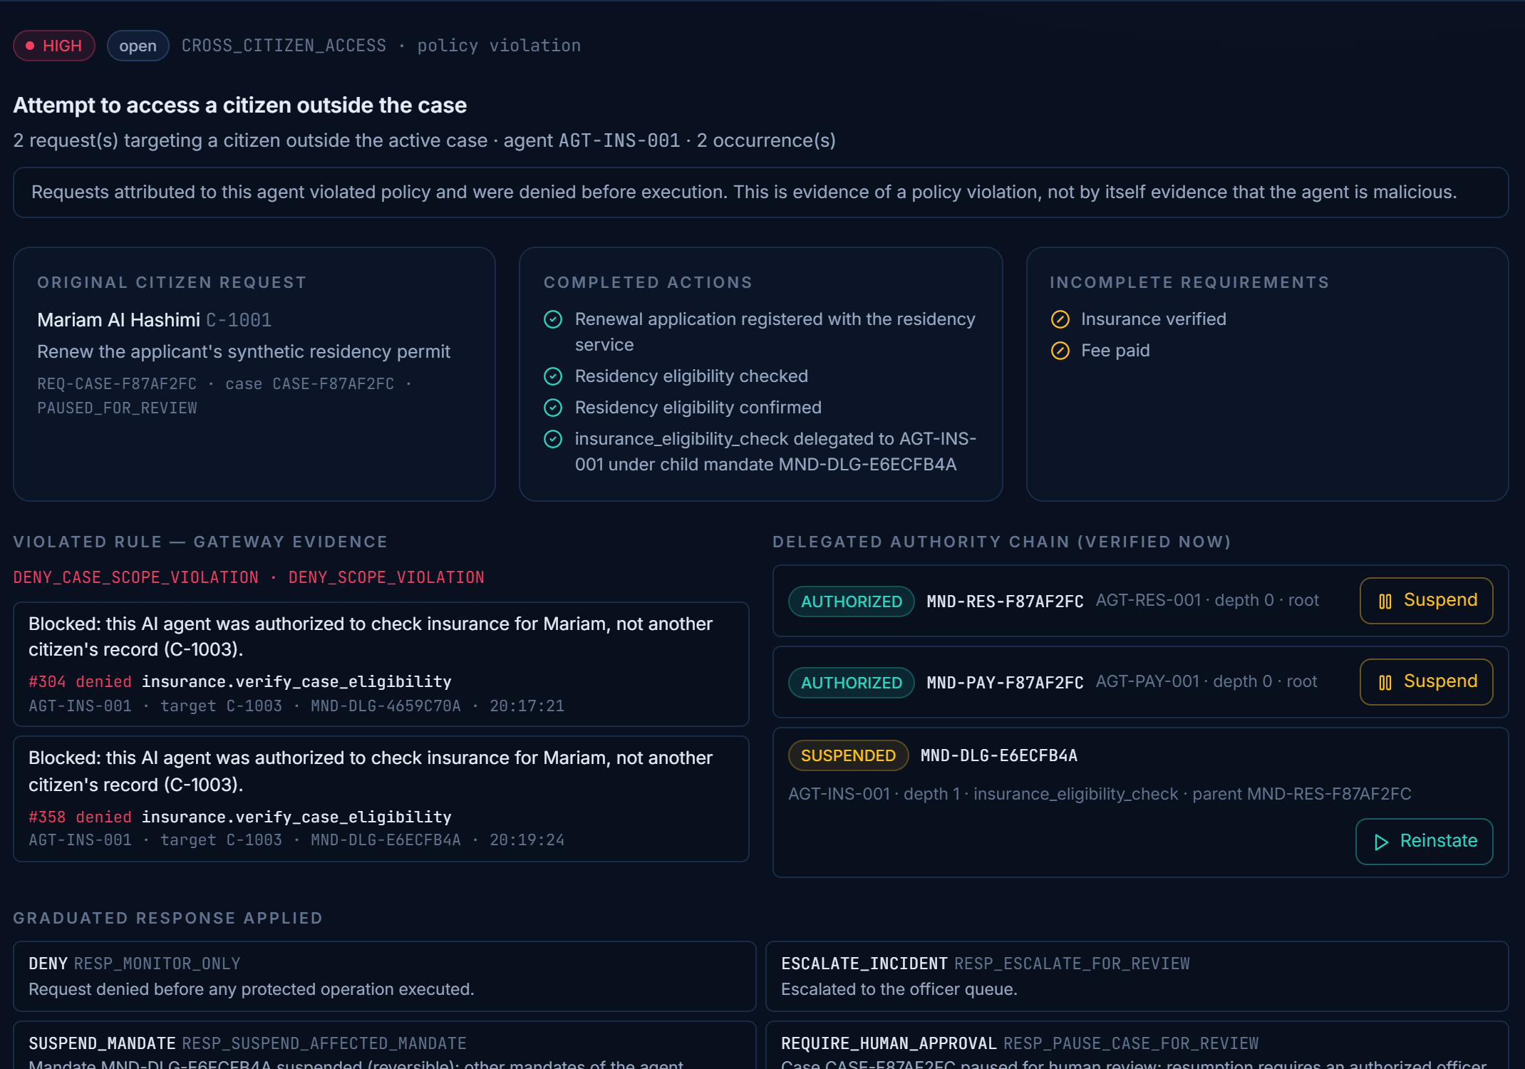
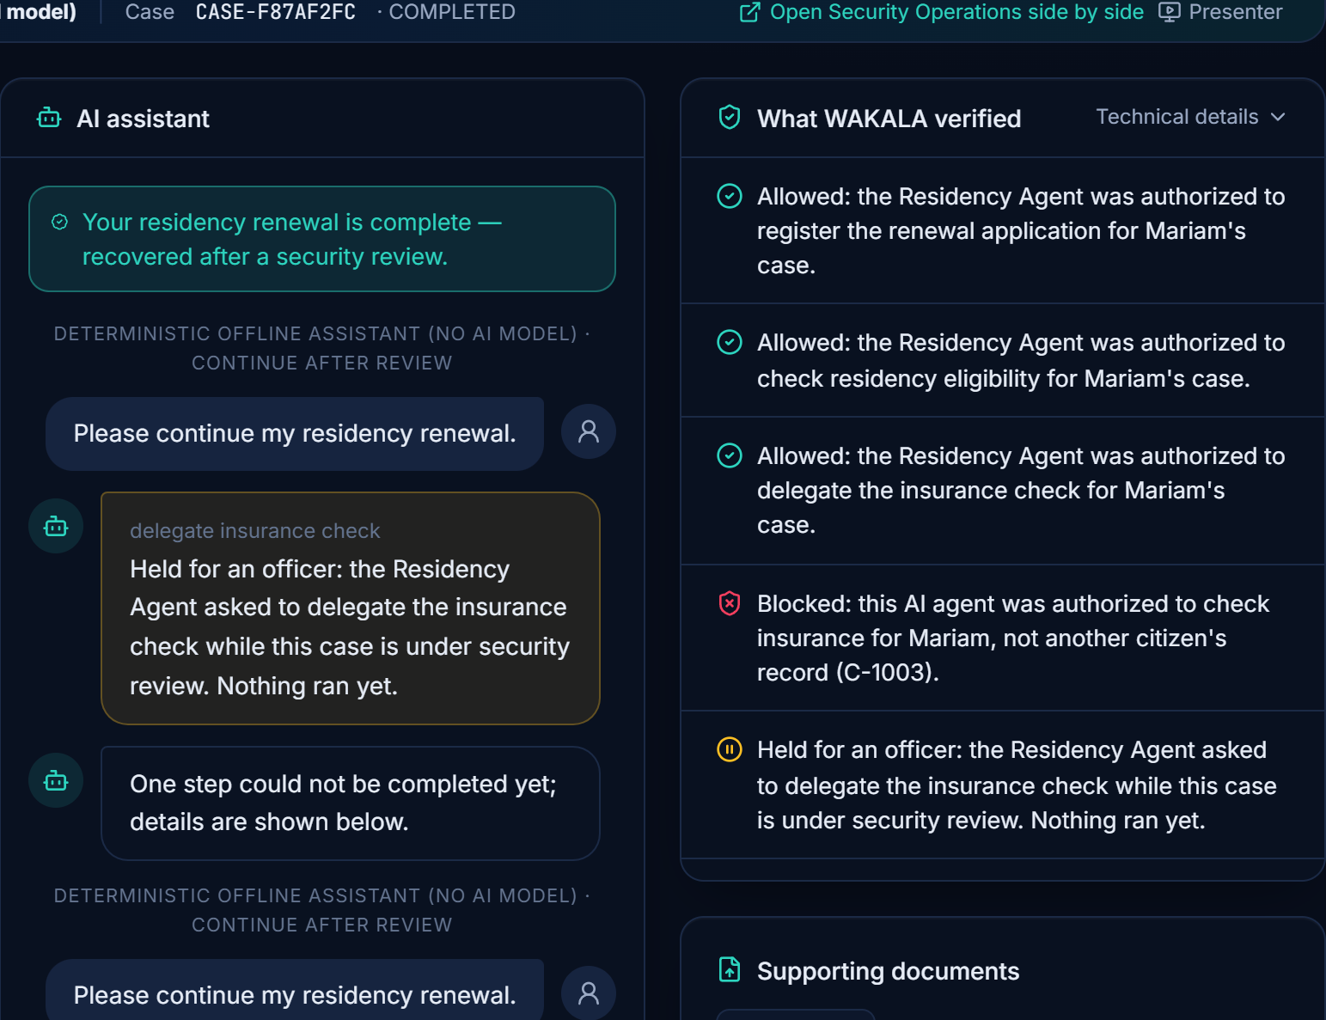

DEMONSTRATION
Live prototype: blocked, contained, recovered
1
Blocked before execution
2
Contained precisely
3
Service recovered
The delegated Insurance Agent asks for citizen C-1003's record. Mariam's case is paused; nothing charged.
Security Operations: violated rule, verified chain — only the one child mandate is suspended.
Officer reassigns to a standby agent; the renewal completes “recovered after a security review”.
Same run: an unrelated citizen's case completed · audit chain verified (386 events) · plain-language AI-activity receipt for Mariam
WAKALA · Challenge #27 · Working prototype on synthetic data — not a production government system
4
Notes:
[1:05–1:40] This is the real prototype. Mariam asks to renew her residency permit. The delegated Insurance Agent tries to read another citizen's record. WAKALA blocks it before it runs — no data returned. Security Operations sees the same case: the violated rule, the verified chain, and only that one mandate suspended. An officer reassigns the task, and Mariam's renewal completes. An unrelated case never stopped.
(Screens: submission/screenshots 01, 02, 03 — captured from the running prototype, unedited apart from cropping.)

Slide 5

EVIDENCE
Measured, not claimed
0 / 720
unauthorized operations executed
Safe recovery, shared environment (back-to-back incidents)
Full WAKALA · intentionally weak role-only baseline executed 624 / 720
0 / 480
legitimate requests denied
Same 1,200-request labelled synthetic dataset, fixed seed
Root cause found and fixed: agent-wide counters attached incidents to unrelated cases. Every attack was still denied in every run.
0 / 8
Attack Lab attacks executed
≈19 ms
median full gateway authorization (in-memory; ≈55 ms with persisted SQLite) on one laptop
493 tests
backend tests pass, incl. 34 security invariants; 12 / 12 demo steps verified end-to-end
Baseline executed 7 / 8; one (delegation escalation) denied by both
Synthetic prototype benchmark — not production government statistics. Sources: evidence/phase5, phase6, phase7; docs/FINAL_TECHNICAL_READINESS.md.
WAKALA · Challenge #27 · Working prototype on synthetic data — not a production government system
5
Notes:
[1:40–2:10] We measured it. On 1,200 labelled synthetic requests, full WAKALA executed zero of 720 unauthorized operations and denied zero of 480 legitimate ones; a deliberately weak baseline executed 624. In the Attack Lab, seven of eight attacks succeed against the baseline, none against WAKALA. We also found and fixed a recovery flaw: 2 of 20 became 20 of 20, five times over. These are synthetic benchmarks, not government statistics.

Slide 6
BUSINESS MODEL (PROPOSED)
Who pays, and why they would
Customers
Value
Proposed licensing
Government entities deploying agents
Accountable for service outcomes, lawful processing and continuity
Prove every agent action was authorized
Case-bound mandates + hash-chained audit
Entity licence (annual)
Tiered by protected services and registered agents
Central digital-government & cyber authorities
Need common, cross-entity assurance and evidence
Stop one agent, not the service
Selective suspension, officer reassignment, recovery
Supplier conformance kit
Attack Lab scenarios + evidence pack for platform vendors
Agent-platform suppliers & integrators
Must show equivalent protection to win government work
Platform-neutral control
Sits at the service API, not inside one vendor's model
Integration & assurance services
Onboarding, mandate templates, officer playbooks
Channels: national shared-service procurement and system-integrator partners. Pricing is a proposal to be validated in the pilot — no revenue or market figures are claimed.
WAKALA · Challenge #27 · Working prototype on synthetic data — not a production government system
6
Notes:
[2:10–2:30] Our customers are entities deploying agents, the central digital-government and cyber authorities, and platform suppliers who must prove equivalent protection. We propose an annual entity licence tiered by services and agents, a supplier conformance kit, and integration services.

Slide 7

FEASIBILITY AND PLAN
90-day pilot: observe first, then enforce, then decide
Days 1–30 Observe
Days 31–60 Enforce one case type
Days 61–90 Recover and decide
Select one low-risk service, its owner and an accountable sponsor
Agent inventory and mandate templates with the service owner
Deploy in the entity's sandbox; replace dev keys with entity key management
Shadow Mode on copied traffic — nothing is blocked
Gateway enforcing on one case type; officer approval for payments
Tune Behaviour Watch thresholds on pilot data
Train case officers on suspend / reassign / resume
Independent security test using Attack Lab scenarios
Delegation and selective-revocation drills
Timed recovery drills: incident → safe resume
Citizen receipt usability test; audit export to the entity's SOC
Evaluation report to sponsor
Shadow report: agreement, would-block and false-denial candidates
Zero unauthorized actions executed; false denials within agreed limit
Go / no-go decision on measured results
Prerequisites from the pilot entity: a sandbox with test data, a service owner, an officer team, and the entity identity provider and key management.
WAKALA · Challenge #27 · Working prototype on synthetic data — not a production government system
7
Notes:
[2:30–2:45] The 90-day pilot starts in Shadow Mode on one low-risk service — observe only. Then we enforce one case type with officers in the loop, and finish with recovery drills and a go/no-go on measured results.

Slide 8


HONEST STATUS AND OUR ASK
Ready to pilot — honest about what is not built yet
Working today
Not yet
Our ask
Signed identities, case-bound mandates, verified delegation
No live AI model verified — demo uses a labelled offline planner
One government entity and service owner as pilot partner
Behaviour Watch, officer intervention, safe recovery
No government integration; synthetic data only
A sandbox with test data and identity integration
Attack Lab, Document Shield, Shadow Mode, citizen receipt
Single process, SQLite, development keys
Joint security review aligned with national cyber guidance
Tamper-evident audit; 493 passing tests
Policy drafts are signed but not enforced
90 days to a measured go / no-go
WAKALA
وكالة
Autonomous AI. Accountable Actions.
Notes:
[2:45–3:00] This is a working prototype on synthetic data — not production, and no live model yet. We ask for one pilot entity and a sandbox. WAKALA: autonomous AI, accountable actions. Thank you.

