Slide 1
Signal and Pipe

Slide 2
Signals
Interprocess communication primitive
Main()
{
for(;;);
}
signal
Execute some routine
Kernel
User process
Take some action
How to terminate this infinite loop?
Press Ctrl-C

Slide 3
Exactly what happened?
The process is running
You pressed Ctrl-C.
Kernel sends a signal SIGINT to the process
Process stopped working
Kernel executes a routine to terminate the process
SIGINT
User process terminated
Kernel
User process
Signal is like a software interrupt
Each signal has an interrupt number
With each signal, a routine is associated to perform some task

Slide 4
SIGINT
The SIGINT signal is sent to a process by its controlling terminal when a user wishes to interrupt the process. This is typically initiated by pressing Control-C
SIGKILL
The SIGKILL signal is sent to a process to cause it to terminate immediately (kill). In contrast to SIGTERM and SIGINT, this signal cannot be caught or ignored, and the receiving process cannot perform any clean-up upon receiving this signal.
SIGQUIT
The SIGQUIT signal is sent to a process by its controlling terminal when the user requests that the process quit and perform a core dump.
SIGFPE
The SIGFPE signal is sent to a process when it executes an erroneous arithmetic operation, such as division by zero (the FPE stands for floating point error)
SIGSEGV
The SIGSEGV signal is sent to a process when it makes an invalid virtual memory reference, or segmentation fault, i.e. when it performs a segmentation violation
SIGCHLD
The SIGCHLD signal is sent to a process when a child process terminates, is interrupted, or resumes after being interrupted.

Slide 5
Signal Handling
Each signal has a default code attached
Activated whenever the signal is sent
Is it possibly to replace this default code?
Signal handling
Signal(Signal name, function name)
Signal.h

Slide 6
#include<stdio.h>
#include<signal.h>
void abc();
int main()
{
signal(SIGINT,abc);
for(;;);
}
void abc()
{
printf(“You have pressed Ctrl-C\n");
}

Slide 7
Ctrl-C terminates user process
Doesn’t terminate shell
Shell is also a process!
Ignore a signal!
Signal(SIGINT,SIG_IGN)
int main()
{
signal(SIGINT,SIG_IGN);
for(;;);
}

Slide 8
SIGQUIT
Press Ctrl-\
Terminates a process and dump the core
#include<stdio.h>
#include<signal.h>
void abc(int);
int main()
{
signal(SIGINT,abc);
signal(SIGQUIT,abc);
for(;;);
}
void abc(int signo)
{
printf(“You have killed the process with signal ID=%d”,signo\n");
}

Slide 9
SIGCLD
A process sends SIGCLD to its parent after termination
When a user process X terminates
Send this signal to it’s parent (shell)
Shell removes the process X from the Process Table
Not? Then Zombie!
Role of wait()

Slide 10
SIGCLD
int main()
{
pid=fork();
if(pid==0)
sleep(1);
else
{
signal(SIGCLD, abc);
sleep(10);
printf(“Parent exiting”);
}
}
Void abc()
{
printf(“child died”);
}

Slide 11
Other signals
SIGSEGV
Segmentation fault-core dumped
SIGFPE
Division by zero
SIGILL
The SIGILL signal is sent to a process when it attempts to execute an illegal or privileged instruction.

Slide 12
Sending signal
So far, kernel process sends signal to user process
Signal
Kernel
User process
How user process can send signal to another user process?
Signal
User process
User process
Kill(process ID, signal ID)

Slide 13
int main()
{
pid=fork();
if(pid==0)
{
signal(SIGINT,abc);
sleep(2)
}
else
{
kill(pid,SIGINT)
sleep(10);
printf(“Parent exiting”);
}
}
void abc()
{
printf(“Signal received by child ”);
}
SIGINT
Parent
Child

Slide 14
Open signals
SIGUSR1 and SIGUSR2
Are not mapped to any event
int main()
{
pid=fork();
if(pid==0)
{
signal(SIGUSR2, abc);
sleep(1);
printf(“Hello parent!”);
kill(getppid(),SIGUSR1);
sleep(4);
}
else
{
signal(SIGUSR1,def);
sleep(5);
}
}
void abc()
{ sleep(2);
printf(“Bye Parent ”);
}
SIGUSR2
Parent
Child
SIGUSR1
Void def()
{
printf(“Hello child”);
kill(pid,SIGUSR2);
}

Slide 15
Pipe
Interprocess communication primitive
Who | wc -l
Process A
Process B

Slide 16
Pipe
Interprocess communication primitive
Sending data
Process A
Pipe
Process B
p[1]
p[0]
File descriptors
Main()
{
int p[2];
pipe(p);
printf(“%d %d”,p[0],p[1]);
}
Pipe returns -1, if unsuccessful

Slide 17
File descriptor table
File descriptor (integer) | File name
0 | stdin
1 | stdout
2 | stderr
Use open(), read(), write() system calls to access files
Open() creates a file and returns fd (minimum value)
fd=open(path, O_WRONLY|O_CREAT|O_TRUNC, mode)
Think what happens in case of redirection?
ls>file

Slide 18
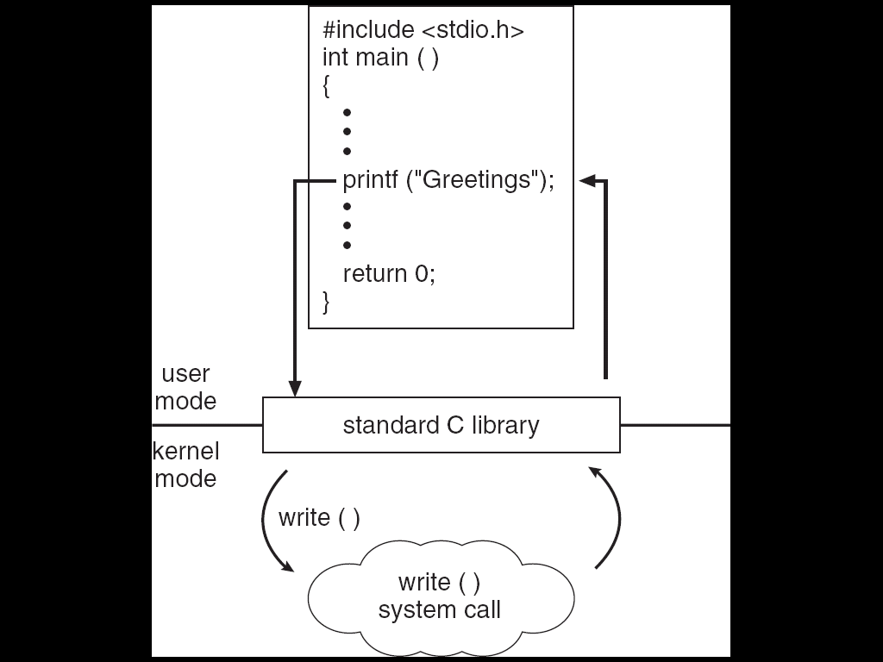
Standard C Library Example
C program invoking printf() library call, which calls write() system call
Notes:
<number>

Slide 19
p[0]
p[1]
Parent
Read fd
write fd
Child
p[0]
write fd
Read fd
p[1]
Main()
{
char *msg=“hello”;
char buff[MAX];
pipe(p);
pid=fork();

Slide 20
#define MAX ****
Main()
{
char *msg=“hello”;
char buff[MAX];
pipe(p);
pid=fork();
if(pid>0)
write(p[1], msg1, MAX);
else
{
sleep(1);
read(p[0],buf, MAX);
printf(“%s”, buff);
}
}

Slide 21
Anybody can write (parent or child)
#define MAX ****
main()
{
char *msg=“hello”;
char buff[MAX];
pipe(p);
pid=fork();
if(pid>0)
write(p[1], msg1, MAX);
else
{
sleep(1);
write(p[1], msg1, MAX);
for(i=0;i<2;i++)
{
read(p[0],buf, MAX);
printf(“%s”, buff);
}
}
}

Slide 22
main()
{
char *msg=“hello”;
char buff[MAX];
pipe(p);
pid=fork();
if(pid==0)
printf(“child exiting”)
else
{
read(p[0],buf, MAX);
}
}
Read will wait since write end of parent is open.

Slide 23
Role of close()
main()
{
char *msg=“hello”;
char buff[MAX];
pipe(p);
pid=fork();
if(pid==0)
{
printf(“child exiting”)
}
else
{
close(p[1]);
read(p[0],buf, MAX);
}
}
Closing write end
Read will return immediately.

Slide 24
Role of close()
main()
{
char *msg=“hello”;
char buff[MAX];
pipe(p);
pid=fork();
if(pid==0)
{
sleep(5);
printf(“child exiting”)
}
else
{
close(p[1]);
read(p[0],buf, MAX);
}
}
What will happen?

Slide 25
Closing the read end
main()
{
char *msg=“hello”;
char buff[MAX];
pipe(p);
pid=fork();
if(pid==0)
{
printf(“child exiting”)
}
else
{
write(p[1],buf, MAX);
}
}
Write will return successfully

Slide 26
main()
{
char *msg=“hello”;
char buff[MAX];
pipe(p);
pid=fork();
if(pid==0)
{
printf(“child exiting”)
}
else
{
close(p[0]);
write(p[1],buf, MAX);
}
}
All the read ends are closed!
Write returns -1
Kernel generates SIGPIPE signal
Terminates with “Broken pipe” message

Slide 27
Homework
popen()
Named pipe or FIFO

