Slide 1
Assessing the Linguistic Design Quality of APIs of Distributed Systems and Microservices
Krishno Dey, Hung Cao, Francis Palma
SE+AI Research Lab
Analytics Everywhere Lab
Faculty of Computer Science
University of New Brunswick

Slide 2
Outline
Distributed Systems and Microservices
Application Programming Interface (API)
Linguistic Design Quality of APIs
Research Objectives and Method
Findings
Conclusion and Future Works

Slide 3
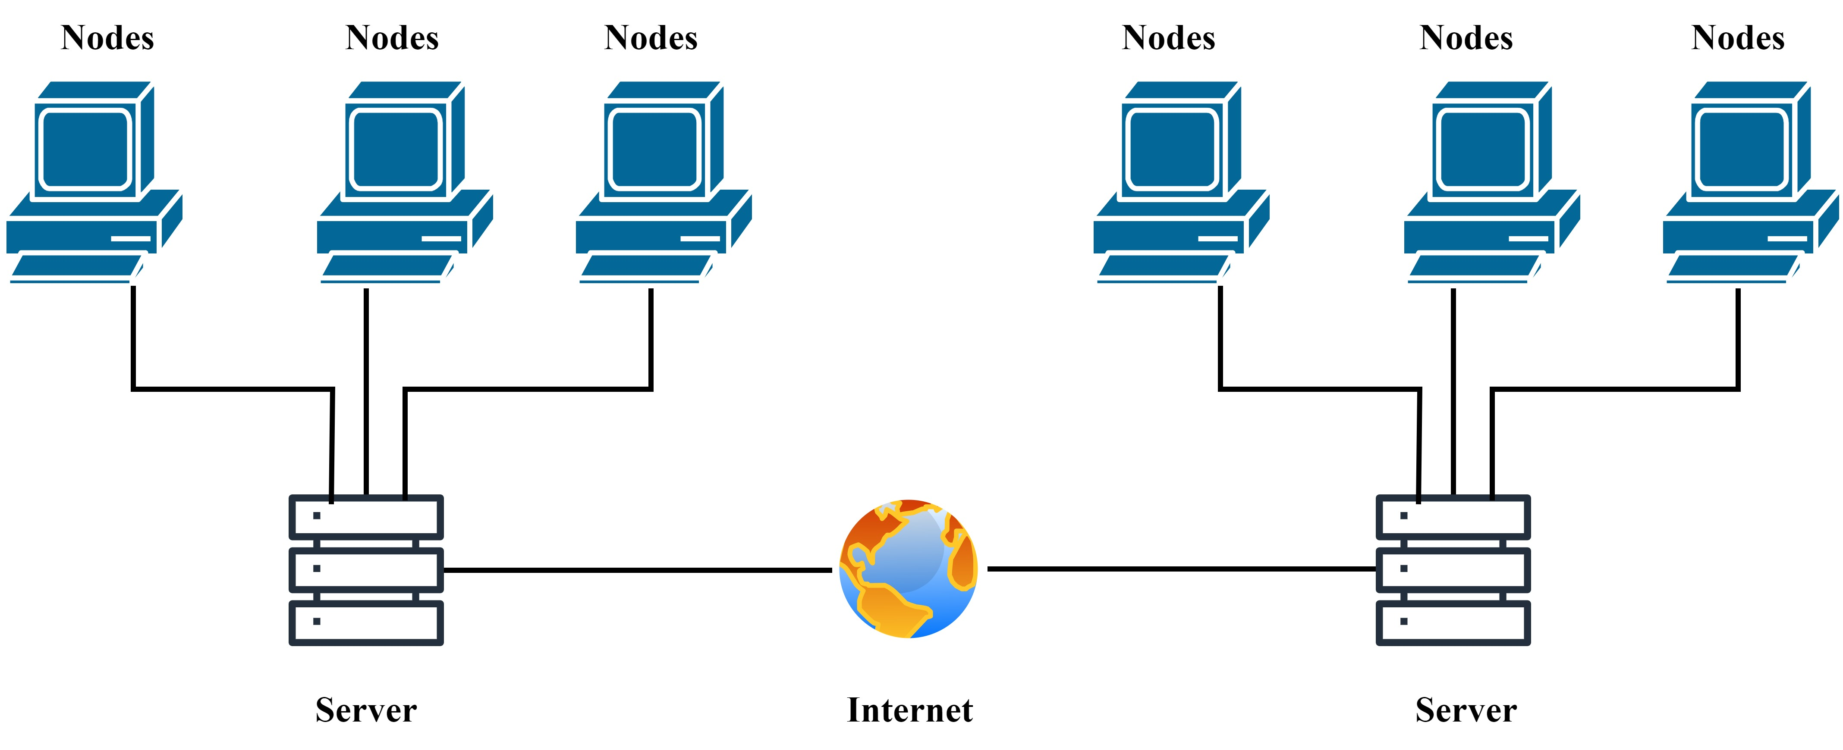
Distributed Systems
A collection of independent computers that appear as a single coherent system [1].
Components coordinate by passing messages.
Notes:
A collection of independent computers that appear as a single coherent system [1].
Components coordinate by passing messages.
Key Features
Scalability
Fault tolerance
Resource sharing
Examples
Telecommunication Networks
Distributed Database Systems

Slide 4
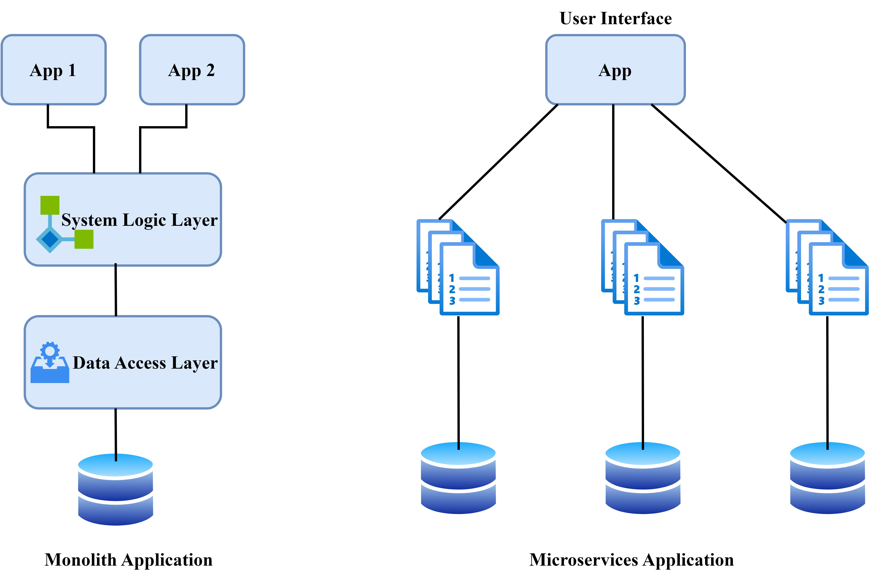
Microservices
An architectural style that structures an application as a collection of loosely coupled services [1].
Notes:
Characteristics
Self-contained services implementing a single business capability.
Communication occurs through APIs.
Benefits
Improved modularity, easier scaling, faster deployment cycles
Examples
Amazon, Netflix, Uber, and many more…

Slide 5
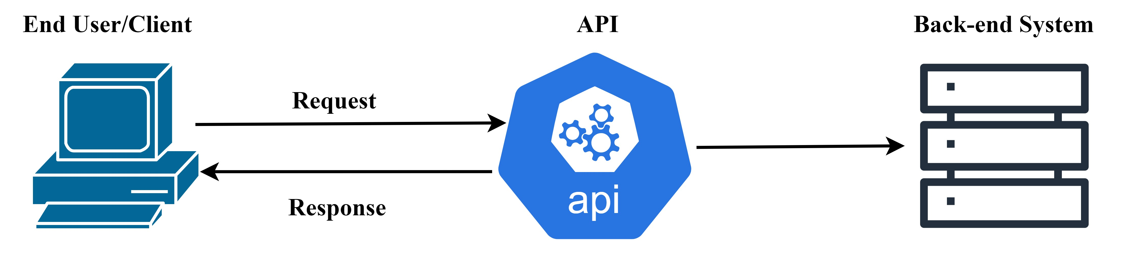
Application Programming Interface
Mechanisms that enable software components or microservices to communicate with each other using a set of definitions and protocols [2-4].
Facilitate functionality exposure in distributed systems and microservices [1].

Slide 6
Types of APIs
REST APIs
An architectural style for networked applications.
Use HTTP requests to access and use data, follows a stateless, client-server, cacheable communications protocol.
GraphQL APIs
A query language for APIs and a runtime for executing those queries by using a type system.
Allows clients to request exactly the data they need, reducing over-fetching and under-fetching of data.

Slide 7
Linguistic Design Quality of APIs
Well-Designed APIs (Patterns)
Easy to understand and use
Increase adoption rates
Improve developer experience
Poorly Designed APIs (Antipatterns)
Difficult to understand and use
Reduce adoption rates
Worsen developer experience
High-quality API design is crucial for both providers and developers [5-7].

Slide 8
Poor vs. Good Design Practices
× Contextless Resource Names Antipattern
/newspapers/planet/players
✓ Contextualized Resource Names Pattern
/soccer/team/ players

Slide 9
Poor vs. Good Design Practices
× Non-pertinent Documentation Antipattern
Endpoint: /v2/berry-firmness/{names}/ Description: "The name of this resource is listed in different languages"
✓ Pertinent Documentation Pattern
Endpoint: /v2/berry-firmness/{berries}/ Description: "A list of the berries with this firmness."

Slide 10
Detection Heuristic for ×Contextless Resource Names
1: CONTEXTLESS-RESOURCE(Request-Endpoint, Documentation)
2: TopicsModel ← EXTRACT-TOPICS(Documentation)
3: EndpointNodes ← EXTRACT-ENDPOINT-NODES(Request-Endpoint)
4: Avg-Similarity-Value ← COSINE-SIMILARITY- SCORE(EndpointNodes, TopicsModel)
5: if Avg-Similarity-Value < threshold
6: return ’Contextless Resource Names’ antipattern
7: end if
8: return ’Contextualized Resource Names’ pattern

Slide 11
Linguistic patterns and antipatterns
✗Amorphous vs. ✓Tidy Endpoint
✗Contextless vs. ✓Contextualized Resource Names
✗CRUDy vs. ✓Verbless Endpoint
✗Inconsistent vs. ✓Consistent Documentation
✗Non-descriptive vs. ✓Self-descriptive Endpoint
✗Non-hierarchical vs. ✓Hierarchical Nodes
✗Non-standard vs. ✓Standard Endpoint
✗Non-pertinent vs. ✓Pertinent Documentation
✗Pluralized vs. ✓Singularized Nodes
✗Unversioned vs. ✓Versioned Endpoint

Slide 12
Research Objectives
Assess the linguistic design quality of REST and GraphQL APIs in distributed systems and microservices.
Develop automatic detection algorithms for assessing linguistic design in APIs of distributed systems and microservices.
Find empirical evidence of linguistic antipatterns in APIs of distributed systems and microservices.
Identify the most prevalent linguistic antipatterns in APIs of distributed systems and microservices.

Slide 13
Research Questions
RQ1: To what extent do the APIs in distributed systems and microservices suffer from poor design?
RQ2: What is the accuracy of the detection heuristics of linguistic patterns and antipatterns?
RQ3: Which API category in distributed systems and microservices is more prone to poor linguistic design?
RQ4: Which linguistic patterns and antipatterns are most common in APIs of distributed systems and microservices?

Slide 14
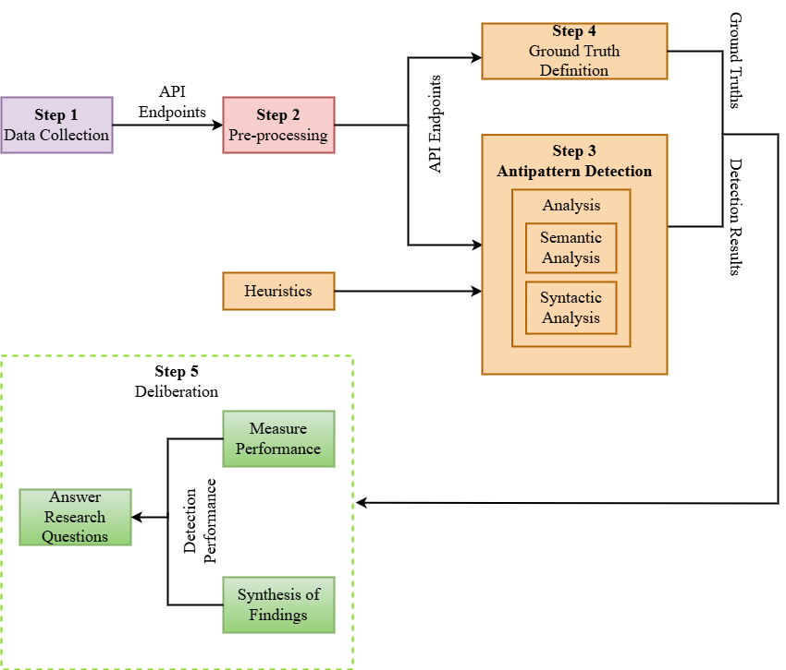
Research Methodology

Slide 15
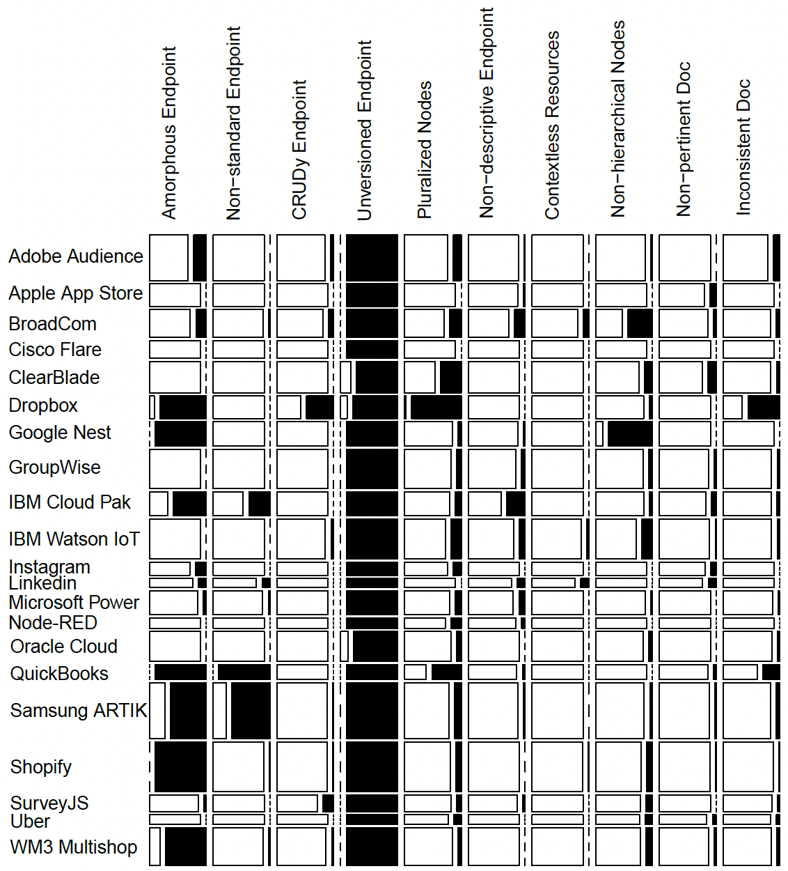
RQ1: Poor Linguistic Design

Slide 16
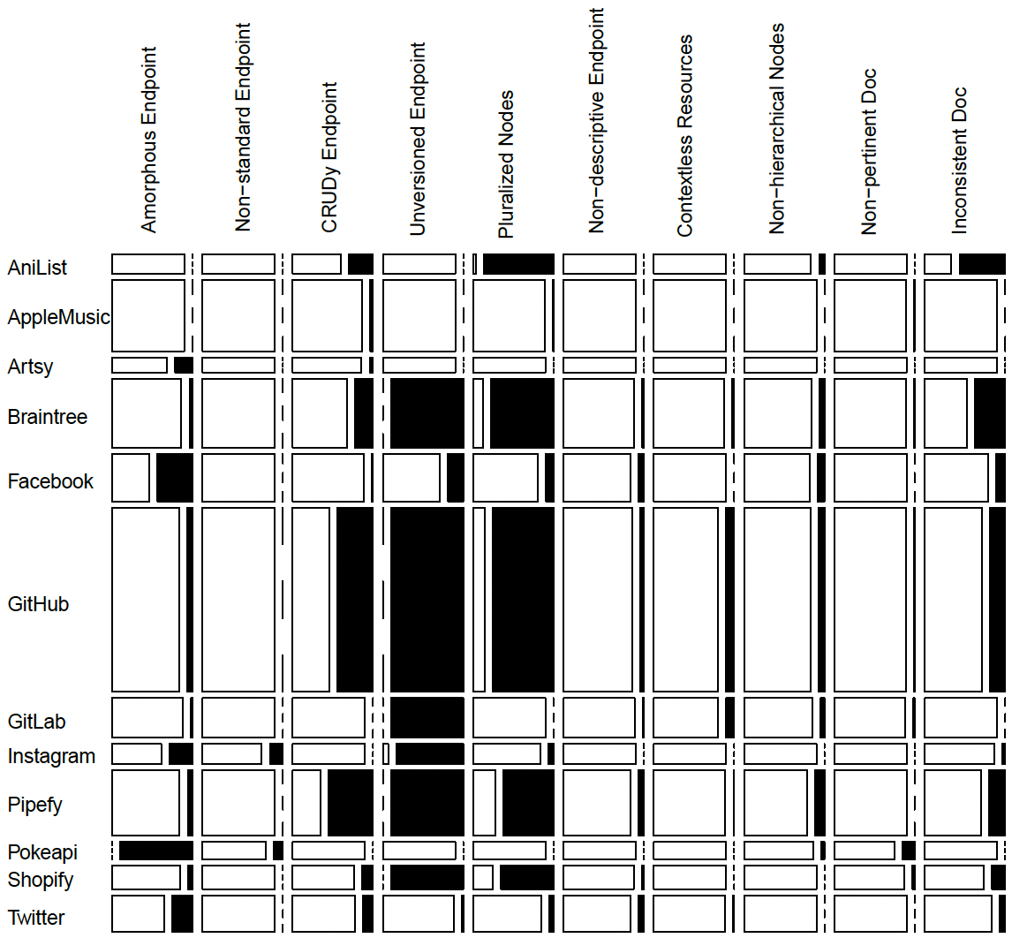
RQ1: Poor Linguistic Design

Slide 17
RQ1: Poor Linguistic Design
Poor linguistic design antipatterns are present in REST and GraphQL APIs. Despite widespread adoption, both REST and GraphQL APIs often lack quality design.

Slide 18
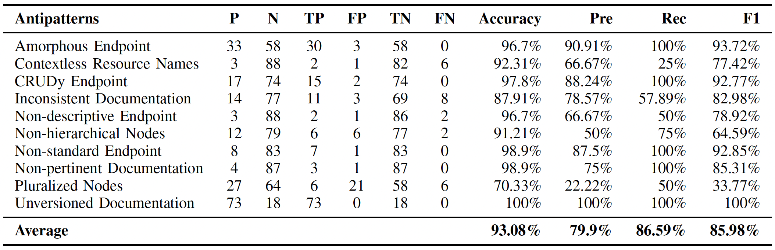
RQ2: Detection Accuracy
F1-score of the state-of-the-art methods:
DOLAR ^{[5]} - 79.5%
SARA ^{[6]} - 80.9%
SARAv2 ^{[7]} - 64%

Slide 19
RQ2: Detection Accuracy
Our detection algorithms achieved an average accuracy of 93.08%, precision of 79.9%, recall of 86.59%, and F1-score of 85.98%.
Compared to the state-of-the-art methods, our detection algorithms yield better detection performance.

Slide 20
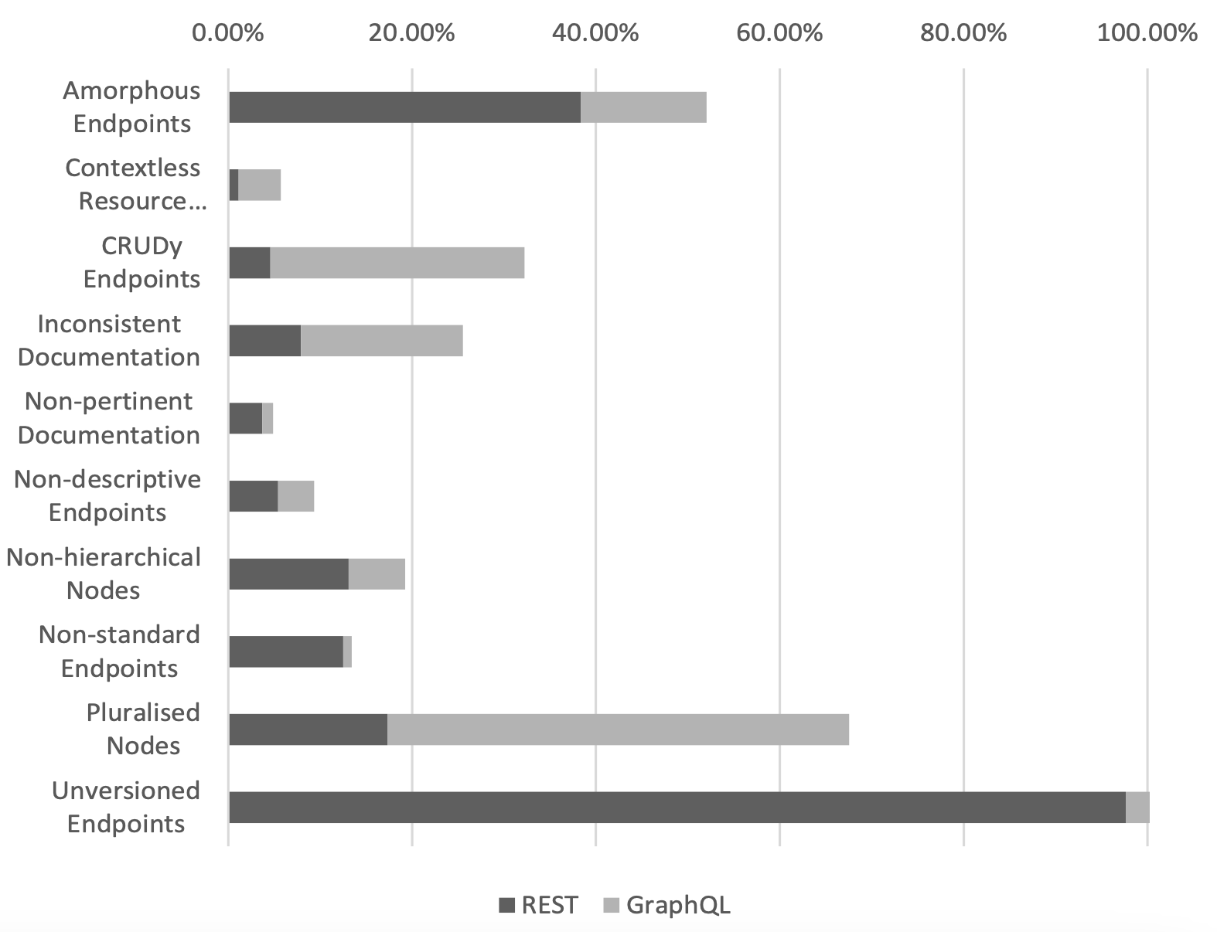
RQ3: API Category Prone to Poor Design

Slide 21
RQ3: API Category Prone to Poor Design
Antipatterns are more prevalent in REST APIs compared to GraphQL APIs. GraphQL APIs generally have better linguistic design quality, though the difference is small.

Slide 22
RQ4: Common Poor Linguistic Design
Most commonly occurring antipatterns are:
Unversioned Endpoint
Amorphous Endpoint
Pluralized Nodes
Moreover, using uppercase, underscores, file extensions, and trailing slashes are common poor practices in endpoint design.

Slide 23
Implications for Developers
Developers analyze API documentation to understand and use APIs effectively.
Well-designed APIs facilitate easier understanding and usage, making them more attractive to developers.
Our study identify and provide empirical evidence of linguistic antipatterns in APIs of distributed systems and microservices.
API developers can use our findings to improve API design quality, enhancing user experience and attracting more consumers.

Slide 24
Conclusion
Assessed the linguistic design quality of REST and GraphQL APIs in distributed systems and microservices.
Developed an automatic detection tool for linguistic design antipatterns.
Identified the most common linguistic antipatterns in APIs of distributed systems and microservices.
Achieved better detection performance compared to state-of-the-art methods.

Slide 25
Future Works
Improvements
Enhance detection accuracy and expand our analysis to cover a broader range of APIs and endpoints of distributed systems and microservices.
Linguistic quality comparison
Compare the linguistic design quality of APIs across public, private, and partner categories.
Impact study
Investigate the impact of poor linguistic design on the understandability of APIs.

Slide 26
References
Newman, S. (2021). Building microservices. " O'Reilly Media, Inc.".
Mark, M. (2011). REST API Design Rulebook: Designing Consistent RESTful Web Service Interfaces.".
Subramanian, H., & Raj, P. (2019). Hands-On RESTful API Design Patterns and Best Practices: Design, develop, and deploy highly adaptable, scalable, and secure RESTful web APIs. Packt Publishing Ltd.
Architectural styles and the design of network-based software architectures.
Palma, F., Gonzalez-Huerta, J., Moha, N., Guéhéneuc, Y. G., & Tremblay, G. (2015). Are restful apis well-designed? detection of their linguistic (anti) patterns. In Service-Oriented Computing: 13th International Conference, ICSOC 2015, Goa, India, November 16-19, 2015, Proceedings 13 (pp. 171-187). Springer Berlin Heidelberg.
Palma, F., Gonzalez-Huerta, J., Founi, M., Moha, N., Tremblay, G., & Guéhéneuc, Y. G. (2017). Semantic analysis of RESTful APIs for the detection of linguistic patterns and antipatterns. International Journal of Cooperative Information Systems, 26(02), 1742001.
Palma, F., Olsson, T., Wingkvist, A., & Gonzalez-Huerta, J. (2022). Assessing the linguistic quality of REST APIs for IoT applications. Journal of Systems and Software, 191, 111369.

Slide 27
Thank you!

