Slide 1
TSD Admin Panel
Videos
Subscriptions
Packages
Orders
Studios
Settings

Slide 2
Home
Videos
Vdieo 1
Video 2
Video 3
Video 4
Video 5
Video 6
Video 7
Video 8
Add Video
Add Video

Slide 3
Home
Videos
Video 1
Video Title
Thumbnail
Vdieo Descirption
Upload
Video Price
Thumbnail URL
Iframe Code
Subscriptions
Update to Subscription
Subscription1
Subscription2
Subscription1
Subscription2

Slide 4
Subsciption 1
Subsciption 2
Subsciption 3
Subsciption 4
Subsciption 5
Subsciption 6
Subsciption 7
Subsciption 8
Done Adding

Slide 5
Home
Subscriptions
Subscription 1
Subscription 2
Subscription 3
Subscription 4
Subscription 5
Subscription 6
Subscription 7
Subscription 8
Add Subscription

Slide 6
Home
Subscriptions
Subscription 1
Subscription Title
Thumbnail
Subscription Descirption
Upload
Subscription Price Yearly
Subscription Price Monthly
Thumbnail URL
Videos
Update Videos
Video 1
Video 2
Video 1
Video 2

Slide 7
Video 1
Video 2
Video 3
Video 4
Video 5
Video 6
Video 7
Video 8
Done Adding

Slide 8
Home
Packages
Package 1
Package 2
Package 3
Package 4
Package 5
Package 6
Package 7
Package 8
Add Package

Slide 9
Home
Packages
Package 1
Package Title
Thumbnail
Package Descirption
Upload
Charge Yearly ${ 0.00 }
Charge Monthly ${ 0.00 }
Thumbnail URL
Subscriptions
Subscription 1
Subscription 2

Slide 10
Home
Orders
Search
Name
Date
Email
Order Id
Name
MMDDYY
email@email.com
00001
Edit
Name
MMDDYY
email1@email.com
00002
Edit
Name
MMDDYY
email2@email.com
00003
Edit
Name
MMDDYY
email3@email.com
00004
Edit
Name
MMDDYY
email4@email.com
00005
Edit
Delete

Slide 11
Home
Orders
Order 0001
Back
Delete
Fname Lname
MMDDYY
email@email.com
00001
Subscription
Price
Term
Status
Subscription 1
10.99
Monthly
Paid
Subscription 2
100.99
Yearly
Failed
Subscription 3
200.99
Monthly
Pending
Subscription 4
100.45
Yearly
Cancelled
Subtotal
$413.42
Tax
#####
Total
#####
Email
Apply

Slide 12
Home
Studios
Search
Studio Name
Studio Name
Studio Name
Studio Name
Studio Name
Studio Name
Studio Name
Studio Name
Studio Name

Slide 13
Home
Studios
Studio Name
Studio Name
Name
Address Line 1
Address Line 2
State
Zip
Orders
Delete
Textbox

Slide 14
Home
Settings
Admin Username
Change Password
Email
Add Email
Contact Form Email

Slide 15
2
Instructors
Classes
My Videos
Dancers
Settings

Slide 16
Home
My Videos
Videos
UPDATE AVAILABLE!
Package 12
Subscription 3
Subscription 4

Slide 17
Home
My Videos
Subscription 1
Video 1
Video 2
Video 3
Video 4
Video 5
Video 6
Video 7
Video 8
Updates
Available

Slide 18
Home
My Videos
Subscription 1
Video 1
Video 1
Video 2
Video 3
Video 4
Video 5
Video 6
Video 7
Video 8
Video 9

Slide 19
Home
My Videos
Subscription 1
Video 1
Video 2
Video 3
Pick 2 of the following videos to add to your library!
Video 1
Video 2
Video 4
Video 5
Video 6
Video 2
Items remaining
2
Video 7
Video 8
Updates
Available

Slide 20








Home
Instructors
Instructor 1
Yada Yada
More info
Instructor 2
Yada Yada
More info
Instructor 3
Yada Yada
More info

Slide 21

Home
Instructors
Instructor 1
Email Address
Password
Phone Number
Class 1
Class 2

Slide 22
Home
Instructors
Instructor 1
Email Address
Class 3
Class 4
Password
Phone Number
Class 5
Add
Class 1
Class 2

Slide 23
Home
Classes
Class 1
Class 3
Class 2
Class 4
Class 99

Slide 24

Home
Settings
Name
Email Address
Upload
Password
Image URL
Phone Number
Address
(imported from account creation)
Credit Card
Add Credit Card
Billing Address
(imported from account creation)

Slide 25
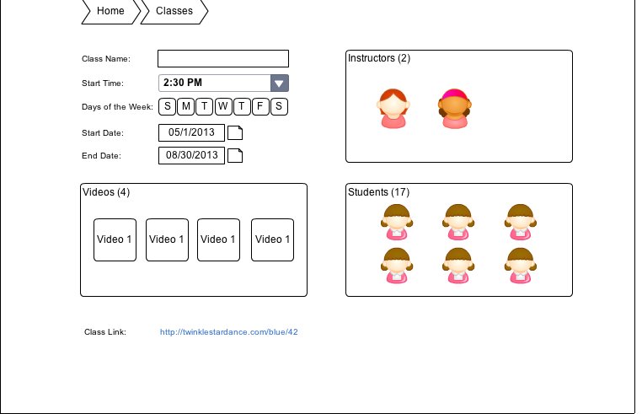

Slide 26
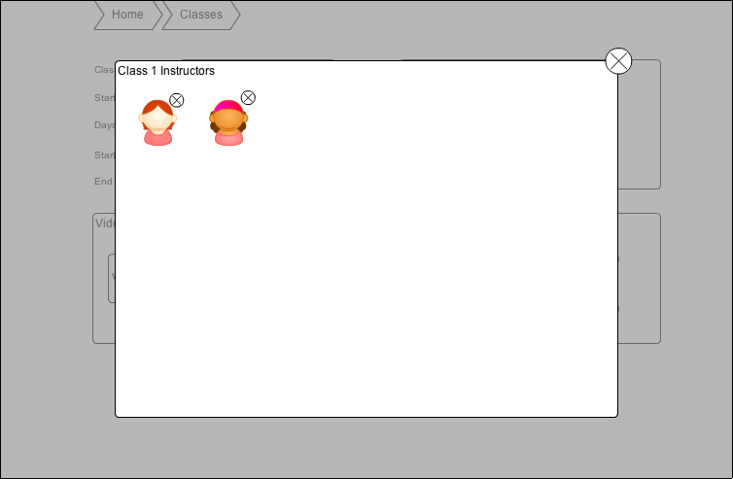

Slide 27
