Slide 1

Amazon Fine Food Reviews
SFSU – ISYS812
Date – 12/12/2019
Team members:
Kavita Kathaith
Sairaj Rege
Shailesh Krishna
Sushma Srinivas

Slide 2

INTRODUCTION

Slide 3
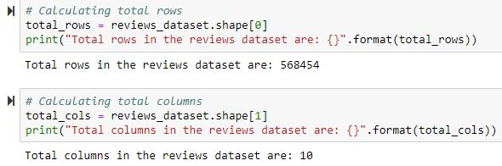
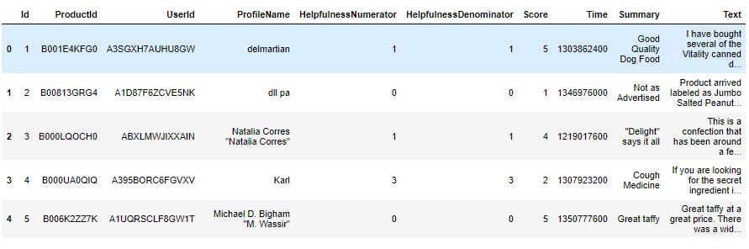
THE DATASET – Amazon fine food reviews
This dataset consists of reviews of fine food from amazon.
The data is for a period of ten years up to October 2012.
The dataset includes product and user data, ratings and a plain text review.
It also includes reviews from all other Amazon categories.

Slide 4

DRIVING QUESTION

Slide 5







HOW HELPFUL ARE THESE REVIEWS?
Make more informed decisions
Customer
Rating/Review
Analyze and strategize
Company

Slide 6

DATA CLEANING

Slide 7
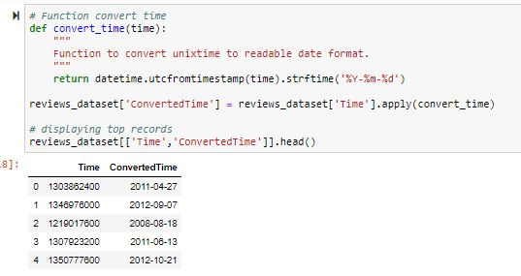
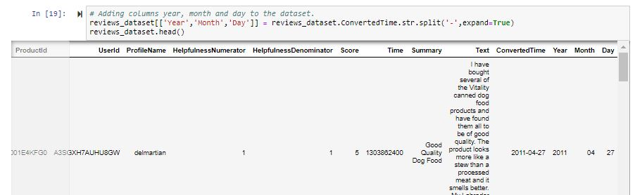
STEP-1 : Check if data is readable
All columns in the dataset are readable except the ‘Time’ column.
The time present in the dataset is the Unix timestamp.
We convert it into a readable format and add three columns - day, month and year for further analysis

Slide 8
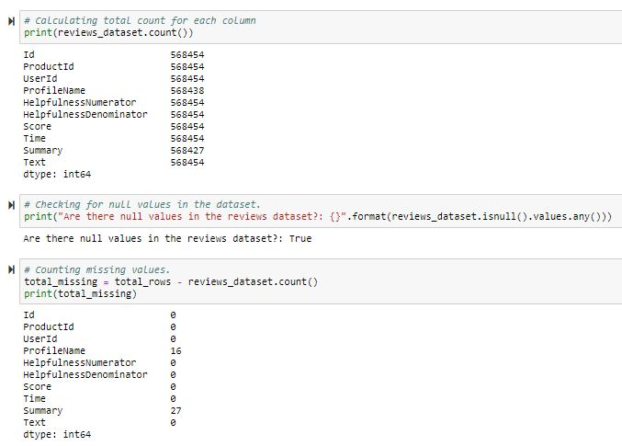

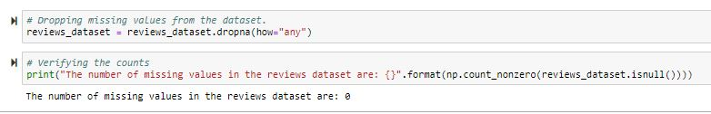
STEP-2 : Checking for missing values
Number of rows = 568454
Number of columns = 10
We see that there is anomaly in some columns
16 values are missing from ProfileName and 27 from Summary
A total of 43 missing values in the entire dataset of 568454 records is very miniscule
Hence, we are dropping the missing values from the dataset

Slide 9
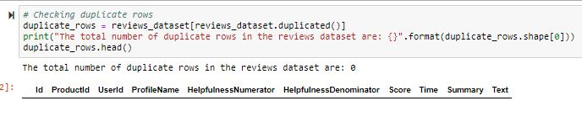

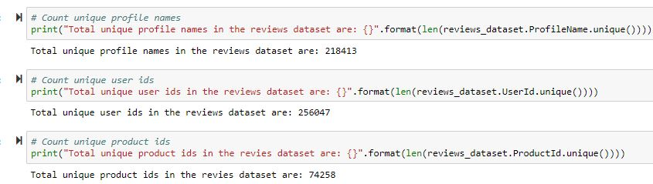
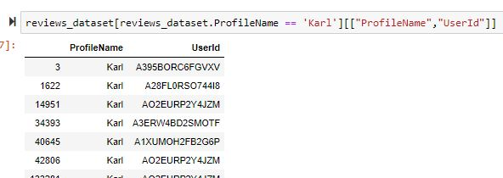
STEP-3 : Checking for duplicate rows
We see that there are no duplicate rows in the dataset.
STEP-4 : Checking if each profile name corresponds to one user id
There are 74258 unique products which were rated in the dataset
Number of unique user ids > Number of unique profile names
In the example, we see that the profile name Karl maps to multiple user ids
This clearly shows that the profile names are not unique and different users can have same profile name

Slide 10
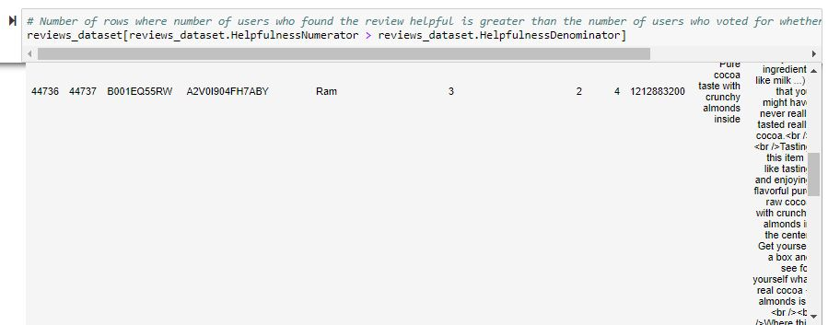
STEP-5: Checking for HelpfulnessNumerator and HelpfulnessDenominator
HelpfulnessNumerator = Number of users who found the review helpful
HelpfulnessDenominator = Number of people who indicated that they found the review helpful or not helpful
Ideally HelpfulnessNumerator should be less than Helpfulness Denominator
We see that it is not so in some rows
We filter out these records

Slide 11
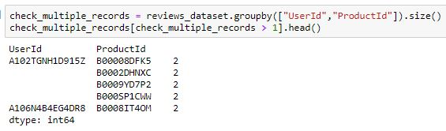
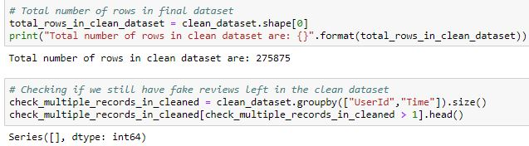
STEP-6: Fake review identification
Same user - same product - duplicate reviews
Same user - multiple products - duplicate reviews
We remove these fake reviews from the dataset
And….THE DATA IS READY FOR ANALYSIS!!

Slide 12

DATA ANALYSIS

Slide 13
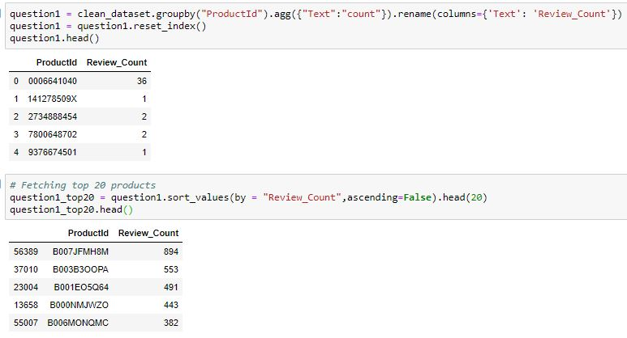
Q1 - Which products are reviewed the most?
To answer this question, we consider a new dataframe with two columns – ProductId and Review_count
We plot the chart of productId vs review count.
The chart displays top 20 most reviewed products.

Slide 14
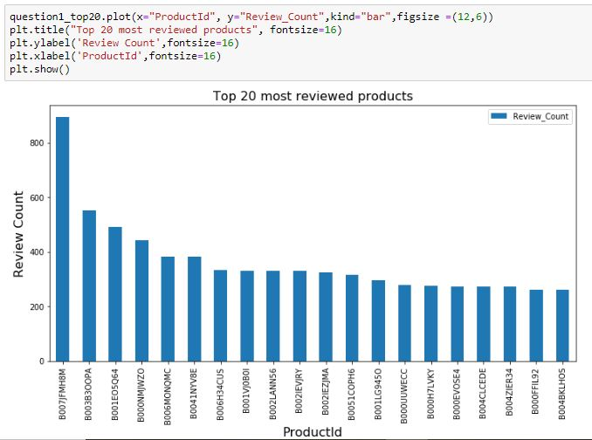
Q1 - Plot
The product with highest reviews is ?

Slide 15
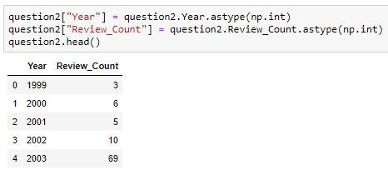
Q2 - What is the review count trend over the years?
To answer this question, we consider a new dataframe with two columns – Year and Review_count
We plotted the chart of Year vs review count.
The chart displays review trend over the years.

Slide 16
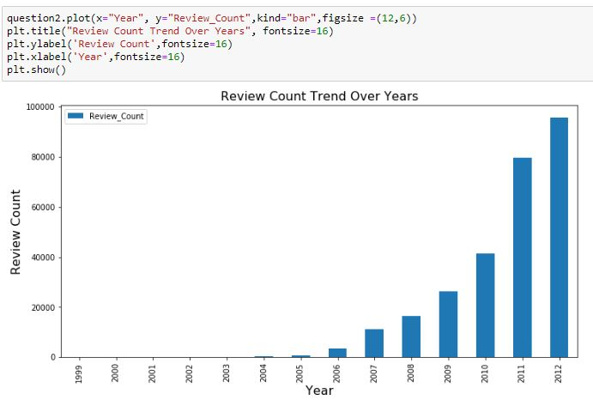
Q2 - Plot
We see that over the years, the count of reviews has increased i.e there has been more engagement by the year

Slide 17
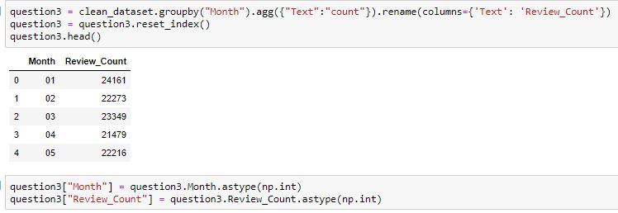
Q3 - What are the monthly review trends?
To answer this question we plotted the chart of Month vs Review count.

Slide 18
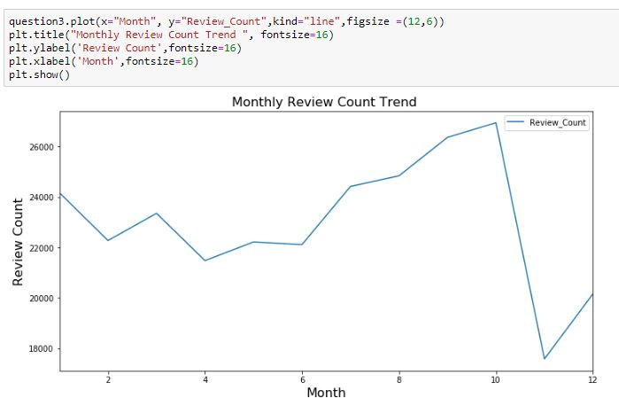
Q3 - Plot
We see that the count of reviews is maximum till October and then drops significantly

Slide 19
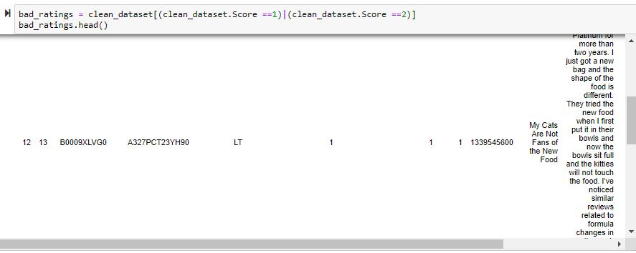
Q4 - What are the three most important topics of a bad rating?
Bad ratings impact businesses more than good ratings.
Here we have categorized Scores 1 and 2 as bad ratings.
For analysis we have only used reviews with score 1 and 2.

Slide 20
Q4 – Data preparation and modeling
Approach:
Use summary text to prepare word corpus.
Perform pre-processing by removing special characters, numbers, stop words and filtered out words with length less than 3.
Created Document Term Matrix as an input to LDA.
Perform Topic Modeling using Latent Dirichlet Allocation(LDA)

Slide 21

Q4 – Data modeling using LDA
Document has several topics
Each topic contains words
What LDA does
Identify top topics
Identify top words in each topic
LDA

Slide 22
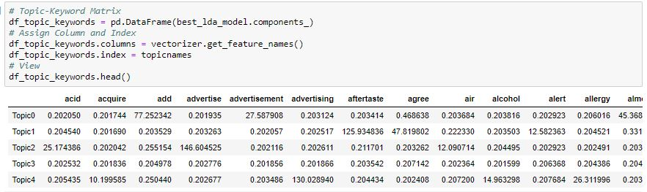
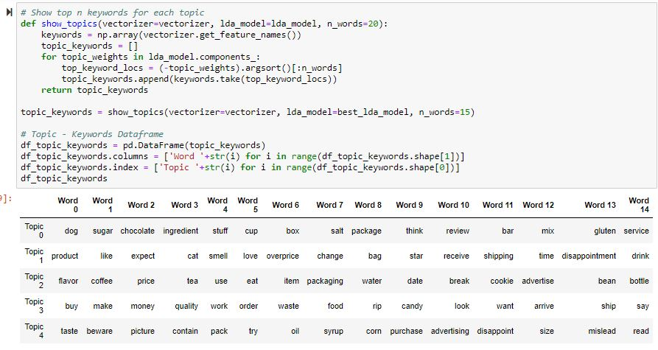
Q4 – Data modeling using LDA
Top topics
Top words in top topics

Slide 23
Q4 – Interpretations
The most important topics of bad reviews are:
Ingredient, quality and packaging related aspects of products.
Overpriced products and shipping disappointment.
Beware of misleading advertised product pictures, leading to shipping disappointment.

Slide 24
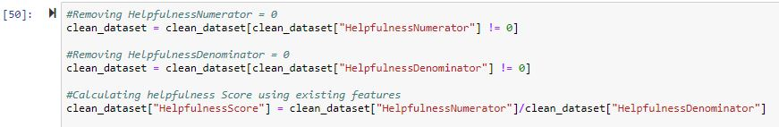
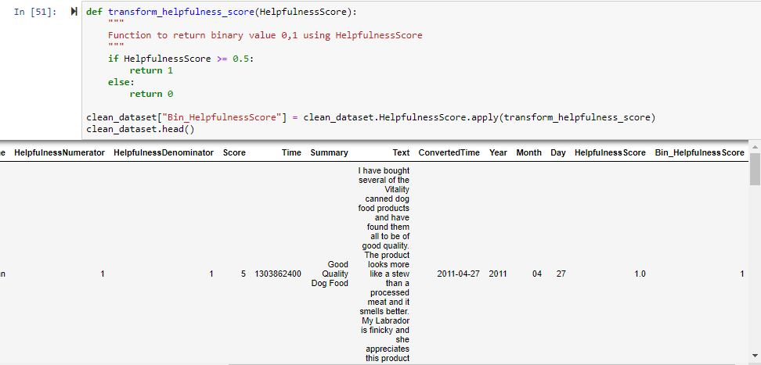
Q5 - What are the most important characteristics of a helpful review?
We need to identify the factors that make a review helpful.
First, we create our own response variable i.e. HelpfulnessScore.
We transform HelpfulnessScore into binary. If helpfulness score > 0.5, then 1 else, 0

Slide 25
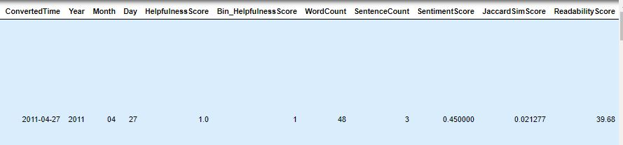
Q5 - Data preparation
NEW PREDICTORS
Word Count - Number of words in a text
Sentence Count - Number of sentences in a text
Sentiment Score - Sentiment polarity of a text
Similarity Score - Similarity of a text to the top 200 words
Readability Score - How easy it is to read the text
To quantify the data for further analysis, we used NLP libraries such as TextStat, Sklearn and Gensim
New columns in dataset

Slide 26
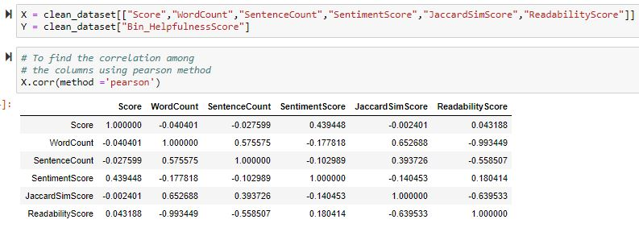
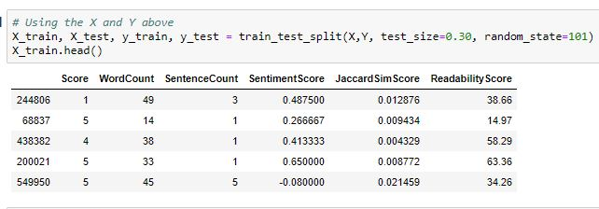
Q5 - Data modeling
Check for correlation among predictors
Split the data into Training and Test

Slide 27
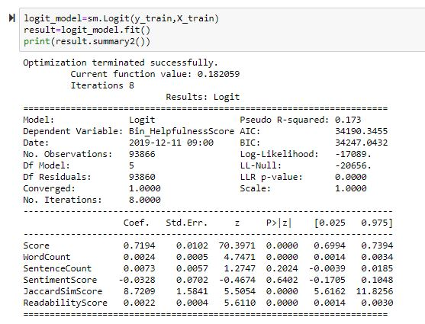
Q5 Data modeling and Interpretations
Rating of a review impacts the degree of helpfulness of a review.
Number of words in the review impacts the degree of helpfulness of a review
Surprisingly, sentence count and sentiment score doesn't have an impact on the helpfulness of a review.
Reviews containing more words which describe the product and packaging attributes and provide recommendation are considered more helpful
Readability score impacts the degree of helpfulness of a review.

Slide 28
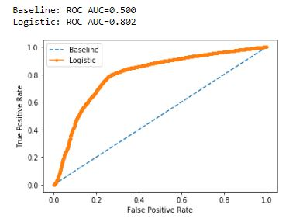
Q5 - Data modeling
Plot the ROC curve to check the performance of the model

Slide 29
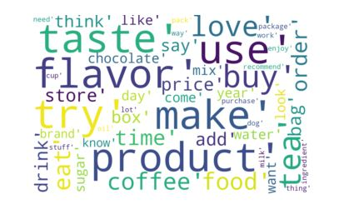
Q6 – What are the most used words in helpful reviews?
Plot a Wordcloud for top 50 words

Slide 30
THANK YOU! ☺

