Slide 1

RNN: Evolution and Limitations In Generating Text Sequences
CSC 872: Pattern Analysis and Machine Intelligence
By
Shailesh Krishna
December 2019

Slide 2
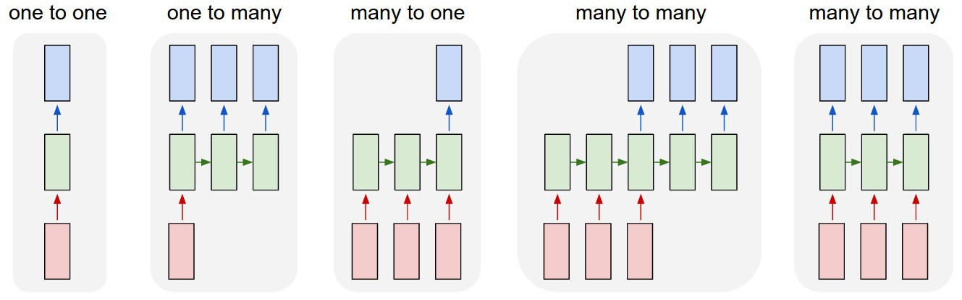
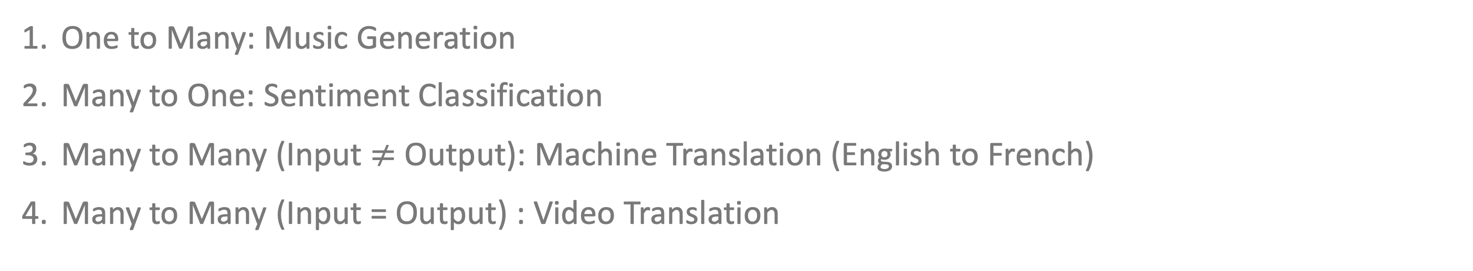
Sequence Modeling
One to Many: Music Generation
Many to One: Sentiment Classification
Many to Many (Input $≠$ Output): Machine Translation (English to French)
Many to Many (Input = Output) : Video Translation
Image source: http://karpathy.github.io/2015/05/21/rnn-effectiveness/

Slide 3
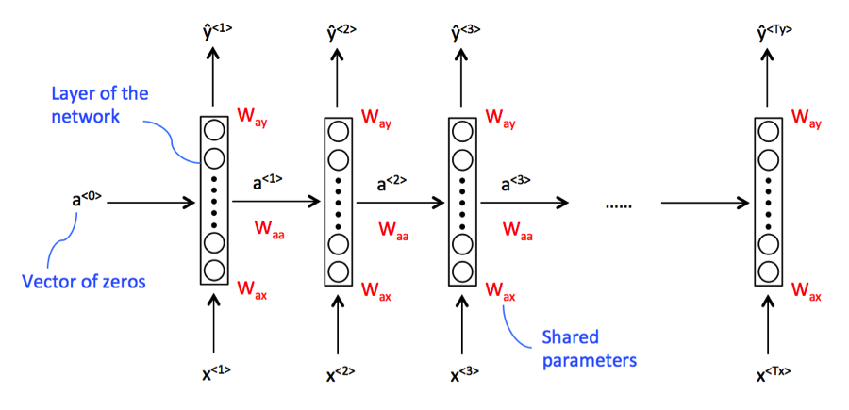
RNN Architecture and Types
W_{ax}: Shared data parameters
W_{aa}: Horizontal connection parameters
W_{ay}: Govern output predictions
Image source: Medium.com

Slide 4
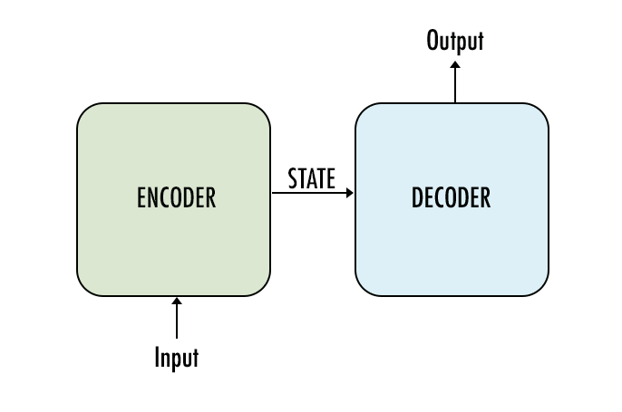
Sequence-to-Sequence Architecture (Encoder-Decoder)
Image source: Google Images

Slide 5

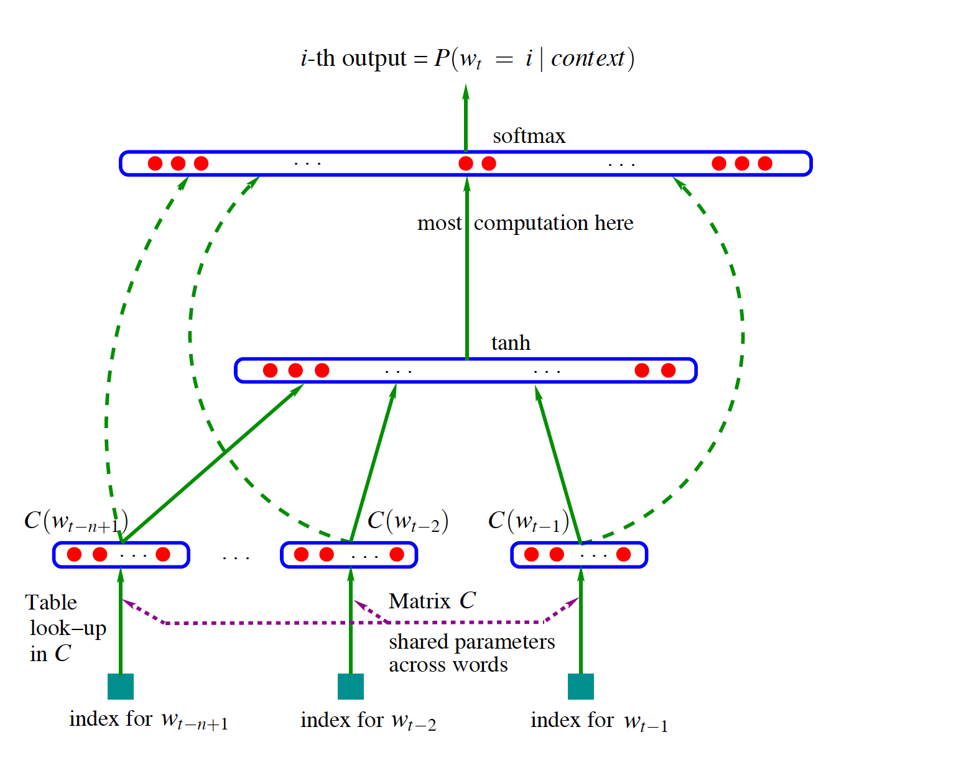
A Neural Probabilistic Language Model
Bottom Layer: Input nodes
Middle layer: Tanh is the hidden layer
Top layer: Output (softmax) function
Image source: http://www.jmlr.org/papers/volume3/bengio03a/bengio03a.pdf

Slide 6

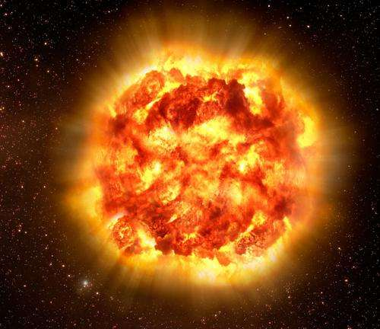
The Challenges of Long-Term Dependencies
Image source: Google Images

Slide 7
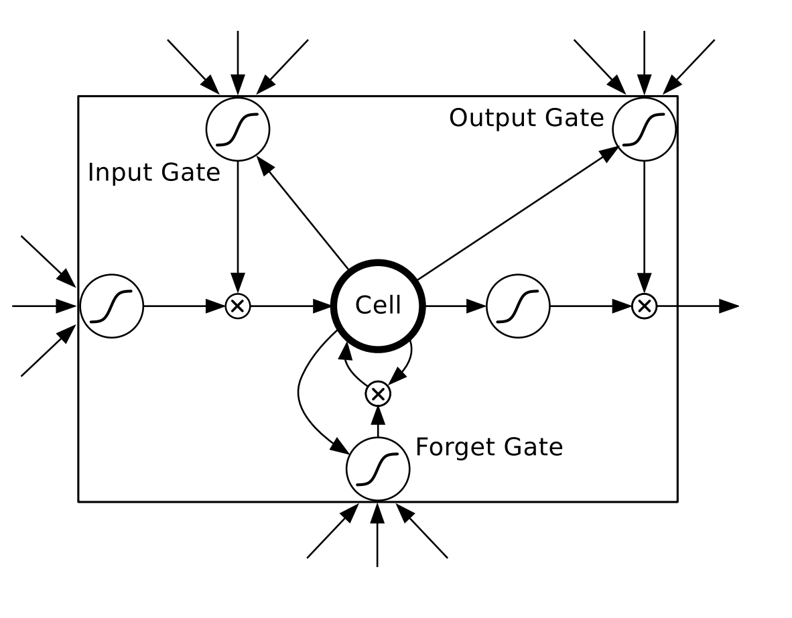
LSTM: Long Short Term Memory
Input Gate: scales input to cell (write)
Output Gate: scales output from cell (read)
Forget Gate: scales old cell value (rest)
Image source: https://www.bioinf.jku.at/publications/older/2604.pdf

Slide 8
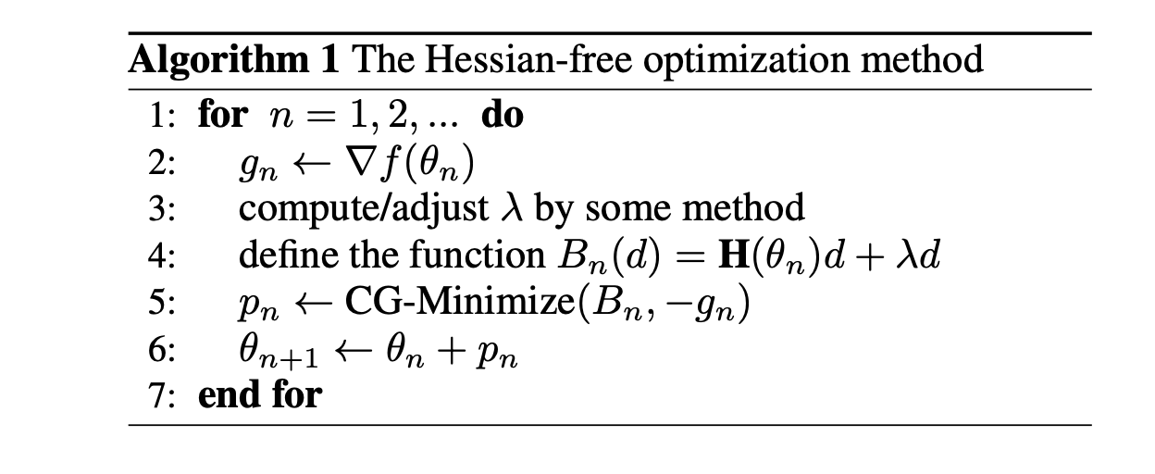
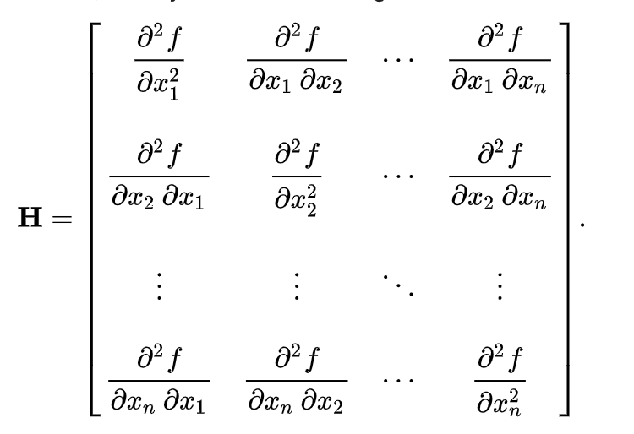
Alternate Approaches Using Conjugate Gradient and HF Optimization
Image source: Wikipedia, https://www.cs.utoronto.ca/~ilya/pubs/ilya_sutskever_phd_thesis.pdf

Slide 9
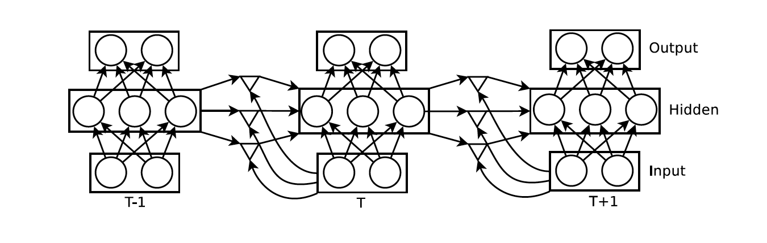
Multiplicative (Gated) RNN
I am HF Optimized!
Image source: https://www.cs.utoronto.ca/~ilya/pubs/ilya_sutskever_phd_thesis.pdf

Slide 10
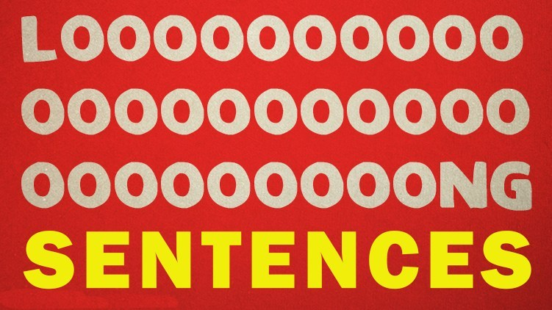
Limitations of RNN and LSTM

Slide 11

Attention Is All You Need (Transformer Model)
Image source: Google Images

Slide 12
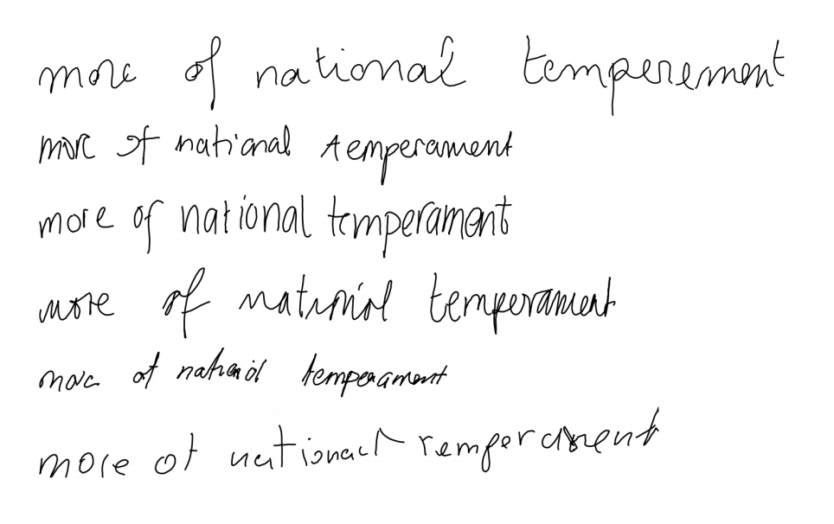
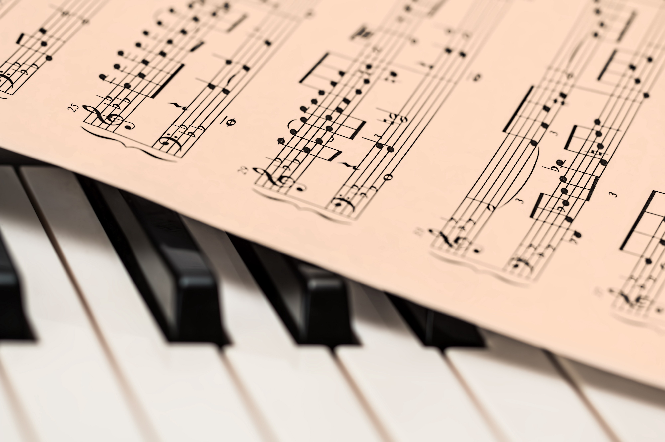

Applications
Image source: Google Images

