Slide 1

Ministry/Organization Name/Student Innovation:
Ministry of Communications
PS Code: SIH1413
Problem Statement Title: Dak Ghar Niryat Kendra
Team Name: Code Crew
Team Leader Name: Mungalapra Krish Arvindbhai
Institute Code (AISHE):
Institute Name: Leelaben Dashrathbhai Ramdas Patel (LDRP) Institute of Technology and Research
Theme Name: Transportation & Logistic

Slide 2
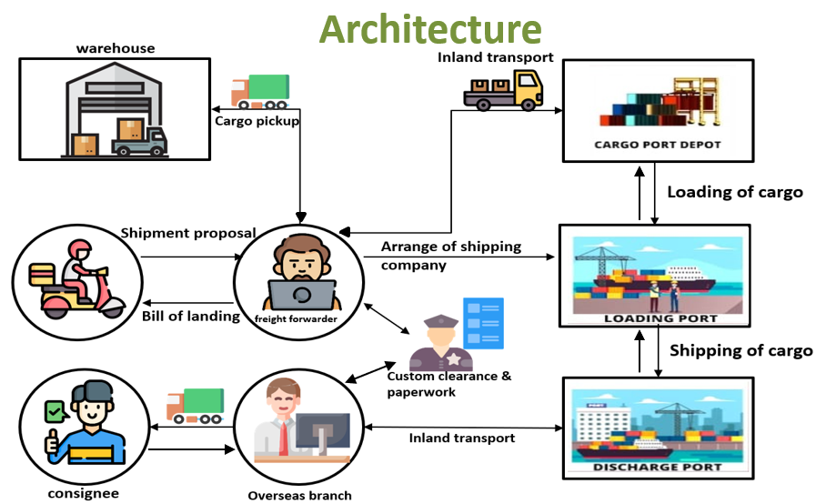
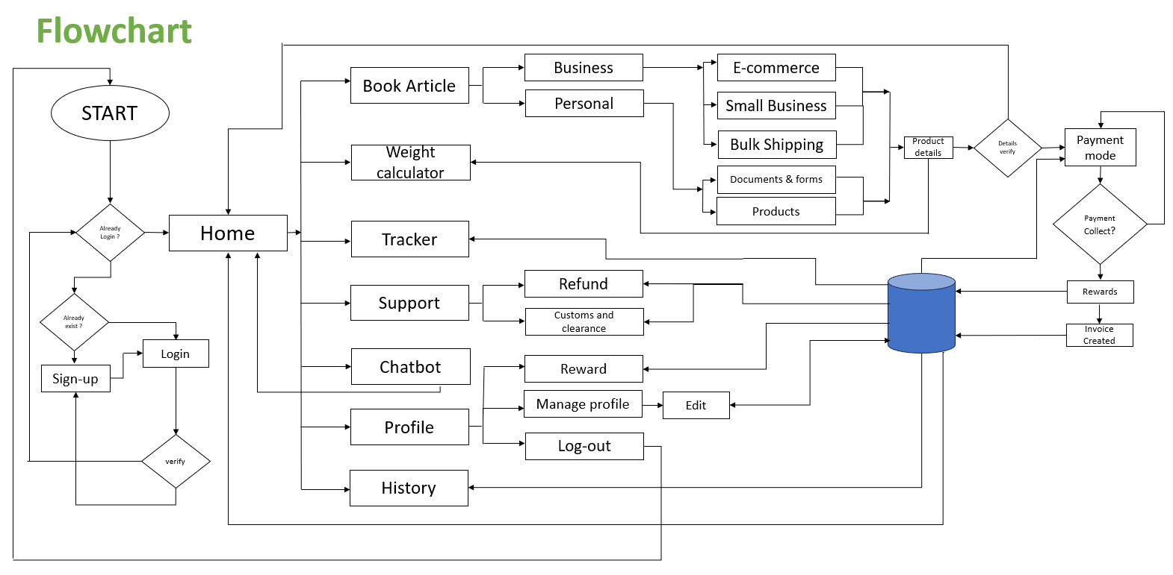
Problem statement
Dak Ghar Niryat Kendra (DNK) is an initiative of the Department of Posts and CBIC, wherein the small exporters are able to electronically file a Portal Bill of Export and then present the parcel at DNK for export and it still not able to bring small traders, artisans and MSMEs onto the DNK platform. The private e-Commerce portals charge upto 40% of the sale price of orders, which is prohibitively expensive. Dak Ghar Niryat Kendra" refers to a concept in the Indian postal system. .The establishment of Dak Ghar Niryat Kendra aims to simplify and streamline the export process for small and medium-sized enterprises (SMEs) by leveraging the extensive postal network and infrastructure already in place. It provides exporters with a cost-effective and accessible solution for their export logistics requirements."
Idea solution
We are developing DNK portal to bring small traders , artisans and MSMEs on this platform and make it easy import and export system.
The website provides personal and business cost-effective product shipping service.
It provide QR code based real time tracking system of order to customers.
We provides cost estimation of orders and chatbot.
It provides safety and insurance of orders and time sensitive delivery.
The site provides payment safety and refund policy.
We offer reward system to attract new customers.

Slide 3


















Use Cases :
Technology stack :
E-commerce and Retailers
Documentation and Forms
Bulk shipping
Global network
Payment Processing
Customs and Compliance
Cost Estimation
Time Sensitive Shipments
Dependencies :
Security
Database Management
Real Time Tracking
Product Insurance
Business and Personal Use
3

Slide 4
Team Member Details
Team Leader Name: Mungalpara Krish Arvindbhai
Branch (Btech/Mtech/PhD etc): B.E. Stream (ECE, CSE etc): CE
Team Member 1 Name: Vyas Anjali Kaushikbhai
Branch (Btech/Mtech/PhD etc): B.E. Stream (ECE, CSE etc): CE
Team Member 2 Name: Vaishnav Sanjay Dilipbhai
Branch (Btech/Mtech/PhD etc): B.E. Stream (ECE, CSE etc): CE
Team Member 3 Name: Patel Mit Jayeshbhai
Branch (Btech/Mtech/PhD etc): B.E. Stream (ECE, CSE etc): CE
Team Member 4 Name: Mungalpara Kirtan Ghanshyambhai
Branch (Btech/Mtech/PhD etc): B.E. Stream (ECE, CSE etc): CE
Team Member 5 Name: Movaliya Raj Jagdishbhai
Year (I,II,III,IV): II
Year (I,II,III,IV): II
Year (I,II,III,IV): II
Year (I,II,III,IV): II
Year (I,II,III,IV): II
Branch (Btech/Mtech/PhD etc): BE
Team Mentor 1 Name: Prof. Dharmesh Tank
Category (Academic/Industry): Academic
.
Stream (ECE, CSE etc): CE
Year (I,II,III,IV): II
Expertise: Software engineering, Computer Network, Data mining, Python, Core Java,
Domain Experience (in years): 8.5 Years
Team Mentor 2 Name: Prof. Palak J. Parmar
Category (Academic/Industry):Academic
Expertise: AI ,CV ,Wireless sensor ,Adhoc network ,MANET ,Image processing
Domain Experience (in years):11+ Years

