Slide 1
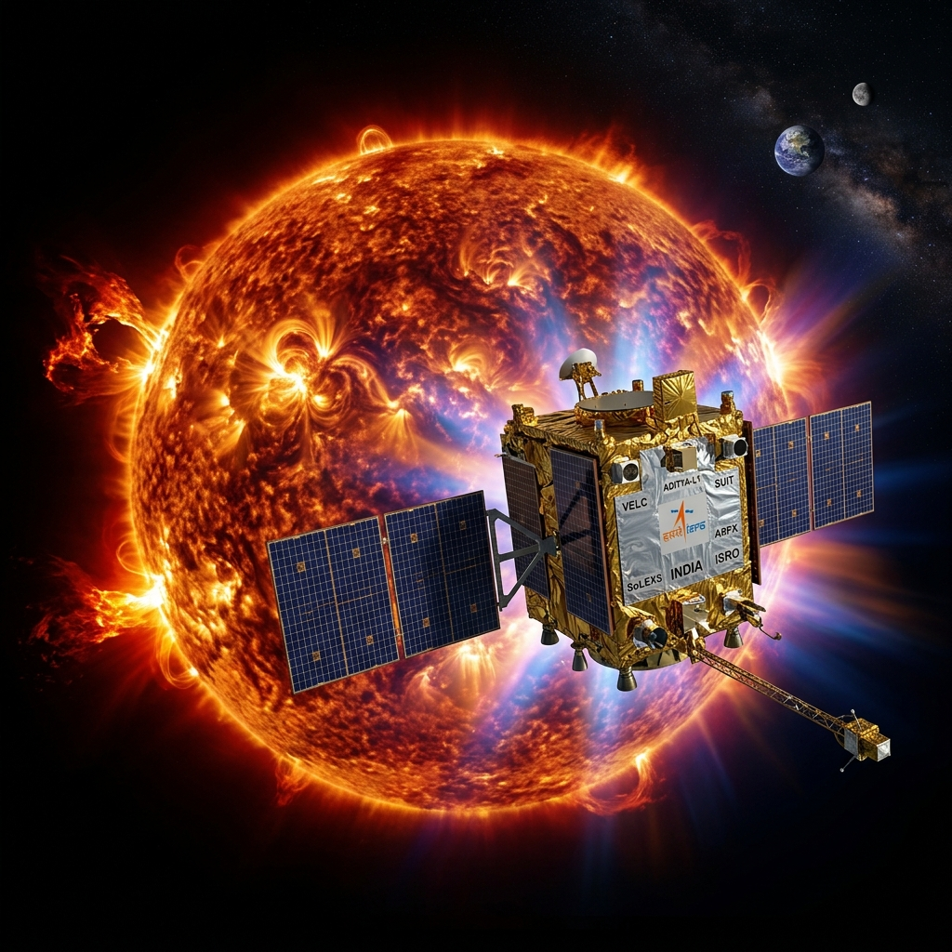
PROBLEM STATEMENT 15
Sovereign Space Weather
Resilience
Automated Nowcasting & Forecasting of Solar Flares
Utilizing Aditya-L1 X-Ray Payloads
🛰️ ISRO Aditya-L1 Mission
📡 SoLEXS + HEL1OS Payloads
🧠 AI/ML Forecasting Pipeline
50+
8 min
₹1000 Cr+
5–15 min
Satellites
Protected
Warning
Window
Infrastructure
at Risk
Prediction
Lead Time
Indian Space Research Organisation | Department of Space | Government of India

Slide 2
00
PRESENTATION AGENDA
Comprehensive Technical Blueprint
01
Strategic Imperative
10
Forecasting Model
Why sovereign space weather forecasting is critical
1D-CNN + BiLSTM + Transformer architecture
02
Mission & Instrumentation
11
System Architecture
Aditya-L1, SoLEXS & HEL1OS specifications
End-to-end pipeline & dashboard
03
Problem Definition
12
Evaluation Metrics
Infrastructure risk quantification
TSS, HSS, POD, FAR benchmarks
04
Solar Flare Physics
13
Technology Stack
Thermal & non-thermal emission mechanisms
Open-source tools & frameworks
05
Flare Classification
14
Expected Outcomes
GOES A/B/C/M/X classification system
Deliverables & strategic value
06
Dataset Acquisition
15
Implementation Roadmap
PRADAN portal + supplementary data sources
15-week phased execution plan
07
Data Engineering Pipeline
16
Data Sources Registry
Parsing, synchronization & augmentation
All referenced datasets & URLs
08
Nowcasting Algorithm
17
Strategic Conclusions
Real-time detection & master catalogue
Summary & next steps
09
HOPE Precursor Technique
Hot Onset Precursor Event physics
2 / 20

Slide 3
01
THE STRATEGIC IMPERATIVE
Why Sovereign Space Weather Forecasting is Critical for National Security
🛰️
Satellite Vulnerability
₹1,000+ Cr
50+ critical assets (NavIC, INSAT, GSAT)
require real-time protection from
radiation-induced anomalies
Estimated economic impact of
a single unmitigated X-class event
⚡
Power Grid Risk
Geomagnetically Induced Currents (GIC)
can cause catastrophic transformer
damage in terrestrial power grids
~8 Minutes
Time for solar radiation to
traverse Earth-Sun distance
📡
Communications Blackout
X-class flares cause R4-R5 radio blackouts,
crippling HF communications critical
for aviation & defense operations
Solar Cycle 25
🌐
Navigation Disruption
Ionospheric delays of 9–20 meters during
major events cripple GPS/NavIC
precision for civil & military use
Currently at solar maximum —
peak flare activity period
"Anticipating disruptions is critical for infrastructure safeguarding" — ISRO Problem Statement 15
3 / 20

Slide 4
02
ADITYA-L1 MISSION & INSTRUMENTATION
India's First Dedicated Solar Observatory at Lagrange Point L1
Mission Parameters
SoLEXS
HEL1OS
Soft X-ray Spectrometer
Hard X-ray Spectrometer
Launch Date:
September 2, 2023 (PSLV-C57)
Energy: 2–22 keV
Energy: 10–150 keV
L1 Insertion:
January 6, 2024
Detector: Si Drift (SDD)
Detector: CdTe + CZT
Orbit:
Halo orbit at Sun-Earth L1
Area: 7.1 mm² + 0.1 mm²
Area: 0.5 cm² + 32 cm²
Resolution: ~170 eV @ 5.9 keV
VS
Resolution: ~1 keV @ 14 keV
Distance:
~1.5 million km from Earth
Cadence: 1-second spectra
Cadence: Event-mode (μs)
Payloads:
7 indigenous scientific instruments
Target: Thermal coronal
Target: Non-thermal
Vantage:
Continuous, uninterrupted solar view
plasma heating
bremsstrahlung
Data Released:
23+ TB into public domain
Developed: URSC Bengaluru
Developed: SAG/URSC
✅ Eliminates atmospheric absorption & geomagnetic shielding
✅ 24/7 uninterrupted solar surveillance from L1
4 / 20

Slide 5
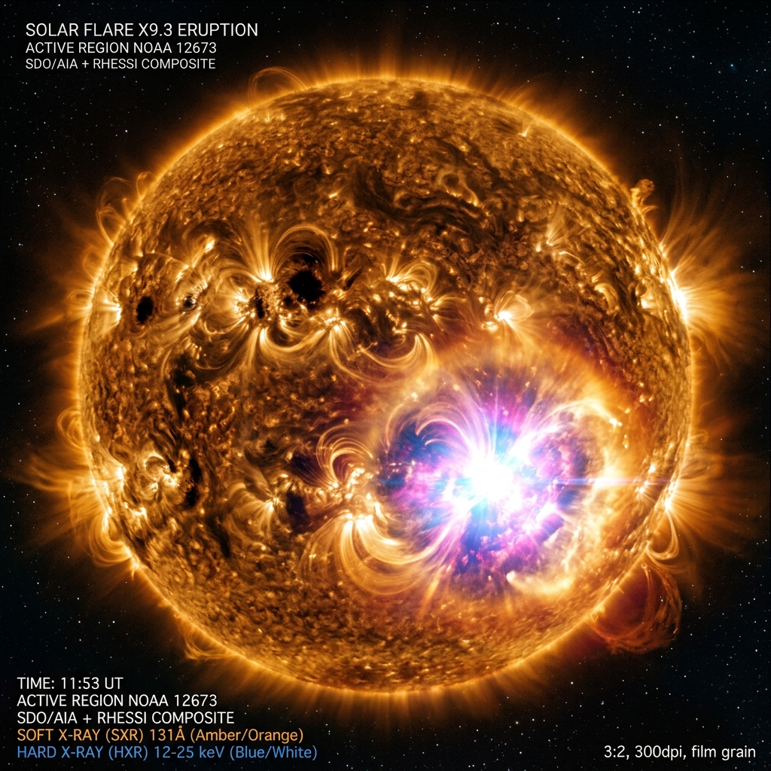
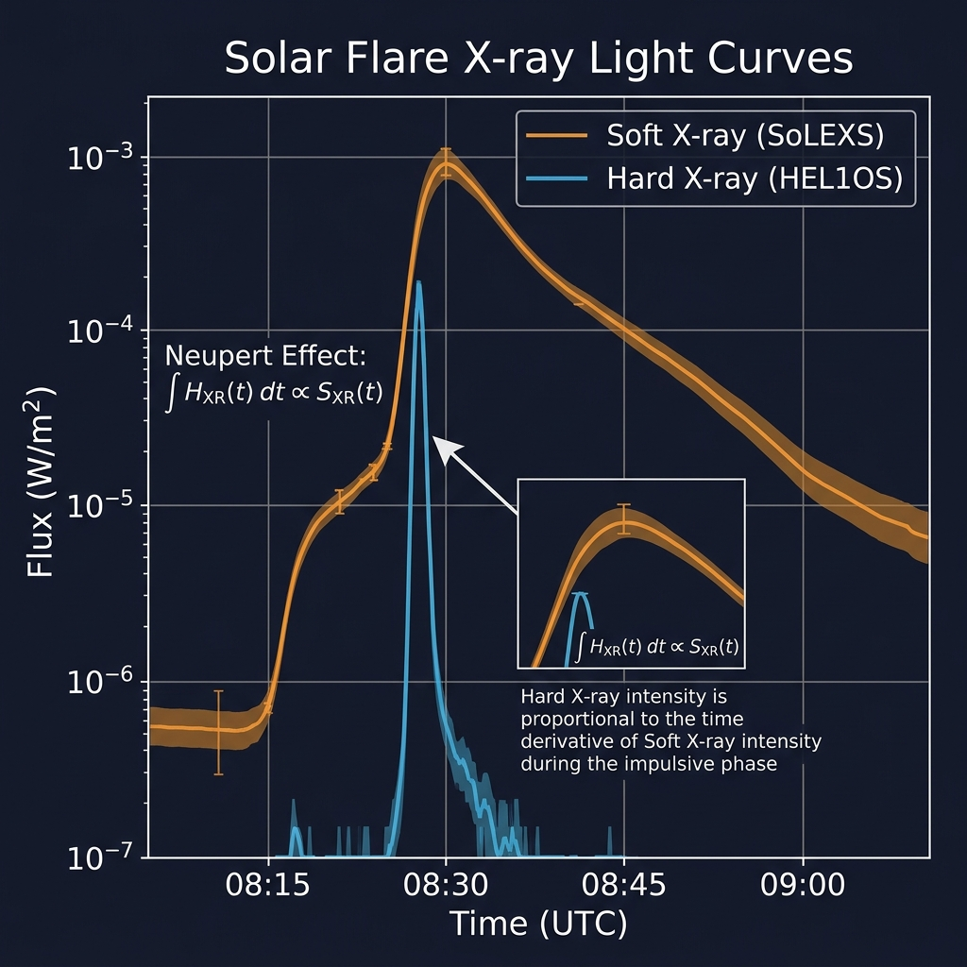
04
SOLAR FLARE PHYSICS
Thermal & Non-Thermal X-Ray Emission Mechanisms
Thermal Regime — Soft X-rays (1–22 keV)
• Emission from multi-million degree coronal plasma
• Quiescent corona: 1–3 MK → Flare plasma: 10–35 MK
• Primary metric for flare magnitude classification
• Gradual rise and decay profile (thermal timescale)
Non-Thermal Regime — Hard X-rays (10–150 keV)
• Impulsive bremsstrahlung from accelerated electrons
• Thick-target radiation at chromospheric footpoints
• Direct indicator of explosive energy release
• Exhibits Quasi-Periodic Pulsations (QPPs)
⚡ The Neupert Effect — Key Physical Coupling
The rate of increase of Soft X-ray flux is directly
proportional to the instantaneous Hard X-ray flux.
F_SXR(t) ∝ ∫ F_HXR(t') dt' → dF_SXR/dt ∝ F_HXR(t)
This serves as the PRIMARY cross-validation mechanism
for the nowcasting pipeline.
5 / 20

Slide 6
05
SOLAR FLARE CLASSIFICATION
GOES X-Ray Flux Standard (1–8 Å Band)
Flare Class | Peak Flux (W/m²) | Physical Description | Space Weather Impact
A | < 10⁻⁷ | Micro-flares; baseline background level | No terrestrial effect
B | 10⁻⁷ – 10⁻⁶ | Very minor localized active region heating | No significant effect
C | 10⁻⁶ – 10⁻⁵ | Minor flare events with limited coronal heating | Brief HF radio degradation (R1)
M | 10⁻⁵ – 10⁻⁴ | Medium-large flares; often with CMEs | R2-R3 blackouts; minor storms
X | ≥ 10⁻⁴ | Extreme events; severe infrastructure risk | R4-R5 blackouts; GIC damage
⚠️ KEY: Each class represents a 10× increase in peak flux. The pipeline must detect ALL classes (A through X) while maintaining high True Positive Rate for M and X-class events — the classes with severe infrastructure impact. Extreme class imbalance (X-class events are ~100× rarer) demands specialized loss functions.
6 / 20

Slide 7
06
DATASET ACQUISITION
Primary & Supplementary Data Sources for Model Training
SUPPLEMENTARY DATA SOURCES
🛰️ PRIMARY DATA — ISRO PRADAN Portal
Portal: pradan.issdc.gov.in/al1
• SoLEXS Level-1 FITS — 1-sec cadence SXR spectra
• HEL1OS Level-1 FITS — Event-mode HXR photon list
• SolexsLOODS processing software included
• 23+ TB released into public domain
• Registration required; Chrome recommended
GOES/XRS
RHESSI
Fermi/GBM
ngdc.noaa.gov/stp/
satellite/goes/
hesperia.gsfc.
nasa.gov/rhessi3/
hesperia.gsfc.
nasa.gov/fermi/
Ground-truth labels
2-sec SXR since 1975
HXR flare catalogue
3-300 keV imaging
Gamma-ray burst
monitor data
SDO/AIA
NOAA SWPC
SunPy
📊 5-STEP DATA PIPELINE
sdo.gsfc.
nasa.gov/data/
swpc.noaa.gov
docs.sunpy.org
1. Register & authenticate on PRADAN portal
2. Download SoLEXS + HEL1OS Level-1 FITS files
EUV images &
magnetograms
Real-time alerts
& forecasts
Python API for
all solar data
3. Parse with Astropy + SolexsLOODS toolkit
4. Cross-match with GOES ground-truth labels (UTC)
📄 KEY INSTRUMENT PAPERS (arXiv)
• SoLEXS calibration: arxiv.org/abs/2509.26292
• HEL1OS spectrometer: arxiv.org/abs/2512.12679
• HOPE nowcasting: arxiv.org/abs/2509.05234
5. Augment with RHESSI/Fermi/SDO supplementary data
7 / 20

Slide 8
07
DATA ENGINEERING PIPELINE
Level-1 FITS Parsing, Calibration & Temporal Synchronization
1
2
3
4
5
RAW
TELEMETRY
→
BACKGROUND
SUBTRACTION
→
DEADTIME
CORRECTION
→
TEMPORAL
ALIGNMENT
→
GROUND TRUTH
LABELING
FITS/CDF files
from PRADAN
⁵⁵Fe calibration
Ni/Pb removal
Photon pileup
compensation
1-sec grid
resample HXR
GOES class
UTC matching
HYPERMET Detector Response Model
HEL1OS Fixed Filtration Advantage
Temporal Synchronization Challenge
SoLEXS response modeled as superposition of:
• Main Gaussian Peak — true photon absorption
• Si Escape Peak — 1.74 keV below main peak
• Exponential Tail — incomplete charge collection
• Shelf Component — flat low-energy continuum
In-flight calibration via ⁵⁵Fe source + Ti foil
producing Mn Kα (5.89 keV) & Kβ (6.49 keV) lines
Unlike RHESSI/STIX which use movable attenuators:
• HEL1OS uses FIXED stainless steel mesh collimator
• No artificial discontinuities in light curves
• Critical for ML pipeline — prevents false triggers
• Enables robust QPP detection & detrending
CdTe detectors cooled to -25°C for optimal
spectral resolution in 10-40 keV transition band
SoLEXS: Native 1-second spectral bins
HEL1OS: Event-mode (microsecond timestamps)
Solution: High-speed min/max/std pooling
to resample HXR events → 1-sec grid
Synchronized UTC axis is PREREQUISITE for
sequential deep learning model ingestion
8 / 20

Slide 9
08
ALGORITHMIC NOWCASTING
Real-Time Detection, Classification & Master Catalogue Generation
1
DYNAMIC
BASELINE
2
SIGMA
TRIGGER
3
RISE-RATE
FILTER
5-min rolling median filter
Compute μ(t) and σ(t)
Robust to cosmic ray spikes
Onset: I(t) > μ(t) + 3σ(t)
Debounce: 3 consecutive sec
Eliminate sensor noise
Compute dF/dt derivative
Reject gradual brightenings
Confirm impulsive onset
4
NEUPERT
VALIDATION
5
PEAK
TRACKING
6
TERMINATION
CRITERIA
Cross-correlate d(SXR)/dt
with HXR flux signal
True Flare confirmation
Track to global maximum
Record t_peak timestamp
Monitor decay phase
Flux < μ_onset + 1σ
Record total duration
Log to catalogue
📋 UNIFIED MASTER CATALOGUE OUTPUT: UTC Start/Peak/End • Duration • Peak SXR & HXR Flux • Spectral Indices • Equivalent GOES Class • Neupert Correlation Score • Stored in PostgreSQL + JSON/CSV export
9 / 20

Slide 10
09
HOPE PRECURSOR TECHNIQUE
Hot Onset Precursor Event — Physics-Based Pre-Flare Detection
What is HOPE?
🌡️
📈
🔬
A physically-driven pre-flare signature identified in dual-channel
soft X-ray data. Before the HXR impulsive phase begins and before
the main SXR flux ramps up, a localized pocket of plasma in the
active region undergoes intense, silent heating.
Manifestation window: 5 – 15 minutes BEFORE flare peak
Temperature Surge
Emission Measure Spike
Abundance Shift
Plasma T rapidly elevates
from baseline to 10–15 MK
'Horizontal branch' in
T-EM diagram
Volumetric EM spikes by
~1 order of magnitude
Indicates density increase
in coronal loops
Low-FIP element abundances
shift to photospheric values
Indicates early chromospheric
material injection
📐 Real-Time Plasma Parameter Derivation
Temperature Derivation (Filter Ratio Method):
R = F_short / F_long = f(T) — independent of EM
Numerical interpolation against CHIANTI lookup tables
Continuous high-speed computation from SoLEXS bands
Emission Measure Calculation:
EM = F_long / G_long(T)
Where G_long is temperature-dependent response function
HOPE Trigger Condition:
dT/dt > threshold AND ΔEM > 1 order of magnitude
→ Generate Flare Anticipation Index (FAI) alert
⏱️ DEMONSTRATED LEAD TIMES
• 5–15 minutes before flare peak (20 diverse flares)
• Validated across C, M, and X-class events
• Based on arxiv.org/abs/2509.05234
• SoLEXS dual-band ratio enables real-time T extraction
• Automated HOPE → FAI trigger feeds ML forecaster
10 / 20

Slide 11
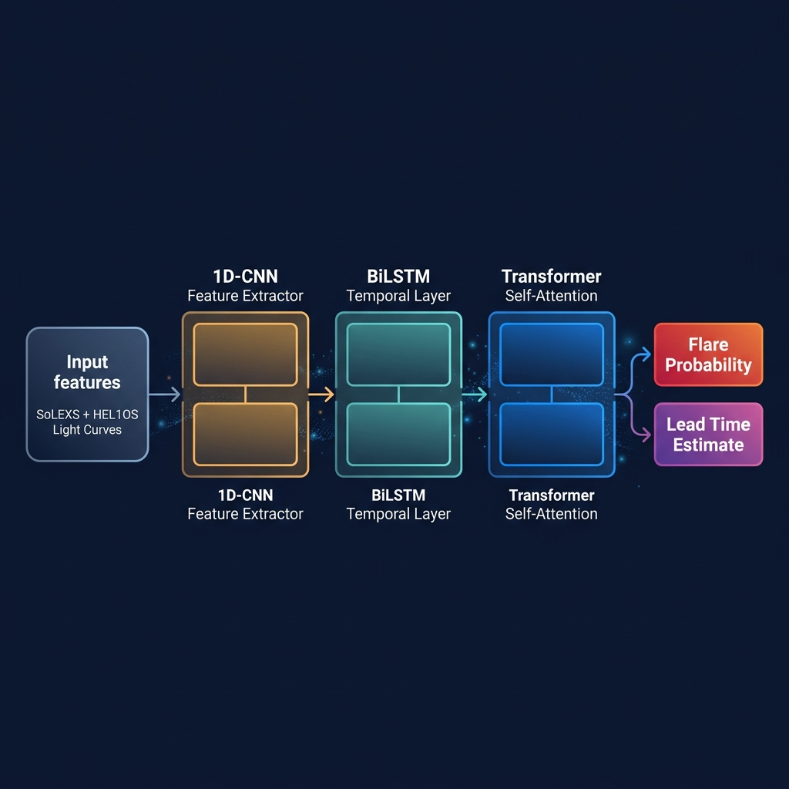
10
FORECASTING MODEL ARCHITECTURE
Hybrid 1D-CNN + BiLSTM + Transformer Deep Learning Pipeline
INPUT TENSOR
1D-CNN ENCODER
BiLSTM LAYER
TRANSFORMER
30–60 min trailing window
1-sec cadence features:
• SoLEXS flux + HEL1OS counts
• dF/dt derivatives
• T(MK) & EM values
• SXR/HXR ratio
• Spectral indices
Convolutional feature extractor
• Slides across time window
• Detects micro-variations
• Identifies sharp spikes
• Captures inflection points
• Localized pattern matching
• QPP detection
Bidirectional temporal encoder
• Forward + backward pass
• Maps sequential dependencies
• Learns flare morphologies
• Differentiates steep rise vs
gradual brightening
• Maintains long memory
Multi-head self-attention
• Resolves vanishing gradients
• Attends to specific moments
• Correlates HOPE spike (t-14m)
with current HXR rise
• Attention maps → interpretable
• Time-to-peak estimation
11 / 20

Slide 12
10
HANDLING CLASS IMBALANCE & MODEL OUTPUTS
Focal Loss, SMOTE Augmentation & Dual-Output Architecture
⚠️ The Class Imbalance Problem
MODEL DUAL OUTPUTS
Solar activity follows a power-law distribution:
• A/B/C-class flares: Ubiquitous — occur daily
• M-class flares: Moderate — weekly during solar max
• X-class flares: Extremely rare — ~100× less frequent
Standard Cross-Entropy loss → model predicts 'No severe flare'
Result: Statistically accurate but OPERATIONALLY USELESS
📊 Probability Vector (Classification)
P(flare | next N minutes)
• Multi-horizon: N = 5, 15, 30 minutes
• Per-class probabilities: C, M, X
• Softmax output layer
• Threshold-tunable for operational sensitivity
🎯 Solution: Focal Loss + SMOTE
Focal Loss adds modulating factor (1-p_t)^γ:
FL(p_t) = -α_t (1 - p_t)^γ log(p_t)
• Heavily penalizes missed X/M-class flares (FN)
• Down-weights easy background classifications
• γ parameter tuned via Optuna hyperparameter search
SMOTE (Synthetic Minority Over-sampling):
• Time-series adapted synthetic augmentation
• Balances severity distributions in training batches
• Via imbalanced-learn library
⏱️ Lead Time Regression (Continuous)
t_remaining = time to peak intensity
• Continuous regression output (minutes)
• Quantifies warning buffer for operators
• Linear output layer with MAE loss
• Target: ≥ 5 minutes average lead time
12 / 20

Slide 13
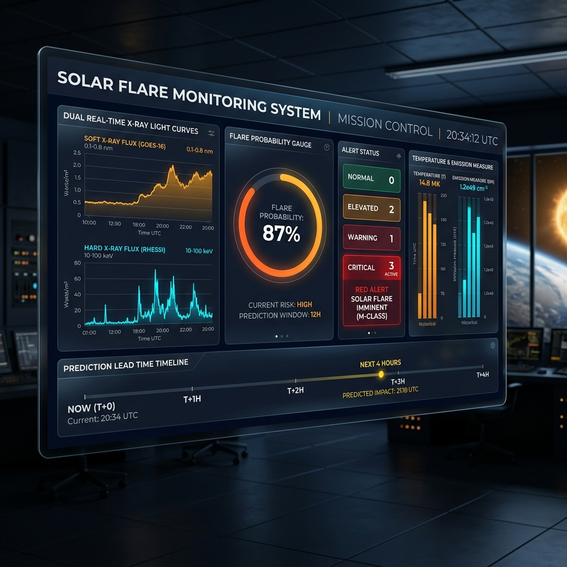
11
SYSTEM ARCHITECTURE & DASHBOARD
End-to-End Operational Pipeline with Real-Time Visualization
LAYER 1
DATA INGESTION
PRADAN API polling → FITS parsing → Background subtraction
LAYER 2
SIGNAL PROCESSING
Temporal alignment → Dynamic baseline → Derivative computation
LAYER 3
NOWCASTING ENGINE
Sigma trigger → Neupert validation → Master catalogue update
LAYER 4
FORECASTING ENGINE
HOPE extraction → Feature tensor → CNN+BiLSTM+Transformer inference
LAYER 5
DASHBOARD — 3 OPERATIONAL TIERS
ALERT & VISUALIZATION
1. Live Telemetry: Dual-panel log-scaled SXR+HXR light curves, 30-min rolling window
Dashboard rendering → Alert generation → Operator notification
2. Nowcast & Alert: GOES-class badge, duration tracker, Neupert correlation score
3. Forecast & Precursor: T(MK) & EM plots, probability bars for 5/10/30-min horizons
🐳 Deployed via Docker containers on ISSDC server clusters
📦 CI/CD pipeline via GitHub Actions for continuous testing
13 / 20

Slide 14
12
EVALUATION METRICS & BENCHMARKS
Operational Performance Standards for Mission-Critical Deployment
Metric | Formula | Definition | Target
POD / TPR | TP / (TP + FN) | Ability to capture real flares | ≥ 0.90
FAR | FP / (FP + TN) | Frequency of false alerts | ≤ 0.20
TSS | TPR - FPR | Primary space weather benchmark (-1 to 1) | ≥ 0.80
HSS | 2(TP·TN - FP·FN) / ... | Improvement over random baseline | ≥ 0.50
Lead Time | t_alert - t_peak | Warning buffer for operators | ≥ 5 minutes
STATE-OF-THE-ART BENCHMARKS
CONFUSION MATRIX FRAMEWORK
SolarFlareNet (2023)
Transformer stack
TSS = 0.84
Predicted: Flare
Predicted: No Flare
CNN-TCN (2025)
Hybrid temporal CNN
TSS = 0.85
Actual: Flare
TP ✅
FN ❌ (CRITICAL)
LSTM+Decomposition
LSTM with signal decomp
TSS = 0.68
Actual: No Flare
FP ⚠️
TN ✅
HOPE Manual (2024)
Precursor-based
5–15 min lead
14 / 20

Slide 15
13
TECHNOLOGY STACK
Open-Source Tools & Frameworks Powering the Pipeline
📥 DATA I/O
📊 SIGNAL PROCESSING
🧠 MACHINE LEARNING
• Python 3.11+ (core language)
• NumPy — array operations
• TensorFlow 2.x / PyTorch
• Astropy — FITS parsing & WCS
• SciPy — convolutions & filters
• Optuna — hyperparameter tuning
• SunPy v6.x — solar data APIs
• Pandas — time-series alignment
• imbalanced-learn — SMOTE
• SolexsLOODS — ISRO toolkit
• statsmodels — baseline estimation
• Focal Loss implementation
• h5py — HDF5 file handling
• scikit-signal — QPP detection
• ONNX — model portability
• requests — PRADAN API calls
📈 VISUALIZATION
🔧 DEVOPS & DATABASE
📋 EVALUATION
• Streamlit / Dash — web framework
• PostgreSQL — master catalogue
• scikit-learn — metrics
• Plotly — interactive charts
• Docker — containerization
• NOAA SWPC — validation
• Bokeh — streaming renders
• GitHub Actions — CI/CD
• GOES XRS — ground truth
• Matplotlib — static plots
• Prometheus — monitoring
• MLflow — experiment tracking
• Seaborn — statistical plots
• FastAPI — REST endpoints
• Custom TSS/HSS calculators
15 / 20

Slide 16
14
EXPECTED OUTCOMES & DELIVERABLES
Quantifiable Results & Strategic Value Propositions
📋
AUTOMATED FLARE
CATALOGUE
🧠
TRAINED FORECASTING
MODEL
• Indigenous database of nowcasted solar flares
• Combined SXR + HXR master catalogue
• PostgreSQL storage + JSON/CSV export
• UTC timestamps, peak flux, GOES class
• Spectral indices & Neupert scores
• First-of-its-kind from Indian mission data
• 1D-CNN + BiLSTM + Transformer architecture
• Quantifiable lead time ≥ 5 minutes
• Multi-horizon probability outputs
• Focal Loss for rare event sensitivity
• ONNX-exportable for deployment
• TSS ≥ 0.80 target performance
📊
REAL-TIME
DASHBOARD
📄
TECHNICAL
DOCUMENTATION
• Live SXR + HXR light curve visualization
• Flare alert badges with GOES class
• HOPE precursor temperature panel
• Probability bars (5/10/30 min horizons)
• Streamlit/Dash web interface
• Containerized Docker deployment
• Comprehensive system architecture manual
• Algorithm specification documents
• API documentation (FastAPI endpoints)
• Peer-review-ready manuscripts
• User training guides
• Reproducible deployment playbooks
16 / 20

Slide 17
15
IMPLEMENTATION ROADMAP
15-Week Phased Execution Plan with Key Milestones
PHASE 1
PHASE 2
PHASE 3
PHASE 4
PHASE 5
Weeks 1–3
Weeks 4–6
Weeks 7–10
Weeks 11–13
Weeks 14–15
DATA
PREPROCESSING
NOWCASTING
ALGORITHM
FORECASTING
MODEL
DASHBOARD &
INTEGRATION
REPORTING &
DELIVERY
✓ PRADAN portal registration
✓ Sliding σ-threshold onset detector
✓ Feature engineering (T, EM, ratios)
✓ Streamlit/Dash GUI development
✓ Database catalogue export
✓ SoLEXS + HEL1OS FITS download
✓ SXR derivative vs HXR Neupert validator
✓ HOPE precursor trigger encoding
✓ Live streaming data wiring
✓ Technical documentation
✓ Astropy FITS parsing pipeline
✓ Unified SXR+HXR Master Catalogue
✓ 1D-CNN+BiLSTM+Transformer build
✓ Visual/audio alert triggers
✓ Peer-review manuscripts
✓ HYPERMET calibration implementation
✓ Validation against NOAA flare list
✓ Focal Loss + SMOTE implementation
✓ End-to-end inference pipeline
✓ User training materials
✓ GOES ground-truth label matching
✓ Performance benchmarking
✓ Hyperparameter tuning (Optuna)
✓ Docker containerization
✓ Final system handover
W1
W3
W4
W6
W7
W10
W11
W13
W14
W15
17 / 20

Slide 18
16
DATA SOURCES REGISTRY
Complete Reference of All Datasets, Portals & Research Papers
Source | URL / Reference | Description
ISRO PRADAN Portal | pradan.issdc.gov.in/al1 | SoLEXS + HEL1OS Level-1 FITS data
ISSDC Main Archive | issdc.gov.in | ISRO science data archive; bulk download
GOES/XRS (NOAA) | ngdc.noaa.gov/stp/satellite/goes/ | Ground-truth SXR labels since 1975
RHESSI Catalogue | hesperia.gsfc.nasa.gov/rhessi3/ | HXR flare imaging catalogue
Fermi/GBM | hesperia.gsfc.nasa.gov/fermi/ | Gamma-ray burst monitor solar data
SDO Data Archive | sdo.gsfc.nasa.gov/data/ | EUV imagery + magnetograms
NOAA SWPC | swpc.noaa.gov | Real-time space weather alerts
SunPy Library | docs.sunpy.org | Python APIs for solar data access
NJIT Solar Flares | solarflare.njit.edu | Academic solar flare research portal
SoLEXS Paper | arxiv.org/abs/2509.26292 | Ground calibration & in-flight performance
HEL1OS Paper | arxiv.org/abs/2512.12679 | Hard X-ray spectrometer architecture
18 / 20

Slide 19
17
STRATEGIC CONCLUSIONS
Sovereign Capability & Future Impact Assessment
🛰️
Sovereign Monitoring
⚡
Dual-Band Synergy
First indigenous solar flare catalogue derived entirely from an Indian space mission — establishing data sovereignty in space weather intelligence
SoLEXS (thermal) + HEL1OS (non-thermal) synergy captures the complete flare lifecycle, enabling Neupert Effect cross-validation to eliminate false alarms
🔬
Physics-Driven Prediction
🧠
AI-Powered Forecasting
HOPE precursor technique provides 5–15 minute physics-based early warning — extracted from real-time plasma temperature and emission measure monitoring
Transformer self-attention architecture exceeds traditional LSTM limitations, targeting TSS ≥ 0.80 and FAR ≤ 0.20 for mission-critical reliability
🛡️
Infrastructure Protection
📊
Scalable Architecture
Provides satellite operators, aviation authorities, and power grid managers the vital temporal buffer to protect 50+ critical national space assets
Containerized, open-source pipeline deployable on ISSDC infrastructure — designed for continuous operation throughout Solar Cycle 25 and beyond
5–15 min
1–150 keV
TSS ≥ 0.80
24/7
50+
Prediction
Lead Time
Energy
Coverage
Skill Score
Target
Continuous
Monitoring
Satellites
Protected
19 / 20

Slide 20
Sovereign Space Weather
Resilience
Protecting India's Critical Space & Terrestrial Infrastructure
From Reactive Monitoring → Predictive, Automated Forecasting
Indian Space Research Organisation
Department of Space • Government of India
Aditya-L1 Mission • SoLEXS + HEL1OS Payloads
Problem Statement 15 • Solar Flare Nowcasting & Forecasting
Data Portal: pradan.issdc.gov.in/al1 | Archive: issdc.gov.in

