Slide 1
SKILLBRIDGE AI
AI Workforce & Knowledge Copilot
CAREER READINESS
From Skill Gaps
to Real Opportunity
76%
Target Role: Data Analyst
Highest Gap
Next Skill
Power BI
Statistics
Connect what people know, what companies need,
and what people need to learn.
Evidence
Matches
3 Projects
12 Roles

Slide 2
01 / PROBLEM
What is the Problem?
The skills economy is changing faster than traditional career guidance.
👨‍💻 Employees
🏢 Companies
🎓 Students
👩‍🏫 Professors
Don't know which emerging skills to learn next.
Cannot easily identify workforce skill gaps.
Learning is not directly connected to jobs.
Curriculum is not always aligned with industry needs.

Slide 3
02 / SOLUTION
Step-by-Step AI Solution
01
02
03
04
05
DISCOVER
COMPARE
PRIORITIZE
BUILD & PROVE
MATCH
Capture skills & career goals.
Compare profile with target role.
Identify the biggest skill gaps.
Learn and build projects.
Match with jobs & opportunities.
→
→
→
→

Slide 4
03 / AI DEMO
How SkillBridge AI Works
AI Skill Gap Analyzer
Personalized Action Plan
Opportunity Matching
AI compares current skills with target role and finds missing skills.
Recommends Power BI, Statistics and Visualization based on priority.
Matches users with jobs, projects and learning opportunities.
Profile → AI Analysis → Skill Gaps → Learn → Build Proof → Match

Slide 5
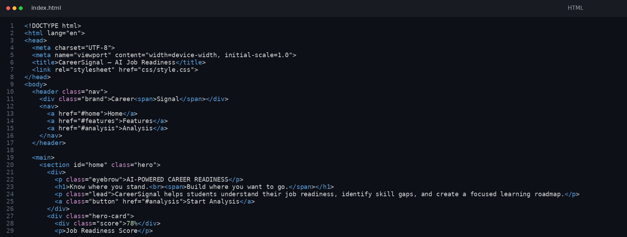
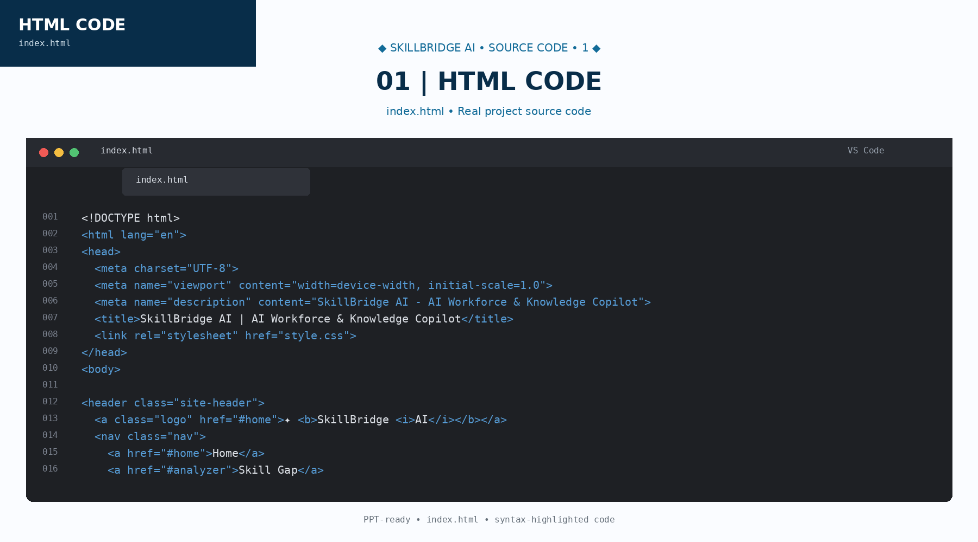
04 / SOURCE CODE — HTML
index.html
HTML structure & content
SkillBridge AI • Real implementation screenshot

Slide 6
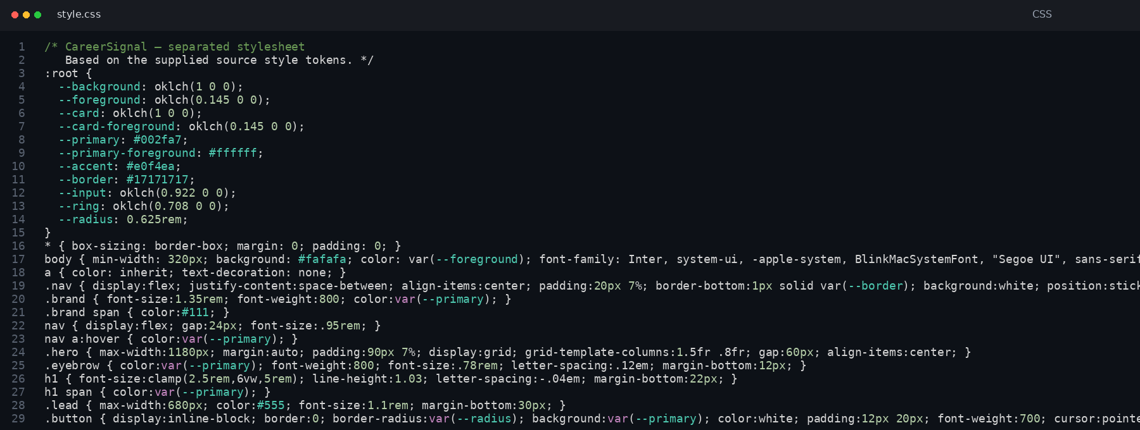
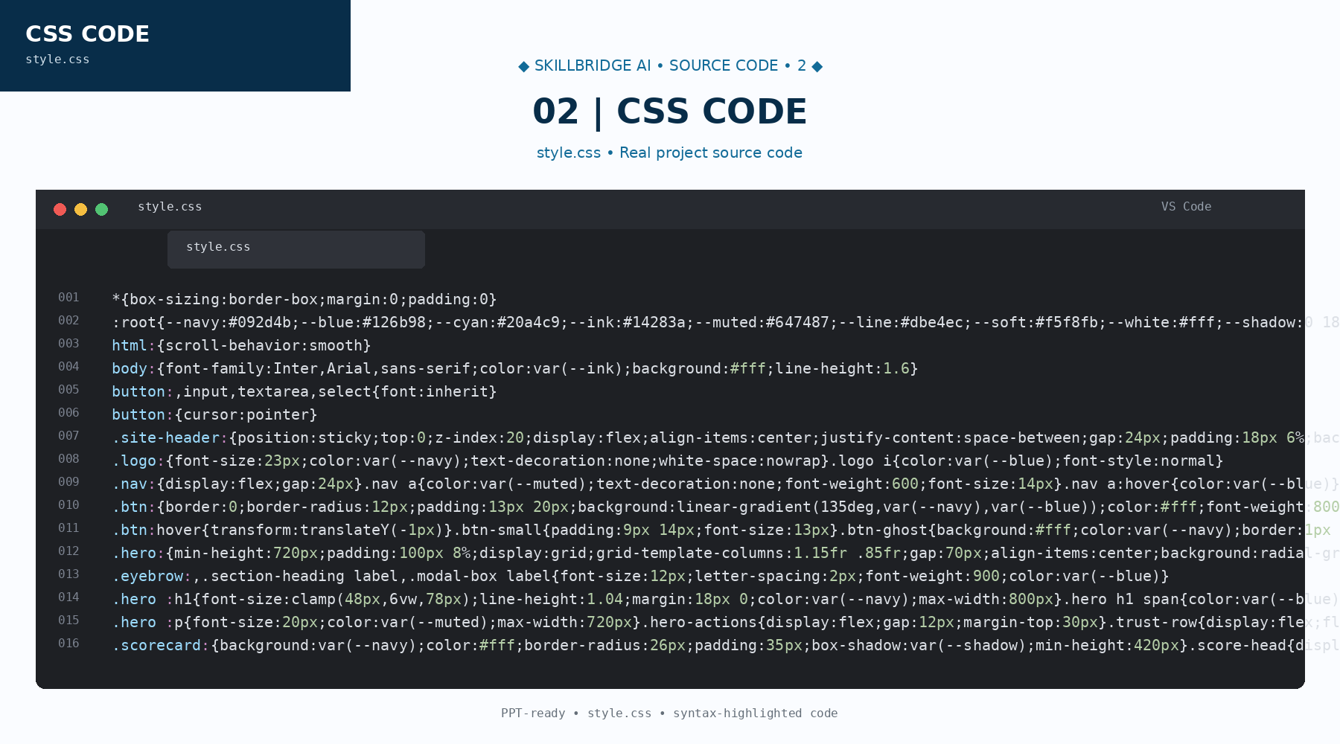
05 / SOURCE CODE — CSS
style.css
UI styling & visual design
SkillBridge AI • Real implementation screenshot

Slide 7
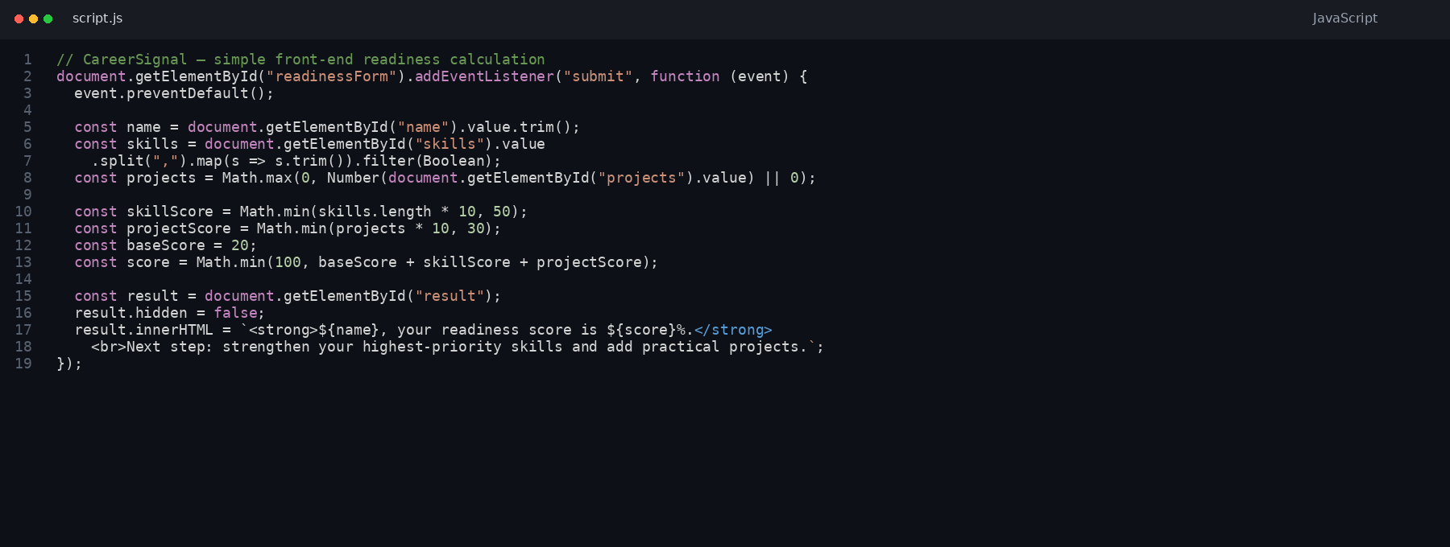
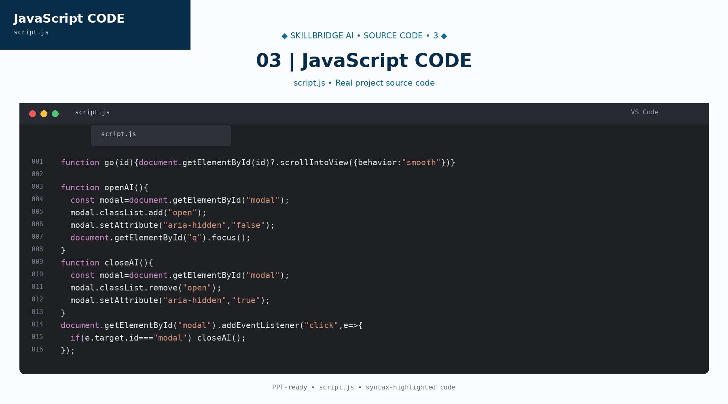
06 / SOURCE CODE — JAVASCRIPT
script.js
Interaction & functionality
SkillBridge AI • Real implementation screenshot

