Slide 1

Comprehensive Data Analysis for Zomato
- Sql Project
- Krish Prajapati

Slide 2

krishprajapati
Dataset Overview
Users Table:
Columns: row_index, user_id, name, email, password, age, gender
Orders Table:
Columns: row_index, order_date, sales_qty, sales_amount, currency, user_id, r_id
Restaurant Table:
Columns: row_index, id, name, city, rating, rating_count, cost, cuisine, lic_no, address, marital_status, occupation, monthly_income, educational_qualification, family_size
Menu Table:
Columns: row_index, menu_id, r_id, f_id, cuisine, price
Food Table:
Columns: row_index, f_id, item, veg_or_non_veg

Slide 3
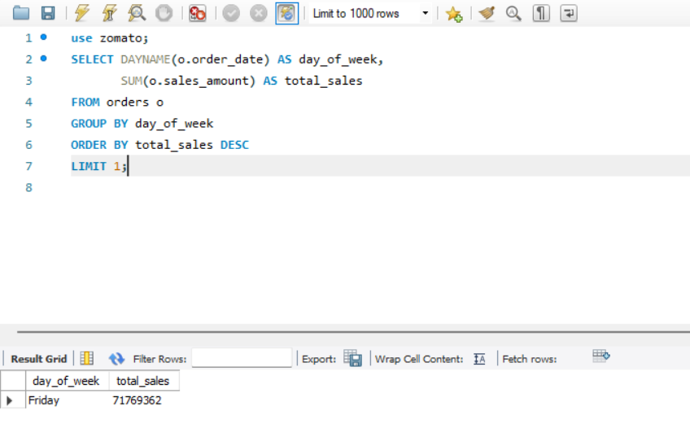
krishprajapati
Query 1
Question: On which day of the week are total sales the highest across all restaurants?

Slide 4
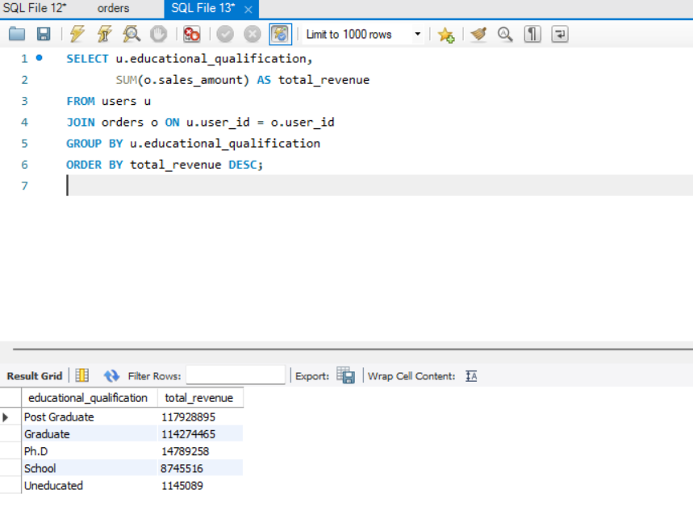
Query 2
Question: What is the total revenue generated by customers at different education levels?
SQL Query:
krishprajapati

Slide 5
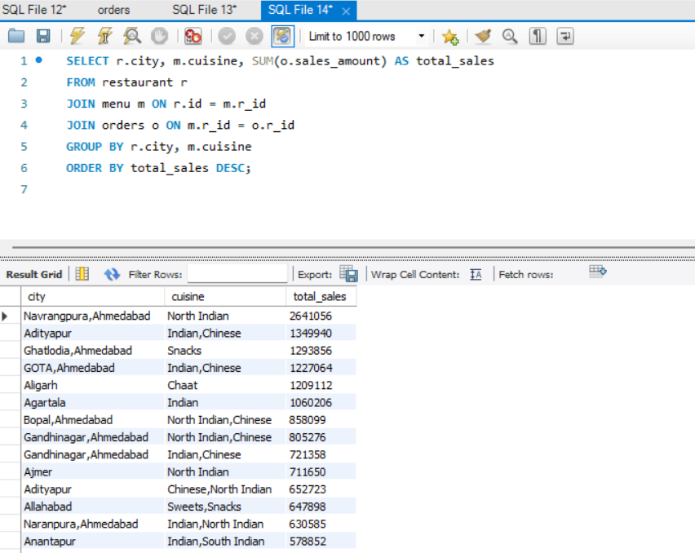
Query 3
Question: What are the most popular cuisines in each city based on total sales?
SQL Query:
krishprajapati

Slide 6
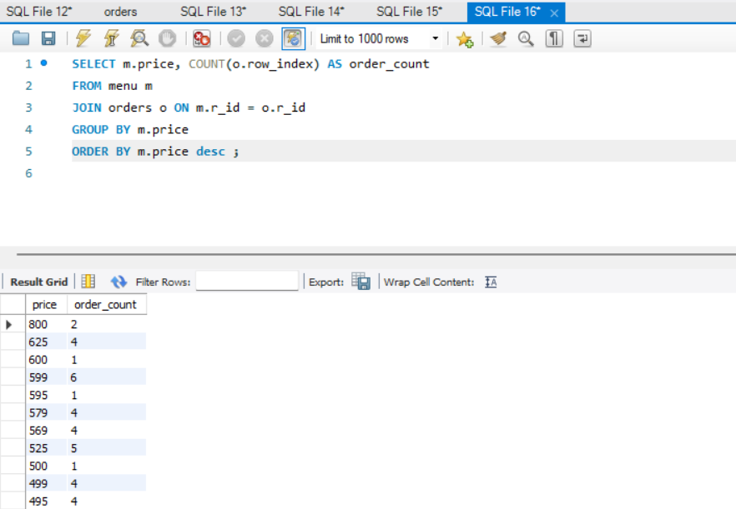

Query 4
Question: What is the relationship between the price of menu items and the number of orders they receive?
SQL Query:
krishprajapati

Slide 7
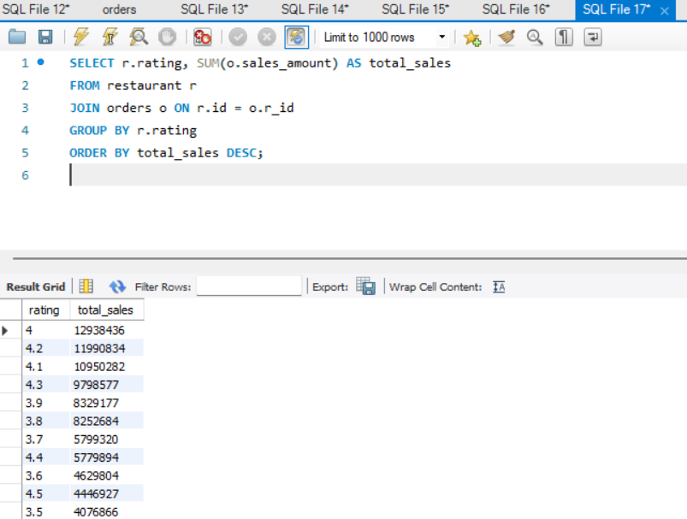
Query 5
Question: What is the correlation between restaurant rating and total sales?
SQL Query:
krishprajapati

Slide 8
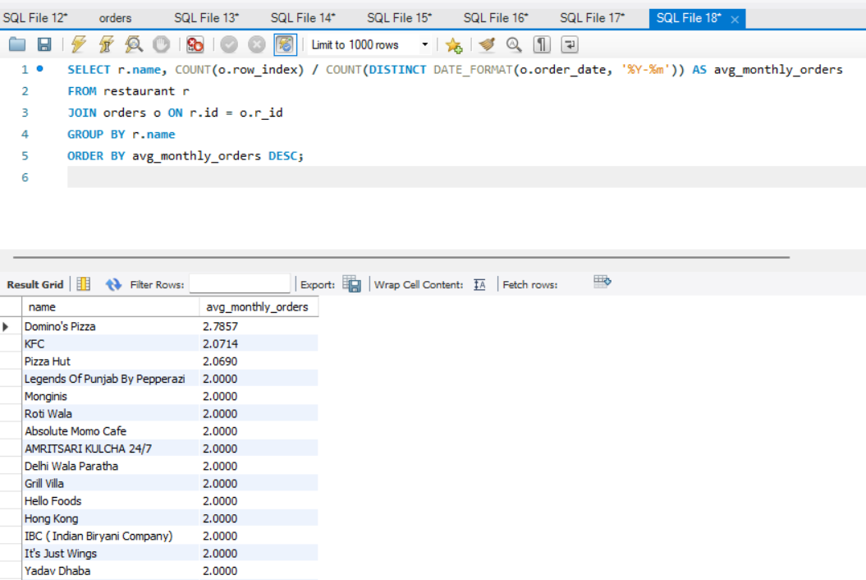
Query 6
Question: What is the average number of orders per restaurant per month?
SQL Query:
krishprajapati

Slide 9
krishprajapati
Conclusion
The Zomato analysis revealed key insights into customer preferences, regional cuisine popularity, and restaurant performance. Targeting high-spending users and re-engaging inactive customers can enhance retention. Optimizing menus based on revenue-generating cuisines will drive growth. Focus on improving service for high-order, low-rated restaurants is essential for customer satisfaction.

