Slide 1
Gradient Domain Imaging
Submitted by:
Dolniak, Oliver / 220678 / Informatik Dip
Klaghstan, Merza / 323179 / Informatik MA
Tutor: Mathias Eitz
TU Berlin
Department of Computer Graphics
Winter Semester 2010-2011

Slide 2
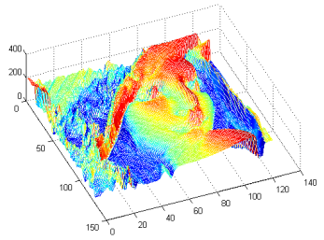
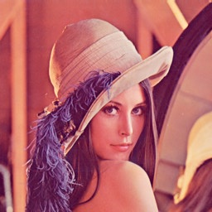
Scalar- vs. Gradient-field
Scalar-field : classic ordinary images
  RGB / Gray-scale
  Every point (pixel) in the image space has a scalar (value)

Slide 3
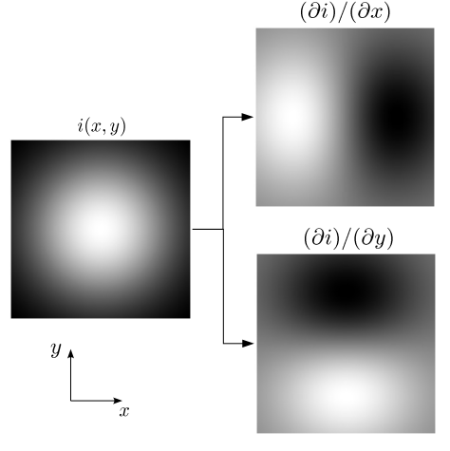

Scalar- vs. Gradient-field
Gradient-field (vector-field)
  Results by deriving scalar-field

Slide 4
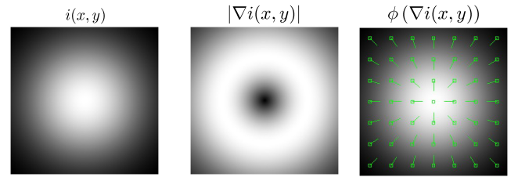
Scalar- vs. Gradient-field
Gradient-field (vector-field)
  Every point is associated with a vector
    Magnitude : rate of intensity change
    Phase : direction of the maximum change

Slide 5
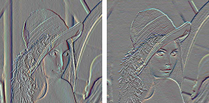
Poisson Equations
Why in the world we would need them ?!
Gradient Manipulation
Image
Ix
Iy
New Images
????!!!!
New
Gradients
Not Integrable

Slide 6
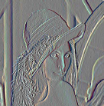

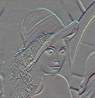
Poisson Equations
So, how to reconstruct the result Image ?!
  Given : G(x,y) = Gx, Gy ; manipulated gradients
  Compute : I(x,y)
Ix
Gx
Solve Poisson Equation 2D
linear system
Iy
Gy
Image

Slide 7
Poisson Equations
We look for an Image I(x,y), whose gradient is close enough to G(x,y)
Minimize
Where

Slide 8

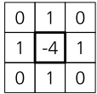
Poisson Equations
Somehow we get
For a numerical solution, we benefit from knowing that is the laplacian operator

Slide 9

Solving Poisson Equations
Substituting we came to a linear equation system
Ax = b
And this is Solvable under 1 of 2 boundary conditions
Boundaries are known (Dirichlet)
  A matrix is 4x4
4x4 Pixels
Known
Unknown

Slide 10

Solving Poisson Equations
Boundaries are not known, but derivative normals instead (Neumann)
  A matrix is 16x16
4x4 Pixels
Known
Unknown

Slide 11
Solving Poisson Equations
Under both conditions we have a linear system solving problem
  Direct Solvers
    Best approach for solving Poisson equation if rectangular boundary
    Basic Idea : decompose A (SVD)
  Basis Functions
  Multigrid
  Conjugate Gradients

Slide 12
Applications
Different categories of applications
  Per pixel
  Corresponding gradients in 2 images
  Corresponding gradients in multiple images
  Combining gradients among seams

Slide 13
Applications
Different categories of applications
  Per pixel
  Corresponding gradients in 2 images
  Corresponding gradients in multiple images
  Combining gradients among seams

Slide 14
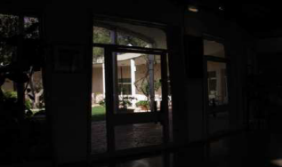
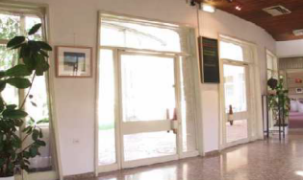
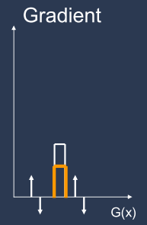
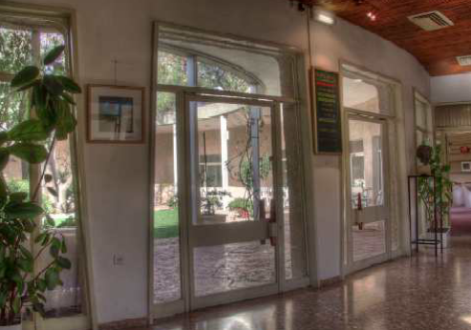
HDR Imaging tone mapping
Tone Map X bit image for 8 bit Display
Attenuate high gradients

Slide 15
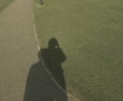
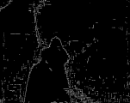
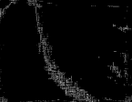
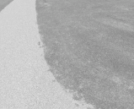

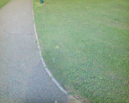
Shadow removal
Original Image
Edge map
Shadow edges
Illumination invariant Image

Slide 16
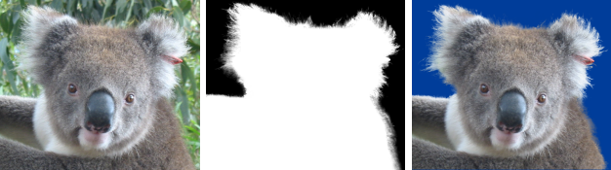
Poisson matting
Extract foreground from background
Image I(x,y) can be extracted from BG image B(x,y), and FG image F(x,y) with its alpha image a(x,y)
I = aF + (1-a)B

Slide 17
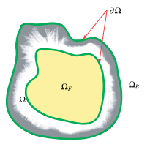
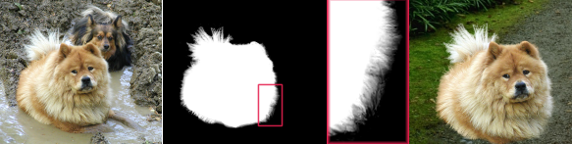
Poisson matting
Interaction by the user is essential
  Definitely BG
  Definitely FG
  Unknown region
Iteratively, perfect results can be obtained

Slide 18
Applications
Different categorization of applications
  Per pixel
  Corresponding gradients in 2 images
  Corresponding gradients in multiple images
  Combining gradients among seams

Slide 19


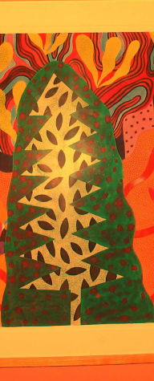
Reflection removal
Ambient image
Flash image
Result

Slide 20
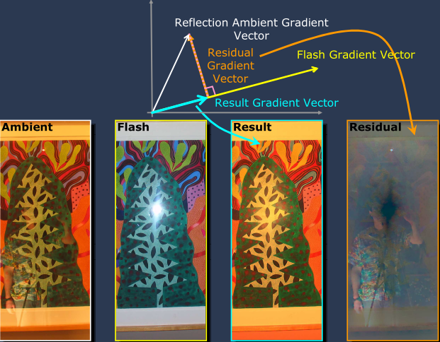
Reflection removal
How is this gonna be achieved ?!

Slide 21
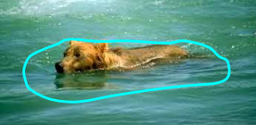
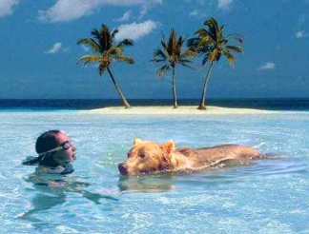
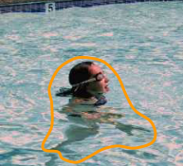
Composition
Copying gradients instead of pixels

Slide 22
Applications
Different categorization of applications
  Per pixel
  Corresponding gradients in 2 images
  Corresponding gradients in multiple images
  Combining gradients among seams

Slide 23
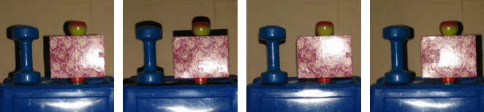
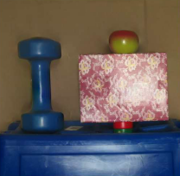
Specularity Reduction in Active Illumination
Multiple images with same viewpoint, varying illumination

Slide 24
Applications
Different categorization of applications
  Per pixel
  Corresponding gradients in 2 images
  Corresponding gradients in multiple images
  Combining gradients among seams

Slide 25
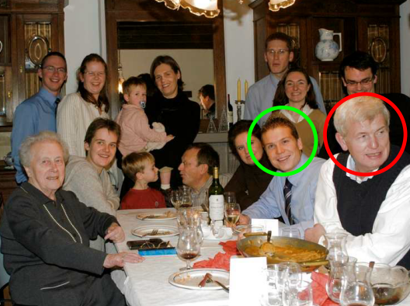
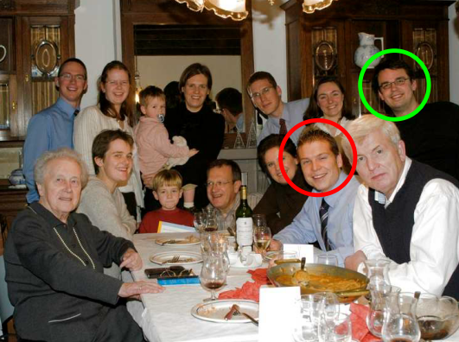
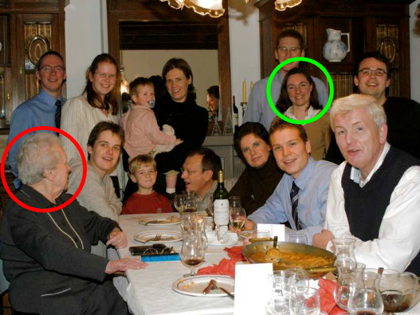
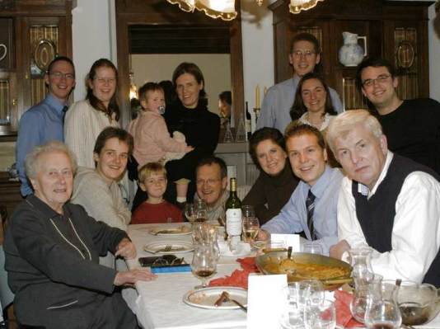
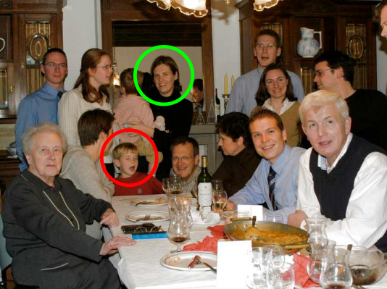
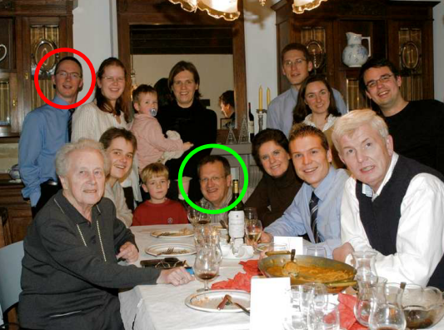
Digital Photo-montage

Slide 26
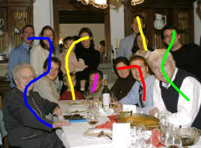
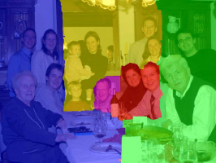
Digital Photo-montage
User defines brush strikes
Computed labeling

Slide 27
Thank you :)
Any questions ??!!
References:
Agrawal A. and Raskar R. 2007. Gradient Domain Manipulation Techniques in Vision and Graphics
Sun J., Jia J., Tang C. and Shum H. 2004. Poisson Matting
Hellwich O. 2009. Digital Image Processing course
www.wikipedia.org

