Slide 1
Gradient Domain Imaging
Introduction & Poisson equation
Submitted by:
Merza Klaghstan / 323179 / Informatik MA
Oliver Dolniak / 220678 / Informatik Dip
Tutor: Mathias Eitz
TU Berlin
Department of Computer Graphics
Winter Semester 2010-2011

Slide 2
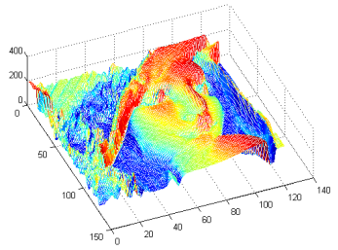
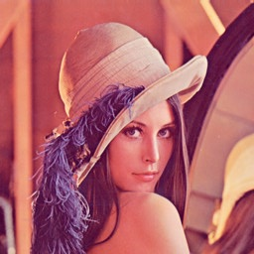
Scalar- vs. Gradient-field
Scalar-field : classic ordinary images
  RGB / Gray-scale
  Every point (pixel) in the image space has a scalar (value)

Slide 3
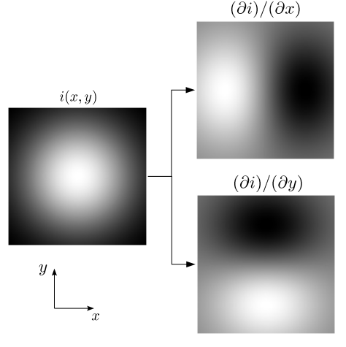

Scalar- vs. Gradient-field (2)
Gradient-field (vector-field)
  2 components
  Partial derivatives of scalar-field

Slide 4
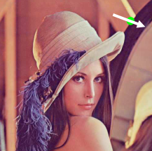
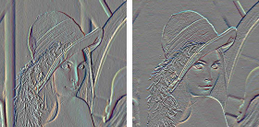
Scalar- vs. Gradient-field (3)
Gradient-field (vector-field)
  Every point is associated with a vector
    Magnitude : rate of intensity change
    Phase : direction of the maximum change
Ix
Iy

Slide 5
Poisson Equations
Why in the world we would need them ?!
Gradient Manipulation
Image
Ix
Iy
New Images
????!!!!
New
Gradients
Not Integrable

Slide 6
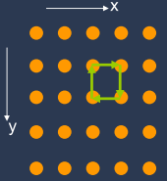
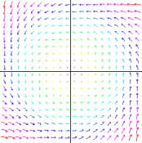

Non-Integrability
Condition of integrability
  Ix(x,y) + Iy(x+1,y) – Ix(x,y+1) – Iy(x,y) = 0
This is called “Curl” property of the gradient
  Shows rotation rate of a vector field
Curl(Ix,Iy) = 0

Slide 7
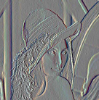

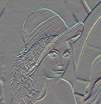
Poisson Equations (2)
So, how to reconstruct the result Image ?!
  Given : G(x,y) = Gx, Gy ; manipulated gradients
  Compute : I(x,y)
Ix
Gx
Solve Poisson Equation 2D
linear system
Iy
Gy
Image
Result
Manipulated Image

Slide 8
Poisson Equations (3)
We look for an Image I(x,y), whose gradient is close enough to G(x,y)
Minimize
Where
close enough as quadratic distance

Slide 9

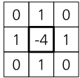
Poisson Equations (4)
mathematically we get
For a numerical solution, we benefit from knowing that is the laplacian operator

Slide 10


Solving Poisson Equations
Substituting we came to a linear equation system
Ax = b
And this is Solvable under 1 of 2 boundary conditions (Dirichlet & Neumann)
Boundaries are known (Dirichlet)
Boundaries are not known,
but derivative normals instead (Neumann)
4x4 Pixels
Known
Unknown

Slide 11
Solving Poisson Equations (2)
Under both conditions we have a linear system solving problem
  Direct Solvers
    Best approach for solving Poisson equation if rectangular boundary
    Basic Idea : decompose A (SVD)
  Basis Functions
  Multigrid
  Conjugate Gradients

Slide 12
Thank you :)
Any questions ??!!
References:
Agrawal A. and Raskar R. 2007. Gradient Domain Manipulation Techniques in Vision and Graphics
Hellwich O. 2009. Digital Image Processing course
www.wikipedia.org

