Slide 1
Gradient Domain Imaging
Applications
Submitted by:
Dolniak, Oliver / 220678 / Informatik Dip
Klaghstan, Merza / 323179 / Informatik MA
Tutor: Mathias Eitz
TU Berlin
Department of Computer Graphics
Winter Semester 2010-2011

Slide 2
Applications
Different categories of applications
  Per pixel
  Corresponding gradients in 2 images
  Corresponding gradients in multiple images
  Combining gradients among seams

Slide 3
Applications
Different categories of applications
  Per pixel
  Corresponding gradients in 2 images
  Corresponding gradients in multiple images
  Combining gradients among seams

Slide 4
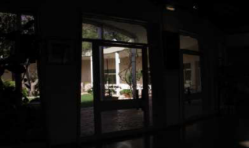
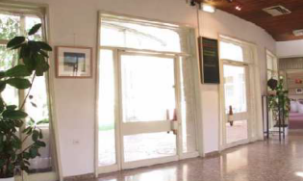
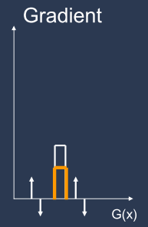
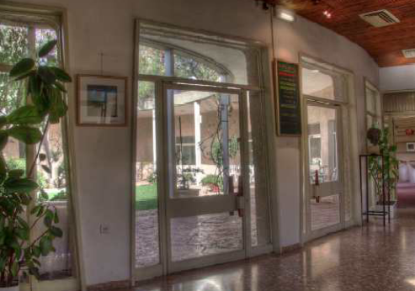
HDR Imaging tone mapping
Tone Map X bit image for 8 bit Display
Attenuate high gradients

Slide 5
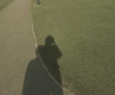
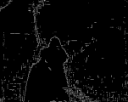
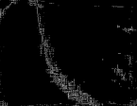
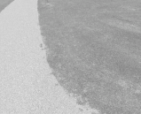

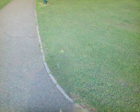
Shadow removal
Original Image
Edge map
Shadow edges
Illumination invariant Image

Slide 6
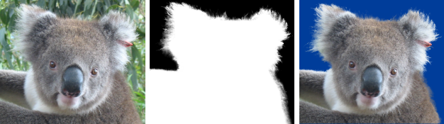
Poisson matting
Extract foreground from background
Image I(x,y) can be extracted from BG image B(x,y), and FG image F(x,y) with its alpha image a(x,y)
I = aF + (1-a)B

Slide 7
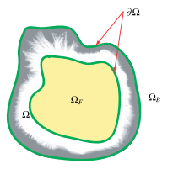
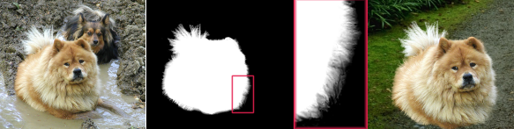
Poisson matting
Interaction by the user is essential
  Definitely BG
  Definitely FG
  Unknown region
Iteratively, perfect results can be obtained

Slide 8
Applications
Different categorization of applications
  Per pixel
  Corresponding gradients in 2 images
  Corresponding gradients in multiple images
  Combining gradients among seams

Slide 9


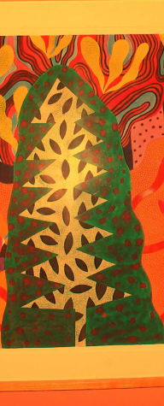
Reflection removal
Ambient image
Flash image
Result

Slide 10
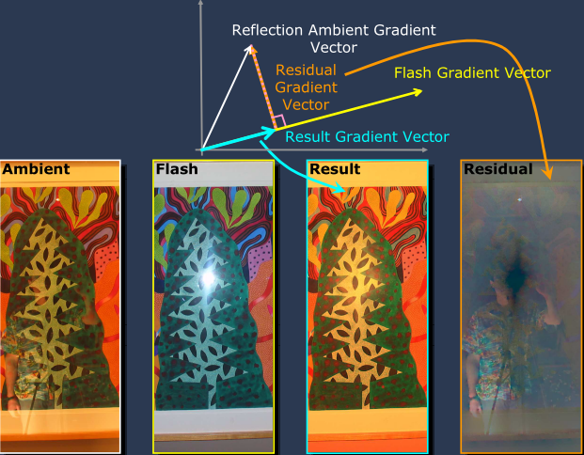
Reflection removal
How is this gonna be achieved ?!

Slide 11
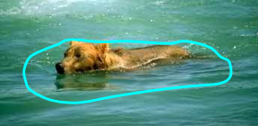
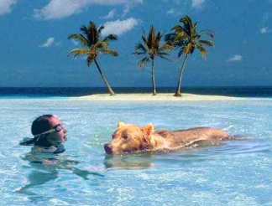
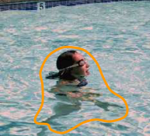
Composition
Copying gradients instead of pixels

Slide 12
Applications
Different categorization of applications
  Per pixel
  Corresponding gradients in 2 images
  Corresponding gradients in multiple images
  Combining gradients among seams

Slide 13
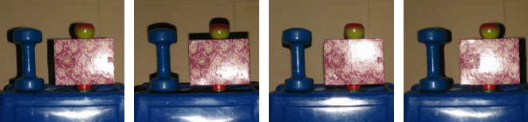
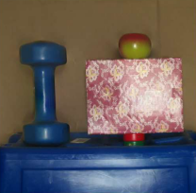
Specularity Reduction in Active Illumination
Multiple images with same viewpoint, varying illumination

Slide 14
Applications
Different categorization of applications
  Per pixel
  Corresponding gradients in 2 images
  Corresponding gradients in multiple images
  Combining gradients among seams

Slide 15
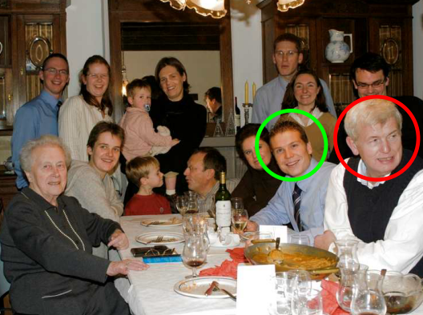
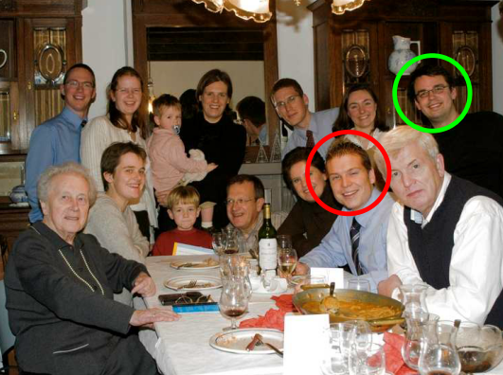
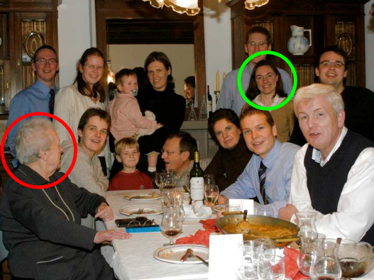
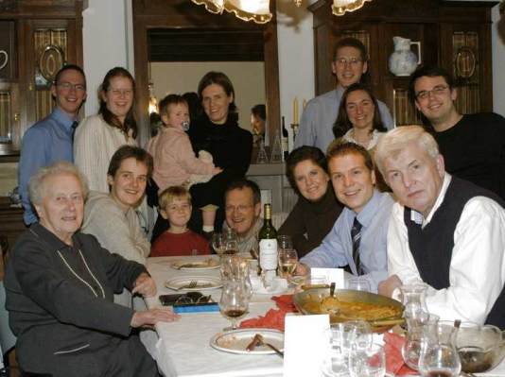
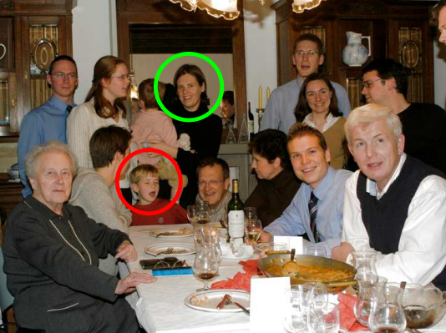
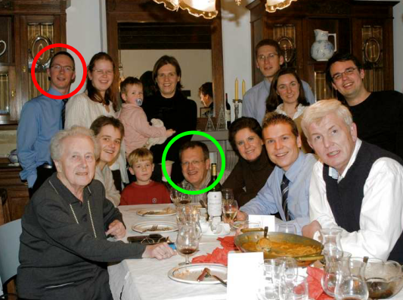
Digital Photo-montage

Slide 16
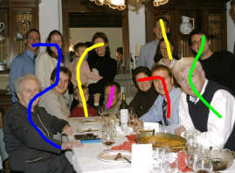
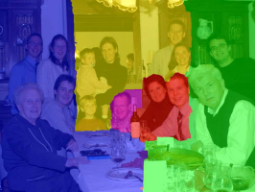
Digital Photo-montage
User defines brush strikes
Computed labeling

Slide 17
Thank you :)
Any questions ??!!
References:
Agrawal A. and Raskar R. 2007. Gradient Domain Manipulation Techniques in Vision and Graphics
Sun J., Jia J., Tang C. and Shum H. 2004. Poisson Matting
www.wikipedia.org

