Slide 1
Rollerslam
GUI Platform Independent Model

Slide 2
Model GUI Layout (1/2)
<<window>>
RollerslamDisplay
<<frame>>
GameCanvas
<<button>>
ConnectButton

Slide 3
Model GUI Layout (2/2)
<<window>>
ConnectionData
<<Text>>
URL
<<InputTextBox>>
ServerURL
<<button>>
OKButton
<<button>>
CancelButton

Slide 4
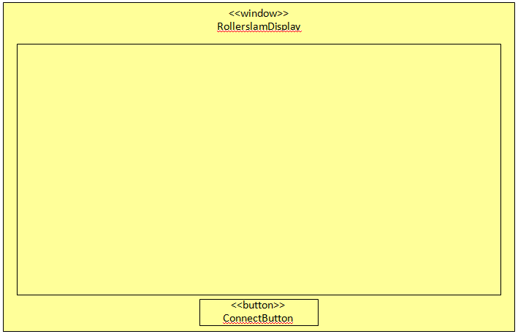
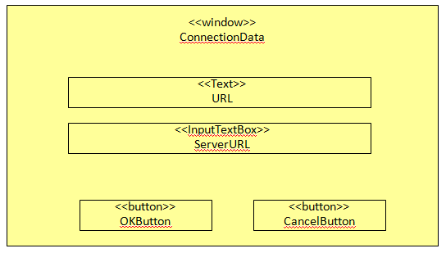
Model GUI Navigation
self.transactionType = LOCK_SOURCE_WINDOW
<<link>>
<<link>>
self.transactionType = CLOSE_SOURCE_WINDOW

Slide 5
Model GUI Data
<<frame>>
GameCanvas
7
<<Image>>
Sprite
image:Image
x
x
1
<<interface>>
Model
<<interface>>
World

Slide 6



Model GUI Internal Structure (1/2)
<<Komponent>>
RollerslamGUI
<<window>>
RollerslamDisplay
+<<create>>new()
+main()
-connectButtonClick()
1
<<interface>>
View
-owner
1
<<button>>
Button
+<<mouse_interaction>>mouseLeftClick()
context RollerslamDisplay::connectButtonClick()
post: self.controller^connect ()
x
-connectButton
1
-view
1
-controller
-owner
<<frame>>
GameCanvas
+init()
<<interface>>
Controller
+connect(host:String)
x
-game
ControllerImpl
+connect(host:String)
1
x
x
<<interface>>
Model
-model:World
+getModel():World
+setModel(newModel:World)
-clientFacade
context Button::mouseLeftClick()
post: self.owner^connectButtonClick()
1
-model
<<interface>>
ClientFacade
1
-model
1
context Model::setModel(newModel:Model)
post: self.model = newModel
ModelImpl
+getModel():World
+setModel(newModel:World)
World
x

Slide 7
Model GUI Internal Structure (2/2)
<<frame>>
GameCanvas
+init()
<<enum>>
SpriteKind
RED_PLAYER
RED_PLAYER_WITH_BALL
RED_PLAYER_GROUNDED
BLUE_PLAYER
BLUE_PLAYER_WITH_BALL
BLUE_PLAYER_GROUNDED
BALL
x
-ss
<<image>>
Sprite
-image:Image
+getWidth():Integer
+getHeight():Integer
+draw(g:Graphics, x:Integer, y:Integer)
1
<<singleton>>
SpriteStore
-single:SpriteStore
-sprites:Map
+get():SpriteStore
+getSprite(spriteKind:SpriteKind):Sprite

Slide 8
OCL Constraints
context RollerslamDisplay::new()
post:
self.game^init()
context GameCanvas::init()
post:
--how to model the canvas update that occurrs each x ms?
context ControllerImpl::connect()
post:
self.façade.clientInitialization^init(?:String) and self.facade.displayRegistry^register(?:Display)
--how to model world update?

