Slide 1

Antonio Jose de Vasconcelos Costa - ajvc
Breno Batista Machado - bbm
Cleyton Mario de Oliveira Rodrigues - cmor
Marcos Aurelio Almeida da Silva - maas
Pablo Santana Barbosa - psb
Weslei Alvim de Tarso Marinho - watm

Slide 2

O que é?
Características
Estratégia do Player
Logging
Dificuldades

Slide 3

Gaelic
Football
Soccer
Australian
Football
Rollerslam!
Handball
Rugby
Basketball
American
Football
Slamball
Ice
Hockey
Roller
Derby

Slide 4

Rollerslam Simulation GUI
Game
Visualization
GUI
Agent Reasoning
Visualization GUI
referee
playerAgent1(team1)
playerAgent1(team2)
...
...
Coach(Team1)
Coach(Team2)
playerAgent20(team1)
gamePhysicsRulesSimulatorAgent
playerAgent20(team2)

Slide 5
O que é?
Características
Estratégia do Player
Logging
Dificuldades

Slide 6

Agente GoalBased:
  Jogadores;
  Técnicos.
effector
sensor
simulation
<<component>>
AutomataAgent
Environment
State
Model
worldModel
+ state : SimulationState
<<component>>
GoalBasedAgent
GoalBased
Environment
State
Model
worldModel
GoalInitialization
GoalUpdate
<<interface>>
GoalInitialization
<<interface>>
GoalUpdate
+ initialize(m:GoalBasedEnvironmentStateModel)
+ updateGoal(m:GoalBasedEnvironmentStateModel)

Slide 7

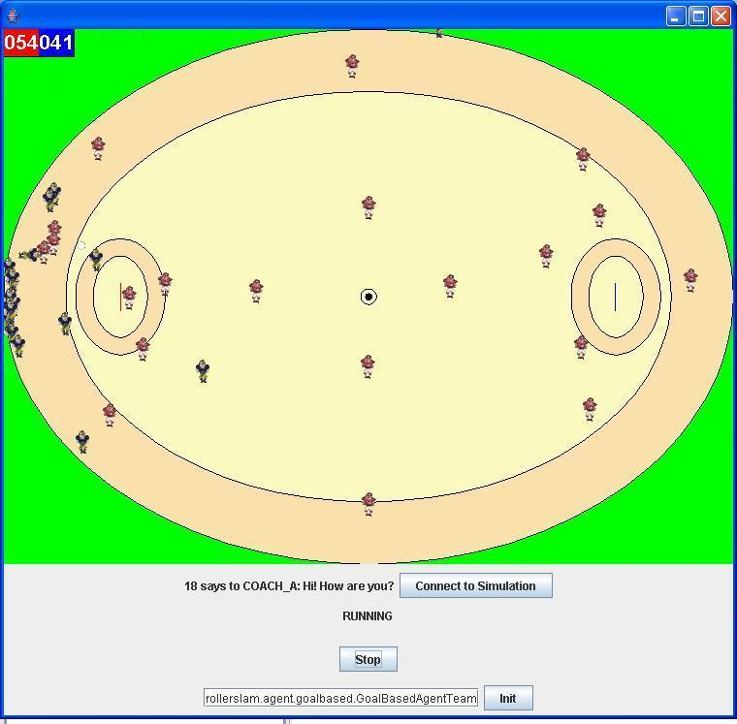
CENTERFORWARD
GOALKEEPER
CENTERBACK
CENTERTRACKER
ENDFORWARD
ENDBACK
HALFBACK
FREEFORWAR1
FREEBACKS1
HALFFORWARD
FREEFORWARD2
FREEBACKS2
ROVER1
RIGHTFORWARD
ROVER2
RIGHTBACK
LEFTFORWARDD
LEFTBACK
RIGHTTRACKER
LEFTTRACKER

Slide 8
O que é?
Características
Estratégia do Player
Logging
Dificuldades

Slide 9
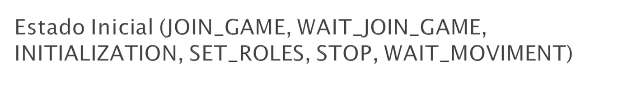
JOIN_GAME
send JoinGameAction/
WAIT_JOIN_GAME
INITIALIZATION
[model->gameStarted]
send InitializationFact/
STAND_UP
send StandUpAction/
GO_TO_INIT_COORD
recv DefineRoleFact/
SET_ROLES
[me->inGround]
send DashAction/
[me->hasBall and
not me->inGround and
not nearBall()]
[nearBall() and not
me->inGround]
[insideArea(0.10) and
not me->hasBall and
not me->inGround and
not nearBall()]
STOP
GO_TO_GOAL
GO_TO_BALL
send DashAction/
[nearBall()]
[not nearBall()]
send DashAction/
WAIT_MOVIMENT
[nearBall()]

Slide 10

GO_TO_INIT_COORD
send DashAction/
[ball->withPlayer and
playerWithBall.team = me.team]
send DashAction/
[not me->inGround
and not nearBall()
and not veryNearBall()]
GO_TO_BALL
send TackleAction/
TACKLE_PLAYER
[not me->inGround
and veryNearBall()]
[ball->withPlayer and
playerWithBall.team <> me.team]
STAND_UP
send StandUpAction/
send CatchAction/
[not ball->withPlayer]
[me->inGround]
CATCH_BALL

Slide 11

send CounterTackleAction/
COUNTER_TACKLE
[nearOpponent()]
send DashAction/
GO_TO_GOAL
[not nearOpponent()]
[me->hasBall]
CATCH_BALL
send DashAction/
GO_TO_BALL
[not me->hasBall]
[nearBall()]
[playerWithBall.team <> me.team]
send DashAction/
[not nearBall()]
send DashAction/
GO_TO_INIT_COOR
[playerWithBall.team = me.team]

Slide 12

TACKLE_PLAYER
send DashAction/
GO_TO_INIT_COORD
[playerWithBall.team = me.team]
[playerWithBall.team <> me.team]
send DashAction/
[not nearBall()]
send DashAction/
GO_TO_BALL
[nearBall()]

Slide 13

STAND_UP
send DashAction/
GO_TO_INIT_COORD
[playerWithBall.team = me.team]
[playerWithBall.team <> me.team]
send DashAction/
[not nearBall()]
send DashAction/
GO_TO_BALL
[nearBall()]

Slide 14

STAND_UP
send StandUpAction/
send DashAction/
GO_TO_BALL
[me->inGround]
[nearBall()]
GO_TO_GOAL
[not me->inGround
and not me->hasBall]
send DashAction/
GO_TO_INIT_COOR
[not nearBall()]
[not me->inGround
and me->hasBall]
send ThrowAction/
THROW_BALL
[not manyOponentsNear()
and nearGoal(30000)]
send KickAction/
[manyOponentsNear()]
Near 30 meter (30000 millimeter)
KICK_BALL
send KickAction/
Near 50 meter (50000 millimeter)
[not manyOponentsNear()
and nearGoal(50000)]

Slide 15

STAND_UP
send StandUpAction/
send DashAction/
GO_TO_GOAL
[me->inGround]
[hasBall()]
THROW_BALL
[not me->inGround
and playerWithBall.team = me.team]
send DashAction/
GO_TO_INIT_COOR
[not me->inGround
and not playerWithBall.team = me.team]
[not hasBall()]
send DashAction/
[not nearBall()]
send DashAction/
[nearBall()]
GO_TO_BALL

Slide 16

STAND_UP
send StandUpAction/
send DashAction/
GO_TO_GOAL
[me->inGround]
[hasBall()]
THROW_BALL
[not me->inGround
and playerWithBall.team = me.team]
send DashAction/
GO_TO_INIT_COOR
[not me->inGround
and not playerWithBall.team = me.team]
[not hasBall()]
send DashAction/
[not nearBall()]
send DashAction/
[nearBall()]
GO_TO_BALL

Slide 17

STAND_UP
send StandUpAction/
[me->inGround]
COUNTER_TACKLE
GO_TO_GOAL
[not me->inGround
and me.hasBall]
[not me->inGround
and not me.hasBall]
send DashAction/
GO_TO_INIT_COOR
[not nearBall()]
send DashAction/
[nearBall()]
GO_TO_BALL

Slide 18
O que é?
Características
Estratégia do Player
Logging
Dificuldades

Slide 19
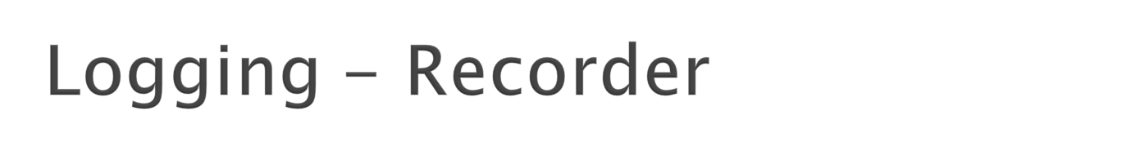
<<component>>
LogRecorder
LogRecording
Service
<<delegate>>
LogRecording
ServiceImpl
Simulation
Description

Slide 20

<<component>>
LogPlayer
Log Playing
Service
<<delegate>>
LogPlayer
Impl
--------------------------------
+ currentCycle : Integer
Simulation
Description

Slide 21

<<window>>
LogPlayerDisplay
<<frame>>
GameCanvas
<<Text>>
CurrentCycle
<<ComboBox>>
AgentFilter
<<ComboBox>>
MessageTypeFilter
<<Button>>
Show
<<Slider>>
CurrentCycleSlider
<<Text>>
Messages
<<Text>>
Speed
<<Slider>>
SpeedSlider
<<Button>>
Run
<<Button>>
LoadSimulation
<<FileChooser>>
SelectSimulation

Slide 22



Slide 23
O que é?
Características
Estratégia do Player
Dificuldades

Slide 24
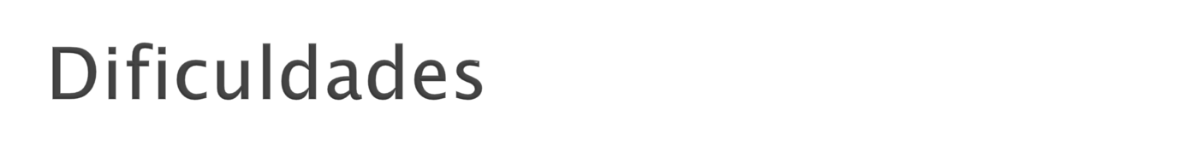


Slide 25

http://rollerslam.googlecode.com

