Slide 1
Rollerslam
GUI Platform Independent Model

Slide 2


General MVC Rollerslam
GUI Architecture
ClientFacade
<<Komponent>>
RollerslamGUI
<<window>>
RollerslamDisplay
+main()
<<interface>>
View
The controller controls the GUI behavior and server connection.
<<interface>>
Controller
The model represents the world and agents with their states.
<<interface>>
Model
The view presents the data to the user and updates itself when model changes.
ControllerImpl
+connect(host:String)
World

Slide 3
Client Display
Game Viewer Display Components and Related Elements

Slide 4
ModelLayout (1/2)
<<window>>
RollerslamDisplay
<<frame>>
GameCanvas
<<button>>
ConnectButton

Slide 5
ModelLayout (2/2)
<<window>>
ConnectionData
<<Text>>
URL
<<InputTextBox>>
ServerURL
<<button>>
OKButton
<<button>>
CancelButton

Slide 6
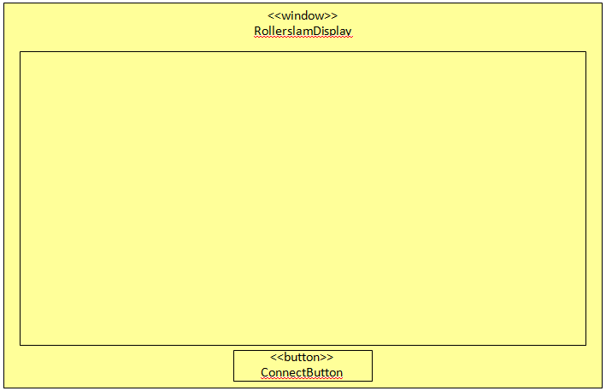
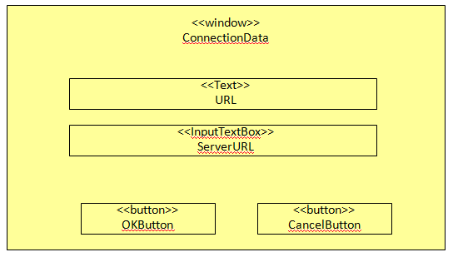
ModelNavigation
<<frame>>
GameCanvas
self.transactionType = LOCK_SOURCE_WINDOW
<<link>>
<<link>>
self.transactionType = CLOSE_SOURCE_WINDOW

Slide 7
ModelData
<<enumeration>>
SpriteKind
RED_PLAYER
RED_PLAYER_WITH_BALL
RED_PLAYER_GROUNDED
BLUE_PLAYER
BLUE_PLAYER_WITH_BALL
BLUE_PLAYER_GROUNDED
BALL
<<singleton>>
SpriteStore
+single:SpriteStore
+sprites:Map
+get():SpriteStore
+getSprite(spriteKind:SpriteKind):Sprite
<<image>>
Sprite
+image:Image
+width:Integer
+height:Integer
+draw(g:Graphics, x:Integer, y:Integer)
1
-ss
x
<<frame>>
GameCanvas
x
1
<<interface>>
Model

Slide 8

ModelInternalStructure (1/3)
<<Komponent>>
RollerslamGUI
<<window>>
RollerslamDisplay
+<<create>>new()
+main()
+connectButtonClick()
1
<<interface>>
View
owner
1
<<button>>
ConnectButton
label:String=“Connect”
+<<mouse_interaction>>mouseLeftClick()
context RollerslamDisplay::connectButtonClick()
post:self.conData^setVisible(true)
x
connectButton
1
view
1
controller
owner
<<frame>>
GameCanvas
+init()
+updateGraphics()
x
game
<<interface>>
Controller
+connect(host:String)
ControllerImpl
+connect(host:String)
1
x
x
<<interface>>
Model
+model:World
clientFacade
context ConnectButton::mouseLeftClick()
post: self.owner^connectButtonClick()
1
model
<<interface>>
ClientFacade
1
model
1
ModelImpl
World
x
Infrastructure element (not part of the GUI, GUI uses them)

Slide 9
ModelInternalStructure (2/3)
<<image>>
Sprite
+image:Image
+getWidth():Integer
+getHeight():Integer
+draw(g:Graphics, x:Integer, y:Integer)
<<enumeration>>
SpriteKind
RED_PLAYER
RED_PLAYER_WITH_BALL
RED_PLAYER_GROUNDED
BLUE_PLAYER
BLUE_PLAYER_WITH_BALL
BLUE_PLAYER_GROUNDED
BALL
<<frame>>
GameCanvas
+init()
x
1
-ss
<<singleton>>
SpriteStore
+single:SpriteStore
+sprites:Map
+get():SpriteStore
+getSprite(spriteKind:SpriteKind):Sprite
context OKButton::mouseLeftClick()
post: self.owner.parent.controller
^connect(self.owner.serverURL.text) and
self.owner^setVisible(false)
<<text>>
URL
+value:String=“URL"
<<button>>
OKButton
label:String=“OK”
+<<mouse_interaction>>mouseLeftClick()
1
url
1
<<window>>
RollerslamDisplay
+<<create>>new()
+main()
+connectButtonClick()
okButton
parent
x
1
owner
owner
context CancelButton::mouseLeftClick()
post: self.owner^setVisible(false)
1
<<window>>
ConnectionData
+setVisible(visible:Boolean)
conData
<<InputTextBox>>
ServerURL
text:String
owner
-owner
1
<<button>>
CancelButton
label:String=“Cancel”
+<<mouse_interaction>>mouseLeftClick()
1
cancelButton
-serverURL

Slide 10
ModelInternalStructure (3/3)
Message
ControllerImpl
+connect(host:String)
1
ci
StateMessage
DisplayAnonymousImpl
+update(message:Message)
1
<<interface>>
Display
dai
context ControllerImpl::connect(host:String)
post:
self.façade.clientInitialization^init(host)
and self.facade.displayRegistry^register(self.dai)
context DisplayAnonymousImpl::update(message:Message)
post:
If message.oclIsKindOf(StateMessage) then
self.ci.model^setModel(message.oclAsType(StateMessage).world)
else true
endif

Slide 11
OCL Constraints
context RollerslamDisplay::new()
post:
self.game^init()
context GameCanvas::init()
post:
self^updateGraphics()
context GameCanvas::updateGraphics()
post:
self^updateGraphics() -- The same operation have been called, for update the GUI in a few milliseconds, over and over

Slide 12
Server Admin Console
Server Administration GUI Components and Related Elements

Slide 13
ModelLayout
<<window>>
ServerDisplay
<<button>>
StartSimulation

Slide 14
ModelInternalStructure
<<Komponent>>
ServerGUI
<<window>>
ServerDisplay
simState:SimulationState
+main()
+startButtonClick()
1
-owner
1
<<button>>
StartSimulation
label:String=“Start”
+<<mouse_interaction>>mouseLeftClick()
x
-sButton
context RollerslamDisplay::connectButtonClick()
post:
If pre@simState = CREATED or STOPPED then
self.simState = RUNNING and self.sButton.text = ‘Stop’
and self.serverFacade.simulationAdmin^run()
else
self.simState = STOPPED and self.sButton.text = ‘Start’
and self.serverFacade.simulationAdmin^stop()
endif
<<enumeration>>
SimulationState
STOPPED
RUNNING
CREATED
context ConnectButton::mouseLeftClick()
post: self.owner^startButtonClick()
-serverFacade
1
<<interface>>
ServerFacade
Infrastructure element (not part of the GUI, the GUI uses them)

Slide 15
Log Player GUI
Log Player GUI Components and Related Elements

Slide 16
ModelLayout
<<window>>
LogPlayerDisplay
<<frame>>
GameCanvas
<<Text>>
CurrentCycle
<<ComboBox>>
AgentFilter
<<ComboBox>>
MessageTypeFilter
<<Button>>
Show
<<Slider>>
CurrentCycleSlider
<<Text>>
Messages
<<Text>>
Speed
<<Slider>>
SpeedSlider
<<Button>>
Run
<<Button>>
LoadSimulation
<<FileChooser>>
SelectSimulation

Slide 17
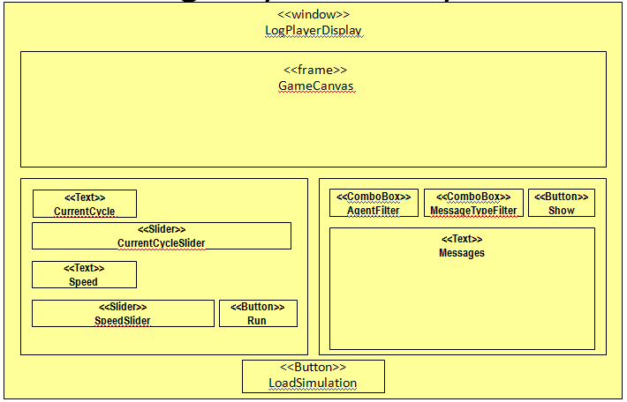
Model Navigation
self.transactionType = LOCK_SOURCE_WINDOW
<<link>>
<<link>>
<<FileChooser>>
SelectSimulation
self.transactionType = CLOSE_SOURCE_WINDOW

Slide 18
ModelInternalStructure (1/3)
<<Komponent>>
LogPlayerGUI
<<window>>
LogPlayerDisplay
context ConnectButton::mouseLeftClick()
post: self.owner^loadButtonClick()
1
owner
1
<<button>>
LoadSimButton
label:String=“Load”
+<<mouse_interaction>>mouseLeftClick()
x
loadSimButton
1
view
owner
<<frame>>
GameCanvas
game
x
1
ControllerImpl
playing:Boolean=false
+load(dbUri:URI)
+play()
+stop()
+goTo(p:Integer)
+setPlaySpeed(ps:Integer)
+getLogForAgent(agId:Integer,mType:String):LogEntry[]
1
controller
<<interface>>
Controller
+load(dbUri:URI)
+play()
+stop()
+goTo(p:Integer)
+setPlaySpeed(ps:Integer)
+getLogForAgent(agId:Integer)
x
x
1
lps
<<interface>>
Model
model
<<interface>>
LogPlayingService
1
Reused from ClientDisplay
Reused from LogPlayer

Slide 19
ModelInternalStructure (2/3)
<<FileChooser>>
LPFileChooser
fc
owner
<<window>>
LogPlayerDisplay
<<interface>>
View
runStopButtonClick()
updateCurrentCycleMsg(c:Integer, m:Integer)
updateSlider(i:Integer)
updateComboAgentsIds(lIds:Integer[])
<<Text>>
CurrentCycle
cc
owner
<<Slider>>
CurrentCycleSlider
ccs
<<Text>>
Speed
speed
show
<<Button>>
Show
<<Slider>>
SpeedSlider
ss
msgs
<<Text>>
Messages
<<Button>>
Run
run
mtf
<<ComboBox>>
MessageTypeFilter
<<ComboBox>>
AgentFilter
af

Slide 20
ModelInternalStructure (3/3)
context RollerslamDisplay::loadButtonClick()
post:self.fc^setVisible(true) and
self.controller^load(self.fc.getSelectedFile())
<<window>>
LogPlayerDisplay
+<<create>>new()
+main()
+loadButtonClick()
+ updateSlider(i:Integer)
+ updateComboAgentsIds(ids:Integer[])
context RollerslamDisplay::updateSlider(i:Integer)
post:self.ccs.value = i
context RollerslamDisplay::updateComboAgentsIds(ids:Integer[])
post:self.af.options->includesAll(ids)

Slide 21
ModelInternalStructure (Constraints)
context ControllerImpl::load(dbUri:URI)
post: self.lps^load(URI) and self.view^updateComboAgentsIds(self.lps. getAgentsIds())
context ControllerImpl::play()
post:
if not self.playing@pre then
self.playing = true
else true endif
and self^goTo(lps@pre.getCurrentCycle() + 1)
and if self.playing then self^play() else true endif

Slide 22
ModelInternalStructure (Constraints)
context ControllerImpl::stop()
post:self.playing = false
context ControllerImpl:: goTo(p:Integer)
post:
if p >= 0 and p <= lps.getTotalCycles() then
self.lps.getCurrentCycle() = p and
self.model^setModel(self.lps.getLogForAgent(-1)) and
self.view^updateSlider(p)
else true endif

Slide 23
ModelInternalStructure (Constraints)
context ControllerImpl::getLogForAgent(agId:Integer, m:String)
post:
result = lps.getAllLogForAgent(agId, m)

Slide 24
ModelInternalStructure (Constraints)
context CurrentCycleSlider::update(i:Integer)
post: self.owner.controller^goTo(i) and self.owner.cc.value = i
context Run::MouseLeftClick()
post:
if self@pre^label = ‘Run’ then
self.owner.controller^run() and self.label = ‘Stop’
else
self.owner.controller^stop() and self.label = ‘Run’
endif

Slide 25
ModelInternalStructure (Constraints)
context Show::MouseLeftClick()
post:
self.owner.msgs.Value = self.owner.controller.getLogForAgent(
self.owner.af.getSelectedItem().value, self.owner.mtf.getSelectedItem().value)

Slide 26
K2 Drafts

Slide 27
K2 Rollerslam Display
Draft
Game Viewer Display Components and Related Elements

Slide 28
K2SpecificationView

Slide 29
K2SpecificationServiceView
<<K2I>>
IRollerslamDisplay
<<K2INew>> +create():RollerslamDisplay
<<K2I>>
IConnData
<<K2Use>>
<<K2IRealiz>>
<<K2SubjCompoClass>>
RollerslamDisplay
<<K2Use>>
<<K2Use>>
<<K2I>>
ClientFacade
<<K2I>>
ISpriteStore

Slide 30
K2SpecificationOperationView
context IRollerslamDisplay::create() : RollerslamDisplay
post: result.oclIsNew() and result.oclIsKindOf(RollerslamDisplay)

Slide 31
K2 ConnectionDataDisplay
Draft
Connection Data Window Components and Related Elements

Slide 32
K2SpecificationView

Slide 33
K2SpecificationServiceView
<<K2I>>
IConnData
<<K2IAttr>>+visible:Boolean = false
<<K2INew>> +create():ConnectionData
<<K2IOper>>+receiveInputData():String
<<K2IRealiz>>
<<K2SubjCompoClass>>
ConnectionDataDisplay

Slide 34
K2SpecificationOperationView
context IConnData::create() : ConnectionDataDisplay
post: self.visible and result.oclIsNew() and result.oclIsKindOf(ConnectionDataDisplay)
context IConnData::receiveInputData() : ConnectionDataDisplay
post: not self.visible and result.oclIsKindOf(String)

Slide 35
K2 SpriteStore
Draft
Sprite Store
Components and Related Elements

Slide 36
K2SpecificationView

Slide 37
K2SpecificationServiceView
<<K2I>>
ISpriteStore
<<K2IAttr>> +sprites:Sprite[0..*]{BAG}
<<K2INew>> +create():SpriteStore
<<K2IOper>>+draw(g:Graphic, kind:SpriteKind, x:Integer, y:Integer)
<<K2IRealiz>>
<<K2SubjCompoClass>>
SpriteStore

Slide 38
K2SpecificationTypeView
<<K2Enum>>
SpriteKind
RED_PLAYER
RED_PLAYER_WITH_BALL
RED_PLAYER_GROUNDED
BLUE_PLAYER
BLUE_PLAYER_WITH_BALL
BLUE_PLAYER_GROUNDED
BALL
<<K2Class>>
<<Image>>
Sprite
+spriteKind:SpriteKind
<<K2Class>>
Graphic
<<K2IOper>>+draw(s:Sprite, x:Integer, y:Integer)

Slide 39
K2SpecificationOperationView
context ISpriteStore::create() : SpriteStore
post: result.oclIsNew() and result.oclIsKindOf(SpriteStore)
context ISpriteStore::draw(g:Graphic, kind:SpriteKind, x:Integer, y:Integer)
body:
let sprite = self.sprites->select(s : Sprite | s.spriteKind = kind)->first()
post: g^draw(sprite, x, y)

Slide 40
K2 Server Administration Display
Draft
Server Administration GUI
Components and Related
Elements

Slide 41
K2SpecificationView

Slide 42
K2SpecificationServiceView
<<K2I>>
IServerDisplay
<<K2INew>> +create():ServerDisplay
<<K2IRealiz>>
<<K2SubjCompoClass>>
ServerDisplay
<<K2I>>
ServerFacade
<<K2Use>>

Slide 43
K2SpecificationOperationView
context IServerDisplay::create() : ServerDisplay
post: result.oclIsNew() and result.oclIsKindOf(ServerDisplay)

Slide 44
K2 Log Player Display
Draft
Log Player GUI Components and Related Elements

Slide 45
K2SpecificationView

Slide 46
K2SpecificationServiceView
<<K2I>>
ILogPlayerDisplay
<<K2INew>> +create():LogPlayerDisplay
<<K2IRealiz>>
<<K2SubjCompoClass>>
LogPlayerDisplay
<<K2I>>
ILogPlayingService
<<K2Use>>

Slide 47
K2SpecificationOperationView
context ILogPlayerDisplay::create() : ILogPlayerDisplay
post: result.oclIsNew() and result.oclIsKindOf(LogPlayerDisplay)

