Slide 1
Rollerslam – A Multi-Agent based Distributed Simulation
Antonio Jose de Vasconcelos Costa - ajvc
Breno Batista Machado - bbm
Cleyton Mario de Oliveira Rodrigues - cmor
Marcos Aurelio Almeida da Silva - maas
Pablo Santana Barbosa - psb
Renata Teles Moreira - rtm
Weslei Alvim de Tarso Marinho - watm

Slide 2

Agenda
Introduction
The Infrastructure PIM Specification
  Overview
  Kobra2 Specification Service View
  Kobra2 Specification Type View
  Kobra2 Specification Lifecycle View
  Kobra2 Specification Operation View
Shared Element Models
The Agents
  Environment Component Model
  Referee Component Model
  Player Component Model
  Coach Component Model
Conclusion and Future Work

Slide 3
Introduction
Fusion of several Team Sports
Gaelic
Football
Soccer
Australian
Football
Rollerslam!
Handball
Rugby
Basketball
American
Football
Slamball
Ice
Hockey
Roller
Derby

Slide 4
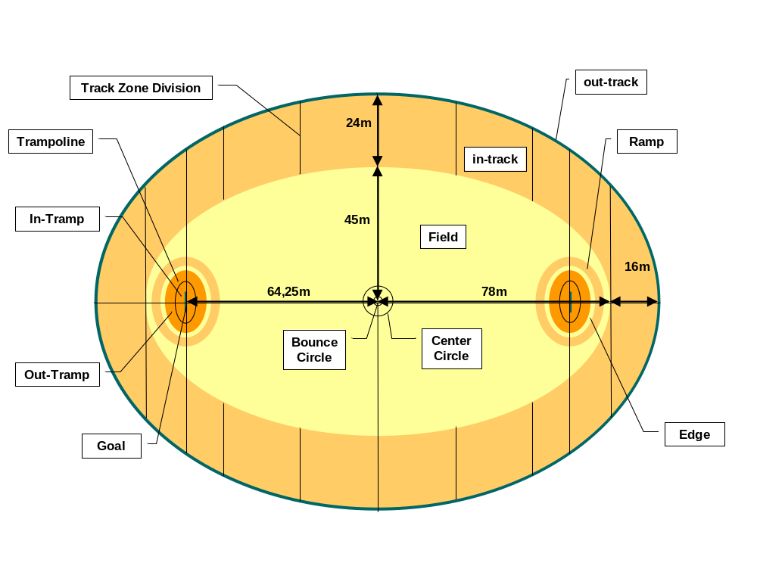
Introduction
The game is played in an elliptical skating rink.

Slide 5
Introduction
There was implemented just a subset of the entire game:
  2D Environment;
  No Baskets;
  No Trampolines;
  No Tramps;
  No Outer Track;
  Reduced set of actions and perceptions;
  Simulation carried out in cycles.

Slide 6
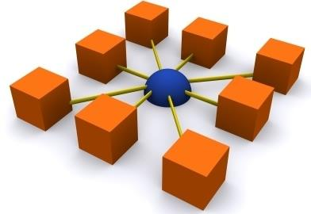
Agenda
Introduction
The Infrastructure PIM Specification
  Overview
  Kobra2 Specification Service View
  Kobra2 Specification Type View
  Kobra2 Specification Lifecycle View
  Kobra2 Specification Operation View
Shared Element Models
The Agents
  Environment Component Model
  Referee Component Model
  Player Component Model
  Coach Component Model
Conclusion and Future Work

Slide 7
The infrastructure PIM Specification
Provides the basic services for an agent based distributed simulation environment.
Can be reused in any kind of distributed agents simulation.
The simulation works in a client-server environment.

Slide 8
Agenda
Introduction
The Infrastructure PIM Specification
  Overview
  Kobra2 Specification Service View
  Kobra2 Specification Type View
  Kobra2 Specification Lifecycle View
  Kobra2 Specification Operation View
Shared Element Models
The Agents
  Environment Component Model
  Referee Component Model
  Player Component Model
  Coach Component Model
Conclusion and Future Work

Slide 9
<<K2Interface>>
ServerFacade
<<K2Interface>>
ClientFacade
<<K2Realization>>
<<K2Realization>>
<<K2Realization>>
<<K2Realization>>
<<K2Component>>
Infrastructure
<<K2Interface>>
Effector
<<K2Interface>>
Sensor
*
*
+ doAction(ac:Message)
+ getActions() : Message[0..*]
envEffector
envSensor
<<K2Realization>>
<<K2Realization>>
*
<<K2Use>>
<<K2Use>>
*
*
<<K2Interface>>
Agent
<<interface>>
Display
+ getName() : Integer
+ setName(newName : Integer)
+ update(m : Message)
Notes:
The typical realization of this component is going to provide two subcomponents, one of them is going to realize the server facade and the other is going to realize the client facade. The proper implementation of the services is probably going to be on the component implementing the server facade whereas the component implementing the client facade should be responsible for locating the server component and delegating its services to it.

Slide 10
Kobra2 Specification Service View
The Agent and Display interfaces represent the agents and the displays on the simulation.
These connections are established by the operations on the AgentRegistry and on the DisplayRegistry interfaces.
The Agent interface provides a unique identifier to each agent, an integer called Name.
The Display interface provides an operation (update()) responsible to inform the current state of the simulation on every cycle.

Slide 11
Kobra2 Specification Service View
The Infrastructure provides also many Sensor and Effector instances:
  one pair for each registered agent;
  and one pair to the environment agent.
The agents should use this interfaces as the unique communication media.

Slide 12
Client and Server Interfaces
<<Interface>>
ServerFacade
---------------------------------------------------------------------------
getDisplayRegistry() : DisplayRegistry
getAgentRegistry() : AgentRegistry
getSimulationAdmin() : SimulationAdmin
getSensorEffectorManager() : SensorEffectorManager
getServerInitialization() : ServerInitialization
getSimulationStateProvider() : SimulationStateProvider
setSimulationStateProvider(e : SimulationStateProvider)
getEnvironmentEffector() : Effector
getEnvironmentSensor() : Sensor
getLogRecordingService() : LogRecordingService
getGeneralSettings() : GeneralSettings
<<Interface>>
ClientFacade
-------------------------------------------------------------------
getServiceDiscoverer() : ServiceDiscoverer
getClientInitialization() : ClientInitialization
getAgentEffector(ag : Agent) : Effector
getAgentSensor(ag : Agent) : Sensor
getAgentRegistry() : AgentRegistry
getDisplayRegistry() : DisplayRegistry
getSimulationAdmin() : SimulationAdmin
getLogRecordingService() : LogRecordingService
getGeneralSettings() : GeneralSettings
Notes:
. Each of them provides an initialization service (the ServiceInitialization on the server and the ClientInitialization on the client) and also access to the LoggingService and to the GeneralSettings (providing access to some constants).

Slide 13
Kobra2 Specification Service View
The server facade provides acess to:
  The Effector;
  The Sensor.
The client facade provides acess to:
  The effector and the sensor of each agent;
  The AgentRegistry;
  The DisplayRegistry;
  The SimulationAdmin.

Slide 14
DisplayRegistry
The DisplayRegistry provides operations to register and unregister new displays.
On every simulation cycle, a message containing the current state is sent to all of the registered displays.
<<interface>>
DisplayRegistry
+ register(d:Display)
+ unregister(d:Display)
Notes:
There should be no effects when calling the register operation passing an already registered display or when calling the unregister operation passing a display that was not previously registered.

Slide 15
AgentRegistry
The DisplayRegistry provides operations to register and unregister new agents.
When registered, every agent has access to an Effector and to a Sensor, by the means of the ClientFacade.
<<interface>>
AgentRegistry
+ register(a:Agent)
+ unregister(a:Agent)
Notes:
There should be no effects when calling the register operation passing an already registered agent or when calling the unregister operation passing an agent that was not previously registered.

Slide 16
SimulationAdmin
The SimulationAdmin interface provides means to remotely control the simulation.
Provides the following operations:
  The run operation which starts an already running simulation;
  The stop operation which stops the running simulation;
  The getState operation which returns the current state of simulation.
<<interface>>
SimulationAdmin
+ run()
+ stop()
+ getState() : SimulationState

Slide 17
LogRecordingService
The LogRecordingService interface provides means to log informations about the simulation during the simulation.
At the infrastructure level, the agents are not obliged to send logging informations.
Neverthless, the environment agent should provide a copy of its world model on each cycle.
<<interface>>
LogRecordingService
+ addEntry(e : LogEntry)

Slide 18
Sensor and Effector
The Environment
receives actions from
the agents.
2. The agents receive
actions (perceptions)
from the environment.
Sensor
The Environment
send actions (perceptions)
to the agents.
2. The agents send
actions to the environment.
Effector
<<interface>>
Effector
<<interface>>
Sensor
+ doAction(ac:Message)
+ getActions()
: Message[0..*]

Slide 19
Sensor and Effector
The communication services just allows messages being sent from the environment to the agents and from the agents to the environment.
At the rollerslam game we extended the messaging capabilities to support messages being sent from one agent to another.
Notes:
The environment agent through the simulation should address any other kind of messaging requirements.
At the rollerslam game we extended the messaging capabilities to support messages being send from one agent to another.
This was accomplished by the definition of a special action that attaches the sent message to a list in the current world model.

Slide 20
Initialization Facade
The ServerInitialization interface requires at least an agent (the environment agent) in order to initialize the simulation.
A component implementing the LogRecordingService interface can also be provided.
The ClientInitialization requires no parameters in order to initialize the client facade.
ServerInitialization
----------------------------------------------------------
+ init(env:Agent)
+ init(env:Agent, log:LogRecordingService)
ClientInitialization
----------------------------------
+ init()
Notes:
Since these services usually involve very platform related issues, these methods are will probably require extra parameters on a more platform specific model.

Slide 21
General Settings
The GeneralSettings Interface provides means to define a set of parameters of the simulation that should be reused throughout the code, like:
  Cycle duration;
  Number of Agents;
  Path to necessary tools.
GeneralSettings
----------------------------------------------------------
+ getSetting(id:String) : String

Slide 22
Agenda
Introduction
The Infrastructure PIM Specification
  Overview
  Kobra2 Specification Service View
  Kobra2 Specification Type View
  Kobra2 Specification Lifecycle View
  Kobra2 Specification Operation View
Shared Element Models
The Agents
  Environment Component Model
  Referee Component Model
  Player Component Model
  Coach Component Model
Conclusion and Future Work

Slide 23
Kobra2 Specification Type View
A Message is an abstract prototype for all messages.
Every message should at least point to its sender (when this association is undefined, the environment agent is acknowledged as the sender).
The actions and perceptions should be subclasses of the Message class.
Message
<<enumeration>>
SimulationState
sender
STOPPED
RUNNING
CREATED
Agent

Slide 24
LogEntry
The LogEntry represents an entry on the log.
It should contain at least the cycle during which this entry was generated, the Agent that generated it and the timestamp of its generation.
The LogEntry should also contain some additional info.
LogEntry
---------------------------
+ cycle: Integer
+ agent : Agent
+ timestamp : Date
LogData
additionalInfo

Slide 25
Agenda
Introduction
The Infrastructure PIM Specification
  Overview
  Kobra2 Specification Service View
  Kobra2 Specification Type View
  Kobra2 Specification Lifecycle View
  Kobra2 Specification Operation View
Shared Element Models
The Agents
  Environment Component Model
  Referee Component Model
  Player Component Model
  Coach Component Model
Conclusion and Future Work

Slide 26
Kobra2 Specification Lifecycle View
run()
RUNNING
NOT
INITIALIZED
init()
CREATED
run()
stop()
STOPPED
stop()

Slide 27
Agenda
Introduction
The Infrastructure PIM Specification
  Overview
  Kobra2 Specification Service View
  Kobra2 Specification Type View
  Kobra2 Specification Lifecycle View
  Kobra2 Specification Operation View
Shared Element Models
The Agents
  Environment Component Model
  Referee Component Model
  Player Component Model
  Coach Component Model
Conclusion and Future Work

Slide 28
Kobra2 Specification Operation View
OCL specification of the operations of the SimulationAdmin.
context SimulationAdmin::run()
post: getState() = RUNNING
context SimulationAdmin::stop()
post: getState() = STOPPED

Slide 29
Agenda
Introduction
The Infrastructure PIM Specification
  Overview
  Kobra2 Specification Service View
  Kobra2 Specification Type View
  Kobra2 Specification Lifecycle View
  Kobra2 Specification Operation View
Shared Element Models
The Agents
  Environment Component Model
  Referee Component Model
  Player Component Model
  Coach Component Model
Conclusion and Future Work

Slide 30
Actions
Message
+sender
<<interface>>
Agent
*
1
ArmAction
UpdateScoreAction
VoiceAction
JoinGameAction
LegAction
CatchAction
ReleaseAction
SendMsgAction
DashAction
StandUpAction
TackleAction
ThrowAction
1
1
+subject
1
KickAction
HitAction
Fact
CountertackleAction
+a
+a
+a
Vector
1
1
1
+a
1

Slide 31
Perceptions
Message
+sender
<<interface>>
Agent
*
1
1
+receiver
GameStartPerception
*

Slide 32
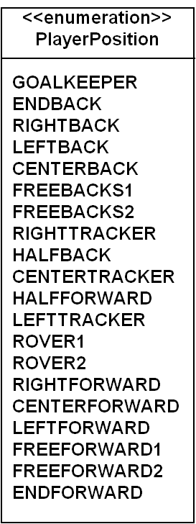
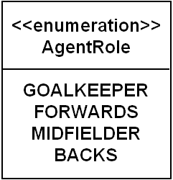
Facts
<<interface>>
Serializable
InitializationFact
ChangeRoleFact
GoToBallFact
DefineRoleFact
+ role : AgentRole
+ position : PlayerPosition
1
Vector
+posCoord
1

Slide 33
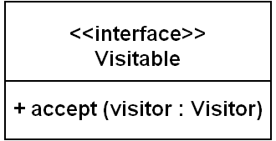

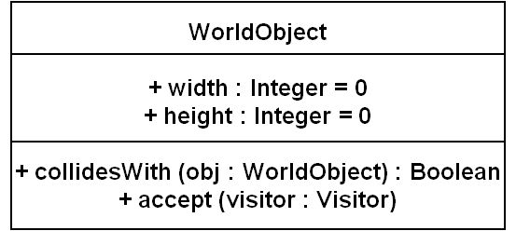
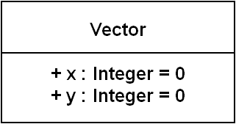
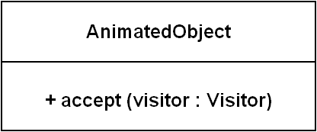
Environment Model
+s
+v
1
1
+a
1
1
1

Slide 34
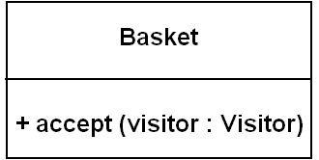
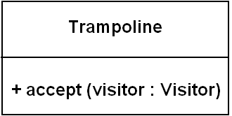
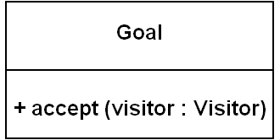
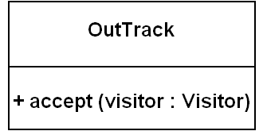
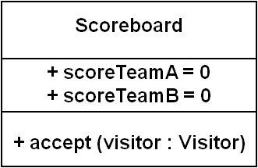
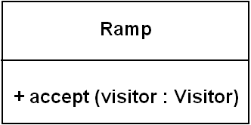
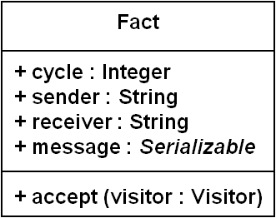
Environment Model
WorldObject

Slide 35
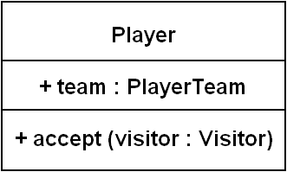
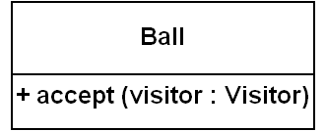
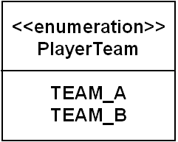
Environment Model
AnimatedObject

Slide 36


Environment Model
OutTrack
1
+outTrack
ChangeRoleFact
+rampB
Ramp
Scoreboard
1
1
+scoreboard
1
1
+rampA
1
1
World
+ accept (visitor : Visitor)
Player
+ball
1
1
20
Ball
1
1
+playersA
1
20
1
1
1
1
1
+playersB
Message
+goalA
1
+actions
0..*
1
+trampolineA
Trampoline
1
Goal
3
Basket
1
1
+goalB
+baskets
+trampolineB

Slide 37
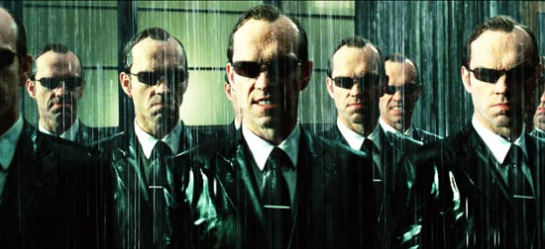
Agenda
Introduction
The Infrastructure PIM Specification
  Overview
  Kobra2 Specification Service View
  Kobra2 Specification Type View
  Kobra2 Specification Lifecycle View
  Kobra2 Specification Operation View
Shared Element Models
The Agents
  Environment Component Model
  Referee Component Model
  Player Component Model
Conclusion and Future Work

Slide 38
The Agents - Class Diagram
Basically, at this project we have defined and used two types of agents.
These types are depicted in the following picture.
<<Interface>>
Agent
GoalBasedAgent
AutomataAgent
Player
Coach
Environment
Referee

Slide 39
Agenda
Introduction
The Infrastructure PIM Specification
  Overview
  Kobra2 Specification Service View
  Kobra2 Specification Type View
  Kobra2 Specification Lifecycle View
  Kobra2 Specification Operation View
Shared Element Models
The Agents
  Environment Component Model
  Referee Component Model
  Player Component Model
Conclusion and Future Work

Slide 40
Service Specification View

Slide 41
<<K2Interface>>
Logging
<<K2Interface>>
ServerInitialization
<<K2Interface>>
AgentRegistryExt
<<K2Use>>
<<K2Use>>
logging
initialization
<<K2Interface>>
SimulationStateProvider
<<K2Realization>>
<<K2Component>>
Rollerslam
Environment
<<K2Use>>
simulation
<<K2Use>>
<<K2Use>>
<<K2Interface>>
ActionInterpretationComponent
+processAction(w:EnvironmentStateModel,
m:Message)
<<K2Interface>>
RamificationComponent
+processRamifications(world: EnvironmentStateMode)
<<K2Use>>
<<Sensor>>
Sensor
<<Effector>>
Effector

Slide 42
<<K2Interface>>
JavaPrologWorldVisitor
+getPrologRepresentation( world:World):String
<<K2Use>>
<<AutomataAgent>>
Environment
<<K2Use>>
<< K2Interface >>
PrologJavaWorldVisitor
+updateWorldRepresentation(world:World, Object: WorldState)

Slide 43
Realization Service View

Slide 44
<<Automatagent>>
Environment
------------------------------------------------------------------------------------------+ <<create>> create()
------------------------------------------------------------------------------------------
<<ActionInterpretationComponent>>
FluxActionInterpretationComponent
<<K2Interface>>
ActionInterpretationComponent
0
<<RamificationComponent>>
FluxRamificationComponent
<<K2Interface>>
RamificationComponent
0
<< JavaPrologWorldVisitor >>
SampleJavaPrologWorldVisitor
<<K2Interface>>
JavaPrologWorldVisitor
0
<< PrologJavaWorldVisitor >>
SamplePrologJavaWorldVisitor
<< K2Interface >>
PrologJavaWorldVisitor
0

Slide 45
FLUX
FLUX is a Fluent Calculus’ implementation.
  Flux provides a basic solution to the classical frame problem using the concept of state update axioms.
  Can be used to model:
    Ramification;
    Nondeterministic Actions;
    Concurrent Actions;
    ...
FLUXPLAYER is the current champion at the International General Game Playing Competition.

Slide 46
FLUX – Environment Model
Tool:
  Eclipse Prolog
Axioms:
  Poss Axiom;
  State Update Axiom;
  Ramification.
Files:
  rollerslam.pl;
  util.pl;
  ramification.pl.

Slide 47
Agenda
Introduction
The Infrastructure PIM Specification
  Overview
  Kobra2 Specification Service View
  Kobra2 Specification Type View
  Kobra2 Specification Lifecycle View
  Kobra2 Specification Operation View
Shared Element Models
The Agents
  Environment Component Model
  Referee Component Model
  Player Component Model
  Coach Component Model
Conclusion and Future Work

Slide 48
Service Specification View

Slide 49
<<Sensor>>
{ActionType = StateMessage}
EnvironmentSensor
<<K2Interface>>
RamificationComponent
+processRamifications(world: EnvironmentStateMode)
<<K2Interface>>
ModelInitializationComponent
+ initialize(m:EnvironmentStateModel)
<<K2Use>>
<<AutomataAgent>>
Referee
<<K2Use>>
<<K2Use>>
<<K2Interface>>
ActionInterpretationComponent
+processAction(w:EnvironmentStateModel,
m:Message)
<<K2Interface>>
ModelBasedBehaviorStrategy
Component
+computeAction(w:EnvironmentStateModel: Message)
<<K2Use>>
<<Effector>>
{ActionType=VoiceAction}
Voice

Slide 50
<<K2Interface>>
JavaPrologWorldVisitor
+getPrologRepresentation( world:World):String
<<K2Use>>
<<AutomataAgent>>
Referee
<<K2Use>>
<< K2Interface >>
PrologJavaWorldVisitor
+updateWorldRepresentation(world:World)

Slide 51
Realization Service View

Slide 52
<<Automatagent>>
Referee
------------------------------------------------------------------------------------------+ <<create>> create()
------------------------------------------------------------------------------------------
<<InitializationComponent>>
RefereeAgentInitializer
<<K2Interface>>
ModelInitializationComponent
<<ActionInterpretationComponent>>
RefereeActionInterpretationComponent
<<K2Interface>>
ActionInterpretationComponent
0
<<RamificationComponent>>
RefereeRamificator
<<K2Interface>>
RamificationComponent
0
<<ModelBasedBehavior
StrategyComponent>>
RefereeAgentStrategy
<<K2Interface>>
ModelBasedBehavior
StrategyComponent
0

Slide 53
RefereeWorldModel
-----------------------------------------+ lastBallPositionX : Real
+ lastBallPositionY : Real

Slide 54
Realization Operational View

Slide 55
RefereeRamificator::processRamifications(EnvironmentStateModel refereeWorld)
%% Intersection %%%
intersect(X1, Y1, X2, Y2, X3, Y3, X4, Y4) :-
lineEqConstants(A1, B1, C1, X1, Y1, X2, Y2),
lineEqConstants(A2, B2, C2, X3, Y3, X4, Y4),
det(A1, B1, A2, B2, Det),
Px is ((B2*C1 - B1*C2) / Det),
Py is ((A1*C2 - A2*C1) / Det),
contains(X1, Y1, X2, Y2, Px, Py),
contains(X3, Y3, X4, Y4, Px, Py).
lineEqConstants(A, B, C, X1, Y1, X2, Y2) :-
A is Y2-Y1,
B is X1-X2,
C is A*X1+B*Y1.

Slide 56
%% Intersection %%%
det(A1, B1, A2, B2, Det) :-
Det is A1*B2 - A2*B1,
not Det = 0.
contains(X1, Y1, X2, Y2, X, Y) :-
min(X1, X2, Xmin),
max(X1, X2, Xmax),
min(Y1, Y2, Ymin),
max(Y1, Y2, Ymax),
X >= Xmin, X =< Xmax,
Y >= Ymin, Y =< Ymax.

Slide 57
state_update(Z1,lookBall,Z2,[scored(Team)]) :-
(holds(score(Score, team(Team)),Z1),
Score2 #= Score + 1,
update(Z1,[score(Score2, team(Team))],[score(Score, team(Team))],Z2))
;
(Z1=Z2).
perform(lookBall, [Y]) :-
(current_state(Z),
holds(ballPosition(X1, Y1), Z),
holds(lastBallPosition(X2,Y2), Z),
holds(golLine(X3, Y3, X4, Y4, team(Team)), Z),
intersect(X1, Y1, X2, Y2, X3, Y3, X4, Y4),
Y = scored(Team)).

Slide 58
complex_action(lookBall, Z1, Z2) :- Z2 = Z1.
processRamificationsReferee(InitialState, FinalState) :- retract_all(current_state(_)),
assert(current_state(InitialState)),
execute(lookBall, InitialState, FinalState).

Slide 59
Agenda
Introduction
The Infrastructure PIM Specification
  Overview
  Kobra2 Specification Service View
  Kobra2 Specification Type View
  Kobra2 Specification Lifecycle View
  Kobra2 Specification Operation View
Shared Element Models
The Agents
  Environment Component Model
  Referee Component Model
  Player Component Model
  Coach Component Model
Conclusion and Future Work

Slide 60
Service Specification View

Slide 61
<<Sensor>>
Sensor
<<K2Interface>>
ModelInitialization
Component
<<K2Interface>>
RamificationComponent
<<K2Use>>
<<GoalBasedAgent>>
Player
<<K2Use>>
<<K2Use>>
<<K2Interface>>
ModelBasedBehaviorStrategy
Component
<<K2Interface>>
ActionInterpretation
Component
<<K2Use>>
<<K2Interface>>
EnvironmentStateModel
<<Effector>>
Effector

Slide 62
Specification Type View

Slide 63
Message
+sender
<<interface>>
Agent
*
1
ArmAction
UpdateScoreAction
VoiceAction
JoinGameAction
LegAction
CatchAction
ReleaseAction
SendMsgAction
DashAction
StandUpAction
TackleAction
ThrowAction
1
1
+subject
1
KickAction
HitAction
Fact
CountertackleAction
+a
+a
+a
Vector
1
1
1
+a
1

Slide 64
Realization

Slide 65
Realization Service View

Slide 66
<<GoalBasedAgent>>
Player
------------------------------------------------------------------------------------------+ <<create>> create()
------------------------------------------------------------------------------------------
<<InitializationComponent>>
PlayerAgentInitializer
<<K2Interface>>
ModelInitializationComponent
<<ActionInterpretationComponent>>
PlayerActionInterpretationComponent
<<K2Interface>>
ActionInterpretationComponent
0
<<RamificationComponent>>
PlayerRamificator
<<K2Interface>>
RamificationComponent
0
<<ModelBasedBehavior
StrategyComponent>>
PlayerAgentStrategy
<<K2Interface>>
ModelBasedBehavior
StrategyComponent
0
<< EnvironmentStateModel >>
PlayerAgentStrategy
<<K2Interface>>
EnvironmentStateModel
0

Slide 67
Realization Operational View

Slide 68
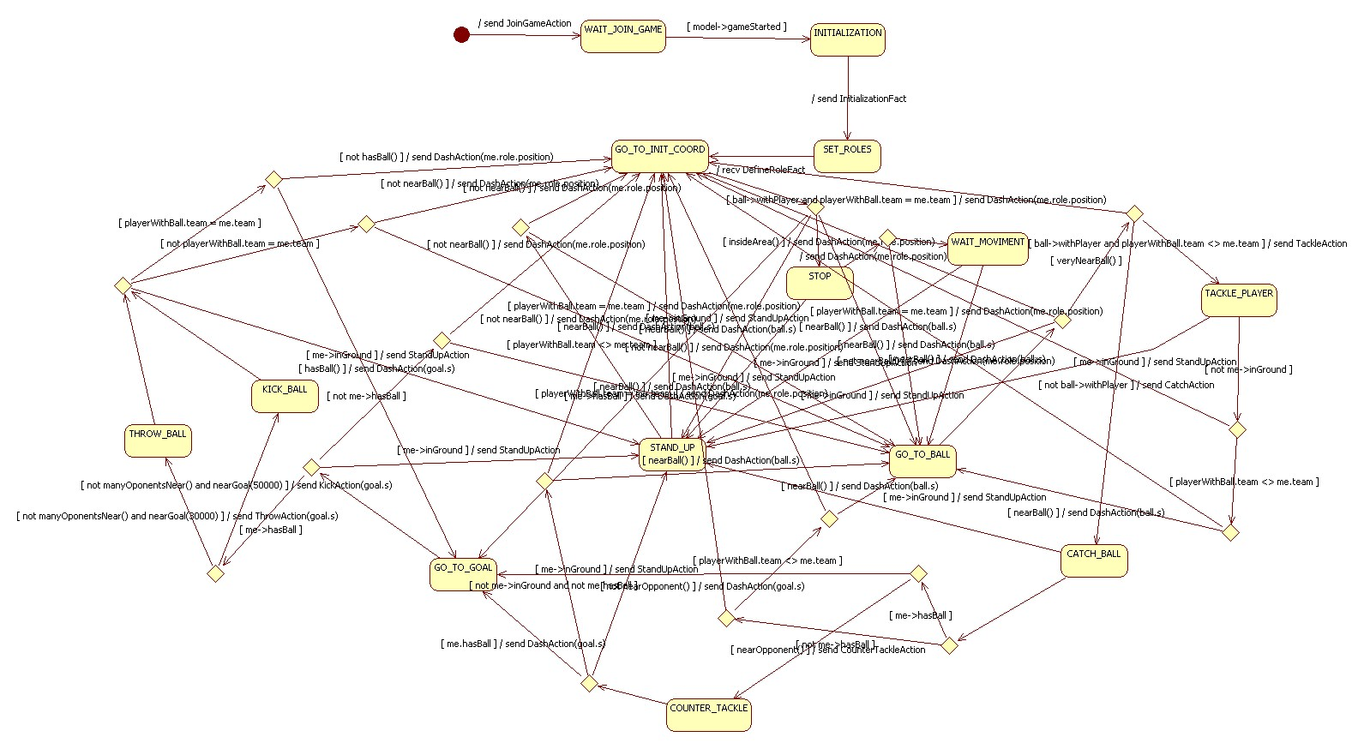
Player Goals

Slide 69
Initial States (JOIN_GAME, WAIT_JOIN_GAME, INITIALIZATION, SET_ROLES, STOP, WAIT_MOVIMENT)
/ send JoinGameAction
WAIT_JOIN_GAME
INITIALIZATION
[model->gameStarted]
JOIN_GAME
/ send InitializationFact
STAND_UP
/ send StandUpAction
GO_TO_INIT_COORD
/ recv DefineRoleFact
SET_ROLES
[me->inGround]
[me->hasBall]
[nearBall()]
[insideArea]
/ send DashAction(me.role.position)
/ send DashAction(goal.s)
/ send DashAction(ball.s)
STOP
GO_TO_GOAL
GO_TO_BALL
/ send DashAction(ball.s)
/ send StandUpAction
[nearBall()]
[me->inGround]
/ send DashAction(ball.s)
WAIT_MOVIMENT
[nearBall()]
/ send StandUpAction
[me->inGround]

Slide 70
GO_TO_BALL State
GO_TO_INIT_COORD
/ send DashAction(me.role.position)
[ball->withPlayer and
playerWithBall.team = me.team]
/ send DashAction(me.role.position)
GO_TO_BALL
/ send TackleAction
TACKLE_PLAYER
[veryNearBall()]
[ball->withPlayer and
playerWithBall.team <> me.team]
STAND_UP
/ send StandUpAction
/ send CatchAction
[not ball->withPlayer]
[me->inGround]
CATCH_BALL

Slide 71
CATCH_BALL State
/ send CounterTackleAction
COUNTER_TACKLE
[nearOpponent()]
/ send DashAction(goal.s)
GO_TO_GOAL
[not nearOpponent()]
[me->hasBall]
CATCH_BALL
/ send DashAction(ball.s)
GO_TO_BALL
[not me->hasBall]
[nearBall()]
/ send StandUpAction
[me->inGround]
[playerWithBall.team <> me.team]
STAND_UP
/ send DashAction(me.role.position)
[not nearBall()]
/ send DashAction(me.role.position)
GO_TO_INIT_COOR
[playerWithBall.team = me.team]

Slide 72
TACKLE_PLAYER State
TACKLE_PLAYER
/ send DashAction(me.role.position)
GO_TO_INIT_COORD
[not me->inGround]
[playerWithBall.team = me.team]
[playerWithBall.team <> me.team]
/ send StandUpAction
/ send DashAction(me.role.position)
[me->inGround]
[not nearBall()]
STAND_UP
/ send DashAction(ball.s)
GO_TO_BALL
[nearBall()]

Slide 73
STAND_UP State
STAND_UP
/ send DashAction(me.role.position)
GO_TO_INIT_COORD
[playerWithBall.team = me.team]
[playerWithBall.team <> me.team]
/ send DashAction(me.role.position)
[not nearBall()]
/ send DashAction(ball.s)
GO_TO_BALL
[nearBall()]

Slide 74
GO_TO_GOAL State
STAND_UP
/ send StandUpAction
/ send DashAction(ball.s)
GO_TO_BALL
[me->inGround]
[nearBall()]
GO_TO_GOAL
[not me->hasBall]
/ send DashAction(me.role.position)
GO_TO_INIT_COOR
[not nearBall()]
[me->hasBall]
/ send ThrowAction(goal.s)
THROW_BALL
[not manyOponentsNear()
and nearGoal(30000)]
/ send KickAction(goal.s)
[manyOponentsNear()]
Near 30 meter (30000 millimeter)
KICK_BALL
/ send KickAction(goal.s)
Near 50 meter (50000 millimeter)
[not manyOponentsNear()
and nearGoal(50000)]

Slide 75
THROW_BALL State
STAND_UP
/ send StandUpAction
/ send DashAction(goal.s)
GO_TO_GOAL
[me->inGround]
[hasBall()]
THROW_BALL
[playerWithBall.team = me.team]
/ send DashAction(me.role.position)
GO_TO_INIT_COOR
[not playerWithBall.team = me.team]
[not hasBall()]
/ send DashAction(me.role.position)
[not nearBall()]
/ send DashAction(ball.s)
[nearBall()]
GO_TO_BALL

Slide 76
KICK_BALL State
STAND_UP
/ send StandUpAction
/ send DashAction(goal.s)
GO_TO_GOAL
[me->inGround]
[hasBall()]
KICK_BALL
[playerWithBall.team = me.team]
/ send DashAction(me.role.position)
GO_TO_INIT_COOR
[not playerWithBall.team = me.team]
[not hasBall()]
/ send DashAction(me.role.position)
[not nearBall()]
/ send DashAction
[nearBall()]
GO_TO_BALL

Slide 77
COUNTER_TACKLE State
STAND_UP
/ send StandUpAction
[me->inGround]
COUNTER_TACKLE
/ send DashAction(goal.s) /
GO_TO_GOAL
[me.hasBall]
[not me->inGround
and not me.hasBall]
/ send DashAction(me.role.postion)
GO_TO_INIT_COOR
[not nearBall()]
/ send DashAction(ball.s)
[nearBall()]
GO_TO_BALL

Slide 78
Agenda
Introduction
The Infrastructure PIM Specification
  Overview
  Kobra2 Specification Service View
  Kobra2 Specification Type View
  Kobra2 Specification Lifecycle View
  Kobra2 Specification Operation View
Shared Element Models
The Agents
  Environment Component Model
  Referee Component Model
  Player Component Model
  Coach Component Model
Conclusion and Future Work

Slide 79
Coach Component
Goal Based Agent
Communicate with players
Who schedule the papers in the beginning of the play
Change the strategy during the game

Slide 80
Service Specification View

Slide 81
<<Sensor>>
Sensor
<<K2Interface>>
ModelInitialization
Component
<<K2Interface>>
RamificationComponent
<<K2Use>>
<<GoalBasedAgent>>
Coach
<<K2Use>>
<<K2Use>>
<<K2Interface>>
ModelBasedBehaviorStrategy
Component
<<K2Interface>>
ActionInterpretation
Component
<<K2Use>>
<<K2Interface>>
EnvironmentStateModel
<<Effector>>
Effector

Slide 82
Specification Type View

Slide 83
Message
+sender
<<interface>>
Agent
*
1
VoiceAction
SendMsgAction
1
1
+subject
Fact

Slide 84
Realization

Slide 85
Realization Service View

Slide 86
<<GoalBasedAgent>>
Coach
------------------------------------------------------------------------------------------+ <<create>> create()
------------------------------------------------------------------------------------------
<<InitializationComponent>>
CoachAgentInitializer
<<K2Interface>>
ModelInitializationComponent
<<ActionInterpretationComponent>>
CoachActionInterpretationComponent
<<K2Interface>>
ActionInterpretationComponent
0
<<RamificationComponent>>
CoachRamificator
<<K2Interface>>
RamificationComponent
0
<<ModelBasedBehavior
StrategyComponent>>
CoachAgentStrategy
<<K2Interface>>
ModelBasedBehavior
StrategyComponent
0
<< EnvironmentStateModel >>
CoachAgentStrategy
<<K2Interface>>
EnvironmentStateModel
0

Slide 87
Realization Operational View

Slide 88
Coach Goals
LISTENING
send SendMsgAction(setPosition)/
[model->gameStarted]
WAIT_JOIN_GAME
[not receiveAgentInitMsg()]
[receiveAgentInitMsg()]
SET_POSITION
[teamWinning()]
[teamLosing()]
[manyEnemyNearBall()]
send SendMsgAction(changeDefPos)/
CHANGE_DEFENSIVE_POSITION
CHANGE_OFFENSIVE_POSITION
GO_TO_BALL
send SendMsgAction(changeOffPos)/
send SendMsgAction(goToBall)/

Slide 89

Agenda
Introduction
The Infrastructure PIM Specification
  Overview
  Kobra2 Specification Service View
  Kobra2 Specification Type View
  Kobra2 Specification Lifecycle View
  Kobra2 Specification Operation View
Shared Element Models
The Agents
  Environment Component Model
  Referee Component Model
  Player Component Model
  Coach Component Model
Conclusion and Future Work

Slide 90
Conclusion and Future Work
Difficulty in the use of FLUX
Difficulty in the integration of the FLUX with JAVA
Performance of the FLUX X JAVA
Maintenance of the Modeling X Implementation
Refactor the current implementation
Change current models for complete conformant to KobrA2
Improve agents AI

