Slide 1
Rollerslam
GUI Platform Independent Model

Slide 2
Client Display
Game Viewer Display Components and Related Elements

Slide 3


General MVC Rollerslam
GUI Architecture
ClientFacade
<<Komponent>>
RollerslamGUI
<<window>>
RollerslamDisplay
+main()
<<interface>>
View
The controller controls the GUI behavior and server connection.
<<interface>>
Controller
The model represents the world and agents with their states.
<<interface>>
Model
The view presents the data to the user and updates itself when model changes.
ControllerImpl
+connect(host:String)
World

Slide 4
Model GUI Layout (1/2)
<<window>>
RollerslamDisplay
<<frame>>
GameCanvas
<<button>>
ConnectButton

Slide 5
Model GUI Layout (2/2)
<<window>>
ConnectionData
<<Text>>
URL
<<InputTextBox>>
ServerURL
<<button>>
OKButton
<<button>>
CancelButton

Slide 6
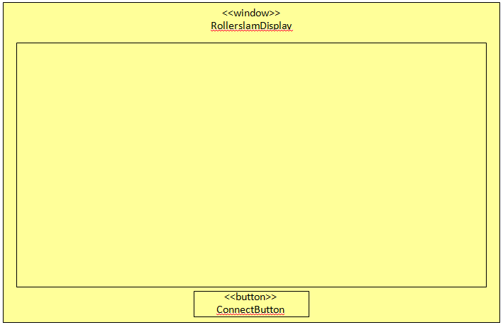
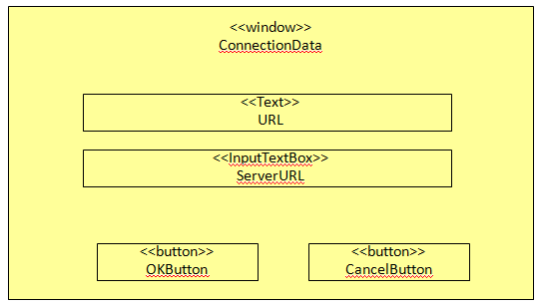
Model GUI Navigation
self.transactionType = LOCK_SOURCE_WINDOW
<<link>>
<<link>>
self.transactionType = CLOSE_SOURCE_WINDOW

Slide 7
Model GUI Data
<<enumeration>>
SpriteKind
RED_PLAYER
RED_PLAYER_WITH_BALL
RED_PLAYER_GROUNDED
BLUE_PLAYER
BLUE_PLAYER_WITH_BALL
BLUE_PLAYER_GROUNDED
BALL
<<singleton>>
SpriteStore
-single:SpriteStore
-sprites:Map
+get():SpriteStore
+getSprite(spriteKind:SpriteKind):Sprite
<<image>>
Sprite
-image:Image
+getWidth():Integer
+getHeight():Integer
+draw(g:Graphics, x:Integer, y:Integer)
1
-ss
x
<<frame>>
GameCanvas
x
1
<<interface>>
Model
<<interface>>
World

Slide 8

Model GUI Internal Structure (1/3)
<<Komponent>>
RollerslamGUI
<<window>>
RollerslamDisplay
+<<create>>new()
+main()
-connectButtonClick()
1
<<interface>>
View
-owner
1
<<button>>
ConnectButton
+<<mouse_interaction>>mouseLeftClick()
context RollerslamDisplay::connectButtonClick()
post:self.conData^setVisible(true)
x
-connectButton
1
-view
1
-controller
-owner
<<frame>>
GameCanvas
+init()
+setModel(newModel:Model)
-updateGraphics()
x
-game
<<interface>>
Controller
+connect(host:String)
ControllerImpl
+connect(host:String)
1
x
x
<<interface>>
Model
-model:World
+getModel():World
+setModel(newModel:World)
-clientFacade
context ConnectButton::mouseLeftClick()
post: self.owner^connectButtonClick()
1
-model
<<interface>>
ClientFacade
1
-model
1
context Model::setModel(newModel:Model)
post: self.model = newModel
ModelImpl
+getModel():World
+setModel(newModel:World)
World
x
Infrastructure element (not part of the GUI, GUI uses them)

Slide 9
Model GUI Internal Structure (2/3)
<<image>>
Sprite
-image:Image
+getWidth():Integer
+getHeight():Integer
+draw(g:Graphics, x:Integer, y:Integer)
<<frame>>
GameCanvas
+init()
<<enumeration>>
SpriteKind
RED_PLAYER
RED_PLAYER_WITH_BALL
RED_PLAYER_GROUNDED
BLUE_PLAYER
BLUE_PLAYER_WITH_BALL
BLUE_PLAYER_GROUNDED
BALL
x
-ss
context OKButton::mouseLeftClick()
post: self.owner.parent.controller
^connect(self.owner.serverURL.text) and
self.owner^setVisible(false)
1
<<singleton>>
SpriteStore
-single:SpriteStore
-sprites:Map
+get():SpriteStore
+getSprite(spriteKind:SpriteKind):Sprite
<<button>>
OKButton
+<<mouse_interaction>>mouseLeftClick()
1
<<window>>
RollerslamDisplay
+<<create>>new()
+main()
-connectButtonClick()
1
-okButton
-parent
-owner
context CancelButton::mouseLeftClick()
post: self.owner^setVisible(false)
1
<<window>>
ConnectionData
+setVisible(visible:Boolean)
-conData
<<InputTextBox>>
ServerURL
text:String
-owner
-owner
1
<<button>>
CancelButton
+<<mouse_interaction>>mouseLeftClick()
1
-cancelButton
-serverURL

Slide 10
Model GUI Internal Structure (3/3)
Message
ControllerImpl
+connect(host:String)
1
-ci
StateMessage
DisplayAnonymousImpl
+update(message:Message)
1
<<interface>>
Display
-dai
context ControllerImpl::connect(host:String)
post:
self.façade.clientInitialization^init(host)
and self.facade.displayRegistry^register(self.dai)
context DisplayAnonymousImpl::update(message:Message)
post:
If message.oclIsKindOf(StateMessage) then
self.ci.model^setModel(message.oclAsType(StateMessage).world)
else true
endif

Slide 11
OCL Constraints
context RollerslamDisplay::new()
post:
self.game^init()
context GameCanvas::init()
post:
self^updateGraphics()
context GameCanvas::updateGraphics()
post:
self^updateGraphics() -- The same operation have been called, for update the GUI in a few milliseconds, over and over

Slide 12
Server Admin Console
Server Administration GUI Components and Related Elements

Slide 13
Server GUI Layout
<<window>>
ServerDisplay
<<button>>
StartSimulation

Slide 14
Server GUI Internal Structure
<<Komponent>>
ServerGUI
<<window>>
ServerDisplay
simState:SimulationState
+main()
-startButtonClick()
1
-owner
1
<<button>>
StartSimulation
+<<mouse_interaction>>mouseLeftClick()
x
-sButton
context RollerslamDisplay::connectButtonClick()
post:
If pre@simState = CREATED or STOPPED then
self.simState = RUNNING and self.sButton.text = ‘Stop’
and self.serverFacade.simulationAdmin^run()
else
self.simState = STOPPED and self.sButton.text = ‘Start’
and self.serverFacade.simulationAdmin^stop()
endif
<<enumeration>>
SimulationState
STOPPED
RUNNING
CREATED
context ConnectButton::mouseLeftClick()
post: self.owner^startButtonClick()
-serverFacade
1
<<interface>>
ServerFacade
Infrastructure element (not part of the GUI, the GUI uses them)

