Slide 1

Antonio Jose de Vasconcelos Costa - ajvc
Breno Batista Machado - bbm
Cleyton Mario de Oliveira Rodrigues - cmor
Marcos Aurelio Almeida da Silva - maas
Pablo Santana Barbosa - psb
Weslei Alvim de Tarso Marinho - watm

Slide 2
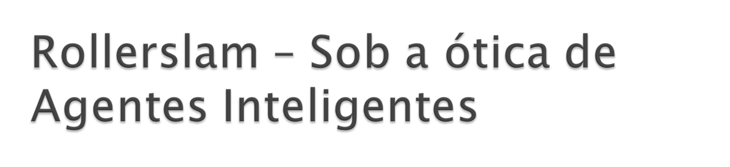


Slide 3


O que é Rollerslam?
Características
Estratégia do Player
Logging
Dificuldades
Estatísticas

Slide 4

Gaelic
Football
Soccer
Australian
Football
Rollerslam!
Handball
Rugby
Basketball
American
Football
Slamball
Ice
Hockey
Roller
Derby

Slide 5
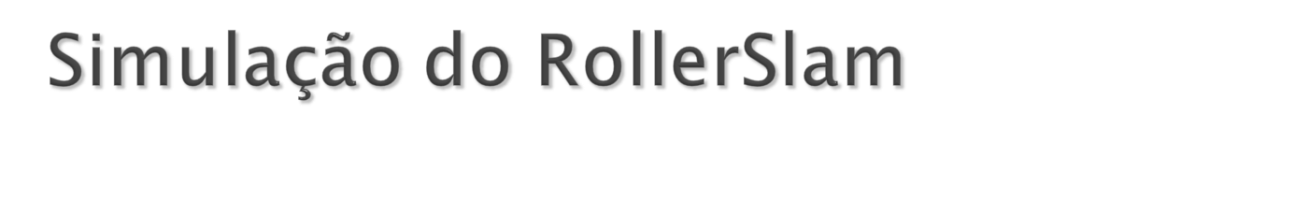
Rollerslam Simulation GUI
Game
Visualization
GUI
Agent Reasoning
Visualization GUI
referee
playerAgent1(team1)
playerAgent1(team2)
...
...
Coach(Team1)
Coach(Team2)
playerAgent20(team1)
gamePhysicsRulesSimulatorAgent
playerAgent20(team2)

Slide 6

O que é Rollerslam?
Características
Estratégia do Player
Logging
Dificuldades
Estatísticas

Slide 7

Effector
effector
sensor
Sensor
<<component>>
Agent
<<interface>>
Effector
<<interface>>
Sensor
+ doAction(ac:Message)
+ getActions()
: Message[0..*]
Message
+ sender : Agent

Slide 8

DisplayRegistry
SimulationStateProvider
SimulationAdmin
Logging
simulation
logging
AgentRegistry
client
server
<<component>>
Server
AgentRegistryExt
ClientInitialization
agent[*]
environment[1]
ServerInitialization
Effector
Sensor
Display
Service
Effector
Sensor
effector
sensor
effector
sensor
simulation
<<component>>
Rollerslam
Agent
<<component>>
Rollerslam
Environment
logging
initialization
registration
logging
logging
initialization
display
registration
<<component>>
Rollerslam
Display
simulation

Slide 9
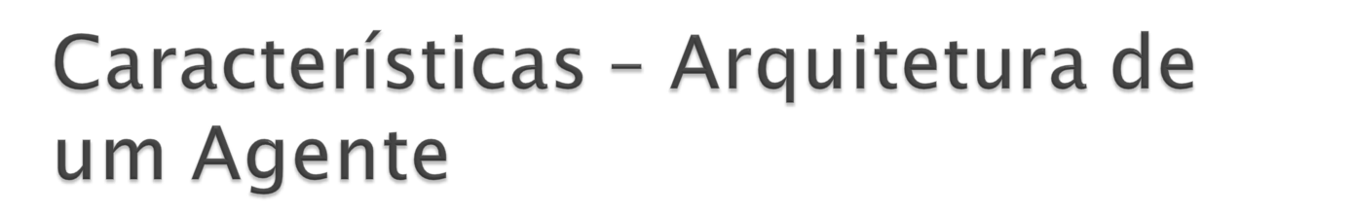
Agente GoalBased:
  Jogadores;
  Técnicos.
effector
sensor
simulation
<<component>>
AutomataAgent
Environment
State
Model
worldModel
+ state : SimulationState
<<component>>
GoalBasedAgent
GoalBased
Environment
State
Model
worldModel
GoalInitialization
GoalUpdate
<<interface>>
GoalInitialization
<<interface>>
GoalUpdate
+ initialize(m:GoalBasedEnvironmentStateModel)
+ updateGoal(m:GoalBasedEnvironmentStateModel)

Slide 10
Agente Autômato – O Ambiente
SimulationStateProvider
<<interface>>
ModelBasedBehaviorStrategy
Effector
Sensor
effector
sensor
simulation
+ computeAction(w:EnvironmentStateModel):Message
<<component>>
AutomataAgent
<<interface>>
ModelInitialization
+ state : SimulationState
# initialize()
# think()
+ initialize(m:EnvironmentStateModel)
Environment
State
Model
<<interface>>
ActionInterpretation
worldModel
ModelInitialization
+processAction(w:EnvironmentStateModel, m:Message)
ActionInterpretation
RamificationComponent
<<interface>>
RamificationComponent
ModelBasedBehaviorStrategy
+processRamifications(world : EnvironmentStateMode)

Slide 11
Comportamento do Ambiente
ramificationsComponent^
processRamifications(worldModel)
self^initialize()
sensor
.getActions()
s : Set of
Message
s->forAll(x | actionInterpretation
^processAction(worldModel,x))
[not state = RUNNING]
self^think()
modelBasedBehaviorStrategy
^computeAction(worldModel)
effector^
doAction(action)
action :
Message

Slide 12

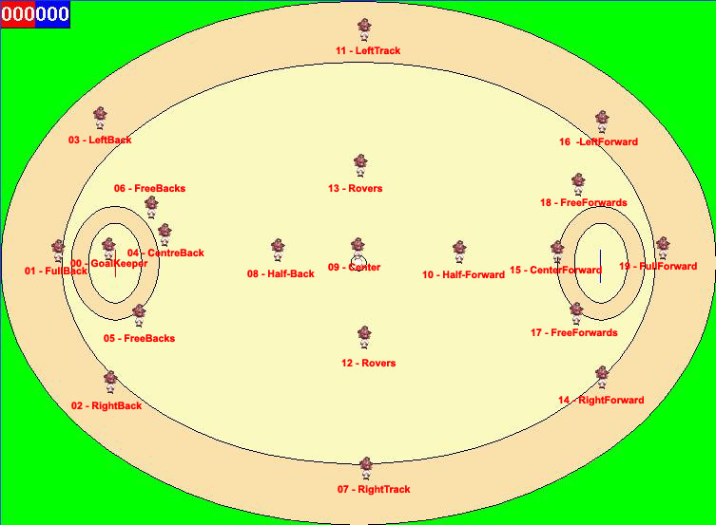
CENTERFORWARD
GOALKEEPER
CENTERBACK
CENTERTRACKER
ENDFORWARD
ENDBACK
HALFBACK
FREEFORWAR1
FREEBACKS1
HALFFORWARD
FREEFORWARD2
FREEBACKS2
ROVER1
RIGHTFORWARD
ROVER2
RIGHTBACK
LEFTFORWARDD
LEFTBACK
RIGHTTRACKER
LEFTTRACKER

Slide 13

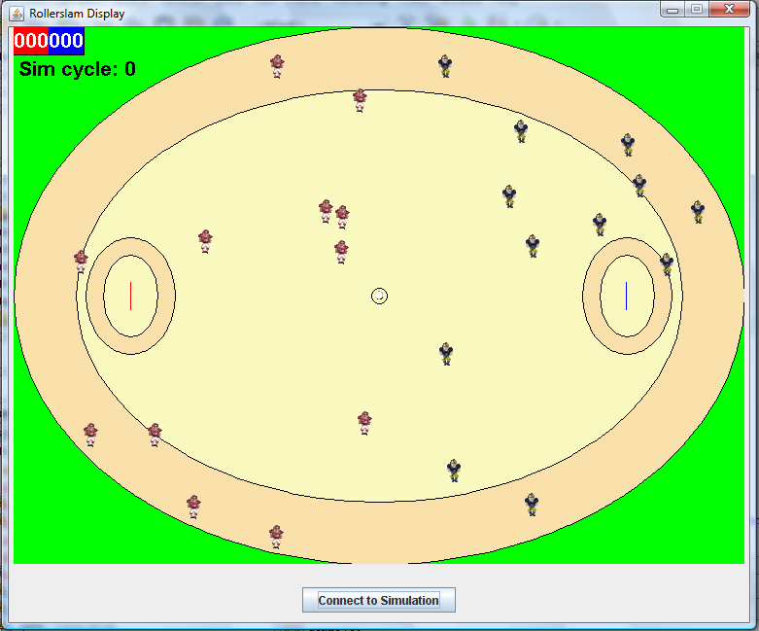

Slide 14
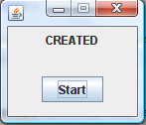
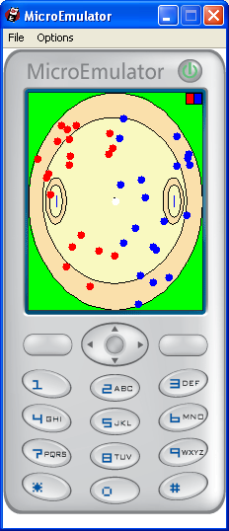
Simulation
RMI
Rollerslam
Mobile
Display
Socket
Socket
Socket
Mobile
Client 1
Mobile
Client 2
Mobile
Client 3

Slide 15
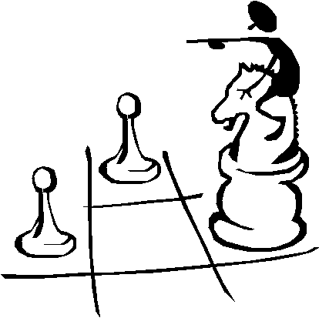
O que é?
Características
Estratégia do Player
Logging
Dificuldades
Estatísticas

Slide 16
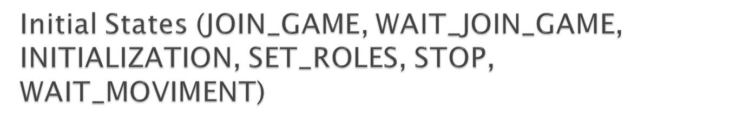
JOIN_GAME
send JoinGameAction/
WAIT_JOIN_GAME
INITIALIZATION
[model->gameStarted]
send InitializationFact/
STAND_UP
send StandUpAction/
GO_TO_INIT_COORD
recv DefineRoleFact/
SET_ROLES
[me->inGround]
send DashAction/
[insideArea(0.10) and
not me->hasBall and
not me->inGround and
not nearBall()]
[me->hasBall and
not me->inGround and
not nearBall()]
[nearBall() and not
me->inGround]
STOP
GO_TO_GOAL
GO_TO_BALL
[not me->inGround]
send DashAction/
send StandUpAction/
[nearBall()]
[not nearBall()]
[me->inGround]
send DashAction/
WAIT_MOVIMENT
[nearBall() and
not me->inGround()]
send StandUpAction/
[me->inGround]

Slide 17

GO_TO_INIT_COORD
send DashAction/
[ball->withPlayer and
playerWithBall.team = me.team]
send DashAction/
[not me->inGround
and not nearBall()
and not veryNearBall()]
GO_TO_BALL
send TackleAction/
TACKLE_PLAYER
[not me->inGround
and veryNearBall()]
[ball->withPlayer and
playerWithBall.team <> me.team]
STAND_UP
send StandUpAction/
send CatchAction/
[not ball->withPlayer]
[me->inGround]
CATCH_BALL

Slide 18

send CounterTackleAction/
COUNTER_TACKLE
[nearOpponent()]
send DashAction/
GO_TO_GOAL
[not nearOpponent()]
[me->hasBall]
CATCH_BALL
[not me->inGround]
send DashAction/
GO_TO_BALL
[not me->hasBall]
[nearBall()]
send StandUpAction/
[me->inGround]
[playerWithBall.team <> me.team]
STAND_UP
send DashAction/
[not nearBall()]
send DashAction/
GO_TO_INIT_COOR
[playerWithBall.team = me.team]

Slide 19

TACKLE_PLAYER
send DashAction/
GO_TO_INIT_COORD
[not me->inGround]
[playerWithBall.team = me.team]
[playerWithBall.team <> me.team]
send StandUpAction/
send DashAction/
[me->inGround]
[not nearBall()]
STAND_UP
send DashAction/
GO_TO_BALL
[nearBall()]

Slide 20

STAND_UP
send DashAction/
GO_TO_INIT_COORD
[not me->inGround]
[playerWithBall.team = me.team]
[playerWithBall.team <> me.team]
send StandUpAction/
send DashAction/
[me->inGround]
[not nearBall()]
STAND_UP
send DashAction/
GO_TO_BALL
[nearBall()]

Slide 21

STAND_UP
send StandUpAction/
send DashAction/
GO_TO_BALL
[me->inGround]
[nearBall()]
GO_TO_GOAL
[not me->inGround
and not me->hasBall]
send DashAction/
GO_TO_INIT_COOR
[not nearBall()]
[not me->inGround
and me->hasBall]
send ThrowAction/
THROW_BALL
[not manyOponentsNear()
and nearGoal(30000)]
send KickAction/
[manyOponentsNear()]
Near 30 meter (30000 millimeter)
KICK_BALL
send KickAction/
Near 50 meter (50000 millimeter)
[not manyOponentsNear()
and nearGoal(50000)]

Slide 22

STAND_UP
send StandUpAction/
send DashAction/
GO_TO_GOAL
[me->inGround]
[hasBall()]
THROW_BALL
[not me->inGround
and playerWithBall.team = me.team]
send DashAction/
GO_TO_INIT_COOR
[not me->inGround
and not playerWithBall.team = me.team]
[not hasBall()]
send DashAction/
[not nearBall()]
send DashAction/
[nearBall()]
GO_TO_BALL

Slide 23

STAND_UP
send StandUpAction/
send DashAction/
GO_TO_GOAL
[me->inGround]
[hasBall()]
THROW_BALL
[not me->inGround
and playerWithBall.team = me.team]
send DashAction/
GO_TO_INIT_COOR
[not me->inGround
and not playerWithBall.team = me.team]
[not hasBall()]
send DashAction/
[not nearBall()]
send DashAction/
[nearBall()]
GO_TO_BALL

Slide 24

STAND_UP
send StandUpAction/
[me->inGround]
COUNTER_TACKLE
GO_TO_GOAL
[not me->inGround
and me.hasBall]
[not me->inGround
and not me.hasBall]
send DashAction/
GO_TO_INIT_COOR
[not nearBall()]
send DashAction/
[nearBall()]
GO_TO_BALL

Slide 25
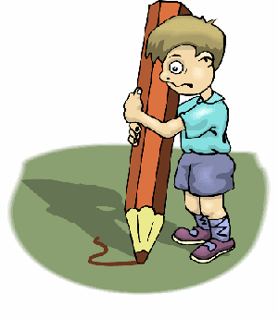
O que é Rollerslam?
Características
Estratégia do Player
Logging
Dificuldades
Estatísticas

Slide 26
Logging – Trace Driver
Minimal Trace Event
Workflow Level
Reasoning Trace
Business Workflow
Multi-Agent Society
Tracer
Driver
User
Additional Data Request
1..*
Additional Data
Individual Agent
Agent Level
Reasoning Trace
Trace
Query
1..*
Component
1..*
Integrated
Multi-
Granularity
Reasoning
Trace Query &
Visualization
GUI
Service
Service Level
Reasoning Trace
Trace Query
Reasoning Service
OO Rule
Firing Level
Reasoning Trace
Non-Reasoning Service
1..*
1..*
Algorithmic Workflow
Object-Oriented Rule
Logical Object
Inheritance Level
Reasoning Trace
1..*
1..*
Imperative Object
Logical Object Molecule
Justification-Based
Logical Constraint
Matching/Entailment Level
Reasoning Trace
1..*
Logical Constraint Atom

Slide 27
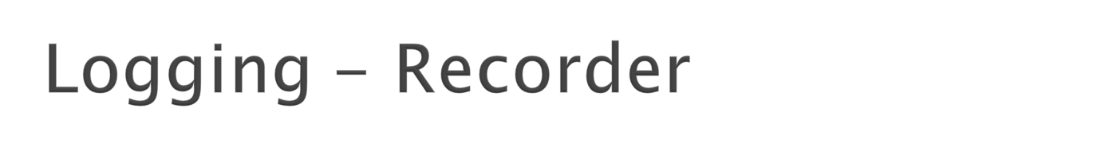
<<component>>
LogRecorder
LogRecording
Service
<<delegate>>
LogRecording
ServiceImpl
Simulation
Description

Slide 28
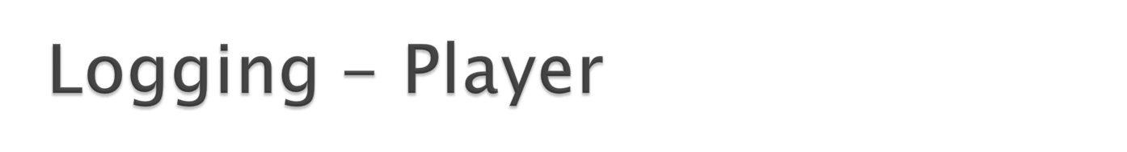
<<component>>
LogPlayer
Log Playing
Service
<<delegate>>
LogPlayer
Impl
--------------------------------
+ currentCycle : Integer
Simulation
Description

Slide 29
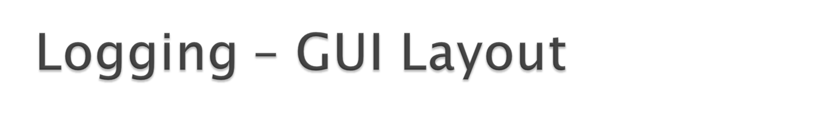
<<window>>
LogPlayerDisplay
<<frame>>
GameCanvas
<<Text>>
CurrentCycle
<<ComboBox>>
AgentFilter
<<ComboBox>>
MessageTypeFilter
<<Button>>
Show
<<Slider>>
CurrentCycleSlider
<<Text>>
Messages
<<Text>>
Speed
<<Slider>>
SpeedSlider
<<Button>>
Run
<<Button>>
LoadSimulation
<<FileChooser>>
SelectSimulation

Slide 30
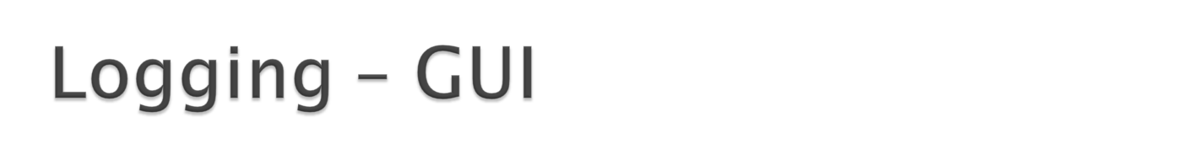
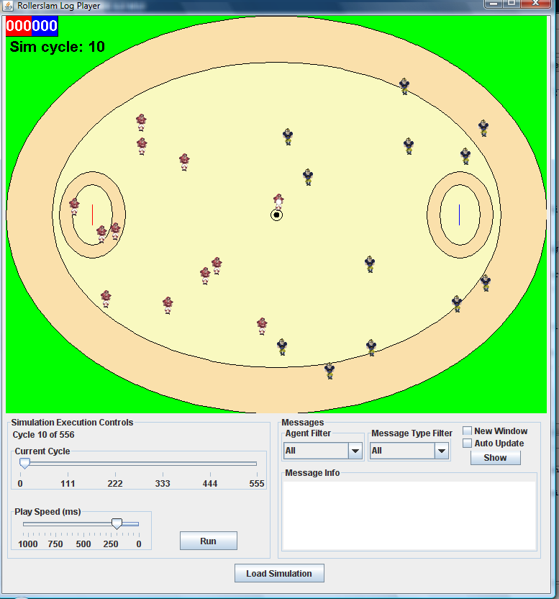

Slide 31
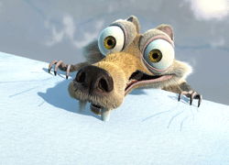
O que é Rollerslam?
Características
Estratégia do Player
Dificuldades
Estatísticas

Slide 32
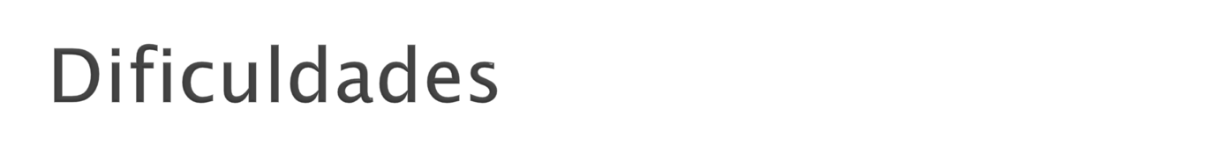
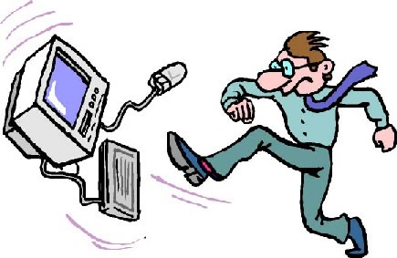
Laboratórios cheios
Problemas relativos a distribuição
Máquinas diferentes nos laboratórios
  IP fora do padrão
  DNS não funciona
  Muito lenta
Uso de:
  CHR
  FLUX
Trace Driver

Slide 33
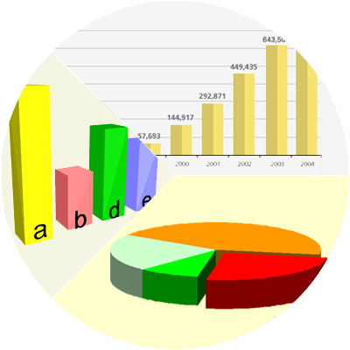
O que é Rollerslam?
Características
Estratégia do Player
Dificuldades
Estatísticas

Slide 34
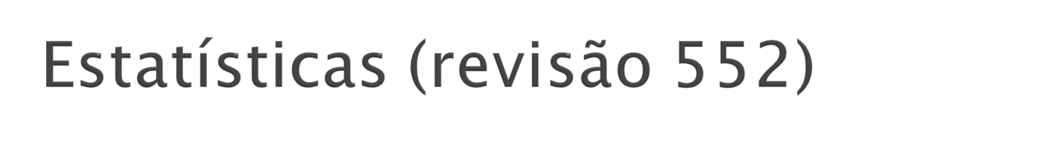
Arquivos: 589 arquivos
Linhas de código:
Commits: 552
Slides (documentação): 202
Reuniões: ~50

Slide 35

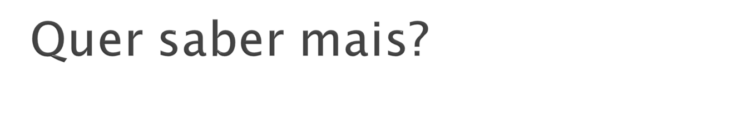
http://rollerslam.googlecode.com

