Slide 1
Rollerslam
GUI Platform Independent Model

Slide 2


General MVC Rollerslam
GUI Architecture
ClientFacade
<<Komponent>>
RollerslamGUI
<<window>>
RollerslamDisplay
+main()
<<interface>>
View
The controller controls the GUI behavior and server connection.
<<interface>>
Controller
The model represents the world and agents with their states.
<<interface>>
Model
The view presents the data to the user and updates itself when model changes.
ControllerImpl
+connect(host:String)
World

Slide 3
Client Display
Game Viewer Display Components and Related Elements

Slide 4
Model GUI Layout (1/2)
<<window>>
RollerslamDisplay
<<frame>>
GameCanvas
<<button>>
ConnectButton

Slide 5
Model GUI Layout (2/2)
<<window>>
ConnectionData
<<Text>>
URL
<<InputTextBox>>
ServerURL
<<button>>
OKButton
<<button>>
CancelButton

Slide 6
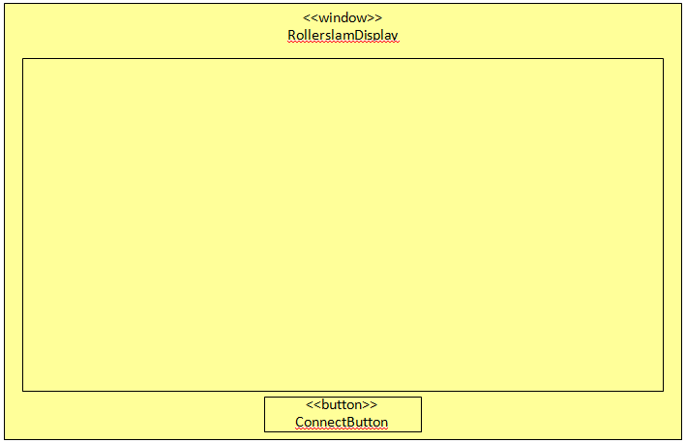
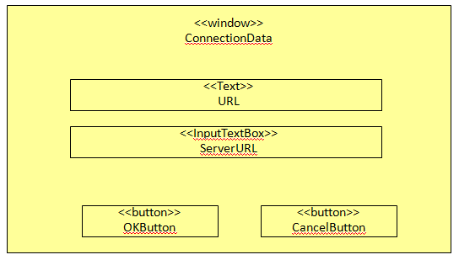
Model GUI Navigation
<<frame>>
GameCanvas
self.transactionType = LOCK_SOURCE_WINDOW
<<link>>
<<link>>
self.transactionType = CLOSE_SOURCE_WINDOW

Slide 7
Model GUI Data
<<enumeration>>
SpriteKind
RED_PLAYER
RED_PLAYER_WITH_BALL
RED_PLAYER_GROUNDED
BLUE_PLAYER
BLUE_PLAYER_WITH_BALL
BLUE_PLAYER_GROUNDED
BALL
<<singleton>>
SpriteStore
-single:SpriteStore
-sprites:Map
+get():SpriteStore
+getSprite(spriteKind:SpriteKind):Sprite
<<image>>
Sprite
-image:Image
+getWidth():Integer
+getHeight():Integer
+draw(g:Graphics, x:Integer, y:Integer)
1
-ss
x
<<frame>>
GameCanvas
x
1
<<interface>>
Model
<<interface>>
World

Slide 8

Model GUI Internal Structure (1/3)
<<Komponent>>
RollerslamGUI
<<window>>
RollerslamDisplay
+<<create>>new()
+main()
-connectButtonClick()
1
<<interface>>
View
-owner
1
<<button>>
ConnectButton
+<<mouse_interaction>>mouseLeftClick()
context RollerslamDisplay::connectButtonClick()
post:self.conData^setVisible(true)
x
-connectButton
1
-view
1
-controller
-owner
<<frame>>
GameCanvas
+init()
+setModel(newModel:Model)
-updateGraphics()
x
-game
<<interface>>
Controller
+connect(host:String)
ControllerImpl
+connect(host:String)
1
x
x
<<interface>>
Model
-model:World
+getModel():World
+setModel(newModel:World)
-clientFacade
context ConnectButton::mouseLeftClick()
post: self.owner^connectButtonClick()
1
-model
<<interface>>
ClientFacade
1
-model
1
context Model::setModel(newModel:Model)
post: self.model = newModel
ModelImpl
+getModel():World
+setModel(newModel:World)
World
x
Infrastructure element (not part of the GUI, GUI uses them)

Slide 9
Model GUI Internal Structure (2/3)
<<image>>
Sprite
-image:Image
+getWidth():Integer
+getHeight():Integer
+draw(g:Graphics, x:Integer, y:Integer)
<<frame>>
GameCanvas
+init()
<<enumeration>>
SpriteKind
RED_PLAYER
RED_PLAYER_WITH_BALL
RED_PLAYER_GROUNDED
BLUE_PLAYER
BLUE_PLAYER_WITH_BALL
BLUE_PLAYER_GROUNDED
BALL
x
-ss
context OKButton::mouseLeftClick()
post: self.owner.parent.controller
^connect(self.owner.serverURL.text) and
self.owner^setVisible(false)
1
<<singleton>>
SpriteStore
-single:SpriteStore
-sprites:Map
+get():SpriteStore
+getSprite(spriteKind:SpriteKind):Sprite
<<button>>
OKButton
+<<mouse_interaction>>mouseLeftClick()
1
<<window>>
RollerslamDisplay
+<<create>>new()
+main()
-connectButtonClick()
1
-okButton
-parent
-owner
context CancelButton::mouseLeftClick()
post: self.owner^setVisible(false)
1
<<window>>
ConnectionData
+setVisible(visible:Boolean)
-conData
<<InputTextBox>>
ServerURL
text:String
-owner
-owner
1
<<button>>
CancelButton
+<<mouse_interaction>>mouseLeftClick()
1
-cancelButton
-serverURL

Slide 10
Model GUI Internal Structure (3/3)
Message
ControllerImpl
+connect(host:String)
1
-ci
StateMessage
DisplayAnonymousImpl
+update(message:Message)
1
<<interface>>
Display
-dai
context ControllerImpl::connect(host:String)
post:
self.façade.clientInitialization^init(host)
and self.facade.displayRegistry^register(self.dai)
context DisplayAnonymousImpl::update(message:Message)
post:
If message.oclIsKindOf(StateMessage) then
self.ci.model^setModel(message.oclAsType(StateMessage).world)
else true
endif

Slide 11
OCL Constraints
context RollerslamDisplay::new()
post:
self.game^init()
context GameCanvas::init()
post:
self^updateGraphics()
context GameCanvas::updateGraphics()
post:
self^updateGraphics() -- The same operation have been called, for update the GUI in a few milliseconds, over and over

Slide 12
Server Admin Console
Server Administration GUI Components and Related Elements

Slide 13
Server GUI Layout
<<window>>
ServerDisplay
<<button>>
StartSimulation

Slide 14
Server GUI Internal Structure
<<Komponent>>
ServerGUI
<<window>>
ServerDisplay
simState:SimulationState
+main()
-startButtonClick()
1
-owner
1
<<button>>
StartSimulation
+<<mouse_interaction>>mouseLeftClick()
x
-sButton
context RollerslamDisplay::connectButtonClick()
post:
If pre@simState = CREATED or STOPPED then
self.simState = RUNNING and self.sButton.text = ‘Stop’
and self.serverFacade.simulationAdmin^run()
else
self.simState = STOPPED and self.sButton.text = ‘Start’
and self.serverFacade.simulationAdmin^stop()
endif
<<enumeration>>
SimulationState
STOPPED
RUNNING
CREATED
context ConnectButton::mouseLeftClick()
post: self.owner^startButtonClick()
-serverFacade
1
<<interface>>
ServerFacade
Infrastructure element (not part of the GUI, the GUI uses them)

Slide 15
Log Player GUI
Log Player GUI Components and Related Elements

Slide 16
Log Player GUI Layout
<<window>>
LogPlayerDisplay
<<frame>>
GameCanvas
<<Text>>
CurrentCycle
<<ComboBox>>
AgentFilter
<<ComboBox>>
MessageTypeFilter
<<Button>>
Show
<<Slider>>
CurrentCycleSlider
<<Text>>
Messages
<<Text>>
Speed
<<Slider>>
SpeedSlider
<<Button>>
Run
<<Button>>
LoadSimulation
<<FileChooser>>
SelectSimulation

Slide 17
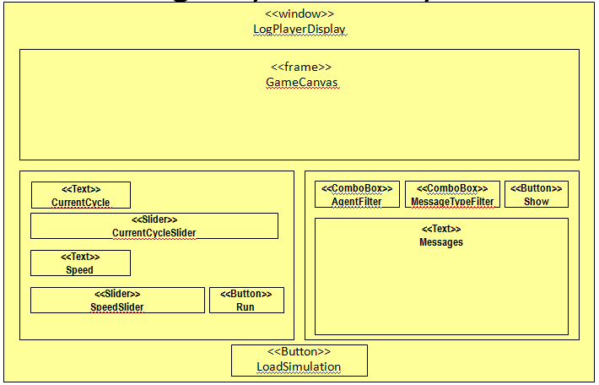
LogPlayer Model GUI Navigation
self.transactionType = LOCK_SOURCE_WINDOW
<<link>>
<<link>>
<<FileChooser>>
SelectSimulation
self.transactionType = CLOSE_SOURCE_WINDOW

Slide 18
Log Player GUI Internal Structure (1/3)
<<Komponent>>
LogPlayerGUI
<<window>>
LogPlayerDisplay
context ConnectButton::mouseLeftClick()
post: self.owner^loadButtonClick()
1
-owner
1
<<button>>
LoadSimButton
+<<mouse_interaction>>mouseLeftClick()
x
-loadSimButton
1
-view
-owner
<<frame>>
GameCanvas
-game
x
1
ControllerImpl
playing:Boolean=false
+load(dbUri:URI)
+play()
+stop()
+goTo(p:Integer)
+setPlaySpeed(ps:Integer)
+getLogForAgent(agId:Integer,mType:String):LogEntry[]
1
-controller
<<interface>>
Controller
+load(dbUri:URI)
+play()
+stop()
+goTo(p:Integer)
+setPlaySpeed(ps:Integer)
+getLogForAgent(agId:Integer)
x
x
1
-lps
<<interface>>
Model
-model
<<interface>>
LogPlayingService
1
Reused from ClientDisplay
Reused from LogPlayer

Slide 19
Log Player GUI Internal Structure (2/3)
<<FileChooser>>
LPFileChooser
-fc
-owner
<<window>>
LogPlayerDisplay
<<interface>>
View
runStopButtonClick()
updateCurrentCycleMsg(c:Integer, m:Integer)
updateSlider(i:Integer)
updateComboAgentsIds(lIds:Integer[])
<<Text>>
CurrentCycle
-cc
-owner
<<Slider>>
CurrentCycleSlider
-ccs
<<Text>>
Speed
-speed
-show
<<Button>>
Show
<<Slider>>
SpeedSlider
-ss
-msgs
<<Text>>
Messages
<<Button>>
Run
-run
-mtf
<<ComboBox>>
MessageTypeFilter
<<ComboBox>>
AgentFilter
-af

Slide 20
Log Player GUI Internal Structure (3/3)
context RollerslamDisplay::loadButtonClick()
post:self.fc^setVisible(true) and
self.controller^load(self.fc.getSelectedFile())
<<window>>
LogPlayerDisplay
+<<create>>new()
+main()
-loadButtonClick()
+ updateSlider(i:Integer)
+ updateComboAgentsIds(ids:Integer[])
context RollerslamDisplay::updateSlider(i:Integer)
post:self.ccs.value = i
context RollerslamDisplay::updateComboAgentsIds(ids:Integer[])
post:self.af.options->includesAll(ids)

Slide 21
Log Player GUI Internal Structure (Constraints)
context ControllerImpl::load(dbUri:URI)
post: self.lps^load(URI) and self.view^updateComboAgentsIds(self.lps. getAgentsIds())
context ControllerImpl::play()
post:
if not self.playing@pre then
self.playing = true
else true endif
and self^goTo(lps@pre.getCurrentCycle() + 1)
and if self.playing then self^play() else true endif

Slide 22
Log Player GUI Internal Structure (Constraints)
context ControllerImpl::stop()
post:self.playing = false
context ControllerImpl:: goTo(p:Integer)
post:
if p >= 0 and p <= lps.getTotalCycles() then
self.lps.getCurrentCycle() = p and
self.model^setModel(self.lps.getLogForAgent(-1)) and
self.view^updateSlider(p)
else true endif

Slide 23
Log Player GUI Internal Structure (Constraints)
context ControllerImpl::getLogForAgent(agId:Integer, m:String)
post:
result = lps.getAllLogForAgent(agId, m)

Slide 24
Log Player GUI Internal Structure (Constraints)
context CurrentCycleSlider::update(i:Integer)
post: self.owner.controller^goTo(i) and self.owner.cc.value = i
context Run::MouseLeftClick()
post:
if self@pre^label = ‘Run’ then
self.owner.controller^run() and self.label = ‘Stop’
else
self.owner.controller^stop() and self.label = ‘Run’
endif

Slide 25
Log Player GUI Internal Structure (Constraints)
context Show::MouseLeftClick()
post:
self.owner.msgs.Value = self.owner.controller.getLogForAgent(
self.owner.af.getSelectedItem().value, self.owner.mtf.getSelectedItem().value)

