Slide 1
SafeCross
Offline Pedestrian & Vehicle Counting at Crossings with ExecuTorch on Raspberry Pi
Namma AI Hackathon · AI for Safer Communities – Edge-Based Object Detection and Counting
Team: <names>

Slide 2
The Problem: Unsafe Crossings, No Data
• Crossings near schools, markets, hospitals and bus stops mix heavy foot traffic with fast two-wheelers, autos, cars and buses.
• Local bodies rarely have data on how busy a crossing is or when pedestrians and vehicles conflict, so decisions on zebra crossings, speed breakers, signal timing or wardens are ad hoc.
• Camera + cloud video analytics is expensive: GPUs, continuous bandwidth, recurring cost, and privacy concerns with uploading video of citizens.
Who is at risk
School children, elderly, street vendors and commuters at unmarked crossings, bus stops and market roads.
Why not cloud CCTV?
GPU servers, continuous bandwidth, recurring cost — and privacy concerns about streaming citizens' video.
SafeCross · Namma AI Hackathon
2

Slide 3
Our Solution: SafeCross on a ₹6–8k Raspberry Pi
• A ~₹6–8k Raspberry Pi runs a pretrained object detector fully offline using ExecuTorch.
• Counts pedestrians and vehicles (car, motorcycle, bicycle, bus, truck) in every frame.
• Flags 'conflict frames' where pedestrians are close to vehicles (LOW / MEDIUM / HIGH).
• Writes only numbers (CSV + summary) — no video needs to leave the device.
Offline
No cloud, no GPU. Runs on Pi CPU via ExecuTorch.
Private
Only numbers leave the device — never video.
Actionable
Per-frame counts + conflict flags for planners.
SafeCross · Namma AI Hackathon
3

Slide 4
System Pipeline
Input
Video clip /
images
Pre-process
320×320 RGB
[0,1]
ExecuTorch
SSDLite-MBv3
INT8 · XNNPACK
Post-process
Box decode
NMS · de-dup
Analytics
Counts · pairs
Risk level
Output
CSV · images
summary.json
• Laptop: torch.export → PT2E INT8 quantisation (calibrated on sample frames) → XNNPACK partitioner → .pte
• Pi: ExecuTorch runtime loads .pte; NumPy handles anchor decoding + NMS (keeps graph static, fully delegated)
• Risk: pedestrian box ×1.5 overlapping a vehicle = proximity pair → LOW / MEDIUM / HIGH per frame
SafeCross · Namma AI Hackathon
4

Slide 5
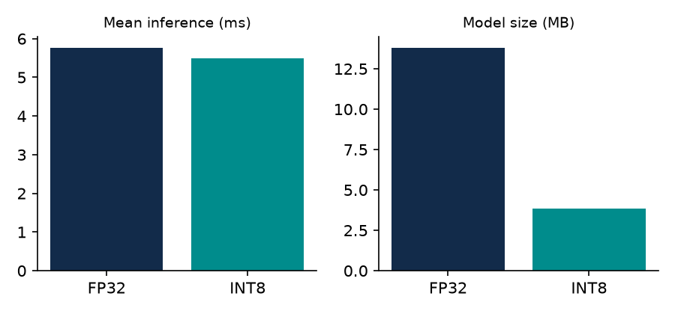
Model & Edge Optimisation
• SSDLite320-MobileNetV3-Large, COCO-pretrained (torchvision)
• Classes used: person · bicycle · car · motorcycle · bus · truck
• ExecuTorch with XNNPACK backend (ARM NEON kernels)
• PT2E static INT8, per-channel weights
• Size: 13.8 MB FP32 → 3.86 MB INT8
• Validated: counts identical to PyTorch reference (11/11 images)
SafeCross · Namma AI Hackathon
5

Slide 6
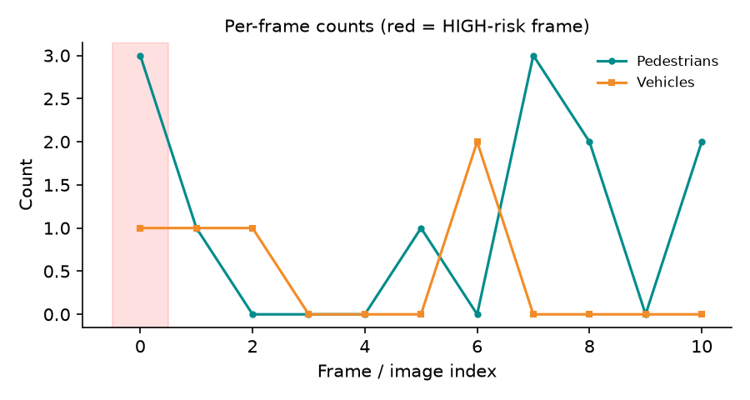
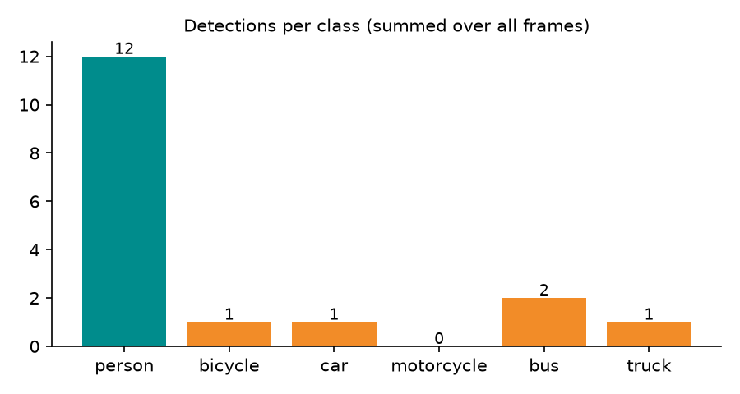
Results: Categories & Counts
11
3 / 2
1.09 / 0.45
1 · 1
frames processed
peak peds / vehicles
avg peds / vehicles
HIGH · MEDIUM risk frames
SafeCross · Namma AI Hackathon
6

Slide 7
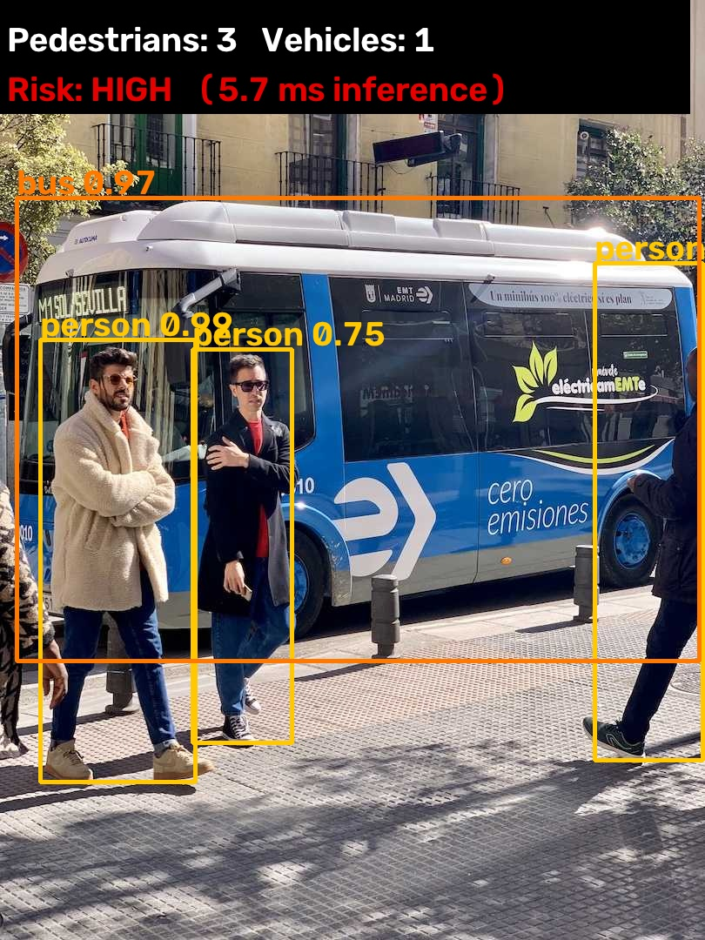
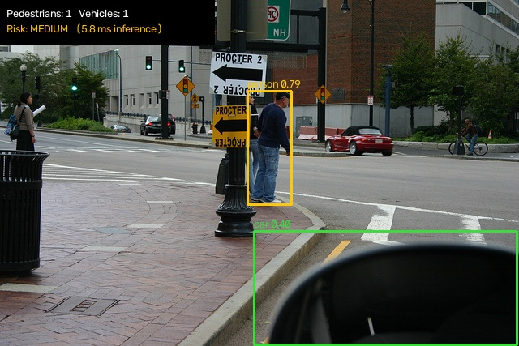
Sample Detection Outputs
3 pedestrians · 1 vehicles · risk HIGH · 5.7 ms
1 pedestrians · 1 vehicles · risk MEDIUM · 5.84 ms
SafeCross · Namma AI Hackathon
7

Slide 8
Performance on Edge
Model | SSDLite320-MobileNetV3-Large (COCO, torchvision) → ExecuTorch .pte, XNNPACK
Device | Development machine (arm64 / macOS-27.2-arm64-arm-64bit) — NOT the Pi
Model file used | ssdlite_int8.pte (3.86 MB)
Frames / images processed | 11
Avg inference time / frame | 5.48 ms (p95 5.86 ms)
Inference throughput | 182.58 FPS
End-to-end (pre + infer + post) | 6.01 ms ≈ 166.47 FPS
Benchmark ssdlite_fp32.pte | 5.76 ms mean · 173.5 FPS · 13.79 MB
Benchmark ssdlite_int8.pte | 5.49 ms mean · 182.3 FPS · 3.86 MB
⚠ Measured on development machine — replace with Raspberry Pi numbers (run benchmark.py on the Pi, then build_docs.py).
SafeCross · Namma AI Hackathon
8

Slide 9
Practical Application: School-Zone Crossing Audit
School-zone crossing audit: place SafeCross at a school gate for a week. Peak pedestrian counts and HIGH-risk frames at 8–9 AM and 2–3 PM give the municipality / traffic police evidence to add a zebra crossing, a speed table, a traffic warden at school hours, or a longer pedestrian signal phase.
Measure
Identify
Act
Pi at school gate for 1 week → hourly pedestrian & vehicle counts
Peak hours + HIGH-risk frames at drop-off / pick-up
Zebra crossing · speed table · warden · longer walk signal
SafeCross · Namma AI Hackathon
9

Slide 10
Limitations & Next Steps
Limitations
Next steps
• SSDLite at 320×320 misses small/distant objects; dense, occluded Indian traffic will be undercounted.
• Counts are per frame, not unique objects (no tracking — not required by the brief).
• Risk score is a 2-D box-overlap heuristic; it has no depth or speed information.
• COCO has no 'auto-rickshaw' class; autos are usually detected as car/truck or missed.
• Fine-tune on Indian traffic data (e.g., IDD / autos) and re-export with the same pipeline.
• Add lightweight tracking (SORT) for unique counts and dwell-time at the kerb.
• Solar + 4G-less deployment: store hourly CSV on SD card, collect weekly.
SafeCross · Namma AI Hackathon
10

Slide 11
Safer crossings, driven by data.
Affordable · Offline · Private — SafeCross on Raspberry Pi + ExecuTorch
Thank you · Questions?

