Slide 1
Vehicle Routing Problem applied to grocery delivery at Ann Arbor
By - Krishna Rao
Siddarth Maheshwari

Slide 2

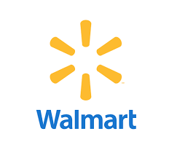
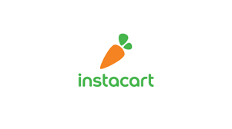

Problem Identification & Definition
Grocery e-commerce sales are forecast to account for 9.5% of total U.S. grocery sales of $1.097 trillion in 2021, up from 8.1% of $1.137 trillion in 2020. Companies like Instacart, Walmart and Amazon Fresh command a major share in the market in the segment.
However, in order to ensure an economically feasible model and in order to retain the market share by charging the customer a minimum amount for the delivery, it is essential to come up with a delivery model that provides the quickest and cheapest service.
For our project we are exploring delivery optimization applied to grocery delivery through Kroger outlets in Ann Arbor by assuming reasonable daily demands throughout the city.

Slide 3
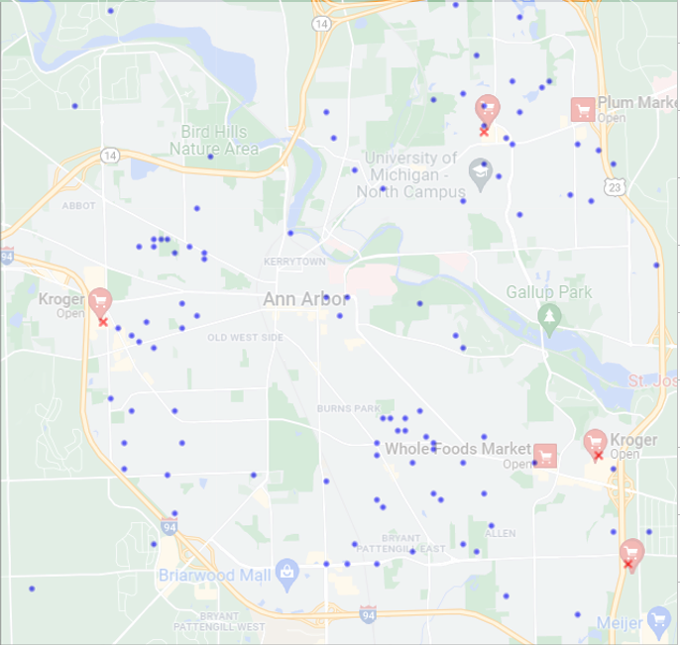
Data Initialization - Kroger
We have assumed Kroger’s shopping mart as our depots for vehicles and distributed customer demands throughout the city of Ann Arbor based on residential areas. For our problem we have generated 100 demands spread throughout the city based on the following demand distributions:
Burns Park and nearby localities - 25%
Eberwhite and nearby localities - 25%
North Campus Housing and nearby localities - 25%
Central Campus and nearby localities - 15%
Random demands distributed over the grid - 10%

Slide 4
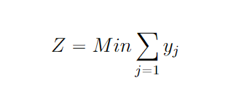
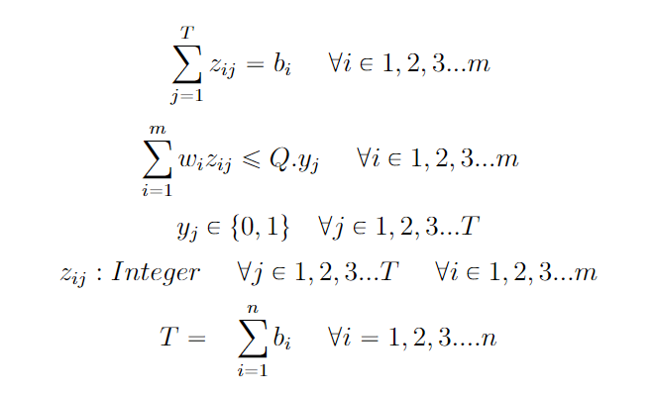
Bin Packing - How many vehicles?
We generate demands from the customers on 5 different products and we plan to arrange these items into vehicles (bins) to minimize the number of vehicles deployed for delivery. For the purpose of obtaining the optimal number of vehicles, we use bin packing formulations.
We developed two formulations of bin packing, one with Integer Programming and the other through Columns generation method.
In the Integer programming formulation, our objective is to minimize the number of container/bins needed to transport all items to the respective customers.
Here,w_{i} represents weight of item i , b_{i}is the quantity of each item, Q represents the vehicle capacity
y_{j} a binary variable determines whether a bin j is used or not.
The variable zij determines the allocation of item i to bin j.

Slide 5
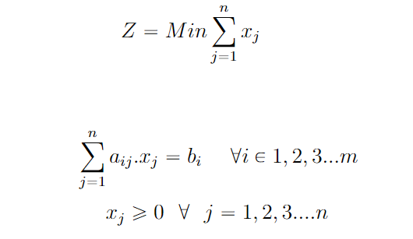
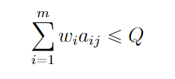
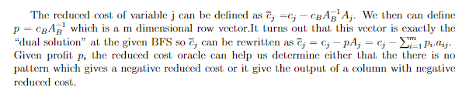
Bin Packing - How many vehicles?
Bin Packing with Column Generation:
In order to obtain a smaller run time while using a more scalable approach, we can use bin packing with column generation to determine the minimum number of bins needed.
Before defining the objective function for the problem we define Pattern here the j^{th} pattern is given by a vector a_{1j} , a_{2j} , ..., a_{mj} which means that the bin contains a_{ij} units of item i (for items ranging from i = 1, ..., m), also X_{j} can be defined as the number of bins filled using pattern j .

Slide 6
Vehicle Routing - How & where to deploy vehicles?
Having determined the number of vehicles needed, we now move on to the next phase of the problem of delivery. Here the aim is to plan a set of minimum cost vehicle routes capable of accommodating as many requests as possible before returning back to the depot. We have explored 3 different models for formulating the problem, namely, Single-depot vehicle routing problem, Multi-depot vehicle routing problem and k-Means clustered vehicle routing problem.
Assumptions:
The demand of multiple items from a customer is assumed in a single parameter overall demand. That is, weights of each item is multiplied by its demand and summed up to form a single demand.
Each customer is visited by a single vehicle.
Each vehicle must start from and return to the same depot, and cannot travel between depots.
Demand at each depot is zero, and all depots have sufficient stocks of each item to cater demands
The demands from all the customers is known one day prior to the delivery

Slide 7
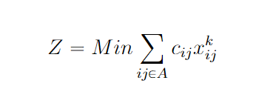
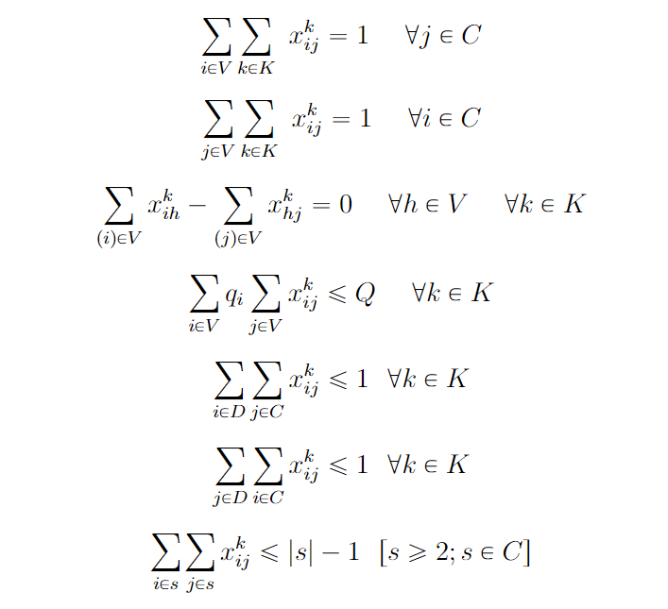
Constrained Vehicle Routing
We have defined c_{ij} as the cost for traversing from node i to node j within the network of nodes V. Customer nodes are defined as set C, depot nodes are defined as set D, and K represents the set of vehicles. Q is the maximum load capacity of each vehicle and q is the total demand from each node. x_{ij}^{k} is a binary decision variable which tells if a vehicle k will traverse between nodes i and j.
Based on the assumptions stated we define our single-depot vehicle routing problem as follows:

Slide 8
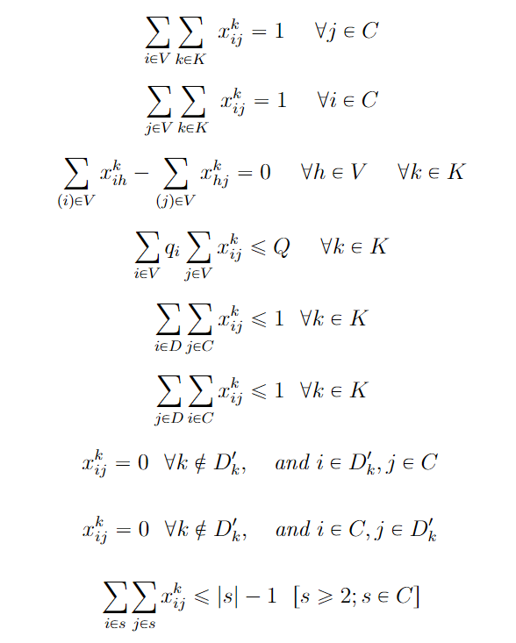
Multi-Depot Vehicle Routing
Following the same conventions and continuing with the equations defined in Constrained VRP, we add two more constraints to scale the single-depot vehicle routing problem to multi-depot vehicle routing problem. The added constraint restricts the travel of a vehicle deployed to a specific depot to other depots in the node. D’_{k} is a subset of D defining the set of depots not containing vehicle k.
Here we assume that the vehicles have been allotted to a specific depot prior to solving the problem.

Slide 9
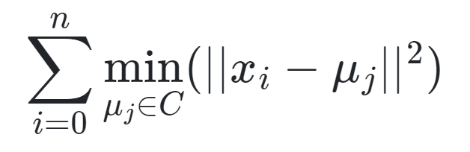
k-Means Clustering with Vehicle Routing
For understanding how clustering could help in easing-off computational load of Multi-depot vehicle routing problem, we use k-Means Clustering to divide the data into smaller vehicle routing problems applied to individual depots.
The k-Means algorithm clusters data by trying to separate samples in n groups of equal variance, minimizing a criterion known as the inertia or within-cluster sum-of-squares.
After applying clustering to the nodes with depot points as our initial cluster centroids (using init parameter) we continue with the same formulation of Constrained VRP used previously to solve our single-depot routing problem.

Slide 10
Results
VRP Models | Total Runtime | Deployed Vehicles | Cost Function Value
Constrained Vehicle Routing with One Depot | 1 hr | 7 | 1353
Multi-Depot Vehicle Routing | 1 hr | 8 | 1028
k-Means Clustering with Vehicle Routing | 1 hr | 7 | 790
Bin Formulation Method | Bins Formed
Integer Programming | 7
MILP with Column-Generation | 9
While there is no way to directly comment on which model to choose based on just the runtime of the program, it is evident that clustering, or in general dividing the problem into subsets of the main problem, tends to produce better results within the same time frame. This is a direct outcome of the ‘curse of dimensionality’.

Slide 11
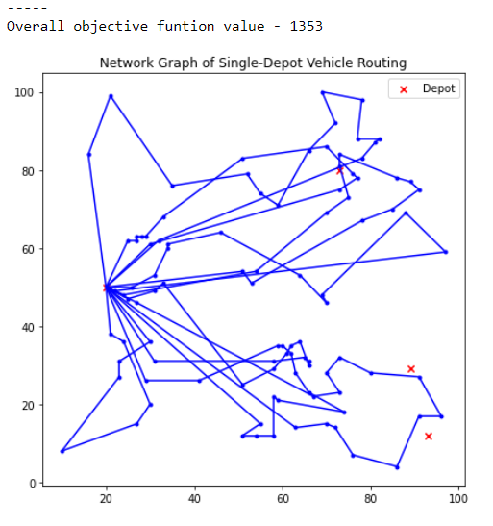
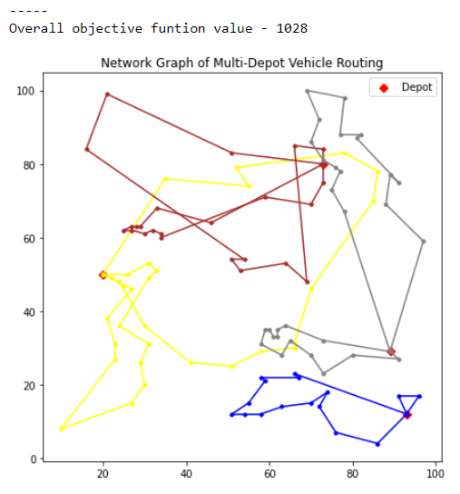
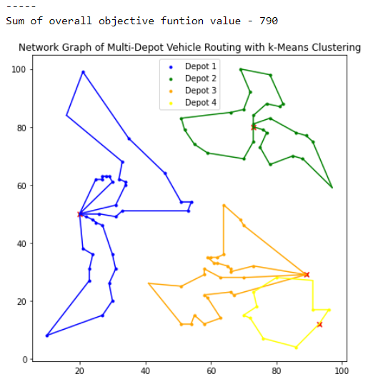
Network Graphs of Models
We have used Python with Gurobi 9.1.2 on an Intel^{(R)} Core^{(TM)} i7-8665U CPU with 16GM RAM.

Slide 12
Further Developments
Further developments which can be made on the model:
Extending the model to account for time-window based constraints on delivery to customers.
Integrate bin packing formulation within Vehicle Routing Problem to account for optimal packing of items within the vehicle payload capacity.
Incorporate distances between nodes from Open Street Map or Google Maps to account for real/actual travel distance between points.

Slide 13
Thank you!

