Slide 1
RESEARCH INTERNSHIP REPORT
Deadline-Constrained Cost
Minimisation for Cloud
Computing Environments
Implementation of the DCCM Algorithm using CloudSim Plus, JGraphT, and Pegasus Workflows
Krish Sangal
B.Tech CSE, IILM University | Roll No. CS-2341002
Research Internship, Department of CSE, IIT Patna
Under the guidance of Prof. Rajiv Misra, Head of Department, CSE

Slide 2
INTRODUCTION
Scheduling Scientific Workflows in the Cloud
Cloud platforms let scientific workflows lease compute on demand — but scheduling many tasks under a cost budget and a deadline at once is a hard, multi-dimensional problem.
EVALUATION WORKFLOWS
Montage
1
Astronomical imaging
THE PROBLEM
LIGO
2
Given a workflow as a DAG of dependent tasks, and a set of heterogeneous VM types, find a task-to-VM assignment that:
Minimises total monetary cost
Meets a user-specified deadline
Handles VM provisioning delay & performance variation
Scales to workflows with hundreds of tasks
Gravitational-wave analysis
Cybershake
3
Seismic hazard analysis
Epigenomics
4
DNA sequence analysis
Krish Sangal | IIT Patna Internship | 02

Slide 3
OBJECTIVES & SCOPE
What This Internship Set Out to Do
1
2
3
4
Study
Implement
Evaluate
Validate
Analyse the DCCM algorithm as proposed by Manam et al. (IEEE Access, 2023).
Build DCCM in Java using CloudSim Plus, JGraphT, and the Pegasus workflow generator.
Benchmark against HEFT, BDHEFT, and BDAS across 4 workflows and 4 deadline factors.
Compare simulation results against the findings published in the original paper.
SCOPE
A single IaaS data centre with six EC2-based VM tiers • 4 scientific workflows • 4 deadline factors (DF = 4, 8, 12, 16) • workflow sizes from 30–150 tasks • evaluated entirely via discrete-event simulation in CloudSim Plus, not on a live cloud platform.
Krish Sangal | IIT Patna Internship | 03

Slide 4
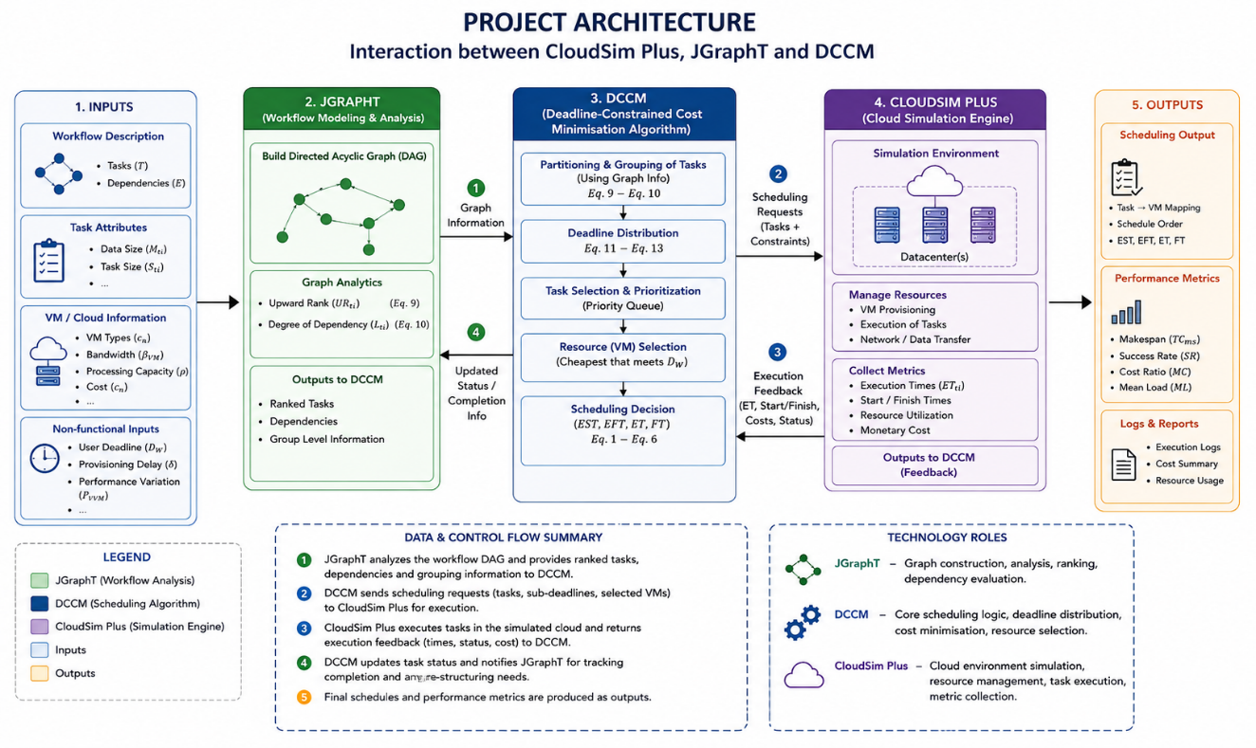
SYSTEM DESIGN
System Architecture
How the workflow model, graph analysis, scheduler, and simulator interact.
Krish Sangal | IIT Patna Internship | 04

Slide 5
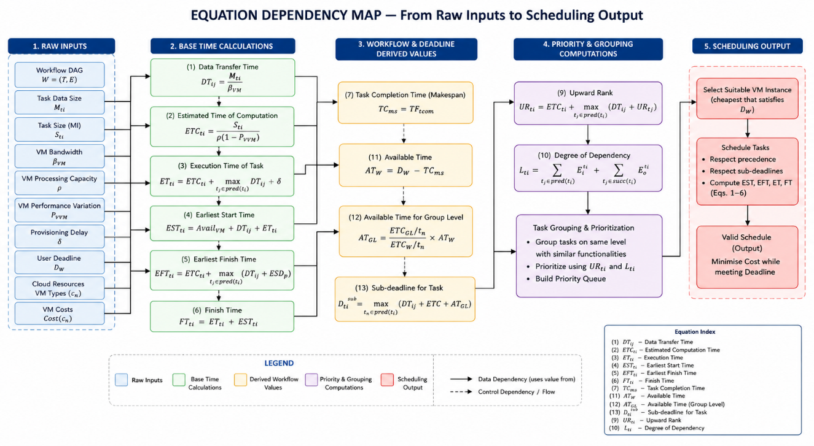
METHODOLOGY
The DCCM Algorithm — Three Phases
1
Partitioning
2
Deadline Distribution
3
Scheduling
Rank by upward rank & dependency degree; group by DAG depth.
Cheapest VM that meets the deadline; slack split across groups.
Sort by rank, execute per group, escalate if a sub-deadline is at risk.
Full derivation, from raw inputs through 13 core equations to the scheduling output:
Krish Sangal | IIT Patna Internship | 05

Slide 6
EXPERIMENTAL SETUP
How the Evaluation Was Run
Implementation
Java 17, CloudSim Plus (v8.x), JGraphT (v1.5.x), Pegasus Workflow Generator
Workflows
Montage, LIGO, Cybershake, Epigenomics — 4 domains, distinct dependency shapes
Workflow sizes
30, 60, 90, 120, 150 tasks — each run 100× with randomised task/data sizes
Deadline factors
DF = 4, 8, 12, 16 (lower = tighter, harder-to-meet deadline)
Baselines compared
HEFT, BDHEFT, BDAS
Metrics
Success Rate (SR), Cost Ratio (MC), Mean Load (ML)
Krish Sangal | IIT Patna Internship | 06

Slide 7
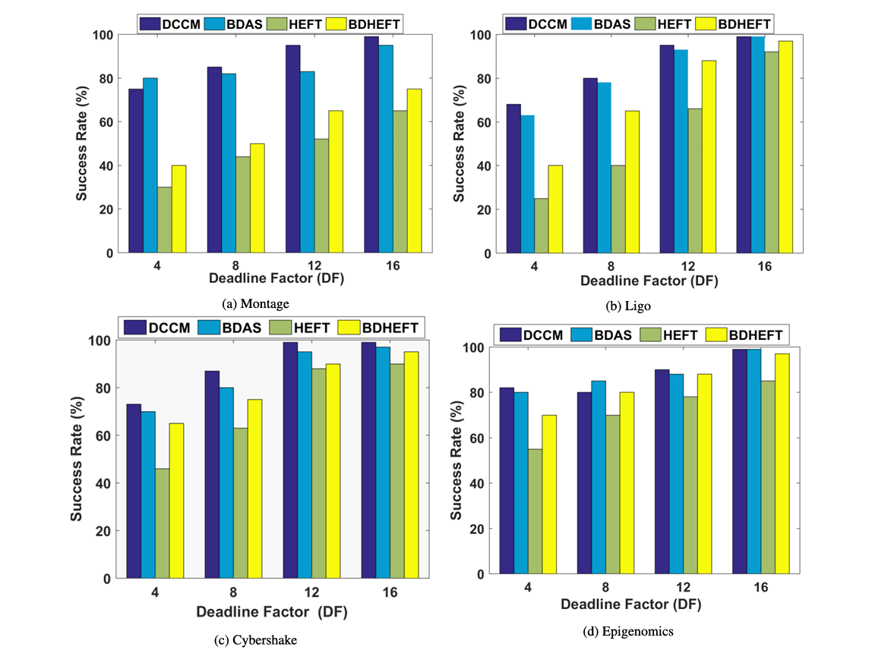
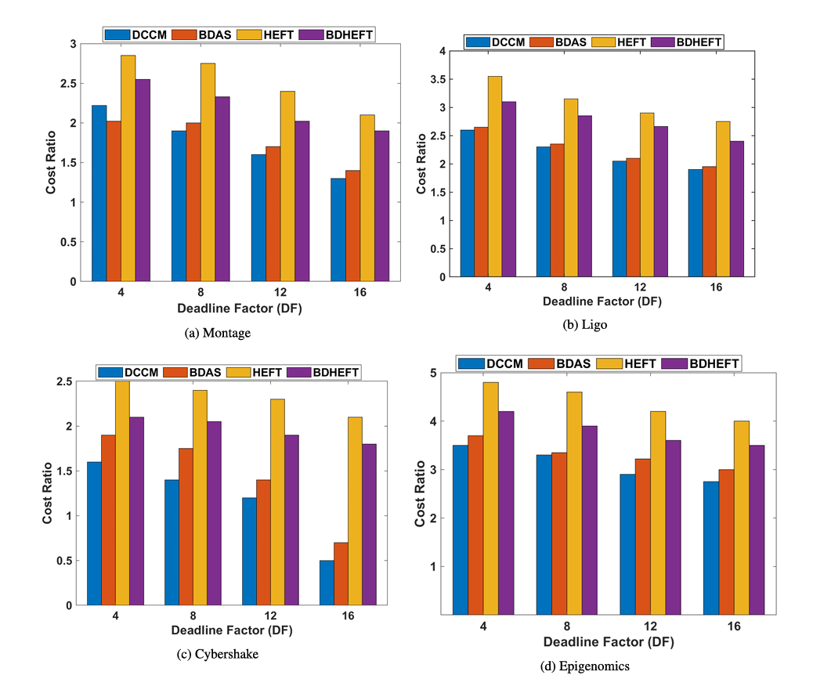
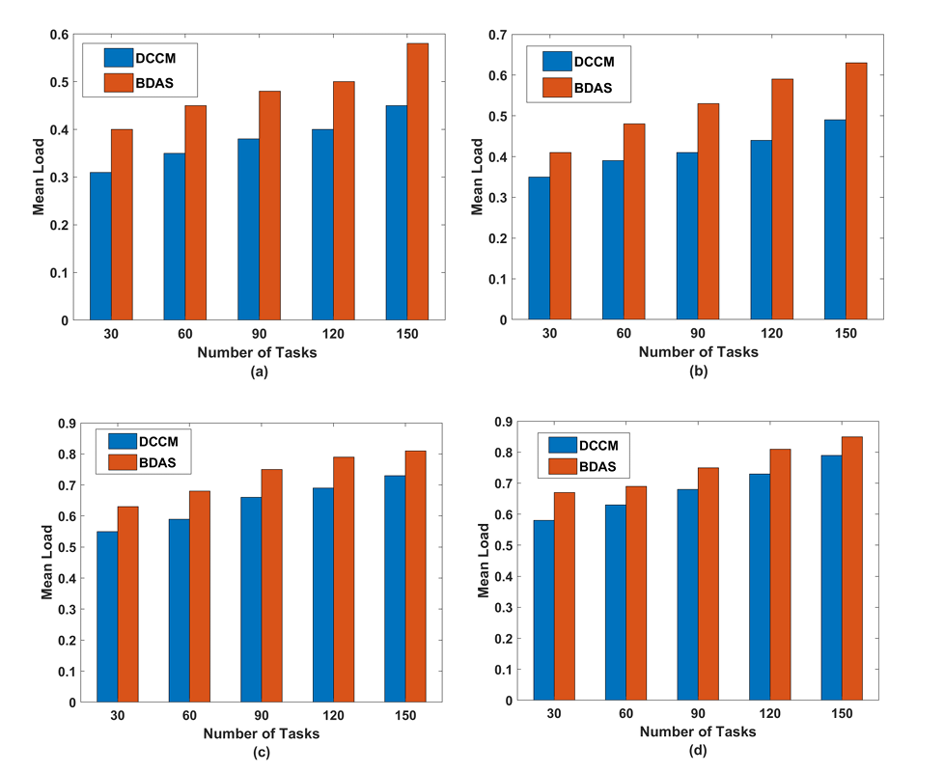
RESULTS
DCCM vs. Baseline Algorithms
Success Rate
Cost Ratio
Mean Load
16–25% higher success rate than HEFT/BDHEFT · lowest cost ratio beyond DF > 4 · lowest mean load of all methods compared
Krish Sangal | IIT Patna Internship | 07

Slide 8
CONCLUSION
What This Internship Delivered
1
Implemented DCCM faithfully from the original IEEE Access publication, validated against its published results.
2
Confirmed that structured task grouping + proportional sub-deadlines + cheapest-VM-first selection outperforms HEFT, BDHEFT, and BDAS.
3
Gained hands-on experience with cloud simulation, DAG-based workflow modelling, and reproducing results from academic literature.
FUTURE WORK
Dual-objective (cost + makespan) optimisation · live IaaS deployment · RL-based adaptive scheduling · multi-cloud extension
Thank you
Krish Sangal | CS-2341002 | Supervised by Prof. Rajiv Misra, IIT Patna

