Slide 1
D
PROJECT CASE STUDY
PROCESS MINING × MACHINE LEARNING × DATA ANALYTICS
Decarbonizing Travel
An end-to-end emissions analytics platform for corporate travel
A data-driven system that combines process mining, predictive modeling, and an interactive dashboard to identify, predict, and reduce the carbon footprint of business travel.
Celonis Process Mining
Python · XGBoost
PQL
Interactive BI Dashboard

Slide 2
01 · THE PROBLEM
Business travel is a major, hidden source of avoidable emissions
178,090 t
25.0%
18.4%
~29%
CO₂e from business travel
of trips are High-Carbon
of trips are out-of-policy
of it is avoidable
THE APPROACH
1
2
3
Mine the actual process
Predict risk before it happens
Turn insight into a live tool
Use process-mining on real trip event logs to see how bookings, approvals, and travel actually unfold — not how policy says they should.
Train a classifier that flags a trip as high-carbon at the moment of booking, using only information available pre-trip.
Ship the analysis as an interactive, filterable dashboard — not a static report — so stakeholders can explore it themselves.
Decarbonizing Travel · Project Case Study
02 / 11

Slide 3
02 · HOW IT WORKS
End-to-End Analytics Pipeline
STEP 1
→
STEP 2
→
STEP 3
→
STEP 4
Data & Process Mining
Feature Engineering
Predictive Modeling
Interactive Dashboard
Load trip, event-log, and cost data into Celonis; reconstruct the actual booking-to-reimbursement process.
Derive route, mode, timing, and policy-compliance features while strictly excluding any target-leaking columns.
Train a classifier to flag high-carbon trips pre-booking. Achieves 0.999 ROC-AUC on held-out data.
Publish a 3-tab live dashboard (Overview, Benchmarking, Drilldown) for self-serve exploration.
Why this matters: the same pipeline that explains what happened also predicts what happens next — turning a historical report into a decision-support tool.
Decarbonizing Travel · Project Case Study
03 / 11

Slide 4
03 · KEY FINDINGS
What the Data Revealed
1
Travel mode — not business unit or trip purpose — drives emissions
Business/First Class flights emit 2–2.6x more than Economy, 10x+ more than rail. BU and purpose vary by only ~10% across the board.
2
Regional efficiency varies enormously
Europe averages 602 kg CO₂e/trip vs 2,956 kg in Asia — a 5x gap driven mostly by distance and rail availability.
3
Process friction correlates with higher emissions
Out-of-policy bookings emit 43.5% more CO₂e; last-minute bookings emit 52.7% more — timing and compliance are carbon levers too.
Decarbonizing Travel · Project Case Study
04 / 11

Slide 5
04 · PREDICTIVE MODEL
Flagging High-Carbon Trips Before They're Booked
0.999
Pre-booking
Binary
Explainable
ROC-AUC on held-out data
features only — no leakage
classification, probability output
feature importances retained
Methodology
Why it's useful, not just accurate
Trained a gradient-boosted classifier on trip-level features (route, mode, timing, policy flags, business context). The target and all CO₂e/cost columns that directly encode it were excluded from the feature set to prevent leakage.
A high ROC-AUC only matters if the score arrives in time to change a decision. Because every input is known at the moment of booking, this model can sit inside the approval workflow itself — not just in a retrospective report.
Decarbonizing Travel · Project Case Study
05 / 11

Slide 6
05 · RECOMMENDATIONS
From Insight to Quantified Action
–34,738 t/yr
–770 t/yr
–16,448 t/yr
All 3 levers
Cap premium cabins on routes <6 hrs
Mandate rail on proven short-haul routes
5-day minimum booking window
Real-time carbon score at booking
Downgrade Business/First to Economy where flight time allows.
Routes with an equal-cost rail alternative default to rail.
Reduce last-minute, high-carbon bookings via an exception process.
Surface CO₂e/cost trade-offs at the point of request, using the model.
19.5% of total footprint
+ cost savings, equal cost
Targets the highest-friction trips
AI-driven, workflow-embedded
Combined impact: ~52,000 tonnes CO₂e/yr abated — roughly 29% of the current footprint — if all four levers reach full adoption.
Decarbonizing Travel · Project Case Study
06 / 11

Slide 7
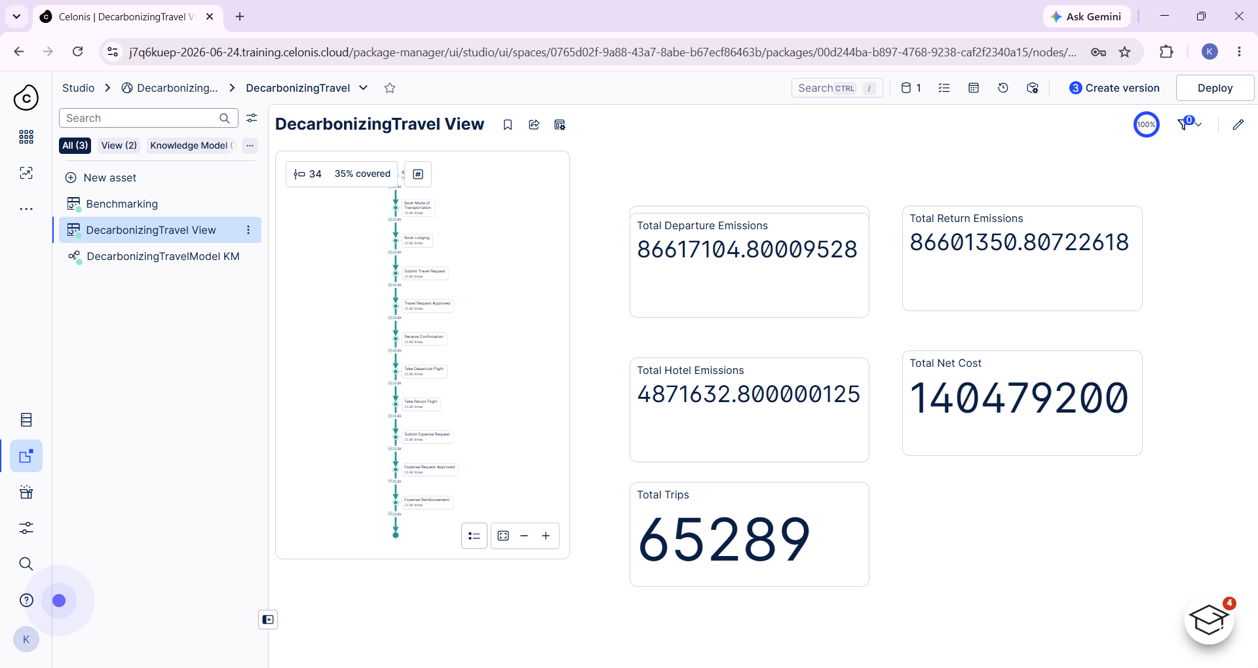
06 · LIVE DASHBOARD — TAB 1 OF 3
Emissions Overview
65,289
Trips analyzed
86.6M
Departure CO₂e
86.6M
Return CO₂e
4.9M
Hotel CO₂e
Key insight: departure and return legs together drive ~97% of total logged CO₂e — hotel stays are a minor share.
Decarbonizing Travel · Project Case Study
07 / 11

Slide 8
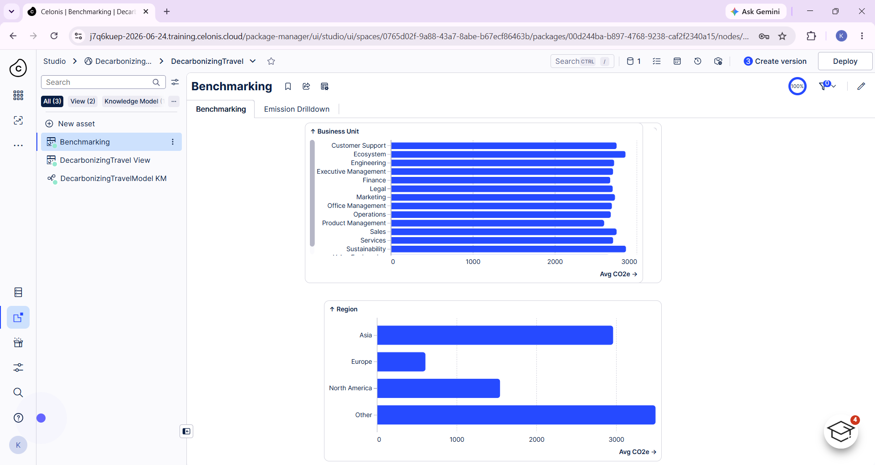
06 · LIVE DASHBOARD — TAB 2 OF 3
Benchmarking
13
Business units
4
Regions compared
Europe
Most efficient region
Public
Only trip set used
Key insight: Europe remains the most carbon-efficient region — consistent with the regional-intensity findings.
Decarbonizing Travel · Project Case Study
08 / 11

Slide 9
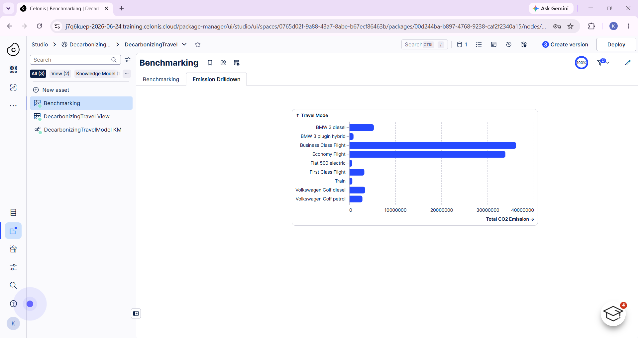
06 · LIVE DASHBOARD — TAB 3 OF 3
Emissions Drilldown
9
Travel modes
2
Drive most CO₂e
Train
Lowest emission
2
EV/hybrid options
Key insight: Business and Economy Class flights dominate the footprint — rail-shift is the highest-leverage lever.
Decarbonizing Travel · Project Case Study
09 / 11

Slide 10
07 · TOOLS & TECH STACK
Built With
Celonis
Python
XGBoost
Pandas / NumPy
Process mining, PQL, live dashboarding
Data processing & feature engineering
Gradient-boosted classification model
Data wrangling & analysis
Summary
A process-mining foundation, a leakage-safe predictive model, and a self-serve dashboard — combined into one system that turns a historical emissions report into an ongoing decision-support tool.
Decarbonizing Travel · Project Case Study
10 / 11

