Slide 1

Credit CARD FRAUD DETECTION
Credit card fraud is a form of identity theft in which criminals make purchases or get cash using the credit card details of other people.
ML models can be applied to predict whether a transaction is a fraud or not .
Usually the transaction data is severely imbalanced and need to be treated.
I tested different techniques to treat class imbalance and different ML classifiers to obtain best model to detect fraud.
Techniques to treat class imbalance
Random Oversampling
SMOTE
SMOTE + UnderSampling
SMOTESVM
Recommended Binary classifiers for Fraud Detection
Logistic Regression (Baseline)
KNN
Naïve Bayes
SVM
Decision Tree
Random Forest (Bagging Ensemble)
XGBoost (Boosting Ensemble)
Model Evaluation
Precision
Recall
F1 score
Average precision (AUC PR)

Slide 2
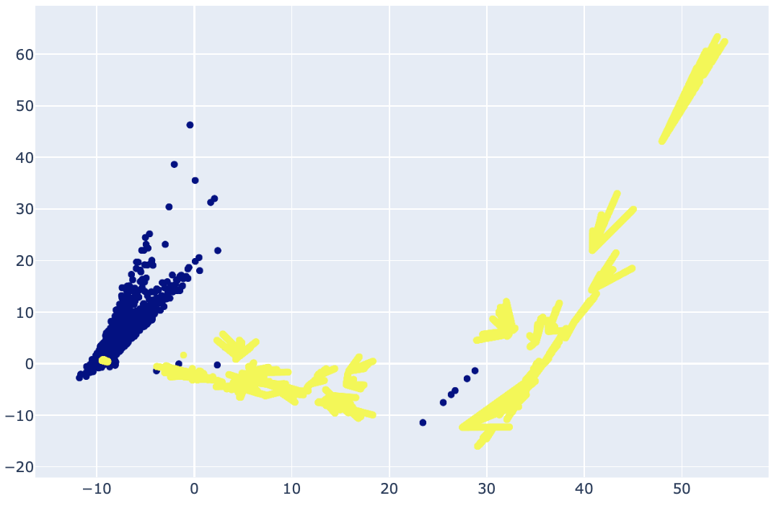
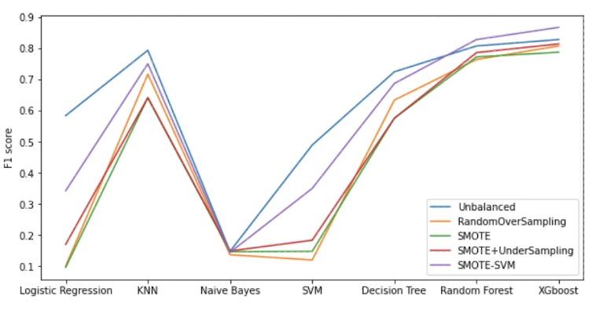
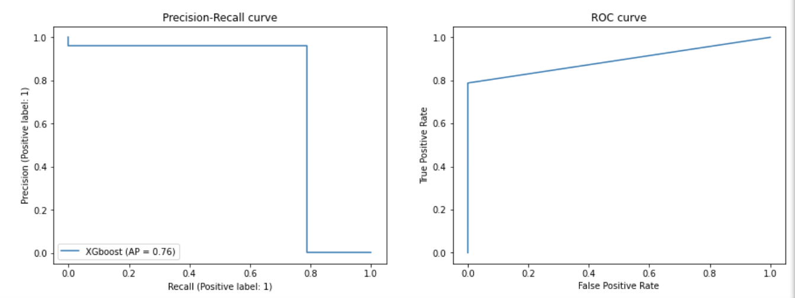
.
The Winner -The best model
XGBoost (with SMOTESVM to treat class imbalance)
Baseline - Logistic Regression
P = 0.036 <0.05 from paired t-test for XGBoost vs Logistic Regression (with SMOTESVM treated data)
Evaluation metrics
PCA1 vs PCA2 for SMOTESVM treated dataset
F1-score for 7 models tested with datasets treated for imbalance
PR AUC (average precision) : 0.7592
Recall : 0.7879
Precision : 0.9630
F1 score : 0.8667
ROC AUC. : 0.9474
Accuracy : 0.9994
PR curve and ROC curve for XGBoost model
Hyperparameters tunning by Exhaustive Gridsearch and successive Halving Gridsearch
 | Exhaustive GridSearch | Halving GridSearch
Best parameters | {'gamma’: 0.25, 'max_depth’: 4, 'min_child_weight': 1} | {'gamma’: 1, 'max_depth’: 4, 'min_child_weight': 1}
Best average precision score | 0.7973 | 0.7898
Total search time (minutes) | 62.32 | 14.61
Krish Weragalaarachchi
Notes:
I selected the baseline model as logistic regression. The best model I found was XGBoost when used with SMOTESVM treated data. Here you see the all evaluation metrics and as you see it has an optimal blend of precision and recall and therby maiantain high
F1 score and high average precision.
The plot to the right shows F1 scores for all these 35 combinations and highest is for XGBoost when used with SMOTESVM.
I then performed a hypothesis test to see whether XGBoost actually shows higher F1 score compared to baseline and the p-vale for paired t-test is 0.036 which less than 0.05 and so that is statistically true.
Then I tried finding the best parameters for XGBoost Exhaustive gridsearch and halving gridserach. I only could tune for 3 parameters they are gamma, max_depth and min_child_weight.
As you can see, results from both methods were same for max_depth and min_child_weight but bit different for parameter gamma
Models were evaluated using average precision and Exhaustive grid search gave the best score which is 0.7948.
However Halving gridserch is efficient when considering the total search time.

