Slide 1
DIGIGREEN Ideathon 2025
Smart Auto-Sorting Bin with In-Built Composting
TEAM: THE DETOXIFIERS
Names & Roles:
Mohamed Shahid
Krishnan T R Sanjay O
Jennis Sanjay Alan

Slide 2



Problem Worth Solving Waste is often disposed of without segregation,leading to:
Overflowing landfills Improper recycling
Missed composting opportunities
Over 70% of Indian
households don't segregate
waste properly

Slide 3


What if
"A smart bin that senses, sorts and starts composting –
all before you walk away"
Automatically classifies bio-waste, e-waste and dry recyclables
Dispenses microbes to start composting
Uses simple sensors – no apps, no human sorting needed

Slide 4






Target Audience s Impact
Target Users
Urban households s apartments
Commercial offices s shared workspaces
Educational institutions (schools, colleges, hostels)
Smart-city s municipal installations
Impact
Automated convenience — no sorting required
Source-level composting — reduces landfill volume
Lower collection frequency — fewer trucks, lower costs, less emissions
Policy alignment — supports Swachh Bharat and SDG goals

Slide 5





Why Our Smart Bin Stands Out
Sensor-Driven Sorting
Uses moisture s inductive sensors to identify waste types immediately
Contrast: Camera or app-based systems rely on visuals + AI, which are costlier and slower
In-Built Composting Module
Dispenses microbes to kick-start compost on-site
Competitors (e.g., Lomi, Bigbelly) mainly store waste or heat/dry it — they don’t integrate active
biological processing
Rotating-lid Mechanism
Servo-powered lid rotates to align waste with correct internal chamber
Most smart bins feature static multiple compartments or rely on manual sorting
Odor s Pest Control
Sealed chambers + fan + activated carbon filter reduce smells s vermin
Bigbelly’s solar bins show sealed bins dramatically reduce rat presence

Slide 6
How it Works
1. Single-Feed Top Inlet
Users deposit all waste types into one common opening—no pre-sorting required.
Sensor-Based Detection
Moisture Sensor — detects bio-organic waste (moisture levels)
Inductive (Metal) Sensor — identifies metallic/e-waste items
Default Channel — remaining items (paper, plastics) are classified as dry recyclables
Servo-Driven Rotating Lid
Once classified, a servo motor spins the lid to align the inlet over the correct internal chamber
This enables automated, mechanical waste separation—no camera or human required
Bio Chamber Processing
For organic waste:
Lid aligns with bio-compost chamber
Bin dispenses a microbe cartridge to initiate decomposition
Chamber is sealed, and a fan + activated carbon filter manage odors

Slide 7

Feasibility s Implementation Plan
Components s Tools
Microcontroller: ESP32 or Arduino — ESP32 offers native Wi-Fi/Bluetooth and is used in prototypes s
Sensors:
Moisture sensors (resistive/capacitive) achieve ~65–68% accuracy in compost s agriculture use .
Inductive/metal proximity sensors are widely used in trash-sorting systems
POCs
Actuators: Servo motors for rotating lid; widely used in DIY trash/compost bins
Composting Module: Cartridge-based microbe dispenser, based on manual compost activators used in small-scale systems
Odor Control: Small fan paired with an activated-carbon filter — proven effective in sealed compost units

Slide 8



Budget Estimate (Prototype)
ESP32 Board: ₹360–615
Sensors: ₹170–400
Servo: ~₹450
Dispenser s Filter: ~₹400–500
Overall Range: ₹1,300 – ₹2,200
Why It’s Feasible
DIY-ready: Uses widely documented, off-the-shelf components
Low build cost: Prototype fits within a modest ₹1.7k–2.2k budget
Scalable design: Easy to shift from dev-board to custom PCB
Proven accuracy s reliability: Sensors deliver ≥65% accuracy in moisture and detection

Slide 9

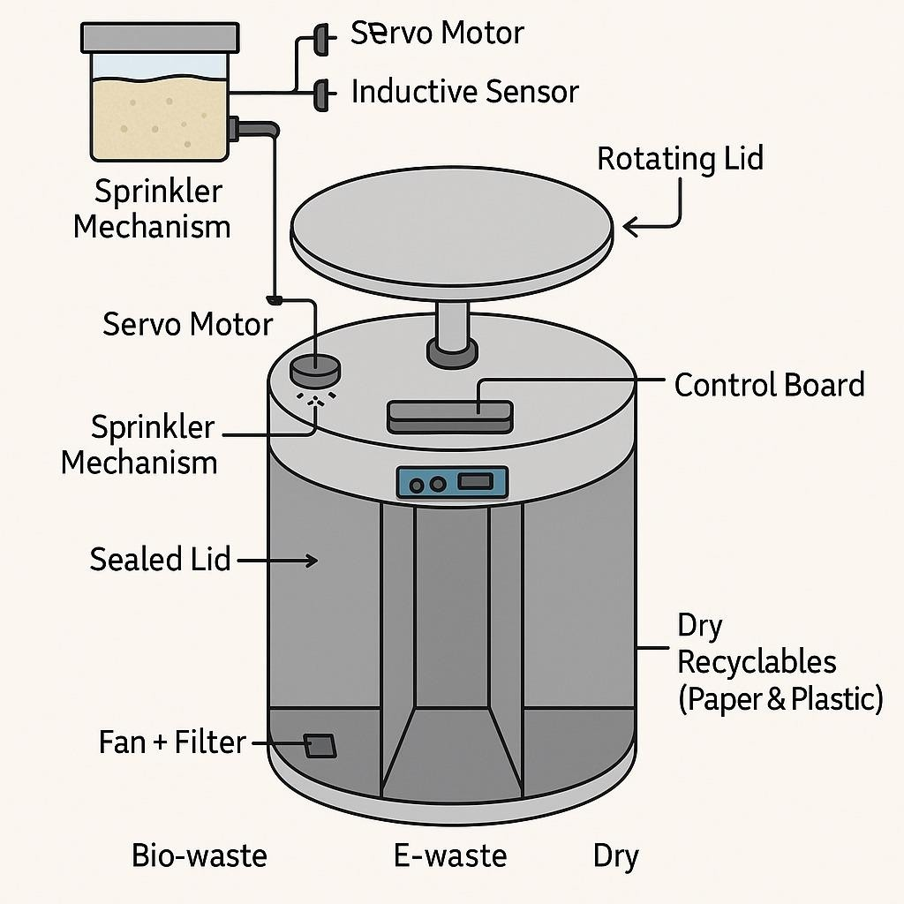

Key Prototype Elements
3-Chamber Layout – Depicted in 3D/CAD renders for clarity and visual appeal
Modular Servo Lid – Allows smooth rotation and
chamber alignment
External Microbe Cartridge Slot – Swappable and easy to refill
Concealed Wiring Diagram – Indicates neat
construction and clear component mapping
Prototype Benefits
Visual clarity makes the design easy to understand at a
glance
Modular, serviceable structure supports future upgrades
Sensor-actuator integration is clearly visible, underlining
feasibility and technical readiness

Slide 10


Market Potential s Scalability
Strategic Target Sectors
Residential s Smart Homes
Consumers are adopting voice-controlled, odor-filtered smart bins.
Commercial s Office Spaces
Over 50% of smart bin revenue already comes from commercial deployments
Municipal s Smart City Projects
Governments in India and globally are funding sensor-enabled bins with automated fill-
level analytics to reduce collection costs by ~50%
Educational s Institutional
Ideal for sustainability initiatives in schools, hostels, and campus dining.

Slide 11



Future Vision s Next Steps
Future Upgrades
IoT Monitoring Platform
Integrate to monitor fill-levels, chamber temperatures, and compost progress remotely
Solar-Powered Operation
Add solar panels and battery for off-grid, eco-friendly autonomy
Auto-Compost-Brick Press Module
Compact hydraulic press converts compost into bricks
Next Steps
Develop s assemble enhanced prototype
Embed IoT sensors, solar panel interface, and press module
Pilot testing
Conduct real-world trials in residences, offices, or hostels
Iterate s optimize
Improve power efficiency, press durability, and data UI
Engage stakeholders
Partner with campus councils or smart-city programs for formal pilots

