Slide 1

Software Engineering (3150711)
Unit-3 Managing Software Projects
Dr. Pradyumansinh U. Jadeja
Computer Engineering Department
pradyuman.jadeja@darshan.ac.in
+91-9879461848

Slide 2

Looping
Outline
W⁵ of Project Management
Software Metrics
Process, Product and Project Metrics
Software Project Estimations
Software Project Planning (MS Project Tool)
Project Scheduling and Tracking
Risk Analysis and Management
Risk Identification
Risk Projection
Risk Refinement
Risk Mitigation

Slide 3
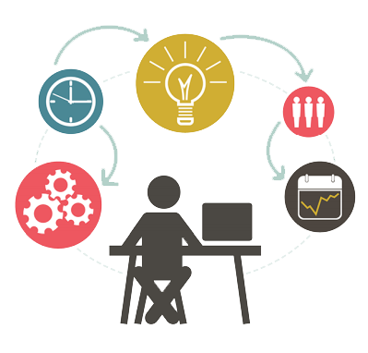

Software Project Management
W⁵HH of Project Management
Boehm suggests an approach (W⁵HH) that addresses project objectives, milestones and schedules, responsibilities, management and technical approaches, and required resources
Why is the system being developed?
Enables all parties to assess the validity of business reasons for the software work. In another words - does the business purpose justify the expenditure of people, time, and money?
What will be done?
The answers to these questions help the team to establish a project schedule by identifying key project tasks and the milestones that are required by the customer
When will it be accomplished?
Project schedule to achieve milestone

Slide 4
W⁵HH of Project Management Cont.
Who is responsible?
Role and responsibility of each member
Where are they organizationally located?
Customer, end user and other stakeholders also have responsibility
How will the job be done technically and managerially?
Management and technical strategy must be defined
How much of each resource is needed?
Develop estimation
W⁵HH
It is applicable regardless of size or complexity of software project

Slide 5
Terminologies
Measure
It provides a quantitative indication of the extent (range), amount, dimension, capacity or size of some attributes of a product or process
Ex., the number of uncovered errors
Metrics
It is a quantitative measure of the degree (limit) to which a system, component or process possesses (obtain) a given attribute
It relates individual measures in some way
Ex., number of errors found per review
Direct Metrics
Immediately measurable attributes
Ex., Line of Code (LOC), Execution Speed, Defects Reported
Indirect Metrics
Aspects that are not immediately quantifiable
Ex., Functionality, Quantity, Reliability
Indicators
It is a metric or combination of metrics that provides insight into the software process, project or the product itself
It enables the project manager or software engineers to adjust the process, the project or the product to make things better
Ex., Product Size (analysis and specification metrics) is an indicator of increased coding, integration and testing effort
Faults
Errors - Faults found by the practitioners during software development
Defects - Faults found by the customers after release

Slide 6

Why Measure Software?
1
To determine (to define) quality of a product or process.
2
To predict qualities of a product or process.
3
To improve quality of a product or process.
Metric Classification Base
Process
Specifies activities related to production of software.
Specifies the abstract set of activities that should be performed to go from user needs to final product.
Project
Software development work in which a software process is used
The actual act of executing the activities for some specific user needs
Product
The outcomes of a software project
All the outputs that are produced while the activities are being executed

Slide 7

Process Metrics
We measure the effectiveness of a process by deriving a set of metrics based on outcomes of the process such as,
Process Metrics are an invaluable tool for companies to monitor, evaluate and improve their operational performance across the enterprise
They are used for making strategic decisions
Process Metrics are collected across all projects and over long periods of time
Their intent is to provide a set of process indicators that lead to long-term software process improvement
Errors uncovered before release of the software
Defects delivered to and reported by the end users
Work products delivered
Human effort expended
Calendar time expended
Ex., Defect Removal Efficiency (DRE) metric
Relationship between errors (E) and defects (D)
The ideal is a DRE of 1
DRE = E / ( E + D )
Conformance to the schedule
Time and effort to complete each generic activity

Slide 8

Project Metrics
Project metrics enable a software project manager to,
Assess the status of an ongoing project
Track potential risks
Uncover problem areas before their status becomes critical
Adjust work flow or tasks
Evaluate the project team’s ability to control quality of software work products
Many of the same metrics are used in both the process and project domain
Project metrics are used for making tactical (smart) decisions
They are used to adapt project workflow and technical activities
Project metrics are used to
Minimize the development schedule by making the adjustments necessary to avoid delays and mitigate (to reduce) potential (probable) problems and risks
Assess (evaluates) product quality on an ongoing basis and guides to modify the technical approach to improve quality

Slide 9
Product Metrics
Product metrics help software engineers to gain insight into the design and construction of the software they build
By focusing on specific, measurable attributes of software engineering work products
Product metrics provide a basis from which analysis, design, coding and testing can be conducted more objectively and assessed more quantitatively
Ex., Code Complexity Metric

Slide 10

Types of Measures
Categories of Software Measurement
Software Measurement
Direct measures of the
Indirect measures of the
Metrics for Software
Cost and Effort estimations
Software process
Ex., cost, effort, etc.
Software product
Ex. functionality, quality, complexity, efficiency, reliability, etc.
Size Oriented Metrics
Software product
Ex., lines of code produced,
execution speed,
defects reported, etc.
Function Oriented Metrics
Object Oriented Metrics
Use Case Oriented Metrics

Slide 11
Size-Oriented Metrics
Derived by normalizing (standardizing) quality and/or productivity measures by considering the size of the software produced
Thousand lines of code (KLOC) are often chosen as the normalization value
A set of simple size-oriented metrics can be developed for each project
Size-oriented metrics are not universally accepted as the best way to measure the software process
Errors per KLOC (thousand lines of code)
Defects per KLOC
$ per KLOC
Opponents argue that KLOC measurements
Pages of documentation per KLOC
Are dependent on the programming language
In addition, other interesting metrics can be computed, like
Penalize well-designed but short programs
Cannot easily accommodate nonprocedural languages
Errors per person-month
Require a level of detail that may be difficult to achieve
KLOC per person-month
$ per page of documentation

Slide 12
Function Oriented Metrics
Function-oriented metrics use a measure of the functionality delivered by the application as a normalization value
Most widely used metric of this type is the Function Point
FP = Count Total * [0.65 + 0.01 * Sum (Value Adjustment Factors)]
Function Point values on past projects can be used to compute,
for example, the average number of lines of code per function point
Advantages
FP is programming language independent
FP is based on data that are more likely to be known in the early stages of a project, making it more attractive as an estimation approach
Disadvantages
FP requires some “sleight of hand” because the computation is based on subjective data
Counts of the information domain can be difficult to collect
FP has no direct physical meaning, it’s just a number

Slide 13
Object-Oriented Metrics
Use Case Oriented Metrics
Conventional software project metrics (LOC or FP) can be used to estimate object-oriented software projects
However, these metrics do not provide enough granularity (detailing) for the schedule and effort adjustments that are required as you iterate through an evolutionary or incremental process
Lorenz and Kidd suggest the following set of metrics for OO projects
Number of scenario scripts
Number of key classes (the highly independent components)
Number of support classes
Like FP, the use case is defined early in the software process, allowing it to be used for estimation before significant (valuable) modeling and construction activities are initiated
Use cases describe (indirectly, at least) user-visible functions and features that are basic requirements for a system
The use case is independent of programming language, because use cases can be created at vastly different levels of abstraction, there is no standard “size” for a use case
Without a standard measure of what a use case is, its application as a normalization measure is suspect (doubtful).
Ex., effort expended / use case

Slide 14
Function Point Metrics
User / Event
The function point (FP) metric can be used effectively as a means for measuring the functionality delivered by a system
Using historical data, the FP metric can be used to
Estimate the cost or effort required to design, code, and test the software
Predict the number of errors that will be encountered during testing
Forecast the number of components and/or the number of projected source lines in the implemented system
Other Applications
User / Event
external
inquiries (EQs)
external
inputs (EIs)
external interface
files (EIFs)
external
outputs (EOs)
Internal
Logic Files
Function / Application

Slide 15
Function Point Components Cont.
Information domain values (components) are defined in the following manner
Number of external inputs (EIs)
input data originates from a user or is transmitted from another application
Number of external outputs (EOs)
external output is derived data within the application that provides information to the user
output refers to reports, screens, error messages, etc.
Number of external inquiries (EQs)
external inquiry is defined as an online input that results in the generation of some immediate software response in the form of an online output
Number of internal logical files (ILFs)
internal logical file is a logical grouping of data that resides within the application’s boundary and is maintained via external inputs
Number of external interface files (EIFs)
external interface file is a logical grouping of data that resides external to the application but provides information that may be of use to the another application

Slide 16
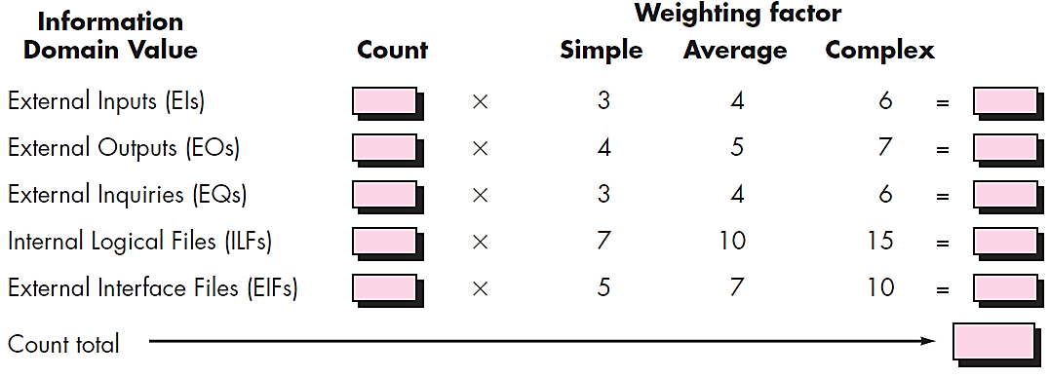
Compute Function Points
Value Adjustment Factors
FP = Count Total * [ 0.65 + 0.01 * ∑(F_{i}) ]
F1. Data Communication
F2. Distributed Data Processing
F3. Performance
F4. Heavily Used Configuration
F5. Transaction Role
F6. Online Data Entry
F7. End-User Efficiency
F8. Online Update
F9. Complex Processing
F10. Reusability
F11. Installation Ease
F12. Operational Ease
F13. Multiple Sites
F14. Facilitate Change
Count Total is the sum of all FP entries
Fi (i=1 to 14) are complexity value adjustment factors (VAF).
Value adjustment factors are used to provide an indication of problem complexity

Slide 17
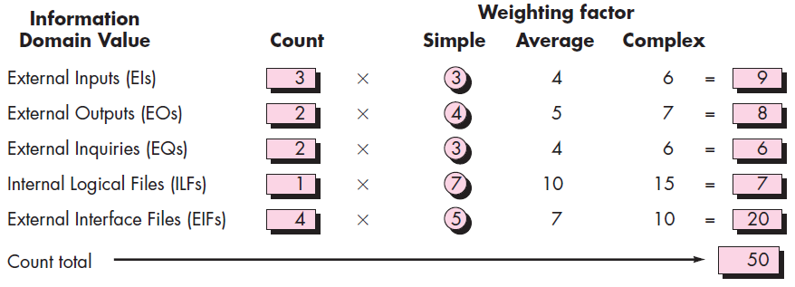
Function Point Calculation Example
Used Adjustment Factors and assumed values are,
F09. Complex internal processing = 3
F10. Code to be reusable = 2
F03. High performance = 4
FP = Count Total * [ 0.65 + 0.01 * ∑(F_{i}) ]
F13. Multiple sites = 3
FP = [50]* [0.65 + 0.01 * 17]
F02. Distributed processing = 5
FP = [50]* [0.65 + 0.17]
Project Adjustment Factor (VAF) = 17
FP = [50]* [0.82] = 41

Slide 18
Function Point Calculation Example 2
Study of requirement specification for a project has produced following results
7
28
10
40
Need for 7 inputs, 10 outputs, 6 inquiries, 17 files and 4 external interfaces
6
18
17
119
4
28
233
Input and external interface function point attributes are of average complexity and all other function points attributes are of low complexity
Value adjustment factors (VAF) = 32 given
FP = Count Total * [ 0.65 + 0.01 * ∑(F_{i}) ]
= 233 * [ 0.65 + 0.01 * 32]
Determine adjusted function points assuming complexity adjustment value is 32.
= 233 * 0.97 = 226.01

Slide 19

Software Project Estimation
To achieve reliable cost and effort estimates, a number of options arise:
Delay estimation until late in the project (obviously, we can achieve 100 percent accurate estimates after the project is complete!)
Base estimates on similar projects that have already been completed
Use relatively simple decomposition techniques to generate project cost and effort estimates
Use one or more empirical models for software cost and effort estimation.
It can be transformed from a black art to a series of systematic steps that provide estimates with acceptable risk

Slide 20

Software Project Decomposing
Software project estimation is a form of problem solving and in most cases, the problem to be solved is too complex to be considered in one piece
For this reason, decomposing the problem, re-characterizing it as a set of smaller problems is required
Before an estimate can be made, the project planner must understand the scope of the software to be built and must generate an estimate of its “size”
Decomposition Techniques
1. Software Sizing
3. Process based Estimation
2. Problem based Estimation
LOC (Lines of Code) based,
FP (Function Point) based
4. Estimation with Use-cases

Slide 21
Software Sizing
Putnam and Myers suggest four different approaches to the sizing problem
“Fuzzy logic” sizing
This approach uses the approximate reasoning techniques that are the cornerstone of fuzzy logic.
Function Point sizing
The planner develops estimates of the information domain characteristics
Standard Component sizing
Estimate the number of occurrences of each standard component
Use historical project data to determine the delivered LOC size per standard component.
Change sizing
Used when changes are being made to existing software
Estimate the number and type of modifications that must be accomplished
An effort ratio is then used to estimate each type of change and the size of the change

Slide 22
Problem Based Estimation
Start with a bounded statement of scope
Decompose the software into problem functions that can each be estimated individually
Compute an LOC or FP value for each function
Derive cost or effort estimates by applying the LOC or FP values to your baseline productivity metrics
Ex., LOC/person-month or FP/person-month
Combine function estimates to produce an overall estimate for the entire project
In general, the LOC/pm and FP/pm metrics should be computed by project domain
Important factors are team size, application area and complexity

Slide 23
Problem Based Estimation Cont.
LOC and FP estimation differ in the level of detail required for decomposition with each value
For LOC, decomposition of functions is essential and should go into considerable detail (the more detail, the more accurate the estimate)
For FP, decomposition occurs for the five information domain characteristics and the 14 adjustment factors
External Inputs, External Outputs, External Inquiries, Internal Logical Files, External Interface Files
For both approaches, the planner uses lessons learned to estimate,
An optimistic (S_{opt}), most likely (S_{m}), and pessimistic (S_{pess}) estimates Size (S) value for each function or count
Then the expected Size value S is computed as
S = (S_{opt} + 4 S_{m} + S_{pess})/6
Historical LOC or FP data is then compared to S in order to cross-check it.

Slide 24

Process Based Estimation
Process-based estimation is obtained from “process framework”
This is one of the most commonly used technique
Identify the set of functions that the software needs to perform as obtained from the project scope
Identify the series of framework activities that need to be performed for each function
Estimate the effort (in person months) that will be required to accomplish each software process activity for each function
Apply average labor rates (i.e., cost/unit effort) to the effort estimated for each process activity
Compute the total cost and effort for each function and each framework activity.
Compare the resulting values to those obtained by way of the LOC and FP estimates
If both sets of estimates agree, then your numbers are highly reliable
Otherwise, conduct further investigation and analysis concerning the function and activity breakdown
Frame
Framework Activities
Application
Functions
Effort required to accomplish
each framework activity for each application function

Slide 25

Estimation with Use Cases
Developing an estimation approach with use cases is problematic for the following reasons:
Use cases are described using many different formats and styles—there is no standard form.
Use cases represent an external view (the user’s view) of the software and can therefore be written at many different levels of abstraction
Use cases do not address the complexity of the functions and features that are described
Use cases can describe complex behavior (Ex., interactions) that involve many functions and features
Although a number of investigators have considered use cases as an estimation input.
Before use cases can be used for estimation,
the level within the structural hierarchy is established,
the average length (in pages) of each use case is determined,
the type of software (e.g., real-time, business, engineering/scientific, WebApp, embedded) is defined, and
a rough architecture for the system is considered
Once these characteristics are established,
empirical data may be used to establish the estimated number of LOC or FP per use case (for each level of the hierarchy).
Historical data are then used to compute the effort required to develop the system.

Slide 26
Empirical Estimation Models
Source Lines of Code (SLOC)
The project size helps to determine the resources, effort, and duration of the project.
SLOC is defined as the Source Lines of Code that are delivered as part of the product
The effort spent on creating the SLOC is expressed in relation to thousand lines of code (KLOC)
This technique includes the calculation of Lines of Code, Documentation of Pages, Inputs, Outputs, and Components of a software program
The SLOC technique is language-dependent
The effort required to calculate SLOC may not be the same for all languages
Source Lines of Code (SLOC)
Function Point (FP)
Constructive Cost Model (COCOMO)

Slide 27



Software Development Project
Based on the development complexity
Software Development Project Classification
Organic
Semidetached
Embedded
Application programs
e.g. data processing programs
Utility programs e.g Compilers, linkers
System programs e.g OS real-time systems
A development project can be considered of organic type, if the project deals with developing a well understood application program, the size of the development team is reasonably small, and the team members are experienced in developing similar types of projects
A development project can be considered of semidetached type, if the development consists of a mixture of experienced & inexperienced staff. Team members may have limited experience on related systems but may be unfamiliar with some aspects of the system being developed.
A development project is considered to be of embedded type, if the software being developed is strongly coupled to complex hardware, or if the strict regulations on the operational procedures exist

Slide 28
Software Development Project Cont.
Dead Line
Innovation
Project Size
Development Environment
Model
Nature of Project
Organic
Typically
2-50 KLOC
Small Size Project, Experienced developers in the familiar environment, E.g. Payroll, Inventory projects etc.
Little
Not Tight
Familiar &
In-house
Semi Detached
Medium Size Project, Medium Size Team, Average Previous Experience, e.g. Utility Systems like Compilers, Database Systems, editors etc.
Typically
50-300 KLOC
Medium
Medium
Medium
Large Project, Real Time Systems, Complex interfaces, very little previous Experience. E.g. ATMs, Air Traffic Controls
Complex hardware & customer Interfaces
Embedded
Typically
Over 300 KLOC
Significant
Required
Tight

Slide 29





COCOMO Model
Basic COCOMO Model
COCOMO (Constructive Cost Estimation Model) was proposed by Boehm
The basic COCOMO model gives an approximate estimate of the project parameters
The basic COCOMO estimation model is given by the following expressions
$$Effort=a_{1}+{\left(KLOC\right)}^{a_{2}} PM$$
$$Tdev=b_{1 }×{\left(Effort\right)}^{b_{2}} Months$$
KLOC is the estimated size of the software product expressed in Kilo Lines of Code
a₁, a₂, b₁, b₂ are constants for each category of software products,
Tdev is the estimated time to develop the software, expressed in months,
Effort is the total effort required to develop the software product, expressed in person months (PMs).
According to Boehm, software cost estimation should be done through three stages:
Project | a₁ | a₂ | b₁ | b₂
Organic | 2.4 | 1.05 | 2.5 | 0.38
Semidetached | 3.0 | 1.12 | 2.5 | 0.35
Embedded | 3.6 | 1.20 | 2.5 | 0.32
Basic COCOMO
Intermediate COCOMO
Complete COCOMO

Slide 30
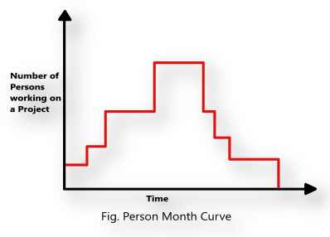
Basic COCOMO Model Cont.
The effort estimation is expressed in units of person-months (PM)
It is the area under the person-month plot (as shown in fig.)
An effort of 100 PM
does not imply that 100 persons should work for 1 month
does not imply that 1 person should be employed for 100 months
it denotes the area under the person-month curve (fig.)
Every line of source text should be calculated as one LOC irrespective of the actual number of instructions on that line
If a single instruction spans several lines (say n lines), it is considered to be nLOC
The values of a₁, a₂, b₁, b₂ for different categories of products (i.e. organic, semidetached, and embedded) as given by Boehm
He derived the expressions by examining historical data collected from a large number of actual projects

Slide 31
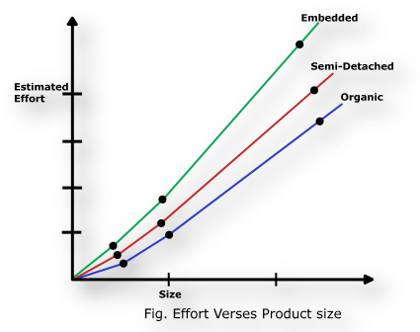
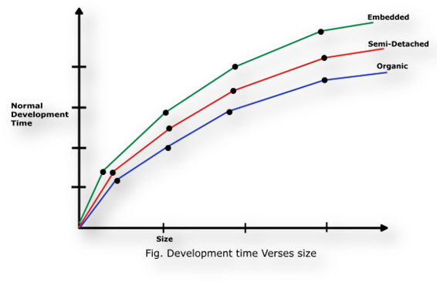
Basic COCOMO Model Cont.
Insight into the basic COCOMO model can be obtained by plotting the estimated characteristics for different software sizes
Fig.1 shows a plot of estimated effort versus product size
From fig. we can observe that the effort is somewhat superlinear in the size of the software product
The effort required to develop a product increases very rapidly with project size
The development time versus the product size in KLOC is plotted in fig. 2
From fig., it can be observed that the development time is a sublinear function of the size of the product
i.e. when the size of the product increases by two times, the time to develop the product does not double but rises moderately
From fig., it can be observed that the development time is roughly the same for all the three categories of products
Fig. 1
Fig. 2

Slide 32






Basic COCOMO Model Cont.
Effort and the duration estimations obtained using the COCOMO model are called as nominal effort estimate and nominal duration estimate
The term nominal implies that
if anyone tries to complete the project in a time shorter than the estimated duration, then the cost will increase drastically
But, if anyone completes the project over a longer period of time than the estimated, then there is almost no decrease in the estimated cost value
Example: Assume that the size of an organic type software product has been estimated to be 32,000 lines of source code. Assume that the average salary of software engineers be Rs. 15,000/- per month. Determine the effort required to develop the software product and the nominal development time
$$Effort=a_{1}+{\left(KLOC\right)}^{a_{2}} PM$$
$$Tdev=b_{1 }×{\left(Effort\right)}^{b_{2}} Months$$
$$=2.4+{\left(32\right)}^{1.05} PM$$
$$=2.5×{\left(91\right)}^{0.38} Months$$
$$=91 PM$$
$$=14 Months$$
Cost required to develop the product = 14 x 15000 = Rs. 2,10,000/-

Slide 33
Intermediate COCOMO model
The basic COCOMO model assumes that effort and development time are functions of the product size alone
However, a host of other project parameters besides the product size affect the effort required to develop the product as well as the development time
Therefore, in order to obtain an accurate estimation of the effort and project duration, the effect of all relevant parameters must be taken into account
The intermediate COCOMO model recognizes this fact and refines the initial estimate obtained using the basic COCOMO expressions by using a set of 15 cost drivers (multipliers) based on various attributes of software development
For example, if modern programming practices are used, the initial estimates are scaled downward by multiplication with a cost driver having a value less than 1
It is requires the project manager to rate these 15 different parameters for a particular project on a scale of one to three.
Then, depending on these ratings, appropriate cost driver values which should be multiplied with the initial estimate obtained using the basic COCOMO.

Slide 34
Intermediate COCOMO model Cont.
The cost drivers can be classified as being attributes of the following items
Product: The characteristics of the product that are considered include the inherent complexity of the product, reliability requirements of the product, etc.
Computer: Characteristics of the computer that are considered include the execution speed required, storage space required etc.
Personnel: The attributes of development personnel that are considered include the experience level of personnel, programming capability, analysis capability, etc.
Development Environment: Development environment attributes capture the development facilities available to the developers. An important parameter that is considered is the sophistication of the automation (CASE) tools used for software development

Slide 35
Complete COCOMO model
A major shortcoming of both the basic and intermediate COCOMO models is that they consider a software product as a single homogeneous entity
Most large systems are made up several smaller sub-systems
These sub-systems may have widely different characteristics
E.g., some sub-systems may be considered as organic type, some semidetached, and some embedded
Also for some subsystems the reliability requirements may be high, for some the development team might have no previous experience of similar development etc.
The complete COCOMO model considers these differences in characteristics of the subsystems and estimates the effort and development time as the sum of the estimates for the individual subsystems
The cost of each subsystem is estimated separately
This approach reduces the margin of error in the final estimate

Slide 36
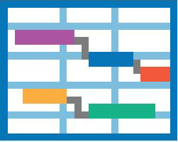

Project Scheduling & Tracking
It is an action that distributes estimated effort across the planned project duration, by allocating the effort to specific software engineering tasks
Scheduling Principles
Compartmentalization
Interdependency
Time Allocation
Define Responsibilities
Define Outcomes
Define Milestones
Effort Validation

Slide 37
Scheduling Principles
Compartmentalization
The product and process must be decomposed into a manageable number of activities and tasks
Interdependency
Tasks that can be completed in parallel must be separated from those that must completed serially
Time Allocation
Every task has start and completion dates that take the task interdependencies into account
Effort Validation
Project manager must ensure that on any given day there are enough staff members assigned to complete the tasks within the time estimated in the project plan
Define Responsibilities
Every scheduled task needs to be assigned to a specific team member
Define Outcomes
Every task in the schedule needs to have a defined outcome (usually a work product or deliverable)
Defined Milestones
A milestone is accomplished when one or more work products from an engg task have passed quality review

Slide 38
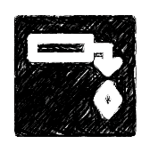
Effort Distribution
General guideline: 40-20-40 rule
40% or more of all effort allocated to analysis and design tasks
20% of effort allocated to programming
40% of effort allocated to testing
Characteristics of each project dictate the distribution of effort
Although most software organizations encounter the following projects types:
Concept Development
initiated to explore new business concept or new application of technology
New Application Development
new product requested by customer
Application Enhancement
major modifications to function, performance or interfaces (observable to user)
Application Maintenance
correcting, adapting or extending existing software (not immediately obvious to user).
Reengineering
rebuilding all (or part) of a existing (legacy) system

Slide 39

Scheduling methods
Two project scheduling methods that can be applied to software development.
Program Evaluation and Review Technique (PERT)
Critical Path Method (CPM)
Both techniques are driven by information already developed in earlier project planning activities:
estimates of effort
a decomposition of the product function
the selection of the appropriate process model and task set
decomposition of the tasks that are selected
Both PERT and CPM provide quantitative tools that allow you to:
Determine the critical path—the chain of tasks that determines the duration of the project
Establish “most likely” time estimates for individual tasks by applying statistical models
Calculate “boundary times” that define a “time window” for a particular task

Slide 40
Project Schedule Tracking
Gantt chart
The project schedule provides a road map for a software project manager.
It defines the tasks and milestones.
Several ways to track a project schedule:
Conducting periodic project status meeting
Evaluating the review results in the software process
Determine if formal project milestones have been accomplished
Compare actual start date to planned start date for each task
Informal meeting with practitioners
Using earned value analysis to assess progress quantitatively
Project manager takes the control of the schedule in the aspects of
Project Staffing, Project Problems, Project Resources, Reviews, Project Budget
A Gantt chart, commonly used in project management, is one of the most popular and useful ways of showing activities (tasks or events) displayed against time.
On the left of the chart is a list of the activities and along the top is a suitable time scale.
Each activity is represented by a bar; the position and length of the bar reflects the start date, duration and end date of the activity. This allows you to see at a glance:

Slide 41
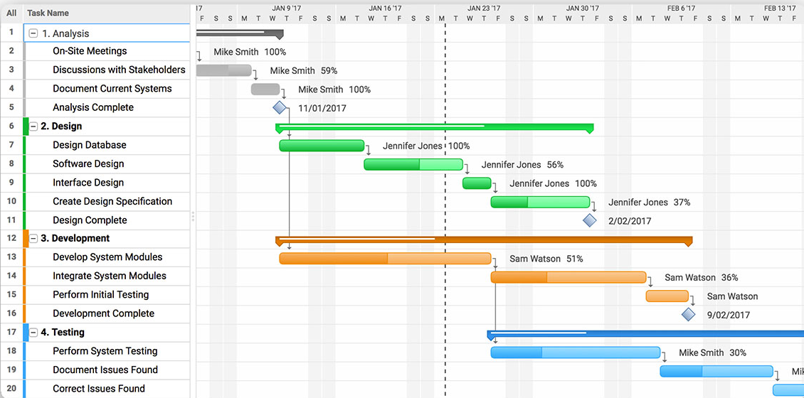
Gantt chart Cont.
What the various activities are
When each activity begins and ends
How long each activity is scheduled to last
Where activities overlap with other activities, and by how much
The start and end date of the whole project

Slide 42


Risk analysis & Management
Risk
A risk is a potential (probable) problem – which might happen and might not
Conceptual definition of risk
Risk concerns future happenings
Risk involves change in mind, opinion, actions, places, etc.
Risk involves choice and the uncertainty that choice entails
Two characteristics of risk
Uncertainty
Loss
The risk may or may not happen, so there are no 100% risks (some of those may called constraints)
If the risk becomes a reality and unwanted consequences or losses occur

Slide 43

Risk Categorization: Approach-1
Sub-categories of Business risks
Project risks
They threaten the project plan
If they become real, it is likely that the project schedule will slip and that costs will increase
Technical risks
They threaten the quality and timeliness of the software to be produced
If they become real, implementation may become difficult or impossible
Business risks
They threaten the feasibility of the software to be built
If they become real, they threaten the project or the product
Market risk
Building an excellent product or system that no one really wants
Strategic risk
Building a product that no longer fits into the overall business strategy for the company
Sales risk
Building a product that the sales force doesn't understand how to sell
Management risk
Losing the support of senior management due to a change in focus or a change in people
Budget risk
Losing budgetary or personnel commitment

Slide 44
Risk Categorization: Approach-2
Known risks
Those risks that can be uncovered after careful evaluation of
the project plan, the business and technical environment in which the project is being developed, and other reliable information sources (Ex. unrealistic delivery date)
Predictable risks
Those risks that are deduced (draw conclusion) from past project experience (Ex. past turnover)
Unpredictable risks
Those risks that can and do occur, but are extremely difficult to identify in advance
Risk Strategies (Reactive vs. Proactive)
Reactive risk strategies
Proactive risk strategies
"Don't worry, I will think of something“.
The majority of software teams and managers rely on this approach
Nothing is done about risks until something goes wrong
The team then flies into action in an attempt to correct the problem rapidly (fire fighting)
Crisis management is the choice of management techniques
Steps for risk management are followed
Primary objective is to avoid risk and to have an emergency plan in place to handle unavoidable risks in a controlled and effective manner

Slide 45



Steps for Risk Management
Risk Identification
Identify possible risks and recognize what can go wrong
Analyze each risk to estimate the probability that it will occur and the impact (i.e., damage) that it will do if it does occur
Rank the risks by probability and impact. Impact may be negligible, marginal, critical, and catastrophic.
Develop a contingency plan to manage those risks having high probability and high impact
Risk identification is a systematic attempt to specify threats to the project plan
By identifying known and predictable risks, the project manager takes a first step toward,
avoiding them when possible
controlling them when necessary
Generic Risks
Risks that are a potential threat to every software project
Product-specific Risks
Risks that can be identified only by clear understanding of the technology, the people and the environment, that is specific to the software that is to be built

Slide 46

Known and Predictable Risk Categories
One method for identifying risks is to create a risk item checklist
The checklist can be used for risk identification which focuses on some subset of known and predictable risks in the following generic subcategories:
Product Size: risks associated with overall size of the software to be built
Business Impact: risks associated with constraints imposed by management or the marketplace
Customer Characteristics: risks associated with sophistication of the customer and the developer's ability to communicate with the customer in a timely manner
Process Definition: risks associated with the degree to which the software process has been defined and is followed
Development Environment: risks associated with availability and quality of the tools to be used to build the project
Technology to be Built: risks associated with complexity of the system to be built and the “newness” of the technology in the system
Staff Size and Experience: risks associated with overall technical and project experience of the software engineers who will do the work

Slide 47

Risk Estimation (Projection)
Risk projection (or estimation) attempts to rate each risk in two ways
The probability that the risk is real
The consequence (effect) of the problems associated with the risk
Risk Projection/Estimation Steps
Establish a scale that reflects the perceived likelihood (probability) of a risk. Ex., 1-low, 10-high
Explain the consequences of the risk
Estimate the impact of the risk on the project and product.
Note the overall accuracy of the risk projection so that there will be no misunderstandings

Slide 48



RMMM
Risk Mitigation, Monitoring, and Management (RMMM)
An effective strategy for dealing with risk must consider three issues
Risk mitigation (i.e., avoidance)
Risk monitoring
Risk management and contingency planning
RMMM
Risk Mitigation is a problem avoidance activity
Risk Monitoring is a project tracking activity
Risk Management includes contingency plans that risk will occur

Slide 49
Risk Mitigation
Risk mitigation (avoidance) is the primary strategy and is achieved through a plan
For Ex., Risk of high staff turnover
To mitigate this risk, you would develop a strategy for reducing turnover.
The possible steps to be taken are:
Meet with current staff to determine causes for turnover (e.g., poor working conditions, low pay, and competitive job market)
Mitigate those causes that are under your control before the project starts
Once the project commences, assume turnover will occur and develop techniques to ensure continuity when people leave
Organize project teams so that information about each development activity is widely dispersed
Define work product standards and establish mechanisms to be sure that all models and documents are developed in a timely manner
Conduct peer reviews of all work (so that more than one person is “up to speed”).
Assign a backup staff member for every critical technologist

Slide 50
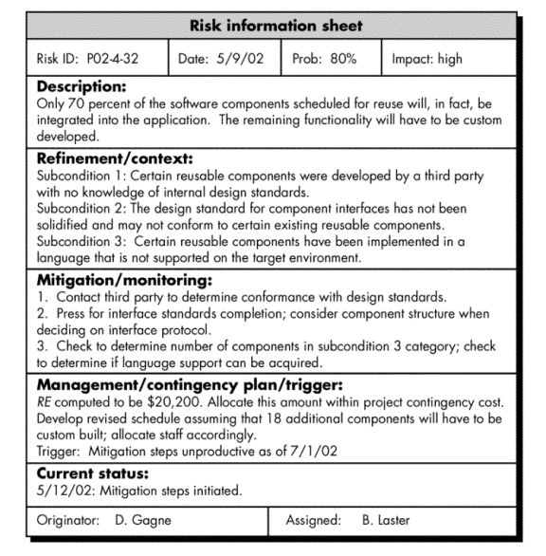
RMMM PLAN
Risk information sheet (RIS)
The RMMM PLAN documents all work performed as part of risk analysis and used by the project manager as part of the overall project plan
Some software teams do not develop a formal RMMM document, rather each risk is documented individually using a Risk information sheet (RIS)
In most cases, RIS is maintained using a database system.
So Creation and information entry, priority ordering, searches and other analysis may be accomplished easily.
The format of RIS is describe in diagram

Slide 51
Software Engineering (3150711)
Dr. Pradyumansinh U. Jadeja
Computer Engineering Department
pradyuman.jadeja@darshan.ac.in
91-9879461848

