Slide 1
Integrity Constraints

Slide 2
Need of Constraints
Database constraints are restrictions on the contents of the database or on database operations.
A rule that restricts the values that may be present in the database is called a constraint.
These are used to limit the type of data that can go into a table.
This ensures the accuracy and reliability of the data in the database.
Database constraints provide a way to guarantee that:
  rows in a table have valid primary or unique key values.
  rows in a dependent table have valid foreign key values that reference rows in a parent table.
  individual column values are valid .

Slide 3
Constraints
You specify one or more of these constraints when you use the create table statement to create a base table.
You can also add or drop constraints with the Alter Table statement.
Constraints can be defined at column level or table level.
Column level constraints are applied only to one column, whereas table level constraints are applied to the whole table.
Constraints are associated to a specific table and are stored in the data dictionary as a part of a structure or schema of a table.

Slide 4
Types of constraints
There are two types of constraints.
Entity Integrity Constraints.
Referential Integrity Constraints.
Entity Integrity Constraints:-
It will restrict the values in row of an individual table.
It is divided into two types:-
  Domain Integrity Constraints
  Key Constraints
Referential Integrity Constraints:-
It specifies that a row in one table that refers to another row must refer to an existing row in that table.
Oracle Provides one constraints:-
  FOREIGN KEY

Slide 5
Types of constraints
Domain Integrity Constraints:-
It specifies value of each column must belong to the domain of that column.
Columns must follow some business rules.
Ex. Balance can’t negative for any account in banking system.
Oracle Provides two constraints:-
NOT NULL
CHECK
Key Constraints:-
It ensures that there must be some way to distinguish two different rows of same table uniquely.
Oracle Provides two constraints:-
UNIQUE
PRIMARY KEY

Slide 6
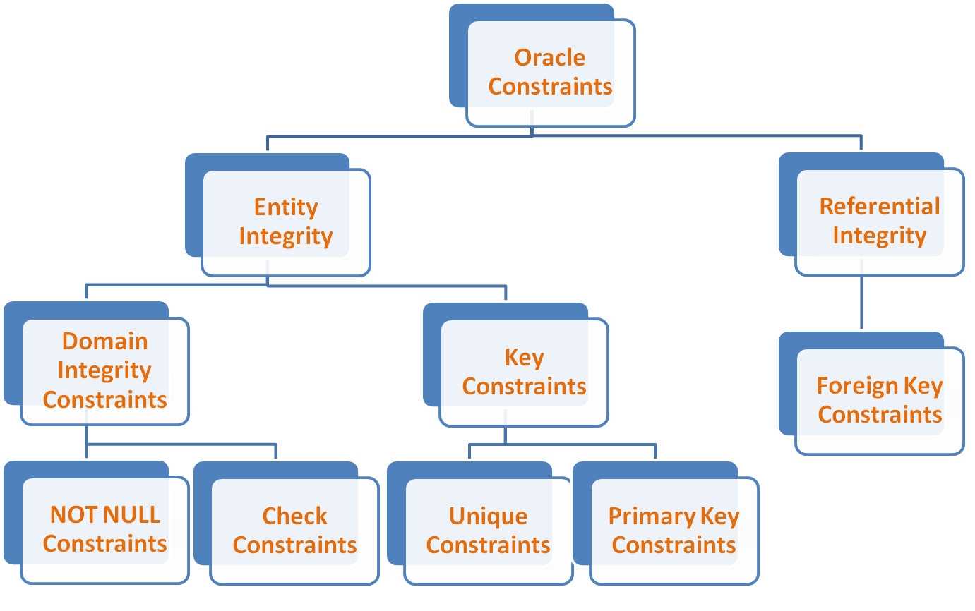
Classification of Constraints

Slide 7
Constraints
Constraints can be defined at column level or at table level.
Column level Constraint:-
Syntax:-
Column Name data type(size) constraint_defination;
Table level Constraint:-
Syntax:-
CREATE TABLE table Name
(column1 data type(size),…,ColumnN data type (size),
constraint_defination1,….,constraint_defination);

Slide 8
NOT NULL Constraints
It is required that a field cannot be left empty.
Characteristic:-
A NULL value indicates ‘not applicable', 'missing’ or ‘not known’.
A NULL value is distinct from zero or other numeric value for numeric data.
A NULL value is distinct from a blank space for character data.
A NULL value will evaluate to NULL to any expression.
i.e. 5* NULL=NULL.
If the column has a NULL value, oracle ignores any unique, Check constraints that may be attached to the column.
Enforce Restriction:-
A column defined as a NOT NULL can not have a NULL value.
NOT NULL at COLUMN LEVEL:-
SYNTAX:-
Column_Name data_type(size) NOT NULL

Slide 9
NOT NULL Constraints
Example:-
mysql> CREATE TABLE ACC
-> (ano CHAR(3),
-> Balance INT NOT NULL,
-> Bname VARCHAR(10));
mysql> describe acc;
+---------+-------------+------+-----+---------+-------+
| Field | Type | Null | Key | Default | Extra |
+---------+-------------+------+-----+---------+-------+
| ano | char(3) | YES | | NULL | |
| Balance | int(11) | NO | | NULL | |
| Bname | varchar(10) | YES | | NULL | |
+---------+-------------+------+-----+---------+-------+
A NOT NULL Constraint can not be applied at a column level.

Slide 10
CHECK Constraint
It is used to implement business rules.
It is also referred as business rule constraints.
Business rules define a domain for a particular column.
Domain of a column is a set of permitted values for that column.
Ex:- a balance can’t negative.
A branch name must be specified.
Enforce Restrictions:-
Once check constraints is implemented, any insert or update operation on that table must follow this constraints.
It is bound to a particular column.
If any operation violets condition, it will be rejected.

Slide 11
CHECK Constraint
Characteristics:-
any business rule validations can be applied using this constraint.
A condition must be some valid logical expression.
It takes longer time to execute. So till possible it should be avoided.
This constraints will be ignored while encountering NULL values.
On violation of this constraint, "check Constraint violated” error message displayed.
Check Constraint at column Level:-
Syntax:-
column_name data_type(size) CHECK(condition)

Slide 12
CHECK Constraint
Check Constraint at column Level:-
Example:-
mysql> create table acc6( ano CHAR(3),
-> Balance int CHECK (not(BALANCE<0)),
-> Bname VARCHAR(10));
mysql> describe acc6;
+---------+-------------+------+-----+---------+-------+
| Field | Type | Null | Key | Default | Extra |
+---------+-------------+------+-----+---------+-------+
| ano | char(3) | YES | | NULL | |
| Balance | int(11) | YES | | NULL | |
| Bname | varchar(10) | YES | | NULL | |
+---------+-------------+------+-----+---------+-------+

Slide 13
CHECK Constraint
Check Constraint at Table Level:-
Syntax:- CHECK(condition)
Example:-
mysql> create table acc7(ano CHAR(3),
-> Balance INT,
-> Bname VARCHAR(10),
-> CHECK(Bname in('surat','valsad','anand')));
mysql> describe acc7;
+---------+-------------+------+-----+---------+-------+
| Field | Type | Null | Key | Default | Extra |
+---------+-------------+------+-----+---------+-------+
| ano | char(3) | YES | | NULL | |
| Balance | int(11) | YES | | NULL | |
| Bname | varchar(10) | YES | | NULL | |
+---------+-------------+------+-----+---------+-------+

Slide 14
CHECK Constraint
Example:-
creates a new table called CUSTOMERS and adds five columns.
(1) we add a CHECK with AGE column, so that you can not have any CUSTOMER below 18 years.
(2) The CHECK constraint specifies that the column “ID“ starts with ‘C’ and followed 3 other characters such as ‘C001’.
(3) Post must be Manager or accountant or clerk.
CREATE TABLE CUSTOMERS
( ID INT NOT NULL CHECK(ID LIKE ‘C_ _ _’),
NAME VARCHAR (20) NOT NULL,
AGE INT NOT NULL CHECK (AGE >= 18),
POST CHAR (15) CHECK(‘Manager’,’Accountant’,’Clerk’),
SALARY DECIMAL (18, 2));

Slide 15
UNIQUE Constraints
It is required Column must have unique values.
It is required that column can’t contain duplicate values.
It permits multiple entries of NULL into column.
These NULL values are clubbed at the top of column in order in which they were entered into the table.
Characteristics:-
It does not allow duplicate values, NULL values are ignored by UNIQUE constraint.
A table can have more than one Unique key which is not possible in Primary key.
More than one column defined as a UNIQUE column.
Maximum 16 columns can be combined as a composite unique key in a table.
It can not be LONG or LONG RAW data type.
Enforce Restriction:-
A column defined as a UNIQUE can not have duplicate values across all records.

Slide 16
UNIQUE Constraints
UNIQUE CONSTRAINTS AT COLUMN LEVEL:-
SYNTAX:-
Column_name data_type(size) UNIQUE
Example:-
mysql> CREATE TABLE ACC1
-> (ano CHAR(3) UNIQUE,
-> Balance INT ,
-> Bname VARCHAR(10));
mysql> describe acc1;
+---------+-------------+------+-----+---------+-------+
| Field | Type | Null | Key | Default | Extra |
+---------+-------------+------+-----+---------+-------+
| ano | char(3) | YES | UNI | NULL | |
| Balance | int(11) | YES | | NULL | |
| Bname | varchar(10) | YES | | NULL | |
+---------+-------------+------+-----+---------+-------+

Slide 17
UNIQUE Constraints
UNIQUE CONSTRAINTS AT TABLE LEVEL:-
Example:-
mysql> CREATE TABLE ACC2
-> (ano CHAR(3) ,
-> Balance INT ,
-> Bname VARCHAR(10),
-> UNIQUE(ano));
mysql> describe acc2;
+---------+-------------+------+-----+---------+-------+
| Field | Type | Null | Key | Default | Extra |
+---------+-------------+------+-----+---------+-------+
| ano | char(3) | YES | UNI | NULL | |
| Balance | int(11) | YES | | NULL | |
| Bname | varchar(10) | YES | | NULL | |
+---------+-------------+------+-----+---------+-------+

Slide 18
PRIMARY KEY Constraints
It is a set of one or more columns used to identify each record uniquely in a column.
It defines the column as a mandatory column as NOT NULL attribute is active.
The data held across the column must be UNIQUE.
A single column primary key is called simple Key.
Multi column primary key is called a composite Key.
Enforce Restriction:-
A column defined as a PRIMARY KEY can not have duplicate values across all records.
A column defined as a PRIMARY KEY can not have a NULL value.
It is a combination of NOT NULL and UNIQUE.

Slide 19
PRIMARY KEY Constraints
Characteristics:-
It can be considered as a combination of NOT NULL and UNIQUE constraints.
Its main purpose is the Record Uniqueness.
A table can not have more than one primary key.
A composite key can be defined only at table level.
Maximum 16 columns can be combine as composite Primary key in a table.
A column having LONG or LONG RAW data type cant define as a Primary KEY column.
A composite key do not allow duplicate values in combination of any record.

Slide 20
PRIMARY KEY Constraints
PRIMARY KEY CONSTRAINTS AT COLUMN LEVEL:-
SYNTAX:-
Column_name data_type(size) PRIMARY KEY
Example:-
mysql> CREATE TABLE ACC3
-> (ano CHAR(3) PRIMARY KEY,
-> Balance INT ,
-> Bname VARCHAR(10));
mysql> describe acc3;
+---------+-------------+------+-----+---------+-------+
| Field | Type | Null | Key | Default | Extra |
+---------+-------------+------+-----+---------+-------+
| ano | char(3) | NO | PRI | NULL | |
| Balance | int(11) | YES | | NULL | |
| Bname | varchar(10) | YES | | NULL | |
+---------+-------------+------+-----+---------+-------+

Slide 21
PRIMARY KEY Constraints
PRIMARY KEY CONSTRAINTS AT TABLE LEVEL:-
Example:-
mysql> CREATE TABLE ACC5
-> (ano CHAR(3),
-> Balance INT ,
-> Bname VARCHAR(10),
-> PRIMARY KEY(ano));
mysql> describe acc5;
+---------+-------------+------+-----+---------+-------+
| Field | Type | Null | Key | Default | Extra |
+---------+-------------+------+-----+---------+-------+
| ano | char(3) | NO | PRI | | |
| Balance | int(11) | YES | | NULL | |
| Bname | varchar(10) | YES | | NULL | |
+---------+-------------+------+-----+---------+-------+

Slide 22
Referential integrity Constraints
A foreign key constraint specifies how records in different tables are related and how handle insert, delete, and update operations that might violate the relationship.
It is used to ensure consistency among records of two tables.
Foreign key is a set of one or more columns whose values are derived from primary key or unique key of other table.
It is also referred as referential Integrity Constraint is specified between two tables.
The table in which a foreign key is defined is called a foreign table, detail table OR child table.
The table of which primary key is referred is called a primary table, master table OR parent table.

Slide 23
Referential integrity Constraints
Account:
Branch:
Example, Bname is common between both tables and provides link between Account and Branch.
In our case an attribute Bname in account table is referred as foreign key as its value are derived from the Branch table where it is defined as a primary key.
Here Branch is Parent table(Master table) and Account is Child table(Detail table).
Ano | Bal | Bname
A01 | 5000 | Valsad
A02 | 6000 | Surat
A03 | 7000 | Navsari
A04 | 7500 | Valsad
A05 | 9000 | Surat
Bname | Baddress
VALSAD | Mota bazaar, Valsad
SURAT | Varachha, Surat
NAVSARI | Lalgate, Navsari

Slide 24
Referential integrity Constraints
Enforced Restrictions:-
The Foreign Key Constraint enforces different restrictions on detail and master table.
Restrictions on Master Table:-
Master table contains a Primary key and which is referred by foreign key in Detail table.
Delete or Update operations on records in master table are not allowed, if corresponding records are present in Detail table.
Ex. Can’t delete a record from branch table.
Restrictions on Detail Table:-
Detail table contains a foreign key and it is related to Master table.
Insert or Update operations involving value of foreign key are not allowed, if corresponding value does not exist in the Master table.
Ex. Can't insert a new record ‘anand’ in Account table.
Thus, a FOREIGN KEY Constraints ensures data consistency between two tables.

Slide 25
Referential integrity Constraints
NOTE:-
Foreign key is the key i.e. attribute which refers to another table primary key.
Reference key is the primary key of table referred by another table.

Slide 26
Referential integrity Constraints
A Foreign Key Constraint at Column Level:-
Syntax:-
Column_name data_type (size)
REFERENCES tableName (Column_name)
[ON DELETE CASCADE]
A table name in REFERENCES clause refers to the Master table.
If Column_name from REFERENCES clause is omitted, then the primary key is automatically referred of a table specified in this clause.
ON DELETE CASCADE:-
When any record from MASTER table is deleted all the corresponding records from Detail table are also deleted automatically.
This Option overcomes the restrictions enforced on Master table for delete operation.

Slide 27
Referential integrity Constraints
A Foreign Key Constraint at Column Level:-
Example:-
CREATE TABLE acc9
(ano CHAR(3) PRIMARY KEY,
balance INT,
bname VARCHAR(10) REFERENCES Branch(bname));
+---------+-------------+------+-----+---------+-------+
| Field | Type | Null | Key | Default | Extra |
+---------+-------------+------+-----+---------+-------+
| ano | char(3) | NO | PRI | NULL | |
| balance | int(11) | YES | | NULL | |
| bname | varchar(10) | YES | | NULL | |
+---------+-------------+------+-----+---------+-------+

Slide 28
Referential integrity Constraints
A Foreign Key Constraint at TABLE Level:-
Syntax:-
Foreign key (Column_name[,Column_name…])
References tableName(Column_name[,Column_name..])
[ON DELETE CASCADE]
Example:-
CREATE TABLE acc
(ano CHAR(3) PRIMARY KEY,
balance INT,
bname VARCHAR(10),
FOREIGN KEY(bname)REFERENCES branch(bname));

Slide 29
NAMING A CONSTRAINT
Syntax:-
CONSTRAINT Constraint_name Constraint_defination
Example:-
CREATE TABLE acc
(ano CHAR(3) PRIMARY KEY,
balance INT,
bname VARCHAR(10),
CONSTRAINT for_key FOREIGN KEY(bname)REFERENCES branch(bname));

Slide 30
ALTER TABLE SCHEMA
ADD Constraint:-
Syntax:-
ALTER TABLE table Name
ADD Constraint_defination
It will adds a new constraint in an existing table.
If this constraint is violated by data previously placed in the table, then this command will be rejected.
Example:-
ALTER TABLE acc
ADD PRIMARY KEY(ano);
ALTER TABLE acc
ADD CONSRAINT for_key FOREIGN KEY (bname) REFERENCES BRANCH (bname);

Slide 31
ALTER TABLE SCHEMA
DROP Constraint:-
Syntax:-
ALTER TABLE table Name
DROP Constraint_defination
It will dropped directly.
It can be dropped by using pre-assigned named to that constraint.
Example:-
ALTER TABLE acc
DROP PRIMARY KEY;
ALTER TABLE acc
DROP CONSRAINT for_key;

Slide 32
Example
Create following table having following specification.
STUDENT: ( stu_id, stu_name, Address, City, contact_no, Branch_name)
(i) Define stu_id as a primary key.
(ii) Stu_id must start with ‘S’.
Create following table having following specification.
STUDENT: ( stu_id, stu_name, Address, City, contact_no, Branch_name)
(i) Define stu_name as not null.
(ii) Student branch must be ‘IT’, ‘Electrical’, ‘Mechanical’ or ‘Civil’.

