Slide 1
Data Vs Information
Data | Information
It means Facts and statistics collected together for analysis. | It means processed or organized Data.
Data is the raw material. | Information is the product.
Examples:- Student no ,name | Examples: Percentage, Run rate
Data convey something less | Information conveys something more.
It is less useful | It is more useful

Slide 2
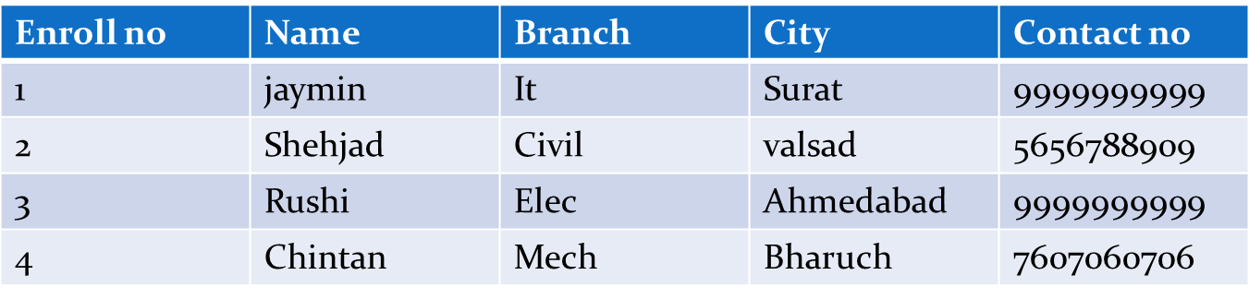
Data item or field
Data field or field is a memory used to store a unit of data item.
It is a character or group of characters that has a specific meaning.
Example:- Enroll no, name etc

Slide 3
Record
Record is a collection of field or data item.
It is a collection of logically related fields.
Each field in a record contains a fixed size and fixed data type.
Example:- Collection of fields no, name, branch, city, contact number-forms a record for student.
Enroll no | Name | Branch | City | Contact no
1 | jaymin | It | Surat | 9999999999
2 | Shehjad | Civil | valsad | 5656788909
3 | Rushi | Elec | Ahmedabad | 9999999999
4 | Chintan | Mech | Bharuch | 7607060706

Slide 4
Database
An organized collection of related information is called database.
A database is a collection of information that is organized so that it can easily be accessed, managed, and updated.
E.g.:-
Dictionary
Student Record Register
Address Book

Slide 5
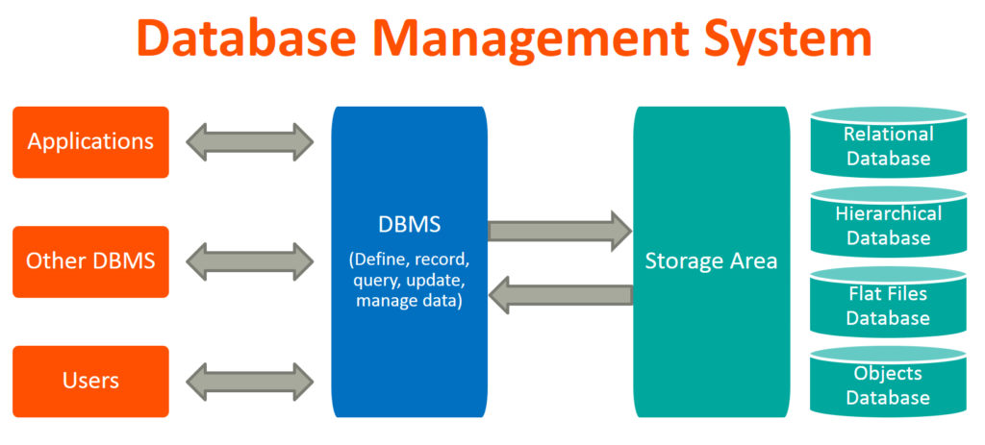
The database management system (DBMS) is the software that interacts with end users, applications, and the database itself to capture and analyze the data.

Slide 6
Application of DBMS
Banking: all transactions
Airlines: reservations, schedules
Inventory: Items, Bills, Orders, Customers
Universities: registration, grades
Sales: customers, products, purchases
Online retailers: order tracking, customized recommendations
Manufacturing: production, inventory, orders, supply chain
Human resources: employee records, salaries, tax deductions.
Library: Books ,Authors , Publications
Hospital: Patients , Doctors , Medicines

Slide 7
Advantages of File oriented system
File oriented system have some advantages over paper based system,
Backup – Possible to take faster and automatic backup of database.
Compactness – It is possible to store data compactly.
Data retrieval – Provides enhanced data retrieved techniques to retrieve data stored in file.
Editing – It is easy to edit any information stored in computers in the form of files.
Remote access – In Computer based system it is possible to access data remotely.
Sharing – Data stored in files systems can be shared among multiple users at a same time

Slide 8
Purpose of Database System
Drawbacks of using file systems to store data:
Data Redundancy :-
Same information may be duplicated in different files.
It results in memory wastage.
Ex:- Customer have both kinds of accounts saving and current. Here duplication occurs.
Data Inconsistency:-
It means that different files may contain different information of a particular object or person.
Due to data redudancy,it is possible that data may not be in consistent state.
Ex:-Address of some customer changes and he/she has both accounts. It is possible that this change address is updated in only one file.

Slide 9
Purpose of Database System
Difficulty in Accessing data :-
Accessing data is not convenient and efficient here.
Need to write a new program to carry out each new task.
Ex:-to find information about customers is difficult.
Limited Data sharing:-
Data are scattered in various files.
Different files may have different formats and stored in different locations.
Due to this data isolation, it is difficult to share data among different application.

Slide 10
Purpose of Database System
Integrity Problems:-
It means that data contained in the database is both correct and consistent.
It must satisfy certain Constraints/Rules.
Integrity constraints (e.g. account balance > 0) become “buried” in program code rather than being stated explicitly.
Hard to add new constraints or change existing ones.
Atomicity of updates:-
Failures may leave database in an inconsistent state with partial updates carried out.
Any Operation on database must be atomic, it must happen in its entirely or not at all.
Example: Transfer of funds from one account to another should either complete or not happen at all It mean that different files may contain different information of a particular object or person.

Slide 11
Purpose of Database System
Concurrent access by multiple users:-
Concurrent accessed needed for performance.
Uncontrolled concurrent accesses can lead to inconsistencies.
Example: Two people reading a balance and updating it at the same time.
Security problems :-
Hard to provide user access to some, but not all, data Failures may leave database in an inconsistent state with partial updates carried out.

Slide 12
Differentiate DA and DBA
DA (Data Administrator) | DBA (Database Administrator)
It is a person in the organization who controls the data of the database | It is a person in the organization who controls the design & use of the database
It determines what data to be stored in database based on requirements of the organization | It provides necessary technical support for implementing a database
It involves more in the requirements gathering, analysis of data | It is involved more in the design, development, testing and operational phases
It is a manager or some senior level person in an organization who understands organizational requirements with respect to data | It is a technical person who have the knowledge of database technology
It is a business focused person | It is a technically focused person

Slide 13
Responsibility of DBA
Schema Definition – DBA defines the logical schema of the database. A Schema refers to the overall logical structure of DB.
Storage structure and access method definition – DBA decides how the data is to be represented and on that basic how they are going to be access the data with different methods.
Defining security and integrity constraints – DBA decides the security and integrity constraints.
Granting of authorization for data access – DBA decides which user needs access to which part of the database.
Assisting Application Programmers – DBA provide assistance to application programmers to develop application program.
Monitoring performance – DBA monitors the performance of system.
Backup and recovery – Data should not be lost or damaged.

Slide 14
Metadata
Metadata is data that describes other data. Meta is a prefix that means "an underlying definition or description.“
An item of metadata describes the specific characteristics about an individual data item.
This means that data such as table name, column name, data type, size, constraints, authorized users, user access privileges for any table is called metadata for that table.
It provides program data independence. i.e. data can be changed without requiring changes in application program.
Examples:
e.g. A .mp3 audio file contains metadata that describes the length of the song, the artist, etc.
e.g. A word document contains metadata such as last time modified, length, author, etc.

Slide 15
Data Dictionary
It is a file that contains metadata including schemas of database.
It is usually part of the system catalog that is generated for each database.
It is usually stored in special tables called system tables and has following type of information
Information | Description
Schema | Overall logical structure of database like table names, owner, column names etc.
Physical database design | Storage structures, access paths and field and record size.
User | Name of users, their responsibilities and access rights, password
Transaction | Operation performed on database
Relationship | Describe relationships among entities.
Usage Statistics | Frequencies of queries and transactions.

Slide 16
Types of Data Dictionary
Active Data Dictionary | Passive Data Dictionary
It is managed automatically by the database management software. | It is managed by the users of the system and is modified whenever the structure of the database is changed.
It is also called integrated data dictionary | It is also called non -integrated data dictionary
It is automatically updated by DBMS with every database access. | It is not updated automatically and usually requires running a batch process.
Information is always consistent. | Information is not consistent because updated periodically by users.
Most of the RDBMS contains active data dictionary. | It is used by DBMS for query optimization purpose.

Slide 17
Schema, sub-schema and instances
 | Schema | Instance
Definition | Overall logical design of DB. | Collection of information stored in DB.
Includes | Table name,colummn name, data type & size of column | Actual information stored in tables in different rows.
Change | Infrequently | Frequently
Cause of change | Insertion/deletion of tables or change in data type size | Insert,updateor delete operation on data stored in DB

Slide 18
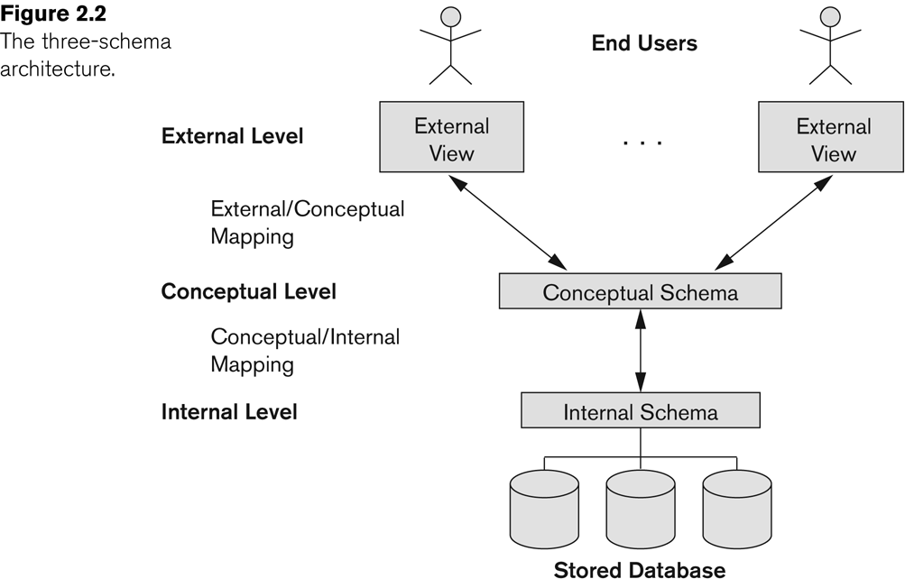
DBMS Architecture

Slide 19
Three levels of the architecture
Internal – physical or storage view
Conceptual – community user view
External – individual user view
Three level database architecture allows a clear separation of the information meaning (conceptual view) from the external data representation and from the physical data structure layout.
A database system that is able to separate the three different views of data is likely to be flexible and adaptable.

Slide 20
Internal View / Physical View
It is the lowest level of data abstraction.
it has the knowledge about software and hardware.
At this level, it keeps the information about the actual representation of the entire database i.e. the actual storage of the data on the disk in the form of records or blocks.
It is close to the physical storage method.
The internal view is the view that tells us “HOW” data is stored in the database .
It deals with data compression and encryption techniques.
It deals with complex low level data structures, file structures & access methods.

Slide 21
Conceptual View
It is next Higher level of Data abstraction.
It describes “WHAT” data are stored in DB & what relationship exist among those data.
It is also known as logical level.
It hides low level complexities of physical storage.
This level is in between the user level and physical storage view.
It hides the details of physical storage structures and concentrates on describing entities, data types, relationships, user operations, and constraints.
DBA & designers works at this level to determine what data to keep in database.

Slide 22
External View / User View / Global View
It is Highest or Top level of data abstraction.
It has No knowledge of DBMS software and hardware or physical storage.
This level is concerned with the user.
It provides end users simple interaction with system and hides the rest of the database from user.
There can be n number of external views for database where n is the number of users.
For example, a accounts department may only be interested in the student fee details. It would not be expected to have any interest in the personal information about students.

Slide 23
Data Independence
The ability to modify a schema definition in one level without affecting a schema definition in the next higher level is called Data Independence.
There are two types of data independence:-
Physical Data Independence
Logical Data Independence.

Slide 24
Data Independence
Physical Data Independence:-
It is the ability to change the physical schema without changing the logical schema is called physical data independence.
Modification at the internal level are occasionally necessary to improve performance.
For example, a change to the internal schema, such as using different file organization or storage structures, storage devices, compression techniques, should be possible without having to change the conceptual or external schemas.
It allows to provide a logical description of the database without the need to specify physical structures.
It is easy to achieve.

Slide 25
Data Independence
Logical Data Independence:-
It is the ability to change the logical (conceptual) schema without changing the External schema (User View) is called logical data independence.
Modification at the logical level are necessary whenever the logical structure of the database is altered.
For example, the addition or removal of new entities, attributes, or relationships to the conceptual schema should be possible without having to change existing external schemas or having to rewrite existing application programs.
It separates external level from the conceptual view.
It is difficult to achieve.

Slide 26
Database System Architecture
naive users
application programmer
sophisticated
users
database administrator
uses
write
uses
uses
application
interfaces
application
program
query
tool
administration tool
translates DML statements into low level instructions that the query evaluation engine understands
Interprets DDL statements into a set of tables containing metadata
compiler and linker
DML queries
DDL interpreter
Executes low level instructions generated by DML compiler.
deal with execution of DDL and DML statements
application program object code
DML compiler and organizer
query evaluation engine
query processor
buffer manager
file manager
authorization and integrity manager
transaction manager
Manages allocation of space on disk storage
storage manager
Fetches data from disk storage to memory for being used
Preserves atomicity and controls concurrency
provides interface between low-level data stored and application program and queries
Checks the authority of users to access data and integrity constraints
To provide faster access to data items
indices
data dictionary
disk storage
To store user data
data
statistical data
To store statistical information about the data
To store metadata

Slide 27
Record based data models
Hierarchical data model:
Here tree concept is used to represent data and relationship among data.
Here each child record can have only one parent record.
Each parent record can have zero or more than one child record.
Records are represented by rectangular box and relationships between records are represented by arcs.
Department
No.
Name
Courses
Students
No.
Name
Unit
ID
Name
Courses
Faculties
ID
Name

Slide 28
Record based data models (Con…)
Network data model:
Data in a network model are represented by collection of records.
Records are organized as a collection of graph.
Connection between an owner and its member is identified by link.
Member can appear in more than one set thus can have several owner, so, many-to-many relationship is possible.
Department
Students
No.
Name
ID
Name
Courses
Courses
Faculties
No.
Name
Unit
ID
Name

Slide 29
Record based data models (Con…)
Relation model:
Department
Faculties
No. | Name
… | …
… | …
… | …
ID | Name | Dep. No. | Courses
… | … | … | …
… | … | … | …
… | … | … | …
Courses
Students
No | Dep. No. | Fac. ID | Unit
… | … | … | …
… | … | … | …
… | … | … | …
ID | Name | Courses
… | … | …
… | … | …
… | … | …

Slide 30
Record based data models (Con…)
Relation model:
The most widely used model today.
Main concept: relation, basically a table with rows and columns.
Describes a database as a collection of tables to represent data and relationship.
Each table is relation.
Every relation has a schema, which describes the columns, or fields.
Each relation has a number of columns representing the attribute of relation.
Each attribute’s value is drawn from a set of value known as domain.
Each domain can have unlimited number of rows called tuples.
Each tuple should be unique in a relation.

Slide 31
Object based data models
Entity-Relationship model:
Entity refers to a real word object that is different from another object.
Entity has set of properties know as attribute.
A collection of same kind of entity is called Entity Set.
Relationship refers to the association between entities.
A collection of same kind of relationship is called Relationship Set.
D_id
DName
E_id
EName
Department
Has
Employee

Slide 32
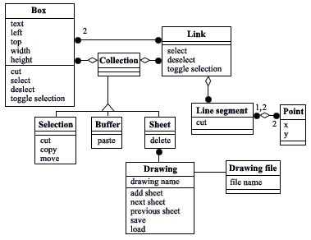
Object based data models (Con…)
Object Oriented Data model:
This model is based on collection of objects.
An object body consists of data as well as methods.
The objects that contain same type of data and same type of function are group together as a class.
This model is represented by UML class diagram.

Slide 33
Types of Database Systems
Based on Data Model :-
Relational DBMS
Object-Oriented DBMS
Network
Hierarchical
Object-Relational DBMS
Based on Number Of Users:-
Single User Systems
Multi User Systems
Based on Purpose :-
Transactional DBMS
Decision Support DBMS
Data Warehouse
Based on Site Locations:-
Centralized DBMS
Parallel DBMS
Distribute DBMS
Client/Server DBMS

