Slide 1
SQL : COMBINE MULTIPLE TABLES
PREPARED BY:-
SHRI D.R.GANDHI
LECTURER IN I.T.

Slide 2
Set operator
A table is basically a subset of Cartesian product among domains(sets) of its columns.
Basically Four types of set operation which is listed below.
Union
Union all
Intersect
Minus

Slide 3
Union operator
The UNION operator is used to combine the result-set of two or more SELECT statements.
Each SELECT statement within the UNION operator must have the same number of fields in the result sets with similar data types.
It removes duplicate rows between the various SELECT statements.
The output will be as a single set of rows and columns in ascending order according to columns present in SELECT statement.
Null value will not be ignored while comparing records from both queries.
Syntax:-
SELECT column_name(s) FROM table1
[where conditions] UNION SELECT column_name(s) FROM table2
[where conditions];

Slide 4
Union all operator
The UNION ALL operator is used to combine the result sets of 2 or more SELECT statements.
It returns all rows from the query and it does not remove duplicate rows between the various SELECT statements.
Each SELECT statement within the MySQL UNION ALL operator must have the same number of fields in the result sets with similar data types.
Syntax:-
SELECT column_name(s) FROM table1
[where conditions] UNION ALL SELECT column_name(s) FROM table2
[where conditions];

Slide 5
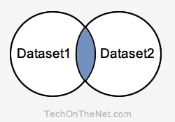
Intersect operator
The INTERSECT clause combines the output of Query1 & Query2.
Output will contain those records which are common to query1 and query2.
Each SELECT statement within the INTERSECT operator must have the same number of fields in the result sets with similar data types.
Null value will not be ignored while comparing records from both queries.
you can't use the INTERSECT operator in MySQL, you will use the IN operator to simulate the INTERSECT query.
Syntax:-
SELECT column_name(s) FROM table1 INTERSECT SELECT column_name(s) FROM table2;

Slide 6
minus operator
The MINUS clause combines the output of Query1 & Query2.
Output will contain those records which are present in query1 but not present in query2.
Each SELECT statement within the INTERSECT operator must have the same number of fields in the result sets with similar data types.
Null value will not be ignored while comparing records from both queries.
Output will not be same if the orders of query1 and query2 are altered.
you can't use the INTERSECT operator in MySQL, you will use the NOT IN operator to simulate the INTERSECT query.
Syntax:-
SELECT column_name(s) FROM table1 MINUS SELECT column_name(s) FROM table2;

Slide 7
EXAMPLE
List out name of person who are either customer or employee.
SELECT Name From Customer UNION SELECT Name from Employee;
Name
-----------
DIYA
FALAK
PALAK
PRIYA
RIYA
SARAT
TARAL
CUSTOMER
EMPLOYEE
CID | Name
C01 | RIYA
C02 | PRIYA
C03 | DIYA
C04 | TARAL
C05 | SARAL
EID | Name | Mngr_ID
E01 | PALAK | E02
E02 | FALAK | NULL
E03 | DIYA | E02
E04 | TARAL | E02
E05 | SARAL | E02

Slide 8
EXAMPLE
List out name of person who are customer as well as employee.
SELECT Name From Customer INTERSECT SELECT Name from Employee;
SELECT Name From Customer where Name IN( SELECT Name from Employee);
Name
-----------
DIYA
SARAL
TARAL

Slide 9
EXAMPLE
List out name of person who are customer but not employee.
SELECT Name From Customer MINUS SELECT Name from Employee;
SELECT Name From Customer where Name NOT IN( SELECT Name from Employee);
Name
-----------
RIYA
PRIYA
List out name of person who are employee but not customer.
SELECT Name From Employee MINUS SELECT Name from Customer;
SELECT Name From Employee where Name NOT IN( SELECT Name from Customer);
Name
-----------
PALAK
FALAK

Slide 10
sub-queries
A sub-query is an SQL statement which appears inside another SQL statement.
Such kind of query can be given as
…..WHERE column_name operator (SELECT ….
Statement containing a sub query is called a Parent or Outer query.
The result of the parent query depends upon the result of the sub-query.
A sub query generally appears as a part of WHERE clause in various SQL statements.
It is also referred as a nested Query.

Slide 11
example
Here, Acc_Holder table represents the link between customers and their accounts.
Find out balance of an account which belongs to customer’C01’
SELECT ano from Acc_Holder where cid=‘c01’;
SELECT Bal from account where ano IN(‘A01’);
SELECT Bal from account where ano IN(SELECT ano from Acc_Holder where cid=‘c01’);
CUSTOMER
Acc_Holder
ACCOUNT
CID | Name
C01 | RIYA
C02 | PRIYA
C03 | DIYA
C04 | TARAL
C05 | SARAL
CID | ANO
C01 | A01
C02 | A02
C03 | A03
C04 | A04
C05 | A05
C02 | A04
Ano | Bal | Bname
A01 | 5000 | Valsad
A02 | 6000 | Surat
A03 | 7000 | Navsari
A04 | 8000 | Valsad
A05 | 9000 | Surat

Slide 12
example
Find out balance of an account which belongs to customer ‘PRIYA’
SELECT cid from customer where name=‘priya’;
SELECT ano from Acc_Holder where cid IN(‘C02’);
SELECT Bal from account where ano IN(A02,A04);
SELECT Bal from account where ano IN
(SELECT ano from Acc_Holder where cid IN
(SELECT cid from customer where name=‘priya’));
Bal
------
6000
8000

Slide 13
joins
In RDBMS table is used to represent relationships among data stored in database, so some columns are used as common columns in multiple tables.
Such column acts as a primary key in one table and as a foreign key in another table.
Join combines columns from different tables and set operations combines rows from different tables.
Join clause is used to combine rows from two or more tables, based on a common field between them.
Join can be classified as
cross join (Cartesian product or simpler join)
Inner Join (Equi and Non-Equi Join)
Self Join
Outer Join (Left,Right,Full)

Slide 14
joins
Cross join:-
It combines every row from one table with every row in other table. It is also referred as Cartesian product.
It is the simplest among all join operations, it is known as simple join.
It is used when it is required to retrieve all possible combinations of rows and columns from both tables.
Syntax:-
Select * from table1,table2;
Example:-
Select * from Account, branch;

Slide 15
joins
Account:- Branch:-
Ano | Bal | Bname
A01 | 5000 | Valsad
A02 | 6000 | Surat
A03 | 7000 | Navsari
A04 | 8000 | Valsad
A05 | 9000 | Surat
Bname | Baddress
VALSAD | Mota bazaar,Valsad
SURAT | Varacha,Surat
NAVSARI | Lalgate,Navsari

Slide 16
joins
Inner join:-
It combines only those records which contain common values in both tables.
In inner join if both the columns are compared for equality, An equal sign (=) is used as comparison operator for equality.then it is referred as an Equi-Join.
It produces only those records which have common values for both of these columns.
Inner join produces only consistent records in output as compared to cross join.
MYSQL Syntax:
SELECT column_name(s) FROM table1 INNER JOIN table2 ON table1.column_name=table2.column_name;
Oracle Syntax:
SELECT column_name(s) FROM table1,table2 where table1.column_name OP table2.column_name;

Slide 17
joins
Inner join (Equi join):-
Combine only consistent information from Account and Branch table.
SELECT ano, balance, account.bname, baddress from account inner join branch
where account.bname = branch.bname;
Here Bname column is common between both tables.
The result of an inner join can be considered as a separate table and can be used to retrieve useful information.
Ano | Bal | Bname | Badd
A01 | 5000 | VALSAD | Mota bazaar,Valsad
A02 | 6000 | SURAT | Varacha,Surat
A03 | 7000 | NAVSARI | Lalgate,Navsari
A04 | 8000 | VALSAD | Mota bazaar,Valsad
A05 | 9000 | SURAT | Varacha,Surat

Slide 18
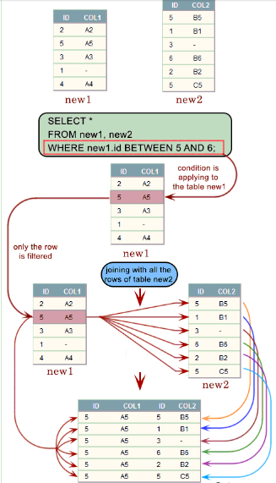
joins
Inner join (Non Equi join):-
The SQL NON EQUI JOIN uses comparison operator instead of the equal sign like >, <, >=, <=along with conditions.
MYSQL Syntax:
SELECT * FROM table_name1, table_name2
WHERE table_name1.column [comparison operator] table_name2.column;

Slide 19
joins
Self join:-
A self join is a join in which a table is joined with itself.
when the table has a FOREIGN KEY which references its own PRIMARY KEY. To join a table itself means that each row of the table is combined with itself and with every other row of the table.
It is similar to inner join except that a table is joined with itself.
The self join can be viewed as a join of two copies of the same table. The table is not actually copied, but SQL performs the command as though it were.
Here each row of a table is combined with other rows of same table to produce result., so alias table is created.
MYSQL Syntax:-
SELECT a.column_name, b.column_name
FROM table1 a, table1 b
WHERE a.common_field = b.common_field;

Slide 20
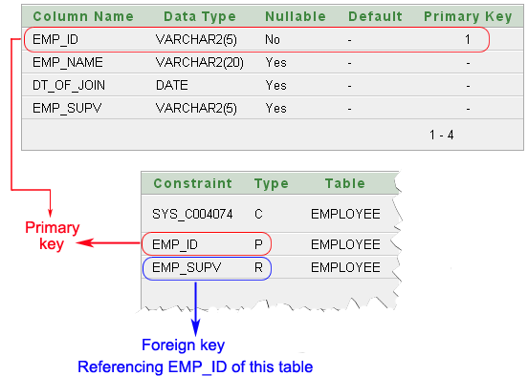
joins
Example:-
CREATE TABLE employee(emp_id varchar(5) NOT NULL,
emp_name varchar(20) NULL,
dt_of_join date NULL,
emp_supv varchar(5) NULL,
CONSTRAINT emp_id PRIMARY KEY(emp_id) ,
CONSTRAINT emp_supv FOREIGN KEY(emp_supv)
REFERENCES employee(emp_id));

Slide 21
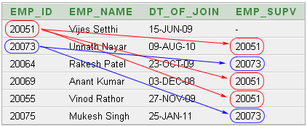
joins
Unary relationship to employee:-
An employee may report to another employee (supervisor).
An employee may supervise himself (i.e. zero) to many employees (subordinates).
The above data shows :
Unnath Nayar's supervisor is Vijes Setthi
Anant Kumar and Vinod Rathor can also report to Vijes Setthi.
Rakesh Patel and Mukesh Singh are under supervison of Unnith Nayar.

Slide 22
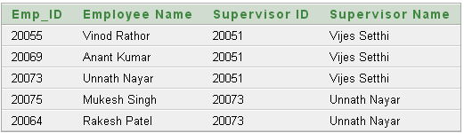
joins
Display list of employees with their supervisor.
SELECT a.emp_id AS "Emp_ID",a.emp_name AS "Employee Name,
b.emp_id AS "Supervisor ID", b.emp_name AS "Supervisor Name"
FROM employee a, employee b
WHERE a.emp_supv = b.emp_id;

Slide 23
joins
Outer join:-
The SQL OUTER JOIN returns all rows from both the participating tables which satisfy the join condition along with rows which do not satisfy the join condition.
it is extension of inner join operation.
Inner join gives consistent information, but some time it may omit some information.
The subtypes of SQL OUTER JOIN is
LEFT OUTER JOIN or LEFT JOIN
RIGHT OUTER JOIN or RIGHT JOIN
FULL OUTER JOIN
College:-
Hostel:-
Name | Id | Department
Amisha | S01 | Computer
Heta | S02 | Computer
Sonika | S03 | I.T.
Name | Hostel_name | Room_no
Amisha | Jamnabai | J01
Sonika | Godavari | G07
Nisha | Kaveri | k02

Slide 24
joins
Example by inner join:-
Combine the academic and hostel related information for all students:-
Select id,college.name,department,hostel_name, room_no from college inner join hostel where college.name=hostel.name;
Output:-
Only details of amisha and sonika will be displayed.
Reason behind this is: there is no matching record for these two students in other table and so academic information of Heta and Hostel related information of Nisha is not shown.
Outer join deals with such kind of information loss.

Slide 25
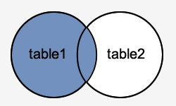
outer join
Left Outer Join:-
This type of join returns all rows from the LEFT-hand table specified in the ON condition and only those rows from the other table where the joined fields are equal.
If a record returned from the left table has no matching record in the table on the right side of the join, it is still returned, and the corresponding column from the right table returns a NULL value.
MYSQL Syntax:-
SELECT columns FROM table1 LEFT [OUTER] JOIN table2 ON table1.column = table2.column;
ORACLE Syntax:-
SELECT columns FROM table1,table2 WHERE table1.column = table2.column(+);

Slide 26
outer join
Left Outer Join Example:-
Perform Left Outer join operation on college and hostel tables:-
SELECT * FROM college left join hostel on college.name=hostel.name;
Name | Id | Dept | Name | Hostel | room
Amisha | S01 | Computer | Amisha | Jamnabai | J01
Heta | S02 | Computer
Sonika | S03 | I.T. | Sonika | Godavari | G07

Slide 27
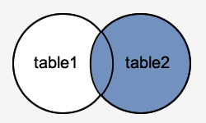
outer join
Right Outer Join:-
This type of join returns all rows from the RIGHT-hand table specified in the ON condition and only those rows from the other table where the joined fields are equal.
The RIGHT JOIN is such a join which specifies that all records be fetched from the table on the right side of the join statement, even if the table on the left has no matching record. In this case, the columns from the left table return NULL values.
MYSQL Syntax:-
SELECT columns FROM table1 RIGHT [OUTER] JOIN table2 ON table1.column = table2.column;
ORACLE Syntax:-
SELECT columns FROM table1,table2 WHERE table1.column (+)= table2.column;

Slide 28
outer join
Right Outer Join Example:-
Perform Right Outer join operation on college and hostel tables:-
SELECT * FROM college right join hostel on college.name=hostel.name;
Name | Id | Dept | Name | Hostel | room
Amisha | S01 | Computer | Amisha | Jamnabai | J01
Sonika | S03 | I.T. | Sonika | Godavari | G07
 |  |  | Nisha | Kaveri | K02

Slide 29
outer join
Full Outer Join:-
It retains all records of both of tables. It also padded null values whenever required.
MYSQL Syntax:-
SELECT columns FROM table1 FULL OUTER JOIN table2 ON table1.column = table2.column;
ORACLE Syntax:-
SELECT columns FROM table1,table2 WHERE table1.column = table2.column (+)
UNION
SELECT columns FROM table1,table2 WHERE table1.column (+) = table2.column;

Slide 30
outer join
Full Outer Join Example:-
Perform Full Outer join operation on college and hostel tables:-
SELECT * FROM college full Outer join hostel on college.name=hostel.name;
Name | Id | Dept | Name | Hostel | room
Amisha | S01 | Computer | Amisha | Jamnabai | J01
Heta | S02 | Computer
Sonika | S03 | I.T. | Sonika | Godavari | G07
 |  |  | Nisha | Kaveri | K02

