Slide 1
SQL Tutorial

Slide 2
What is SQL?
SQL stands for Structured Query Language.
SQL lets you access and manipulate databases (i.e. Insert ,Update ,Delete ,Search ) .
SQL is an ANSI (American National Standards Institute) standard .
SQL can execute queries against a database
SQL can create new databases
SQL can create new tables in a database
SQL can create stored procedures in a database
SQL can create views in a database
SQL can set permissions on tables, procedures, and views

Slide 3
Features of SQL
It is a language that provides an interface to relational database systems.
It was developed by IBM in 1970.
It has been accepted as a standard language for RDBMS.
It is used as command language in oracle/MySQL/SQL server and many RDBMS products.
It is a non-procedural language.
It requires only to specify what operations to be done to retrieve data without specifying how to perform that operations.
It can be used by a range of users.

Slide 4
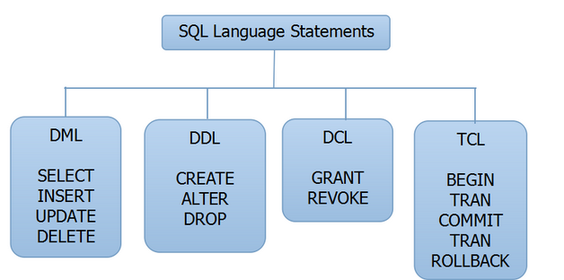
SQL language statements

Slide 5
SQL
Data Definition Language (DDL):-
It is used for Create/alter/delete database objects such as tables, views and their attributes.
It is normally used by DBA and database designers.
CREATE - to create objects in the database.
ALTER - alters the structure of the database.
DROP - delete objects from the database.
TRUNCATE - remove all records from a table, including all spaces allocated for the records are removed.
COMMENT - add comments to the data dictionary.
RENAME - rename an object.

Slide 6
SQL
Data Manipulation Language (DML)
DML statements affect records in a table.
It is a set of SQL commands used to insert, modify and delete data in a database.
It is normally used by general users who are accessing database via applications.
SELECT - retrieve data from the a database
INSERT - insert data into a table
UPDATE - updates existing data within a table
DELETE - deletes all records from a table, the space for the records remain
MERGE - UPSERT operation (insert or update).

Slide 7
SQL
Data Control Language (DCL)
DCL Commands that control a database, including administering privileges and committing data.
GRANT - gives user's access privileges to database.
It allows users to read/write on certain database objects.
REVOKE - withdraw access privileges given with the GRANT command.
It keeps users from read/write permission on database objects.

Slide 8
SQL
TCL (Transaction Control Language):-
These statements are used to manage the changes made by DML statements.
It allow you to control and manage transactions to maintain the integrity of data within SQL statements.
It allows statements to be grouped together into logical transactions.
COMMIT - save work done.
SAVEPOINT - identify a point in a transaction to which you can later roll back.
ROLLBACK - restore database to original since the last COMMIT.
SET TRANSACTION - Change transaction options like isolation level and what rollback segment to use.

Slide 9
Basic Data type
SQL data type is an attribute that specifies type of data of any object. Each column, variable and expression has related data type in SQL.
Numerical
Character/String
Date
Binary

Slide 10
Required Storage and Range for Integer Types Supported by MySQL
Type | Storage (Bytes) | Minimum Value Signed | Minimum Value Unsigned | Maximum Value Signed | Maximum Value Unsigned
TINYINT | 1 | -128 | 0 | 127 | 255
SMALLINT | 2 | -32768 | 0 | 32767 | 65535
MEDIUMINT | 3 | -8388608 | 0 | 8388607 | 16777215
INT | 4 | -2147483648 | 0 | 2147483647 | 4294967295
BIGINT | 8 | -2⁶³ | 0 | 2⁶³-1 | 2⁶⁴-1

Slide 11
Numeric Data Type
Data type | Description
SMALLINT(size) | -32768 to 32767 normal. 0 to 65535 UNSIGNED*.
INT(size) | -2147483648 to 2147483647 normal. 0 to 4294967295 UNSIGNED*.
BIGINT(size) | -9223372036854775808 to 9223372036854775807 normal. 0 to 18446744073709551615 UNSIGNED*.
FLOAT(size ,d) | A small number with a floating decimal point. The maximum number of digits may be specified in the size parameter.
DOUBLE(size ,d) | A large number with a floating decimal point. The maximum number of digits may be specified in the size parameter.
DECIMAL(size ,d) | A DOUBLE stored as a string , allowing for a fixed decimal point. The maximum number of digits may be specified in the size parameter. (max size is 65)

Slide 12
Character/String/Text Data Type
Data type | Description
CHAR(size) | Holds a fixed length string (can contain letters, numbers, and special characters). The fixed size is specified in parenthesis. Can store up to 255 characters
VARCHAR(size) | Holds a variable length string (can contain letters, numbers, and special characters). The maximum size is specified in parenthesis. Can store up to 255 characters.
TINYTEXT | Holds a string with a maximum length of 255 characters
TEXT | Holds a string with a maximum length of 65,535 characters
LONGTEXT | Holds a string with a maximum length of 4,294,967,295 characters

Slide 13
Date Data Type
Data type | Description
DATE() | A date. Format: YYYY-MM-DD. Note: The supported range is from '1000-01-01' to '9999-12-31’.
DATETIME() | *A date and time combination. Format: YYYY-MM-DD HH:MI:SS Note: The supported range is from '1000-01-01 00:00:00' to '9999-12-31 23:59:59‘
TIME() | A time. Format: HH:MI:SS Note: The supported range is from '-838:59:59' to '838:59:59‘
YEAR() | A year in two-digit or four-digit format. Note: Values allowed in four-digit format: 1901 to 2155. Values allowed in two-digit format: 70 to 69, representing years from 1970 to 2069

Slide 14
Binary Data Type
Data type | Description
Binary () | Maximum length of 8,000 bytes(Fixed-length binary data )
Varbinary () | Maximum length of 8,000 bytes.(Variable length binary data)
varbinary(max) | Maximum length of 231 bytes (SQL Server 2005 only). ( Variable length Binary data)
Image () | Maximum length of 2,147,483,647 bytes. ( Variable length Binary Data)

Slide 15
Data Definition Language (DDL)

Slide 16
MySql Client commands
USE Database name: This will be used to select a particular database in Mysql work area.
SHOW DATABASES: Lists the databases that are accessible by the Mysql DBMS.
SHOW TABLES: Shows the tables in the database once a database has been selected with the use command.
SHOW COLUMNS FROM tableName: Shows the attributes, types of attributes, key information, whether NULL is permitted, defaults, and other information for a table.

Slide 17
Data Definition Language (DDL):-
CREATE TABLE statement :-
The CREATE TABLE statement is used to create a table in a database.
Tables are organized into rows and columns; and each table must have a name.
SQL CREATE TABLE Syntax:-
CREATE TABLE table_name (
column_name1 data_type(size),
column_name2 data_type(size),
column_name3 data_type(size),....
);
The column_name parameters specify the names of the columns of the table.
The data_type parameter specifies what type of data the column can hold (e.g. varchar, integer, decimal, date, etc.).
The size parameter specifies the maximum length of the column of the table.

Slide 18
Data Definition Language (DDL):-
Now we want to create a table called “pet" that contains six columns: name, owner, species, sex, birth, death.
Example:-
CREATE TABLE pet
(name VARCHAR(20),
owner VARCHAR(20),
species VARCHAR(20),
sex CHAR(1),
birth DATE,
death DATE);

Slide 19
Data Definition Language (DDL):-
DESCRIBE TABLE Statement:-
Once a table is created, there is a need to verify whether a table has been created according to specification.
Example:-
DESCRIBE tableName;
mysql> describe pet;
+---------+-------------+------+-----+---------+-------+
| Field | Type | Null | Key | Default | Extra |
+---------+-------------+------+-----+---------+-------+
| name | varchar(20) | YES | | NULL | |
| owner | varchar(20) | YES | | NULL | |
| species | varchar(20) | YES | | NULL | |
| sex | char(1) | YES | | NULL | |
| birth | date | YES | | NULL | |
| death | date | YES | | NULL | |
+---------+-------------+------+-----+---------+-------+

Slide 20
Data Definition Language (DDL):-
ALTER TABLE Statement :-
The ALTER TABLE statement is used to add, delete, or modify columns in an existing table.
To Add a column Syntax:-
ALTER TABLE table_name
ADD column_name data_type;
To Drop a column Syntax:-
ALTER TABLE table_name
DROP COLUMN column_name;

Slide 21
Data Definition Language (DDL):-
To change the data type of a column in a table, use the following syntax:
SQL Server / MS Access:
ALTER TABLE table_name
ALTER COLUMN column_name data_type;
My SQL / Oracle:
ALTER TABLE table_name
MODIFY column_name data_type;
Oracle 10G and later:
ALTER TABLE table_name
MODIFY column_name data_type;

Slide 22
Data Definition Language (DDL):-
Now we want to add a column named “Price" in the “pet" table.
Example:-
ALTER TABLE pet
ADD price int;
Now we want to change the data type of the column named “price" in the “pet" table.
Example:-
ALTER TABLE pet
MODIFY price float(10,2);
Next, we want to delete the column named “price" in the “pet" table.
Example:-
ALTER TABLE pet
DROP COLUMN price;

Slide 23
Data Definition Language (DDL):-
Destroying the table:-
Syntax:-
DROP TABLE tableName;
The DROP TABLE command drops the specified table.
All records along with structure of the table will be destroyed.
These deleted records can not be recovered.
Example:-
DROP TABLE Account;

Slide 24
Data Definition Language (DDL):-
Truncating the table:-
Syntax:-
TRUNCATE TABLE tableName;
The TRUNCATE TABLE command empties given table completely.
It removes all the records from the given table.
Truncate operation drops and recreates the table.
It is much faster than deleting all records one by one.
The deleted records cant be recovered in truncate operation.
TRUNCATE does not return number of deleted rows.
Example:-
TRUNCATE TABLE Account;

Slide 25
Data Definition Language (DDL):-
Rename a table:-
Syntax:-
RENAME tableName TO newTableName;
The RENAME command renames a table specified by tableName to newTableName.
Example:-
RENAME Account to Account2;

Slide 26
Data Manipulation Language (DML)

Slide 27
Data Manipulation Language (DML)
SQL INSERT INTO Statement:-
The INSERT INTO statement is used to insert new records in a table.
INSERT INTO statement can be write in two forms.
The first form does not specify the column names where the data will be inserted, only their values:
Syntax:-
INSERT INTO table_name
VALUES (value1,value2,value3,...);
The second form specifies both the column names and the values to be inserted:
Syntax:-
INSERT INTO table_name (column1,column2,column3,...)
VALUES (value1,value2,value3,...);

Slide 28
Data Manipulation Language (DML)
SQL INSERT INTO Statement Example:-
mysql> INSERT INTO pet
VALUES ('Puffball','Diane','hamster','f','1999-03-30',NULL);
+----------+-------+---------+------+------------+-------+
| name | owner | species | sex | birth | death |
+----------+-------+---------+------+------------+-------+
| Puffball | Diane | hamster | f | 1999-03-30 | NULL |
+----------+-------+---------+------+------------+-------+
Insert Data Only in Specified Columns Example:-
mysql> insert into pet
(name,owner,sex) values('chirpy ',‘ Gwin‘ ,'m');
+----------+-------+---------+------+------------+-------+
| name | owner | species | sex | birth | death |
+----------+-------+---------+------+------------+-------+
| chirpy | Gwin | NULL | m | NULL | NULL |
+----------+-------+---------+------+------------+-------+

Slide 29
mysql> INSERT INTO products VALUES
> (NULL, 'PEN', 'Pen Blue', 8000, 1.25),
> (NULL, 'PEN', 'Pen Black', 2000, 1.25);
mysql> INSERT INTO products
> (productCode, name, quantity, price)
> VALUES ('PEC', 'Pencil 2B', 10000, 0.48),
> ('PEC', 'Pencil 2H', 8000, 0.49);
Query OK, 2 row affected (0.03 sec)

Slide 30
Data Manipulation Language (DML)
Select Statement:-
The SELECT statement is used to select data from a database.
You can fetch one or more fields in a single SELECT command.
The result is stored in a result table, called the result-set.
Syntax:-
      SELECT column_name, column_name
      FROM table_name; (OR)
      SELECT * FROM table_name;
It has 4 types:-
All Columns, All Rows
Selected Columns, All Rows
Selected Rows, All Columns
Selected Columns, Selected Rows

Slide 31
Data Manipulation Language (DML)
Select Column, All Rows Example:-
mysql> select name , birth from pet;
+----------+------------+
| name | birth |
+----------+------------+
| Puffball | 1999-03-30 |
| chirpy | NULL |
+----------+------------+
Selected Rows, All Columns Example:-
mysql> select * from pet where sex='m';
+--------+-------+---------+------+-------+-------+
| name | owner | species | sex | birth | death |
+--------+-------+---------+------+-------+-------+
| chirpy | Gwin | NULL | m | NULL | NULL |
+--------+-------+---------+------+-------+-------+
Select Columns, Selected Rows Example:-
mysql> select name, species from pet where sex='f';
+----------+---------+
| name | species |
+----------+---------+
| Puffball | hamster |
+----------+---------+

Slide 32
Data Manipulation Language (DML)
SQL WHERE Clause:-
The WHERE clause is used to filter records.
It is used to extract only those records that fulfill a specified condition.
Syntax:-
SELECT column_name , column_name
FROM table_name WHERE column_name operator value;
Example:-
mysql> select * from pet where sex='m';
+--------+-------+---------+------+-------+-------+
| name | owner | species | sex | birth | death |
+--------+-------+---------+------+-------+-------+
| chirpy | Gwin | NULL | m | NULL | NULL |
+--------+-------+---------+------+-------+-------+

Slide 33
Data Manipulation Language (DML)
SQL WHERE Clause with AND Operator Example :-
mysql> select name , species from pet where sex='f' AND species="Rhams";
+------+---------+
| name | species |
+------+---------+
| Puff | Rhams |
+------+---------+
SQL WHERE Clause with OR Operator Example :-
mysql> select * from pet where sex='f' OR sex='m';
+----------+-------+---------+------+------------+-------+
| name | owner | species | sex | birth | death |
+----------+-------+---------+------+------------+-------+
| Puffball | Diane | hamster | f | 1999-03-30 | NULL |
| chirpy | Gwin | NULL | m | NULL | NULL |
| Puff | Kian | Rhams | f | 1998-06-06 | NULL |
+----------+-------+---------+------+------------+-------+

Slide 34
Data Manipulation Language (DML)
SQL WHERE Clause with Combining AND & OR Example:-
You can also combine AND & OR (use parenthesis to form complex expressions).
mysql> select * from pet where sex='f' AND (species='hamster' OR species='NULL');
+----------+-------+---------+------+------------+-------+
| name | owner | species | sex | birth | death |
+----------+-------+---------+------+------------+-------+
| Puffball | Diane | hamster | f | 1999-03-30 | NULL |
+----------+-------+---------+------+------------+-------+

Slide 35
Data Manipulation Language (DML)
SQL UPDATE Statement:-
The UPDATE statement is used to update existing records in a table.
It can be used to update either all rows or a set of rows from a table.
Updating All rows:-
Syntax:-
UPDATE table_name
SET column1=value1,column2=value2;
This UPDATE command updates all rows from the table and displays message regarding how many rows have been updated
SET clause specifies which column data to modify.
UPDATE Account
SET balance=balance +(balance*0.10);

Slide 36
Data Manipulation Language (DML)
Updating Specific rows:-
Syntax:-
UPDATE table_name
SET column1=value1,column2=value2;
WHERE Condition;
This UPDATE command updates rows from the table that satisfy the condition provided by WHERE clause and displays message regarding how many rows have been updated
SET clause specifies which column data to modify.
UPDATE Account
SET balance=balance +(balance*0.10);
WHERE bname=‘surat’;

Slide 37
Data Manipulation Language (DML)
SQL DELETE Statement:-
The DELETE statement is used to remove either all rows of a table or a set of rows from a table.
Deleting All rows:-
Syntax:-
DELETE FROM table_name;
The DELETE command deletes all rows from the table and displays message regarding how many rows have been deleted.
DELETE from Account;

Slide 38
Data Manipulation Language (DML)
Deleting Specific rows:-
Syntax:-
DELETE FROM table_name
WHERE condition;
The DELETE command deletes rows from the table that satisfy the condition provided by WHERE clause and displays message regarding how many rows have been deleted.
DELETE from Account
WHERE bname=‘surat’;

Slide 39
Creating table from another table
It is a variation of original CREATE TABLE statement.
Syntax:-
CREATE TABLE newTableName(column1,column2,..,columnN) AS select column1,column2,…columnN
from SourceTableName where Condition;
It will create new table as newTableName from given table specified by SourceTableName.
It also populates the new table from the data of source table.
Column names in new table may be different than those of source table.
If WHERE clause is not provided in SELECT statement then all rows of source table will be copied.

Slide 40
Creating table from another table
Example:-
CREATE TABLE ACCOUNT_VAL(acc_no, bal)
AS select ano, balance
FROM Account Where bname=“valsad”;
To create a new table without the records from the source table ,you must specify that type of condition.
Example:-
CREATE TABLE ACCOUNT_VAL2
AS select * FROM Account
Where balance=0;

Slide 41
Inserting data into a table from another table
It is used to copies records from source table to destination table.
INSERT INTO destinationTable (column1,column2,..,columnN) select column1,column2,…columnN
from SourceTableName where Condition;
This statement doesn’t create new table. so destination table must exist with compatible structure with source table.
Example:-
Insert into ACCOUNT_VAL
select * FROM Account where bname=‘VALSAD’;

Slide 42
DCL command
Data Control Language(DCL) is used to control privilege in Database.
To perform any operation in the database, such as for creating tables, sequences or views we need privileges.
Privileges are of two types.
System : creating session, table etc are all types of system privilege.
Object : any command or query to work on tables comes under object privilege.

Slide 43
SQL GRANT Command
SQL GRANT is a command used to provide access or privileges on the database objects to the users.
Granting privileges means to give some permission to some user to access database object or a part of a database object.
It provides various types of access to database objects such as tables, views and sequences.
Syntax :- GRANT privilege _name
ON object _name
TO {user_name |PUBLIC |role name}
[WITH GRANT OPTION];
privilege_name is the access right or privilege granted to the user.
EXAMPLES :- ALL, ALTER,DELETE,INSERT ,UPDATE AND SELECT.
object_name is the name of an database object like TABLE, VIEW, STORED PROC and SEQUENCE.
user_name is the name of the user to whom an access right is being granted.
PUBLIC is used to grant access rights to all users.
ROLES are a set of privileges grouped together.
WITH GRANT OPTION - allows a user to grant access rights to other users.

Slide 44
SQL GRANT Command
Example:
GRANT SELECT ON employee TO user1 WITH GRANT OPTION;
This command grants a SELECT permission on employee table to user1.
If GRANT OPTION is not specified then user can not grant these privileges to other users.
Grant create table to username;
To Allow a User to create Table.
Grant drop any table to username;
To Grant permission to Drop any Table.

Slide 45
SQL REVOKE Command
The REVOKE command removes user access rights or privileges to the database objects that given previously.
The owner on an object can revoke privileges granted to another user.
It is used to revoke privileges.
Syntax:-
REVOKE privilege_name
ON object_name
FROM {user_name |PUBLIC |role_name}

Slide 46
SQL REVOKE Command
Example:-
REVOKE SELECT ON employee FROM user1;
This command will REVOKE a SELECT privilege on employee table from user1.
When you REVOKE SELECT privilege on a table from a user, the user will not be able to SELECT data from that table anymore.

Slide 47
Privileges and Roles
Privileges: Privileges defines the access rights provided to a user on a database object. There are two types of privileges.
System privileges - This allows the user to CREATE, ALTER, or DROP database objects.
Object privileges - This allows the user to EXECUTE, SELECT, INSERT, UPDATE, or DELETE data from database objects to which the privileges apply.

Slide 48
User Account Administration
Create a new user
We can create new MySQL user with the following command:
  CREATE USER 'user'@'localhost' IDENTIFIED BY 'password';
where:
    user – the name of the MySQL user which will be created
    password – the password which we want to assign to that user
Example:
    CREATE USER 'user1'@'localhost' IDENTIFIED BY ‘user123';

Slide 49
User Account Administration
Grant permissions for a user
we will have to grant privileges for user in order to be able to access the MySQL client and to work with the corresponding database/s:
    GRANT ALL PRIVILEGES ON database.table TO 'user1'@'localhost';
where:
    database – the name of the MySQL database to which we grant access
    table – the name of the database table to which we grant access
We use the asterisk wildcard symbol (*) when we want to grant access to all databases/tables:
    GRANT ALL PRIVILEGES ON database.* TO 'user1'@'localhost';

Slide 50
User Account Administration
Grant permissions for a user
List of the MySQL privileges which are most commonly used:
    ALL PRIVILEGES – grants all privileges to the MySQL user
    CREATE – allows the user to create databases and tables
    DROP - allows the user to drop databases and tables
    DELETE - allows the user to delete rows from specific MySQL table
    INSERT - allows the user to insert rows into specific MySQL table
    SELECT – allows the user to read the database
    UPDATE - allows the user to update table rows
  GRANT SELECT, INSERT, DELETE ON database.* TO 'user1'@'localhost';
in order for the changes to take effect and the privileges to be saved the following command should be executed at the end:
    FLUSH PRIVILEGES;

Slide 51
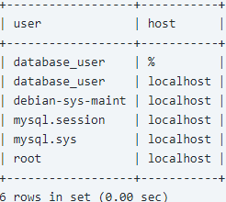
User Account Administration
List all MySQL user accounts
  SELECT user, host FROM mysql.user;
Delete MySQL user account
  DROP USER 'database_user@'localhost';
To find the privilege(s) granted to a specific MySQL user account type:
  SHOW GRANTS FOR 'database_user'@'localhost';

Slide 52
Working with NULLs
NULL means missing value or unknown value.
To test for NULL, you cannot use the arithmetic comparison operators, such as =, < or <>.
Rather, you must use the IS NULL and IS NOT NULL operators instead.
For example, to find all your dead pets (what a morbid example!)
select name from pet where death IS NOT NULL;
+--------+
| name |
+--------+
|Bowser|
+--------+

Slide 53
DISTINCT Statement
In a table, a column may contain many duplicate values; and sometimes you only want to list the different (distinct) values.
It removes duplicate rows from the result set.
It can be used only with SELECT statement.
The DISTINCT keyword can be used to return only distinct (different) values.
Syntax:-
SELECT DISTINCT column_name, column_name
FROM table_name;

Slide 54
DISTINCT Statement
SELECT DISTINCT Example
The following SQL statement selects only the distinct values from the "City" columns from the "Customers" table:
Example
SELECT DISTINCT City FROM Customers;

Slide 55
The SQL ORDER BY Keyword
The ORDER BY keyword is used to sort the result-set by one or more columns.
The ORDER BY keyword sorts the records in ascending order by default.
To sort the records in a descending order, you can use the DESC keyword.
If the ASC or DESC modifier is not provided in the ORDER BY clause, the results will be sorted by expression in ascending order.
SQL ORDER BY Syntax:-
SELECT column_name , column_name
FROM table_name
ORDER BY column_name , column_name ASC|DESC;

Slide 56
ORDER BY Example
The following SQL statement selects all customers from the "Customers" table, sorted by the "Country" column.
Example:-
SELECT * FROM Customers
ORDER BY Country;
The following SQL statement selects all customers from the "Customers" table, sorted DESCENDING by the "Country" column.
Example:-
SELECT * FROM Customers
ORDER BY Country DESC;

Slide 57
ORDER BY Several Columns Example
The following SQL statement selects all customers from the "Customers" table, sorted by the "Country" and the "CustomerName" column:
Example:-
SELECT * FROM Customers
ORDER BY Country, CustomerName;
The following SQL statement selects all customers from the "Customers" table, sorted ascending by the "Country" and descending by the "CustomerName" column:
Example:-
SELECT * FROM Customers
ORDER BY Country ASC, CustomerName DESC;

Slide 58
ORDER BY Several Columns Example
You can also use the MySQL ORDER BY clause to sort by relative position in the result set, where the first field in the result set is 1. The next field is 2, and so on.
Example:-
SELECT * FROM Customers
ORDER BY 2 DESC;

Slide 59
The GROUP BY Statement
The GROUP BY statement is used in conjunction with the aggregate functions to group the result-set by one or more columns.
You can use GROUP BY to group values from a column, and, if you wish, perform calculations on that column.
You can use COUNT, SUM, AVG, etc., functions on the grouped column.
It used for Groups records based on distinct value for specified columns.(create data set).
Group By and Having clauses act on set of records while order by and where clause act on individual records.
Example
SELECT column1,column2,….,aggregate function(argument)
FROM table_name
[WHERE conditions]
GROUP BY column1,column2,…,columnN;

Slide 60
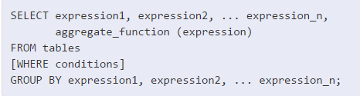
The GROUP BY Statement
expression1, expression2, ... expression_n
The expressions that are not encapsulated within an aggregate function and must be included in the GROUP BY clause.
aggregate_function
A function such as SUM, COUNT, MIN, MAX or AVG functions.
tables
The tables that you wish to retrieve records from. There must be at least one table listed in the FROM clause.
WHERE conditions
Optional. The conditions that must be met for the records to be selected.

Slide 61
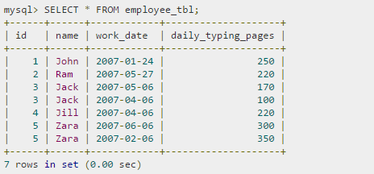
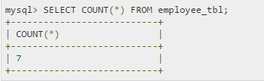
The GROUP BY Statement
To understand GROUP BY clause, consider an employee_tbl table, which is having the following records:
suppose based on the above table we want to count number of days each employee did work.

Slide 62
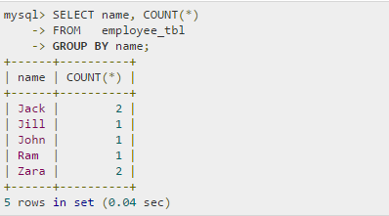
The GROUP BY Statement
This is not serving our purpose, we want to display total number of days work done by each person separately.
This is done by using aggregate functions in conjunction with a GROUP BY clause as follows.

Slide 63
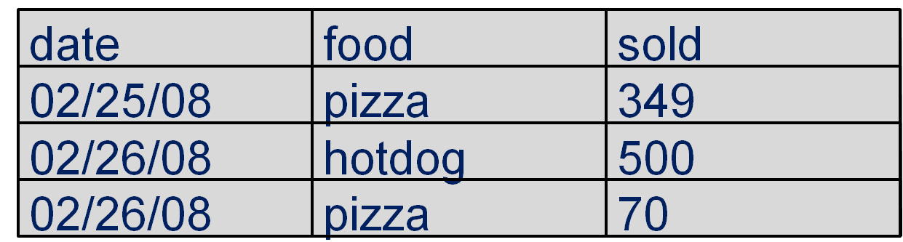
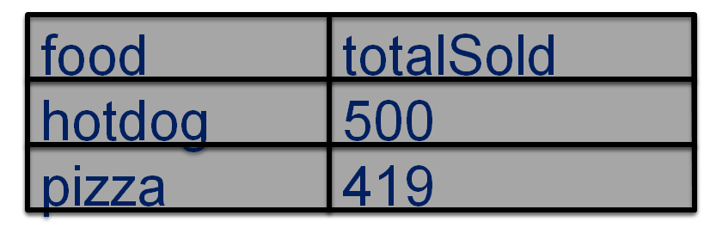
The GROUP BY EXAMPLE
we want to display total number of food sold by each food type separately.
SELECT food, sum(sold) as totalSold
FROM FoodCart group by food;

Slide 64
HAVING CLAUSE EXAMPLE
The MySQL HAVING clause is used in combination with the GROUP BY clause to restrict the groups of returned rows to only those whose the condition is TRUE.
The HAVING clause filters groups based on specific conditions.
WHERE clause filters rows(records) based on specific condition in that clause.
Each column specified in the HAVING clause must appear in the list of columns specified in the GROUP BY clause or within aggregate function.
The HAVING clause was added to SQL because the WHERE keyword could not be used with aggregate functions.
SELECT column1,column2,….,aggregate_function(argument)
FROM table_name
GROUP BY column1,column2,…,columnN
HAVING condition;

Slide 65
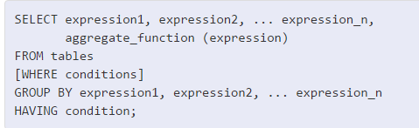
HAVING CLAUSE EXAMPLE
aggregate_function
A function such as SUM , COUNT , MIN , MAX , or AVG functions.
expression1, expression2, ... expression_n
The expressions that are not encapsulated within an aggregate function and must be included in the GROUP BY clause.
WHERE conditions
Optional. These are the conditions for the records to be selected.
HAVING condition
This is a further condition applied only to the aggregated results to restrict the groups of returned rows. Only those groups whose condition evaluates to TRUE will be included in the result set.

Slide 66
HAVING clause
This is not serving our purpose, we want to display total number of pages typed by each person separately having count >1.
This is done by using aggregate functions in conjunction with a GROUP BY and HAVING clause as follows.
Select name, count(*) from employee_tb1 GROUP BY name HAVING count(*)>1;
mysql> select name, count(*)
--> from employee_tb1
--> Group By name Having count(*)>1;
+-------+-----+
| name | count|
+-------+-----+
| jack | 2 |
| Zara | 2 |
+-------+------+

Slide 67
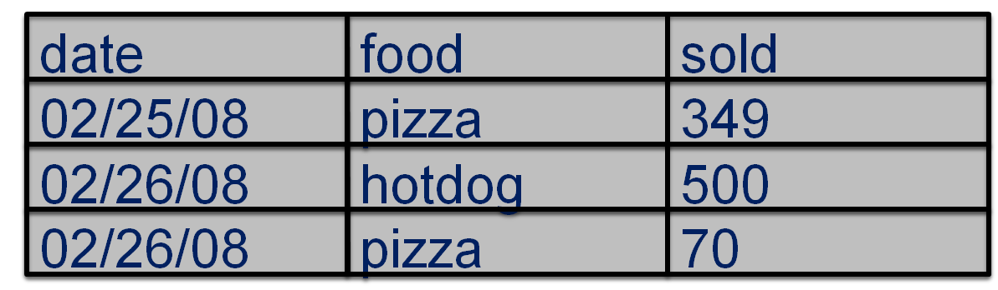
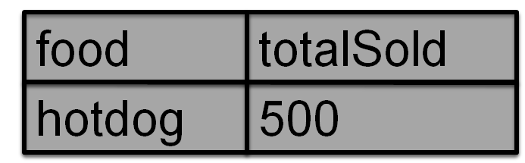
HAVING clause EXAMPLE
we want to display total number of food sold by each food type separately whose value >450.
SELECT food, sum(sold) as totalSold
FROM FoodCart group by food having sum(sold) > 450;

Slide 68
HAVING clause EXAMPLE
Ano | Bal | Bname
A01 | 5000 | VALSAD
A02 | 6000 | SURAT
A03 | 7000 | NAVSARI
A04 | 7500 | SURAT
A05 | 5000 | VALSAD
Display total balance of different accounts for each branch.
Select bname , sum(bal) “Total Balance” from account GROUP BY bname;
Display total balance of different accounts for surat branch.
Select bname , sum(bal) “Total Balance” from account GROUP BY bname HAVING bname= ‘surat’;
Display branch names and total balance for each branch having total balance greater than 10000.
Select bname , sum(bal) “Total Balance” from account GROUP BY bname HAVING sum(bal) >10000;

Slide 69
SQL VIEW
It is a virtual or logical table that allows to view or manipulate parts of tables.
It is derived from one or more tables known as base tables.
It looks like and works similarly to normal tables, but it does not have storage space to store data.
It is created by query.
It is dynamic and always reflect current data of base table.
A view is nothing more than a SQL statement that is stored in the database with an associated name.
A view is actually a composition of a table in the form of a predefined SQL query.
When any operation is performed on view, it is actually perform on base table.

Slide 70
Types of VIEW
There are two type of view.
Read only View
Updatable View
Read only view:-
Allow only select operations.
Data can only be viewed.
No insert, update and delete operations are allowed.
Updatable View:-
Allows select,insert,update and delete operations.
Contents of base table can be displayed and modified.

Slide 71
Creating VIEW
Syntax:-
CREATE[OR REPLACE] VIEW view_name
AS SELECT column1, column2…
FROM table_name WHERE [condition];
[READ ONLY WITH CHECK OPTION]
OR REPLACE :-(It is an Optional).
If you do not specify this clause and the VIEW already exists, the CREATE VIEW statement will return an error.
view_name:-
The name of the VIEW that you wish to create in MySQL.
WHERE conditions:- (It is an Optional).
The conditions that must be met for the records to be included in the VIEW.
WITH CHECK OPTION:-
to ensure that all UPDATE and INSERTs satisfy the condition(s) in the view definition.

Slide 72
View using single base table
Example:-
Create view acc2
as select * from account
where bname=‘VALSAD’;
This CREATE VIEW example would create a virtual table based on the result set of the SELECT statement.
Now we can perform query on view.
Example:-
Select * from acc2;

Slide 73
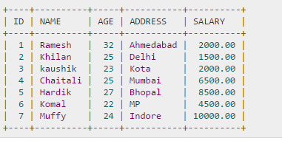
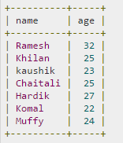
View using single base table
Consider the CUSTOMRS table having the following records
CREATE VIEW CUSTOMERS_VIEW
AS SELECT name, age FROM CUSTOMERS;
SELECT * FROM CUSTOMERS_VIEW;

Slide 74
View using single base table
CREATE VIEW CUSTOMERS_VIEW
AS SELECT name, age FROM CUSTOMERS
WHERE age IS NOT NULL WITH CHECK OPTION;
The WITH CHECK OPTION in this case should deny the entry of any NULL values in the view's AGE column, because the view is defined by data that does not have a NULL value in the AGE column.

Slide 75
View using multiple base table
Example:-
Create view acc3
as select ano , balance, account.bname Branch, baddress from account ,Branch
where account.bname= Branch.bname;
Select * from acc3;
Ano | Bal | Bname
A01 | 5000 | VALSAD
A02 | 6000 | SURAT
A03 | 7000 | NAVSARI
A04 | 7500 | SURAT
Bname | Baddress
VALSAD | Mota bazaar,Valsad
SURAT | Varacha,Surat
NAVSARI | Lalgate,Navsari

Slide 76
Updating a View
A view can be updated under certain conditions:
The SELECT clause may not contain the keyword DISTINCT.
The SELECT clause may not contain summary functions.
The SELECT clause may not contain set functions.
The SELECT clause may not contain set operators.
The SELECT clause may not contain an ORDER BY clause.
The FROM clause may not contain multiple tables.
The WHERE clause may not contain sub queries.
The query may not contain GROUP BY or HAVING.
Calculated columns may not be updated.
All NOT NULL columns from the base table must be included in the view in order for the INSERT query to function.

Slide 77
Updating and Dropping a View
UPDATE CUSTOMERS_VIEW
SET AGE = 35 WHERE name='Ramesh';
This would ultimately update the base table CUSTOMERS and same would reflect in the view itself.
Rows of data can be deleted from a view. The same rules that apply to the UPDATE and INSERT commands apply to the DELETE command.
DELETE FROM CUSTOMERS_VIEW WHERE age = 22;
This would ultimately delete a row from the base table CUSTOMERS and same would reflect in the view itself.
Dropping a view:-
Syntax:-
DROP VIEW view_name;
Example:-
DROP VIEW CUSTOMERS_VIEW;

Slide 78
Purpose/ Advantages of VIEW
It simplifies the access of certain data.
It allows hiding of certain pieces of data from unauthorized users.
It restricts access to the data such that a user can see and modify exactly what they need.
You can protect sensitive data within a table.
It allows summarizing data from various tables which can be used to generate reports.
Used to enforce security in flexible way and to simplify complex queries.

Slide 79
Few CREATE system privileges are listed below:
System Privileges | Description
CREATE ANY object | allows users to create the specified object in any schema.
CREATE object | Allows users to create the specified object in their own schema.
The above rules also apply for ALTER and DROP system privileges.

Slide 80
Few of the object privileges are listed below:
Object Privileges | Description
INSERT | allows users to insert rows into a table.
SELECT | allows users to select data from a database object.
UPDATE | allows user to update data in a table.
EXECUTE | allows user to execute a stored procedure or a function.

Slide 81
Roles
Roles are a collection of privileges or access rights. When there are many users in a database it becomes difficult to grant or revoke privileges to users. Therefore, if you define roles, you can grant or revoke privileges to users, thereby automatically granting or revoking privileges. You can either create Roles or use the system roles pre-defined by oracle.

Slide 82
Some of the privileges granted to the system roles are as given below:
System Role | Privileges Granted to the Role
CONNECT | CREATE TABLE, CREATE VIEW, CREATE SYNONYM, CREATE SEQUENCE, CREATE SESSION etc.
RESOURCE | CREATE PROCEDURE, CREATE SEQUENCE, CREATE TABLE, CREATE TRIGGER etc. The primary usage of the RESOURCE role is to restrict access to database objects.
DBA | ALL SYSTEM PRIVILEGES

Slide 83
Creating Roles:
The Syntax to create a role is:
CREATE ROLE role_name
[IDENTIFIED BY password];
For Example: To create a role called "developer" with password as "pwd",the code will be as follows
CREATE ROLE testing
[IDENTIFIED BY pwd];

Slide 84
For example: To grant CREATE TABLE privilege to a user by creating a testing role:
First, create a testing Role
CREATE ROLE testing
Second, grant a CREATE TABLE privilege to the ROLE testing. You can add more privileges to the ROLE.
GRANT CREATE TABLE TO testing;
Third, grant the role to a user.
GRANT testing TO user1;
To revoke a CREATE TABLE privilege from testing ROLE, you can write:
REVOKE CREATE TABLE FROM testing;
The Syntax to drop a role from the database is as below:
DROP ROLE role_name;
For example: To drop a role called developer, you can write:
DROP ROLE testing;

