Slide 1


3140702
Operating System
Unit-9
Shell Script

Slide 2
Shell Script
Script is a sequence of commands written as plain text and run by an interpreter (shell).
A shell script is a computer program designed to be run by the Unix/Linux shell which could be one of the following:
The Bourne Shell
The C Shell
The Korn Shell
The GNU Bourne-Again Shell

Slide 3
Shell Script - Cont.…
The prompt, $, which is called the command prompt, is issued by the shell. While the prompt is displayed, you can type a command.
The shell interprets commands the user types and manages their execution.
A shell is a command-line interpreter and typical operations performed by shell scripts include file manipulation, program execution, and printing text.

Slide 4
Steps to write and execute a shell script
Create a file using a vi editor(or any other editor like gedit).
Name script file with extension .sh
Write some code.
Save the script file as filename.sh
For executing the script type bash filename.sh

Slide 5
Shell Variables
The user variable name can be any sequence of letters, digits, and the underscore character, but the first character must be a letter.
To assign a value to a variable:
number=25
name=“abc"
There cannot be any space before or after the “=“
Internally, all values are stored as strings.
To use a variable, precede the name with a “$”.
num=3
a=$num

Slide 6
User input in Shell Script
The read command allows a user to provide the runtime input.
shell allows to prompt for user input.
Syntax:
read varname [more vars]
Value entered by user is assigned to varname
Run shell script :
bash filename.sh

Slide 7
Operators
Arithmetic Operators
Bash Operator | Operator | Description
+ | + | Addition
- | - | Subtraction
\* | * | Multiplication
/ | / | Division
% | % | Modulus
Assignment Operators
= | = | Assigns right operand in left operand i.e. a=$b

Slide 8
Operators
Relational Operators – for Numeric
Bash Operator | Operator | Description
-eq | == | Equal
-ne | != | Not equal
-gt | > | Greater than
-ge | >= | Greater than or equal
-lt | < | Less than
-le | <= | Less than or equal
-z | == null | Is null

Slide 9
Operators
Relational Operators – for String
Bash Operator | Operator | Description
= or == | == | Equal
!= | != | Not equal
str1 < str2 | < | str1 is less than str2
str1 > str2 | > | str1 is greater str2

Slide 10
Operators
Boolean Operators
Bash Operator | Operator | Description
! | ! | This is logical negation.
-o | OR | This is logical OR.
-a | AND | This is logical AND.
String Operators
Bash Operator | Operator | Description
= | = | Checks if the value of two operands are equal or not
!= | != | If values are not equal then the condition becomes true.

Slide 11
Arithmetic Operator Example (e.g. a=10, b=20)
Operator | Description | Example
+ (Addition) | Adds values on either side of the operator | `expr $a + $b` will give 30
- (Subtraction) | Subtracts right hand operand from left hand operand | `expr $a - $b` will give -10
* (Multiplication) | Multiplies values on either side of the operator | `expr $a \* $b` will give 200
/ (Division) | Divides left hand operand by right hand operand | `expr $b / $a` will give 2
% (Modulus) | Divides left hand operand by right hand operand and returns remainder | `expr $b % $a` will give 0
= (Assignment) | Assigns right operand in left operand | a = $b assign value of b into a
== (Equality) | Compares two numbers, if both are same then returns true. | [ $a == $b ] would return false.
!= (Not Equality) | Compares two numbers, if both are different then returns true. | [ $a != $b ] would return true.

Slide 12
Relational Operator Example (e.g. a=10, b=20)
Operator | Description | Example
-eq | Checks if the value of two operands are equal or not; if yes, then the condition becomes true. | [ $a -eq $b ] is not true.
-ne | Checks if the value of two operands are equal or not; if values are not equal, then the condition becomes true. | [ $a -ne $b ] is true.
-gt | Checks if the value of left operand is greater than the value of right operand; if yes, then the condition becomes true. | [ $a -gt $b ] is not true.
-lt | Checks if the value of left operand is less than the value of right operand; if yes, then the condition becomes true. | [ $a -lt $b ] is true.
-ge | Checks if the value of left operand is greater than or equal to the value of right operand; if yes, then the condition becomes true. | [ $a -ge $b ] is not true.
-le | Checks if the value of left operand is less than or equal to the value of right operand; if yes, then the condition becomes true. | [ $a -le $b ] is true.

Slide 13
Boolean Operator Example (e.g. a=10, b=20)
Operator | Description | Example
! | This is logical negation. This inverts a true condition into false and vice versa. | [ ! false ] is true.
-o | This is logical OR. If one of the operands is true, then the condition becomes true. | [ $a -lt 20 -o $b -gt 100 ] is true.
-a | This is logical AND. If both the operands are true, then the condition becomes true otherwise false. | [ $a -lt 20 -a $b -gt 100 ] is false.

Slide 14
String Operator Example (e.g. a=“abc”, b=“efg”)
Operator | Description | Example
= | Checks if the value of two operands are equal or not; if yes, then the condition becomes true. | [ $a = $b ] is not true.
!= | Checks if the value of two operands are equal or not; if values are not equal then the condition becomes true. | [ $a != $b ] is true.
-z | Checks if the given string operand size is zero; if it is zero length, then it returns true. | [ -z $a ] is not true.
-n | Checks if the given string operand size is non-zero; if it is nonzero length, then it returns true. | [ -n $a ] is not false.
str | Checks if str is not the empty string; if it is empty, then it returns false. | [ $a ] is not false.

Slide 15

expr Command
The expr command in Unix evaluates a given expression and displays its corresponding output.
It is used for:
Basic operations like addition, subtraction, multiplication, division, and modulus on integers.
Evaluating regular expressions, string operations like substring, length of strings etc.
Syntax : expr EXPRESSION
Backtick
num1=10
num2=20
sum=`expr $num1 + $num2`
echo $sum
output: 30
$ expr 3 + 5
output:
8
$ expr 3 \* 5
output:
15
sum=`expr $num1 + $num2`

Slide 16
if Statement
If statements use the if, then, else, and fi keywords.
The condition goes in square brackets.
Syntax :
if [ <some test> ] then <commands> fi
if [ $no -gt 100 ]
then
echo "Greater than 100"
fi
The spaces before and after the square brackets
[ ] are required.

Slide 17
if Statement
if [ $a -gt $b ]
then
echo “A is Greater than B"
fi
if [ $a -ne $b ]
then
echo “A is not eqal to B"
fi
if [ `expr $mid1_total + $mid2_total` -gt 50 ]
then
echo “Total Marks is Greater than 50"
fi

Slide 18
if…else Statement
if [control command]
then
<statements-1>
else
<statements-2>
fi
if [ $a -eq $b ]
then
echo "a is equal to b"
else
echo "a is not equal to b"
fi
executes statements-1 if condition is true
executes statements-2 if condition is false

Slide 19
Nested if-else-fi Statement
if [control command]
then
if [control command]
then
<statements>
else
<statements>
fi
else
<statements>
fi

Slide 20
if-else-if ladder
if [control command]
then
<statements>
elif [control command]
then
<statements>
elif [control command]
then
<statements>
else
<statements>
fi
The word elif stands for “else if”
It is part of the if statement and cannot be used by itself

Slide 21
if-else-if ladder Example
if [ $i -eq 5 ]
then
echo "Value of i is 5"
elif [ $i -eq 10 ]
then
echo "Value of i is 10"
elif [ $i -eq 20 ]
then
echo "Value of i is 20"
elif [ $i -eq 30 ]
then
echo "Value of i is 30"
else
echo "Value of i is not equal to 5,10,20 or 30"
fi

Slide 22
case Structure
Use the case statement for a decision that is based on multiple choices.
case $word in
pattern1) c
ommand-list1
;;
pattern2)
command-list2
;;
patternN)
command-listN
;;
*)
;;
esac
echo "Enter number:"
read num
case $num in
1)
echo "It's one!"
;;
2)
echo "It's two!"
;;
3)
echo "It's three!"
;;
*)
echo "It's something else!"
;;
esac

Slide 23
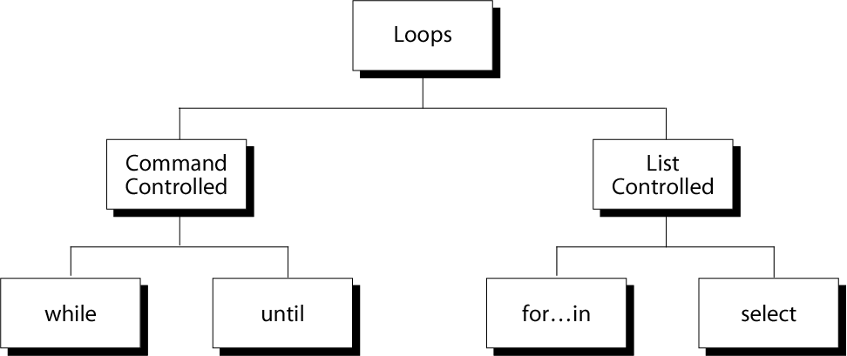
Repetition Constructs

Slide 24
while loop
Syntax:
while [ condition ]
do
command1
command2
…..
.....
done
The while construct tests for a condition, and if true, executes commands.
It keeps looping as long as the condition is true.
i=1
while [ $i -le 10 ]
do
echo “$i”
i=`expr $i + 1`
done

Slide 25
until loop
Syntax:
until [ condition ]
do
command1
command2
…..
.....
done
The until construct tests for a condition, and if false, executes commands.
It keeps looping as long as the condition is false (opposite of while construct)
COUNT=1
until [ $COUNT -gt 5 ];
do
echo "Value of count is: $COUNT"
COUNT=$(($COUNT + 1))
done

Slide 26
for loop using “in” and list of values
for arg in list
do
command(s)
...
done
Where the value of the variable arg is set to the values provided in the list one at a time and the block of statements executed.
This is repeated until the list is exhausted.
for i in 1 2 3 4 5
do
echo "Looping ... number $i"
done

Slide 27
for loop using C like Syntax
for ((initialization; condition test; increment or decrement))
do
//statements to be executed repeatedly
done
for((i=1; i<=5; i++))
do
echo $i
done

Slide 28
select loop
select variableName in choice1 choice2 ... choiceN
do
-- Block of Commands –
done
Select command use PS3 variable to print its prompt.
Each word in list is printed on screen preceded by a number.
If the line consists of the number corresponding to one of the displayed words (from the list), then varName is set to that word. You can use if..else.fi or case..in..esac to make a decision.
If the line is empty, WORDS and the prompt are redisplayed.
If EOF (end of file) is read, the command completes.
The loop continues until a break (CTRL+C) is encountered.

Slide 29
select loop Example
echo "Enter space shuttle to get more information : "
# set shuttle list
select shuttle in Columbia Endeavour Challenger Discovery
do
echo "$shuttle selected"
done
Output:
Enter the space shuttle to get more information :
1) Columbia
2) Endeavor
3) Challenger
4) Discovery
#? 1
Columbia selected
#?

Slide 30
Break and Continue Statement
All statement inside the loop executed as long as some condition are true.
If break placed inside the loop, when loop reach the break statement it will terminated out from the loop.
If continue placed inside the loop, when loop reach the continue statement it will not execute next lines of the loop and it will go to the next iteration.

Slide 31
Break and Continue Statement
break statement
continue statement
while [ condition ]
do
cmd-1
break
cmd-n
done
echo "done"
while [ condition ]
do
cmd-1
continue
cmd-n
done
echo "done"
This iteration is over and there are no more iterations
This iteration is over, do the next iteration

Slide 32




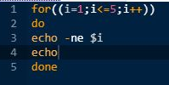
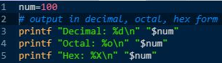
echo and printf Command
echo Command
printf Command
1
2
3
4
5
12345
1
2
3
4
5
12345
1
2
3
4
5
Decimal: 100
Octal: 144
Hex: 64

Slide 33
Average of 4 numbers using bc Command
a=10
b=2
c=12
d=5
sum=$(( a + b + c + d))
avg=`echo $sum / 4 | bc –l`
printf %0.3f “$avg”
OUTPUT :
7.250

Slide 34
Division using bc Command
# get the first number
printf "Enter first integer number: "
read a
# get the second number
printf "Enter second integer number: "
read b
# if b is 0
if [ $b == 0 ]
then
printf "Division by 0 not allowed.\n"
exit # exit the script
fi
# perform division
result=`expr "$a / $b" | bc -l`
printf "%d / %d = %.5f\n" "$a" "$b" "$result"

Slide 35


