Slide 1

Shree shambhubhai v. patel college of Computer science and business management
Title:- Google Play Store Data Analysis
Submitted By ;-
491– Pambhar Krishna B.
521 - Raval Charmi J.
522 – Rokad Laxmi R.
Course: TYBCA semester 6
Submitted To: Asst. Prof. Dharni
Academic Year: 2024- 2025

Slide 2
Introduction
Google Play Store contains millions of applications across different categories. Data analysis helps understand:
App popularity
User engagement
Rating patterns
Installation trends
This project analyzes Google Play Store data using Python visualization and machine learning techniques.

Slide 3
Objectives
Main Objectives
Analyze Google Play Store dataset
Perform data visualization
Identify relationships between rating, installs and reviews
Apply machine learning model
Create an interactive Streamlit dashboard

Slide 4
Tools & Technologies
Programming Language
Python
Libraries Used
Pandas
Numpy
Matplotlib
Seaborn
Scikit-learn
Streamlit

Slide 5
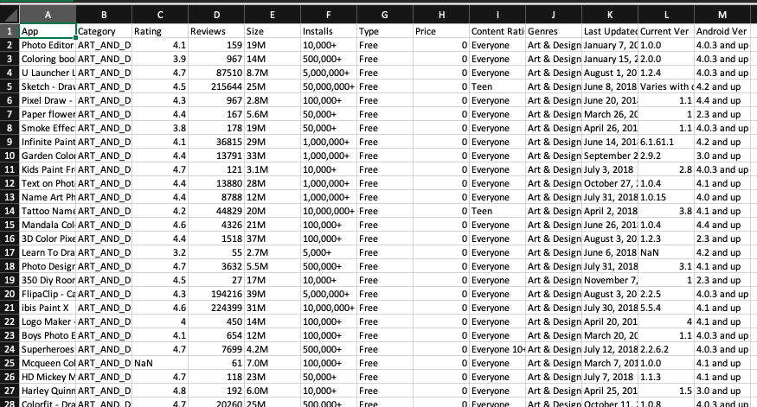
Dataset Description
Dataset: Google Play Store Dataset
Main attributes used:
App
Category
Rating
Reviews
Installs
Type
Content Rating

Slide 6
Data Cleaning
Converted Rating column to numeric
Converted Reviews column to numeric
Removed "+" and "," from Installs
Filled missing values using median

Slide 7
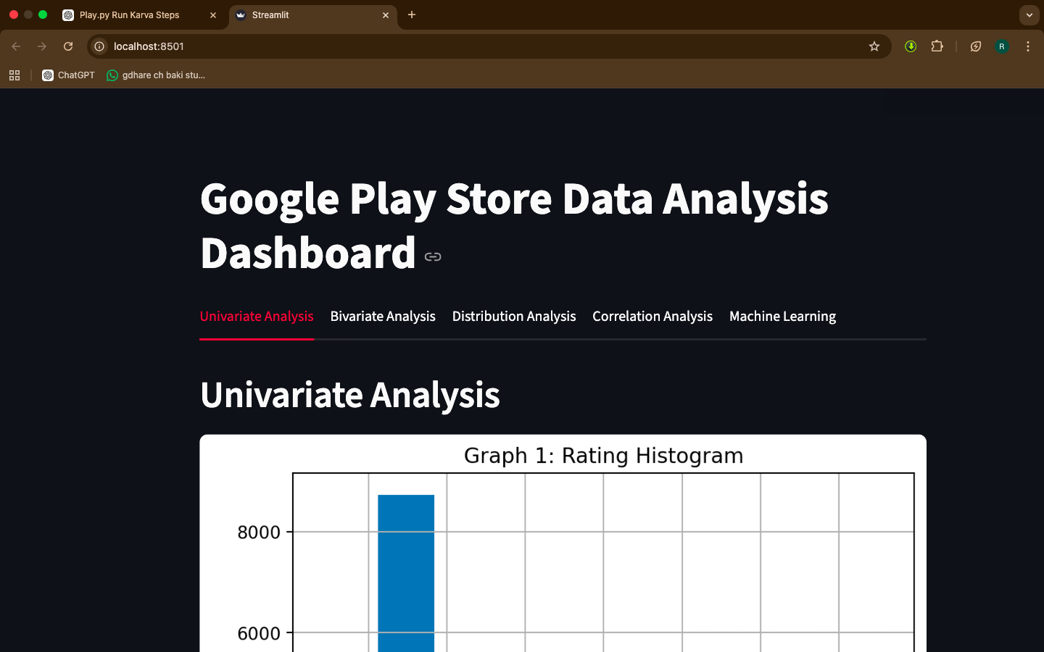
Dashboard Structure
Dashboard contains 5 Analysis Tabs
1️⃣ Univariate Analysis 2️⃣ Bivariate Analysis 3️⃣ Distribution Analysis 4️⃣ Correlation Analysis 5️⃣ Machine Learning
Total Graphs: 42

Slide 8
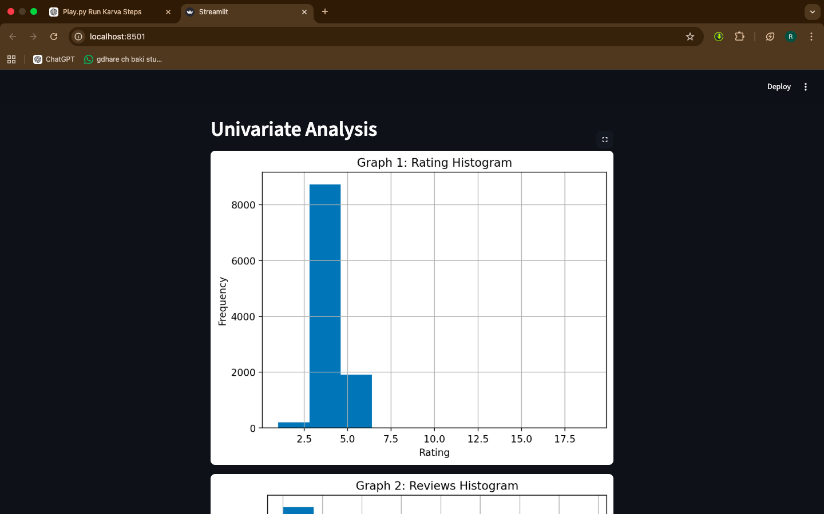
Univariate Analysis
Rating Histogram
Reviews Histogram
Installs Histogram
Category Bar Chart
Content Rating Chart
Total Graphs: 15

Slide 9
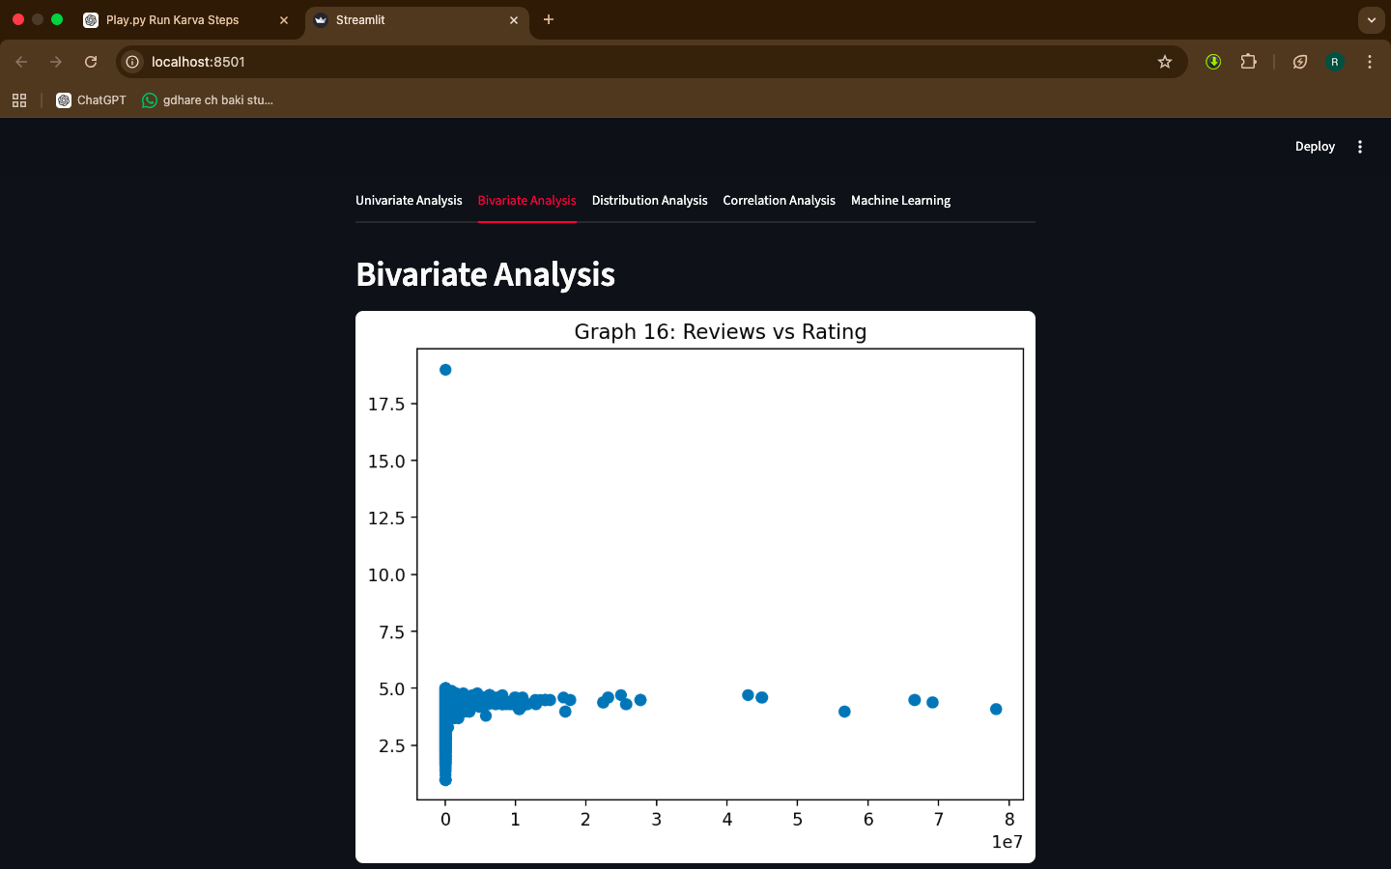
Bivariate Analysis
Bivariate analysis studies relationship between two variables.
Reviews vs Rating
Installs vs Rating
Installs vs Reviews
Rating by Category
Total Graphs: 14

Slide 10
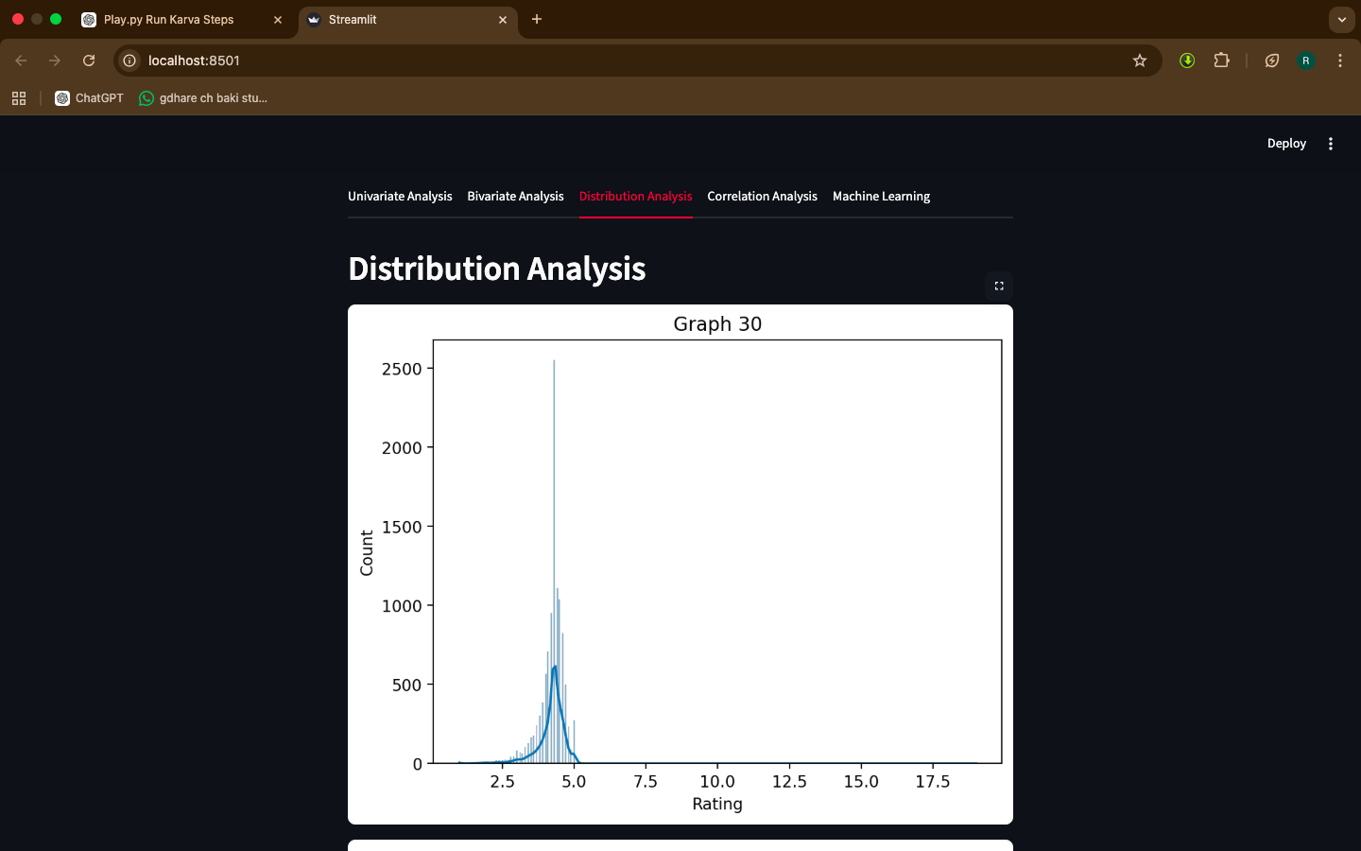
Distribution Analysis
Shows how data values are distributed
Techniques used:
Histogram
KDE plot
Boxplot
Total Graphs: 4

Slide 11
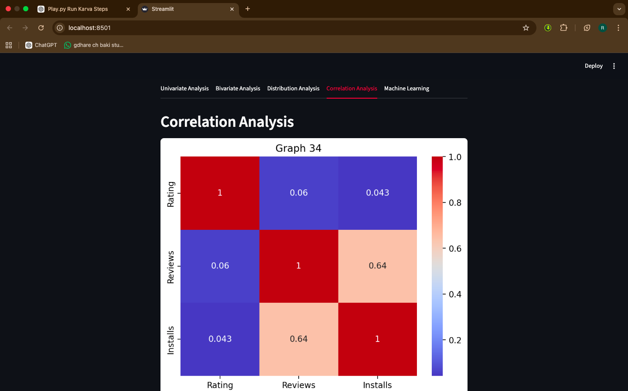
Correlation Analysis
Correlation shows relationship between variables.
Heatmap is used to visualize correlation between:
Rating
Reviews
Installs

Slide 12
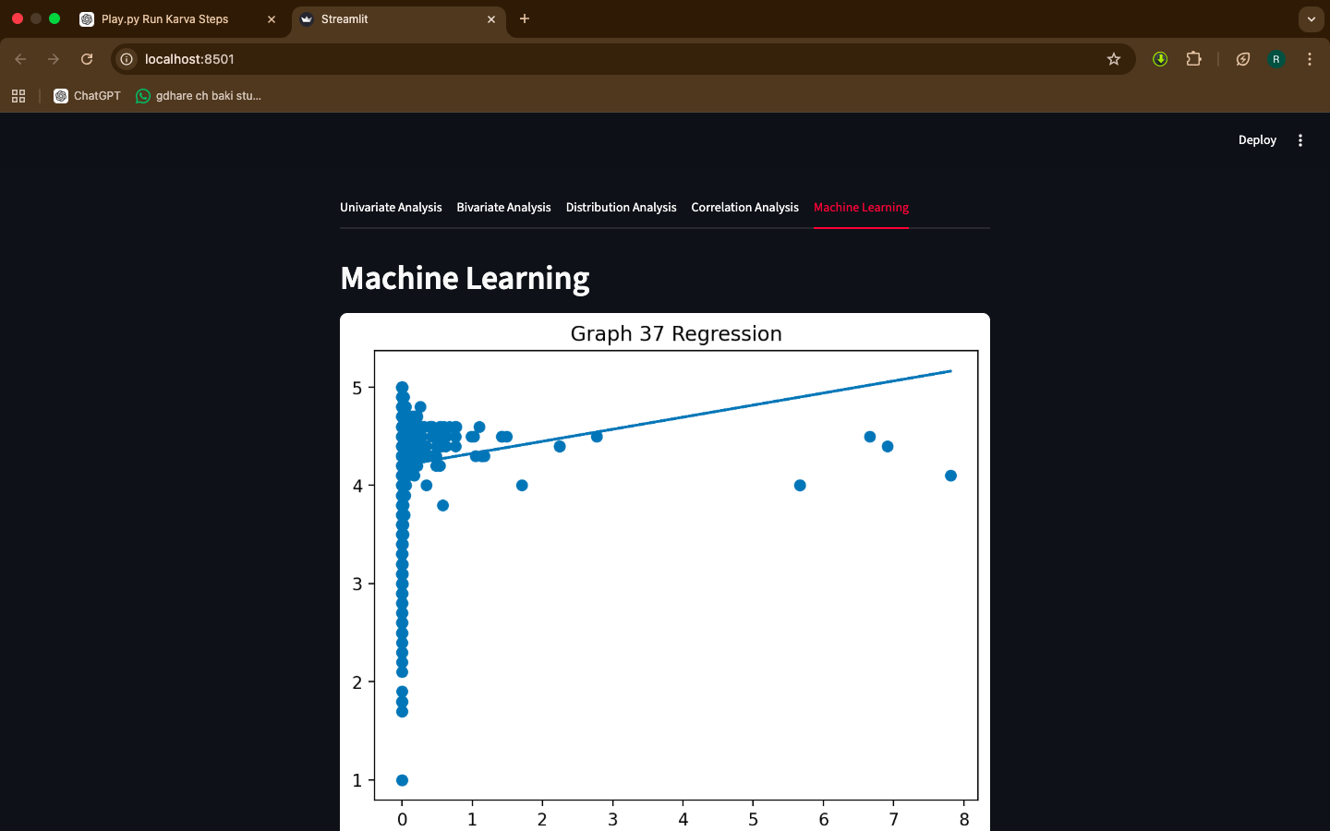
Machine Learning
Machine learning techniques used:
Linear Regression
Predict Rating based on Reviews
K-Means Clustering
Group applications based on:
Reviews
Installs
Total Graphs: 6

Slide 13
Result
Key observations:
Higher installs often lead to higher reviews
Popular apps have better ratings
Categories like Games and Tools have high installs

Slide 14
Conclusion
This project demonstrates how data visualization and machine learning can be used to analyze mobile application data.
The interactive dashboard helps users explore insights easily.

