Slide 1


FRUIT MONITORING
SYSTEM
Manujendra(B20CS035)
Krishna (B22EE090)
Mentor - Dr. Arpit Khandelwal

Slide 2
1
BACKGROUND
>There is always an issue on identifying rot on fruits and their hygiene. Hence there is a need of making of a system that can identify when the rot on the fruit has started for further alerting the people after learning when the fruits have started to rot.
IIT Jodhpur | 2024

Slide 3
2
PROBLEM STATEMENT
-> A Prototype system which detects ripening of the fruits through gas sensors.
-> captures images of the fruits to be monitored
Future Application :
-> These images can be used in a deep learning model for identifying rot in fruits and alerting the user.
IIT Jodhpur | 2024

Slide 4
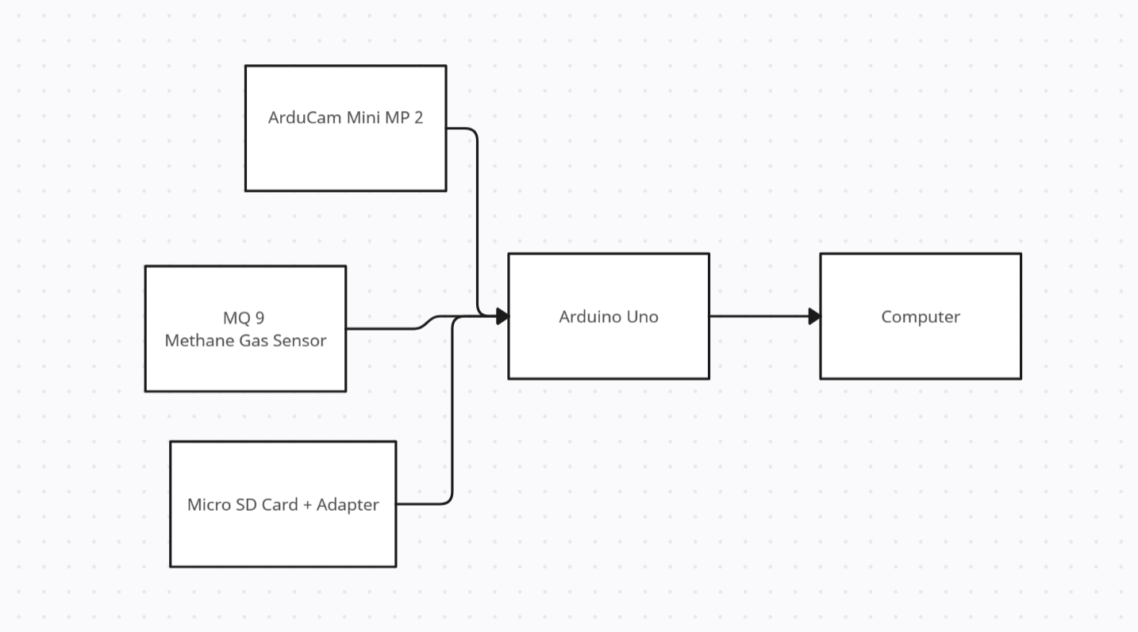
3
BLOCK DIAGRAM
IIT Jodhpur | 2024

Slide 5
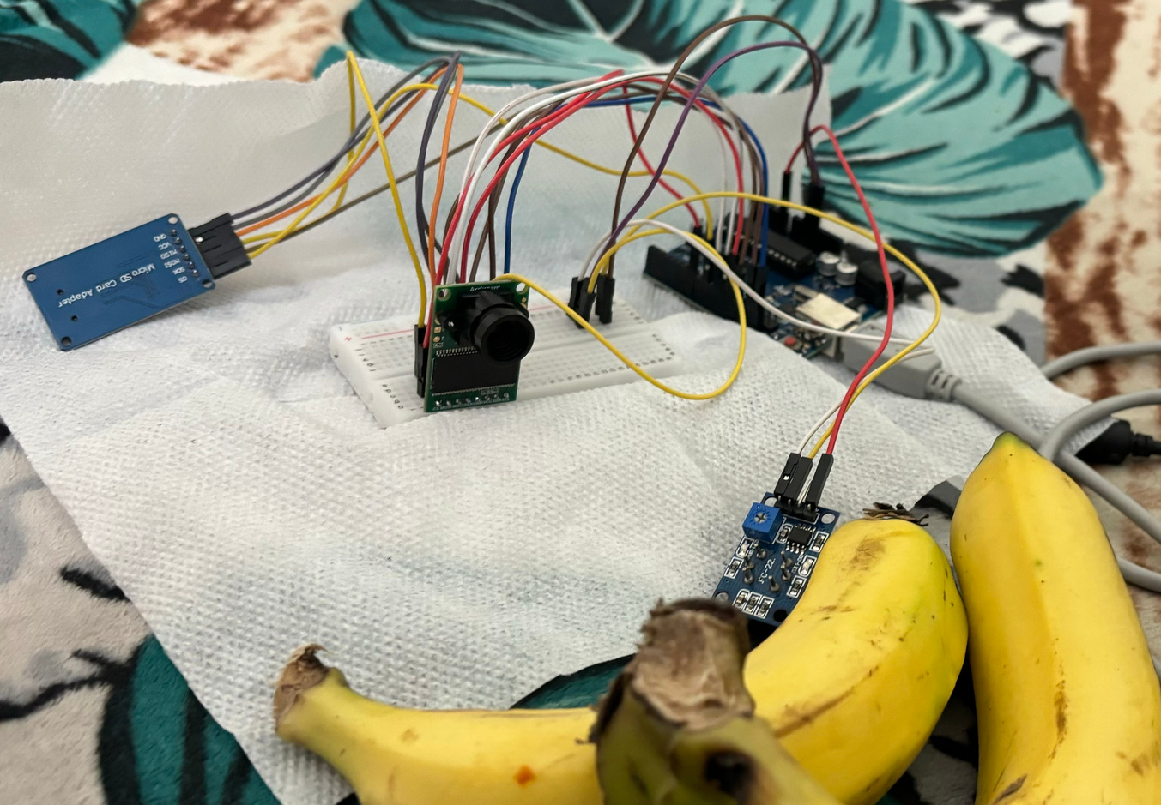
4
PROTOTYPE
We are running code in Arduino IDE with the appropriate libraries and functions for capturing image when the concentration for the methane goes above 32% and stores them in the SD card.
IIT Jodhpur | 2024

Slide 6
5
COMPONENTS
-> Arduino Uno Board
-> Micro SD Card Adapater + Micro SD Card
-> MQ -9 Gas Sensor
-> Bread board
IIT Jodhpur | 2024

Slide 7
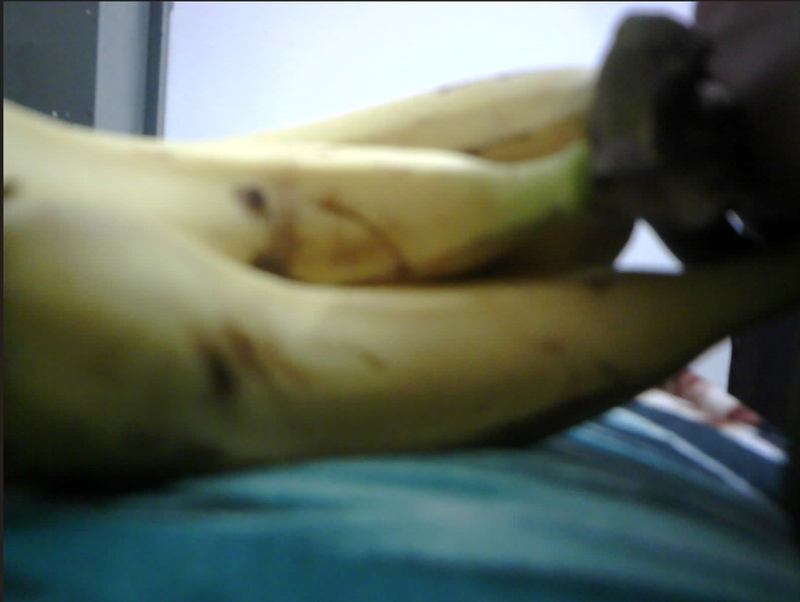
6
DEMO
-> Prototype has been run on an arduino with earlier mentioned components with the code provided on a computer.
This is the demo image captured during the
taking of demo.
IIT Jodhpur | 2024

Slide 8
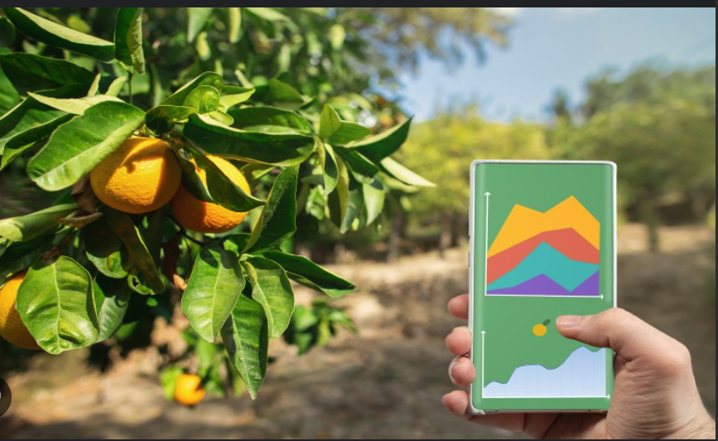
7
FUTURE SCOPE OF WORK
Deep Learning Model
A deep learning model trained for recognizing rotten fruits based on the images captured
IIT Jodhpur | 2024
Alerting System
An alert form of system which would work for sending alert to the user when finding a rotten fruit.

Slide 9
8
REFERENCES
IIT Jodhpur | 2024

Slide 10
Thank you

