Slide 1
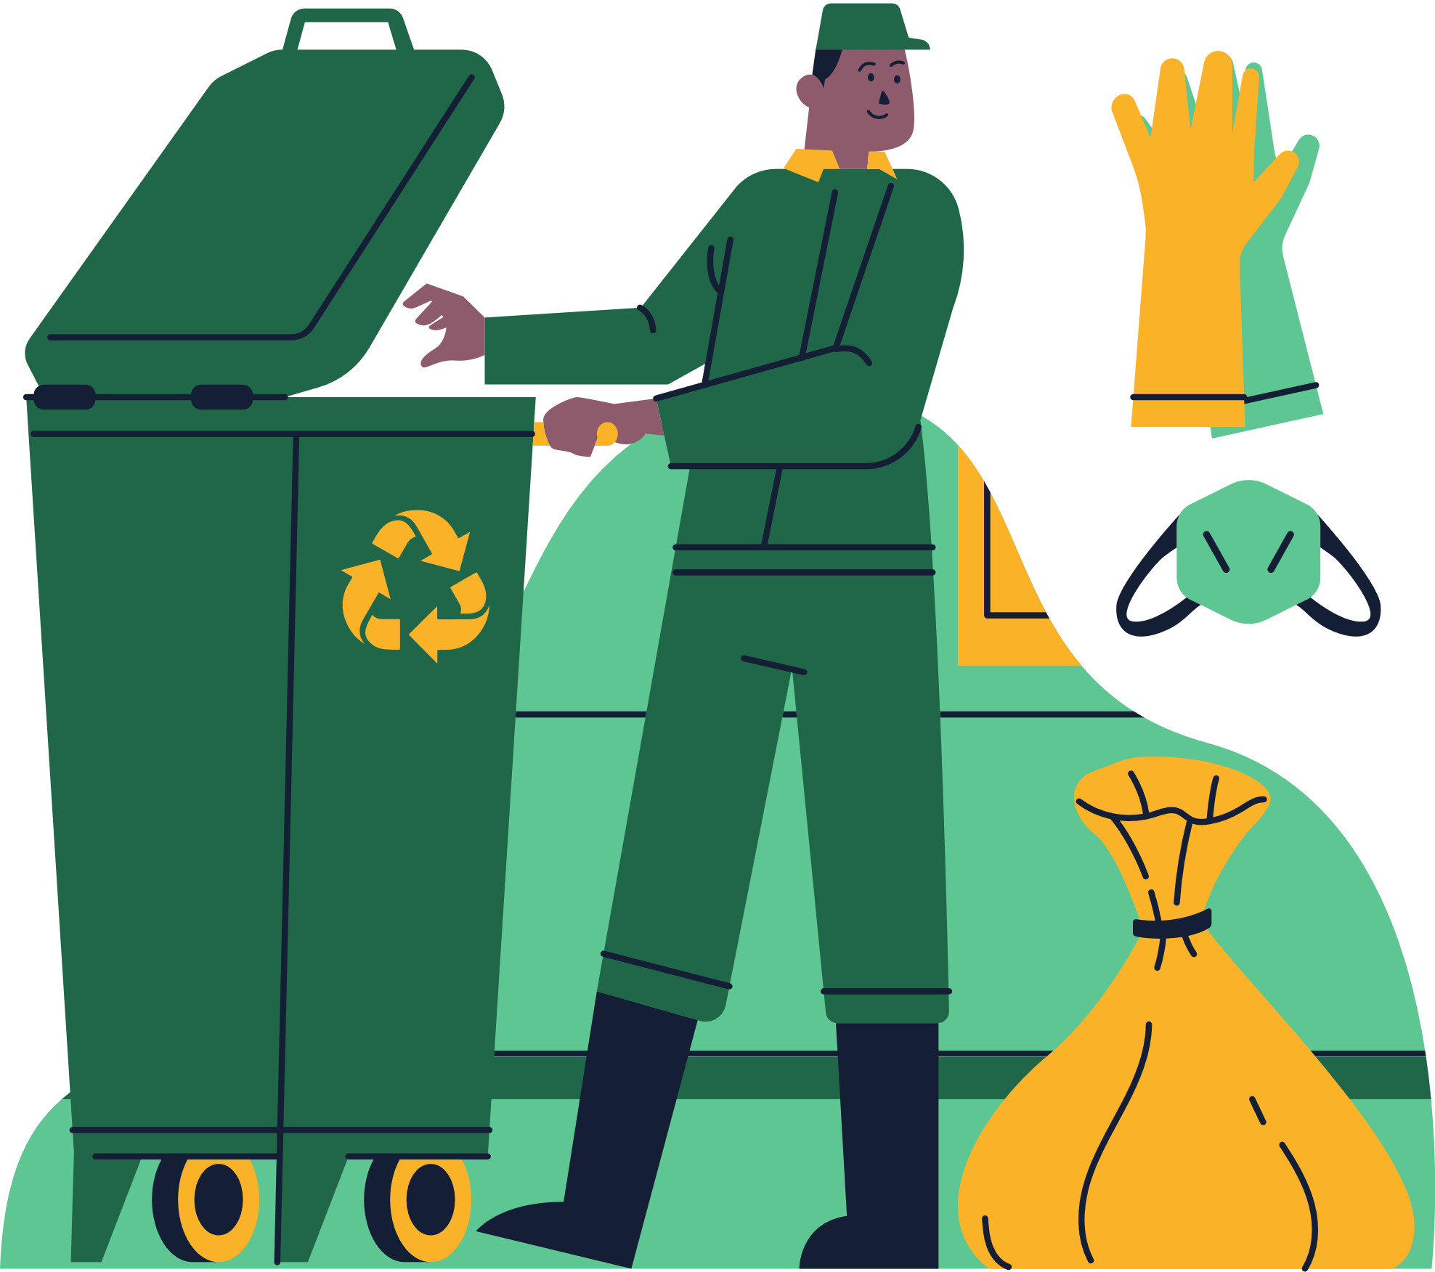
EcoSort
01

Slide 2
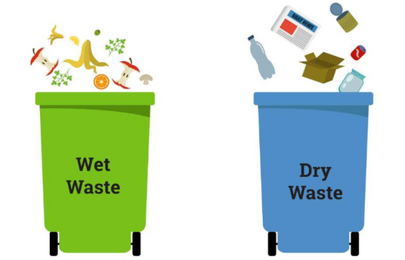
Problem Statement
If waste is not adequately segregated, it will end up disorganized in landfills just as it is in our trash bins.
Food scraps, paper, and liquid waste can combine and decay, releasing toxic gas into the environment and runoff into the soil.
02

Slide 3
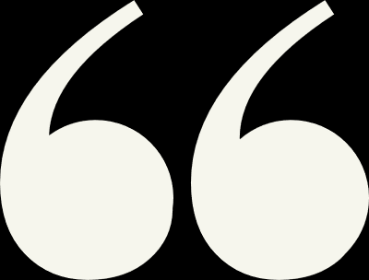
Proposed Solution
CREATE A SMART GARBAGE COLLECTING SYSTEM THAT WILL AUTOMATICALLY SEPARATE THE VARIOUS KINDS OF SOLID WASTE THAT ARE DISPOSED OF, ALLOWING MUNICIPAL AUTHORITIES TO DEAL WITH THE WASTE MORE EFFICIENTLY. THE SYSTEM WILL BE A PHYSICAL DEVICE THAT SEPARATES THE GARBAGE.
03

Slide 4

TECHSTACK
Internet Of Things
Segregating waste with the help of IoT devices requires a combination of sensor and automated process.
Components Needed:
IoT Hardware Platform
Moisture Sensors
Weight Sensors
Gas Sensors
Actuators
Internet connectivity
04

Slide 5
How is our idea unique?
SINCE THE BASIC SEGREGATION WAS ONLY BETWEEN DRY AND WET WASTE SO WE WILL BE SORTING OUT THE WASTE BASED ON HAZARDOUS, BIOMEDICAL AND MUNICIPAL WASTE FURTHER ON THE BASIS OF THEIR SOLIDITY.
05

Slide 6
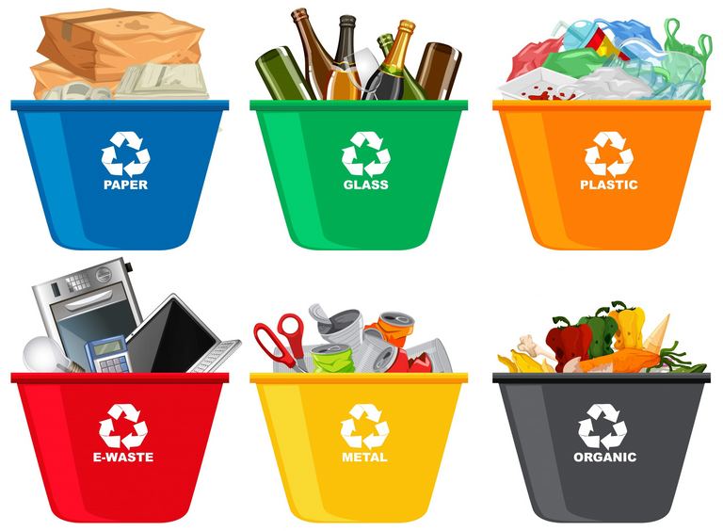
Architecture Of Idea
06
IT READS MOISTURE, WEIGHT VALUES AND GASEOUS COMPONENTS VIA THE SENSORS.
It checks whether the waste is moisture waste based on predefined thresholds for moisture and weight and on the basis of the acidity of the gases.
If moisture waste is detected, it activates the relay (simulating separation); otherwise, it deactivates the relay.

