Slide 1
SE-CURE Tuberculosis
Tuberculosis (TB) is a potentially fatal contagious disease that can affect almost any part of the body but is mainly an infection of the lungs.

Slide 2
Unfortunately..
India accounts for the highest burden of TB According to the World Health Organisation (WHO) TB stats for India
In 2017 there were a total of 1,600,000 TB related deaths.
Also an estimated 234,000 children died of TB in 2017 including children with HIV associated TB.
Estimated burden of TB 2016 are as follows:
Estimates of TB burden (2016) | Number | Rate per 100,000 population
Incidence of TB cases (includes HIV +TB) | 2.790 million | 211
Incidence ( HIV +TB) | 87000 | 6.6
Incidence (MDR/RR-TB) | 147000 | 11
Mortality (excludes HIV+TB) | 423000 | 32
Mortality (HIV + TB only) | 12000 | 0.92

Slide 3
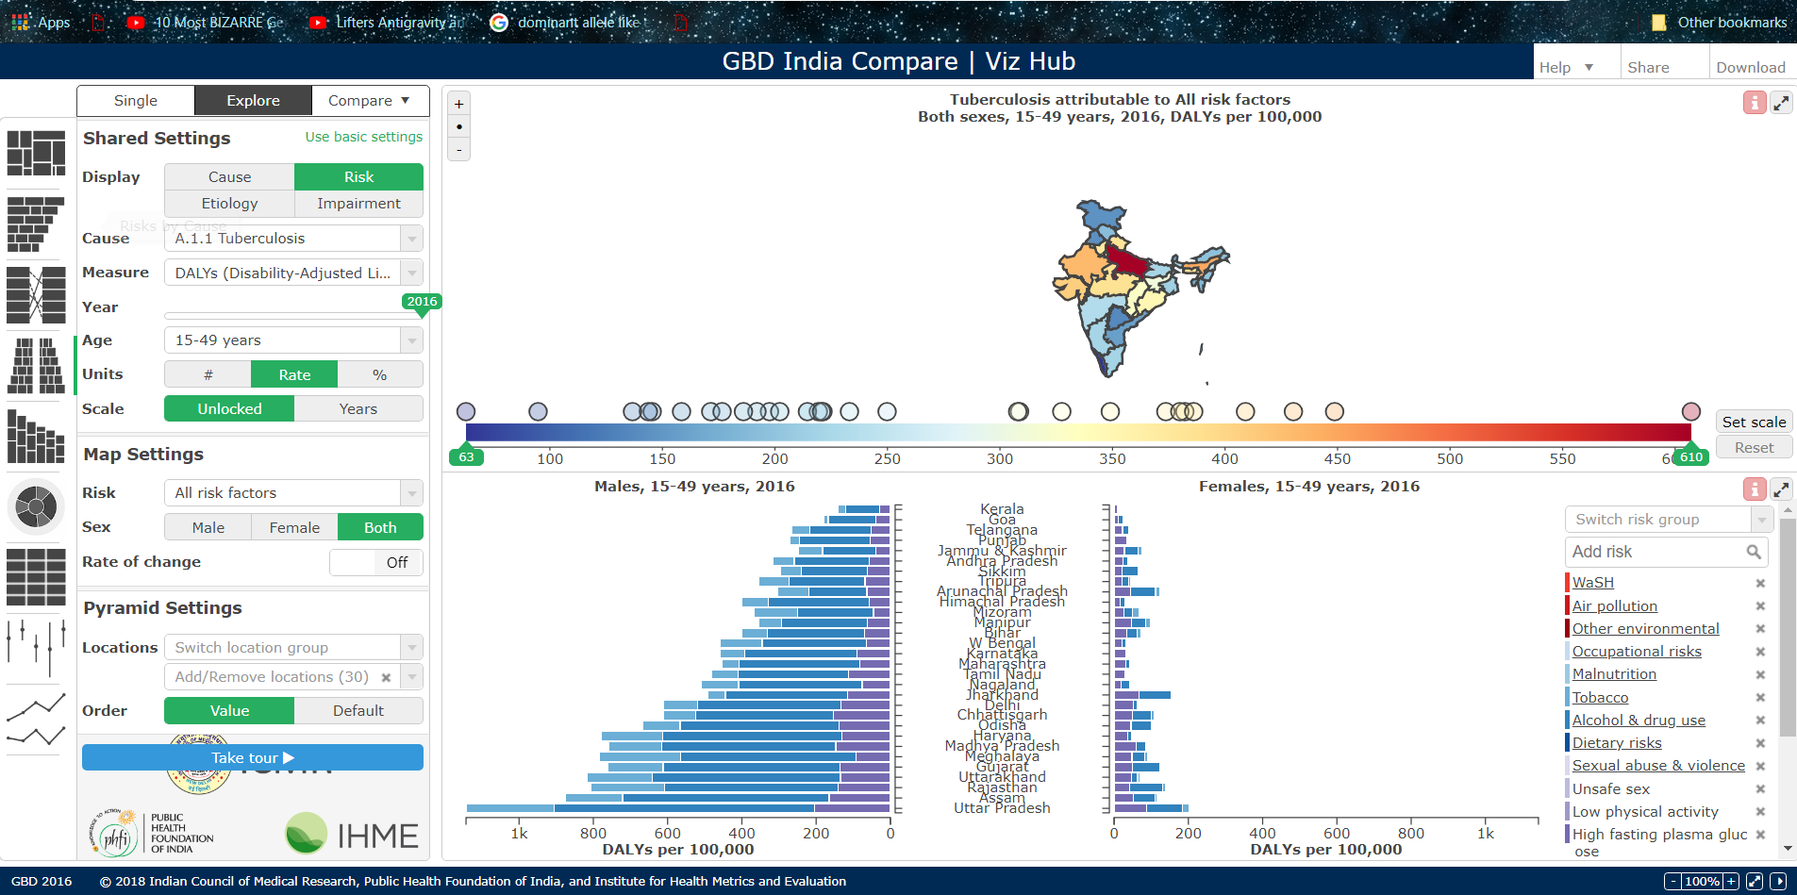

Slide 4
Protocol:
The symptoms once collected will help the IP to analyse the Specific type of TB and thus relate to the antibiotics and disease specific test.
The premitive test like TST,IGRA,suptum,TMAand NAA can be done by the IP to get a clear view of the TB the patient is affected with. Based upon the clinical assays and test the TB can be considered under Two aspects i.e. The latent form The active form
For treating the latent form the IP can go with the therapies like isoniazid monotherapy or Interferon-gamma assay for a period of 9 months as per the directions from government.
While if the TB is found to be a positive for the test then the first line of treatment will be followed by the IP i.e. "RIPE" the acronym for four drugs used in first-line treatment: Rifampin, Isoniazid, Pyrazinamide, and Ethambutol can be followed by the IP. After this comes the concept of Multi drug resistant therapy and TB interlinking to diseases like HIV on which researches are being done to develop technologies to treat TB effectively by therapies.

Slide 5
SPECIFICATIONS
We Have included MVC file structure for fast retrieving of data.
App is designed to keep the prime focus on operability by the IP’s so that they could easily enter the patients detail, and Can even overview the analytical report of each patient under that IP.
DIAGNOSIS: After successfully entering into secure login,IP can select tests that patient is undergoing to get the clear picture of the ongoing process .
ANALYSIS: Visualization of expected Type of TB will be shown for proper curing process.
INNOVATION: Based upon the general behaviour and analyzing the specific symptoms the IP can relate to the specific type of TB.
ANONYMITY: To protect the IP information we have used advanced cryptographic techniques and implemented the proxy server to achieve the same .
SECURITY: SHA - 256 (Secure Hash Algorithm) is used to Keep the IP and Patient details secure for DATA PRIVACY..

Slide 6
COMMUNICATION: IP can communicate with the Patient by using the message portal provided in the application.
FUTURE ASPECTS: Using Python-Excel API we can convert the data from database to the excel form and can send it to the government through any secure means which would be feasible to access.
Which can further be integrated with their database.
Let’s take the overview of the webapp.
THANK YOU.

