Slide 1

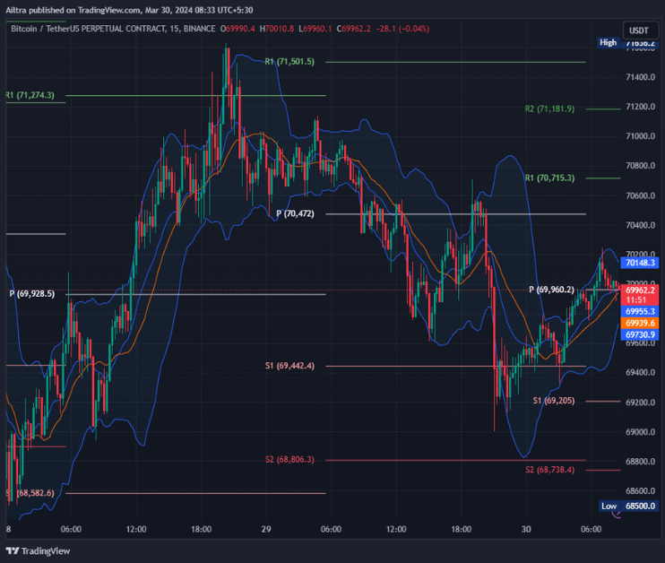
TNSDC- GENERATIVE AI
BITCOIN PRICE PREDICTION USING RNN
STUDENT DETAILS: KRISHWAR V
au211521104057,
Pre-Final Year Student,
B.E Computer Science and Engineering,
Panimalar Institute of Technology
3/21/2024 Annual Review

Slide 2

OUTLINE
INTRODUCTION
PROBLEM STATEMENT
PROJECT OVERVIEW
ALGORITHM
YOUR SOLUTION AND IT’S VALUE PROPOSITION
APPLICATIONS
RESULT
CONCLUSION
REFERENCE
3/21/2024 Annual Review

Slide 3

INTRODUCTION
The cryptocurrency market, and in particular Bitcoin, has attracted a lot of attention from traders and investors across the globe in today's ever-changing financial landscape. Accurate price forecasting techniques are necessary because of the opportunities and challenges that market participants face due to the fluctuating nature of Bitcoin values. Our project uses past data to forecast future Bitcoin prices by utilizing the capabilities of deep learning, most specifically Long Short-Term Memory (LSTM) neural networks. We want to improve the quality of decision-making in the bitcoin market and provide investors with insightful information by utilizing cutting-edge machine learning algorithms. In this talk, we will go deep into the details of our model for predicting the price of Bitcoin. We will examine the methods used for gathering data, preprocessing strategies, the architecture of the LSTM model, training approaches, evaluation measures, and the conclusions drawn from our analysis.
3/21/2024 Annual Review

Slide 4

PROBLEM STATEMENT
Predicting Bitcoin prices accurately is crucial for investors navigating the volatile cryptocurrency market. Our project addresses this challenge by leveraging deep learning techniques, specifically LSTM neural networks, to forecast future Bitcoin prices based on historical data. By developing a reliable predictive model, we aim to empower investors with actionable insights for making informed decisions in cryptocurrency trading.
3/21/2024 Annual Review

Slide 5

PROJECT OVERVIEW
Our project's main goal is to forecast future Bitcoin prices by utilizing deep learning techniques, particularly Long Short-Term Memory (LSTM) neural networks. To get ready for model training, we first gather historical Bitcoin price data and preprocess it. In order to accurately predict prices, the LSTM model architecture is built to capture intricate patterns and dependencies in the data. Our goal is to create a strong predictive model that can offer insightful guidance to investors navigating the bitcoin market through thorough training and assessment. Our goal is to show how deep learning may improve decision-making and reveal patterns in the ever-changing bitcoin trading industry.
3/21/2024 Annual Review

Slide 6

ALGORITHM
In this project, we've employed the Recurrent Neural Network (RNN) architecture, specifically the Long Short-Term Memory (LSTM) variant. RNNs are well-suited for processing sequential data, such as time series, due to their ability to retain information about previous inputs through hidden states. The LSTM architecture, a type of RNN, is particularly effective in capturing long-term dependencies in sequential data. Unlike standard RNNs, LSTM networks utilize memory cells and gating mechanisms to control the flow of information, mitigating issues such as the vanishing gradient problem. This allows the LSTM model to retain relevant information over longer sequences, making it highly suitable for tasks requiring the analysis of historical trends and patterns, such as Bitcoin price prediction. In our project, the RNN with LSTM units is trained on historical Bitcoin price data to learn the underlying patterns and relationships. Once trained, the model is capable of making predictions about future price movements based on the learned patterns, providing valuable insights for investors in the cryptocurrency market.
3/21/2024 Annual Review

Slide 7

YOUR SOLUTION AND ITS VALUE PROPOSITION
Solution:
Our solution utilizes LSTM neural networks to forecast Bitcoin prices from historical data, enabling informed cryptocurrency trading decisions. By analyzing past trends, our model learns intricate patterns influencing price movements. Rigorous evaluation and feature engineering ensure prediction reliability. With LSTM's capability to capture short-term fluctuations and long-term trends, our model offers a comprehensive framework for price prediction.
Proposition:
Our approach empowers investors with actionable insights to navigate the volatile cryptocurrency market effectively. By providing accurate predictions and valuable information for decision-making, we enable investors to manage risks and capitalize on opportunities. With our solution, investors can make informed trading decisions, optimize their portfolios, and achieve better returns. Our proposition aims to enhance decision-making processes, mitigate uncertainties, and facilitate profitable trading strategies in the dynamic world of cryptocurrency investment.
3/21/2024 Annual Review

Slide 8
APPLICATIONS
1. Algorithmic Trading: Automated trading systems can use LSTM-based models to make real-time predictions of Bitcoin prices, enabling algorithmic trading strategies that capitalize on short-term price movements.
2. Risk Management: Investors and portfolio managers can use price forecasts to assess and mitigate risks associated with Bitcoin investments, helping them make more informed decisions and manage their portfolios effectively.
3. Hedging Strategies: Traders and institutional investors can use price predictions to develop hedging strategies that protect against adverse price movements, reducing the impact of market volatility on their investment portfolios.
4. Market Analysis: Researchers and analysts can use LSTM models to analyze historical price data and identify long-term trends and patterns in the Bitcoin market, providing insights into market behavior and dynamics.
3/21/2024 Annual Review

Slide 9
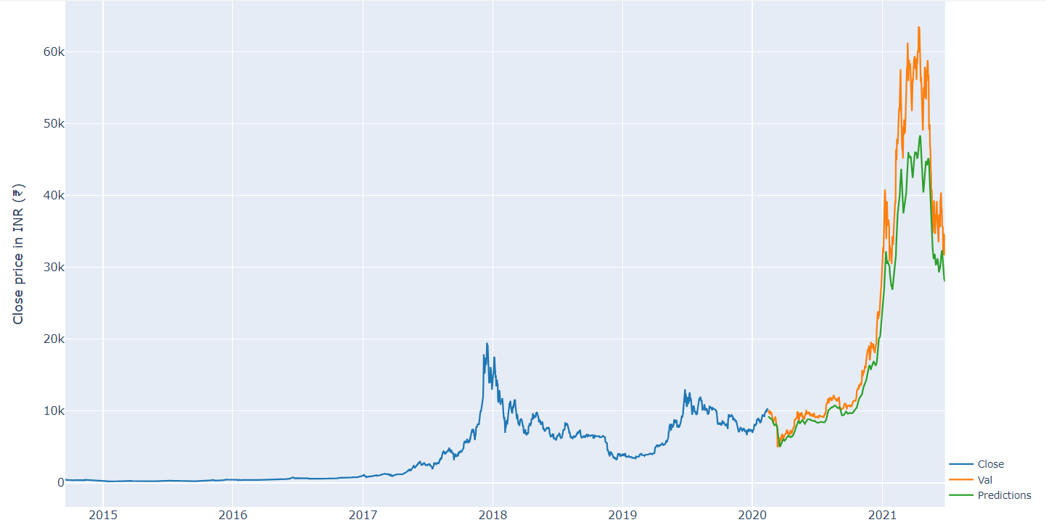
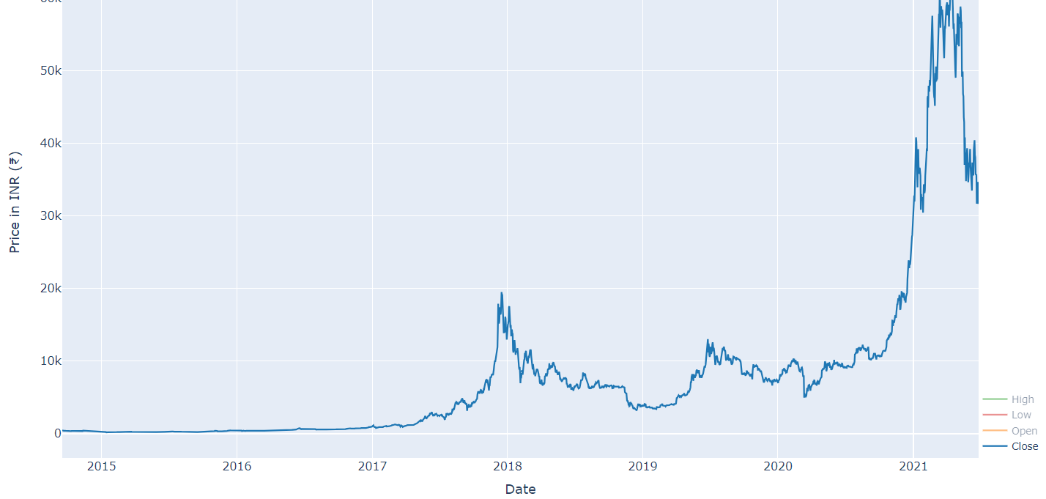
RESULTS
https://github.com/krishwar/BitcoinPricePrediction.git
3/21/2024 Annual Review

Slide 10

CONCLUSION
In conclusion, our LSTM-based Bitcoin price prediction model offers valuable insights for cryptocurrency trading decisions. Rigorous evaluation and feature engineering ensure prediction accuracy, empowering investors with actionable information to navigate the volatile market. Our solution enhances decision-making processes, enabling risk management, portfolio optimization, and strategic investment planning. As cryptocurrency markets evolve, LSTM models will continue to play a crucial role in shaping trading strategies. We anticipate further advancements in this field, driving innovation and providing unprecedented opportunities for investors worldwide.
3/21/2024 Annual Review

Slide 11
REFERENCE
1. "Deep Learning for Time-Series Analysis" by Dr. Rajan Patel and Dr. Jignesh Amipara This book provides a comprehensive overview of deep learning techniques for time-series analysis, including LSTM models. It covers theory, implementation, and applications in finance and other domains.
2. "Python for Finance" by Yves HilpischThis book offers practical examples and code snippets for financial analysis and prediction using Python. It includes sections on time-series analysis, machine learning, and deep learning techniques.
3. "Hands-On Machine Learning with Scikit-Learn, Keras, and TensorFlow" by Aurélien GéronThis popular book covers various machine learning and deep learning topics, including LSTM networks. It provides hands-on examples and code tutorials using Python libraries such as Keras and TensorFlow.
4. "Recurrent Neural Networks for Short-Term Load Forecasting: An Overview and Comparative Analysis" by Tharindu R. Bandaragoda, Maria M. Vasconcelos, and A. G. SilvaThis research paper provides insights into the application of LSTM networks for time-series forecasting, focusing on short-term load forecasting in electrical power systems. It offers valuable insights applicable to Bitcoin price prediction.
5. Online Resources:Websites such as Towards Data Science, Medium, and GitHub repositories offer numerous tutorials, articles, and code examples on LSTM networks, time-series analysis, and cryptocurrency prediction. These resources can provide additional guidance and support for your project.
3/21/2024 Annual Review

