Slide 1

Financial Payments Fraud Detection
ATMECS Data Science Team

Slide 2
Contents
Data preparation
Analysis
Cleaning
Visualization
Feature Engineering
Modelling (xgboost classifier)

Slide 3
Objective
Applying data science techniques such as data preparation to cleaning and then training and ML algorithms for Predicting Fraud in Financial Payment Services

Slide 4
Data preparation
Reading from .csv file
Data size is 6 million rows
Total variables are 11
IsFraud is as label and other 10 are as features

Slide 5
Data Analysis
Which type of transactions are fraudulent?
What determines 'isFlaggedFraud'?
Merchant accounts are labelled ?
Account labels are common to fraudulent TRANSFERs and CASH_OUTs

Slide 6
Data Cleaning
Imputation with missing values
If destination account balance is zero (there's more chance of fraud) so replacing it with -1
If originating account balance is zero , replaced it with null value.
Feature Engineering : Created two new features recording errors in the originating and destination accounts for each transaction.

Slide 7
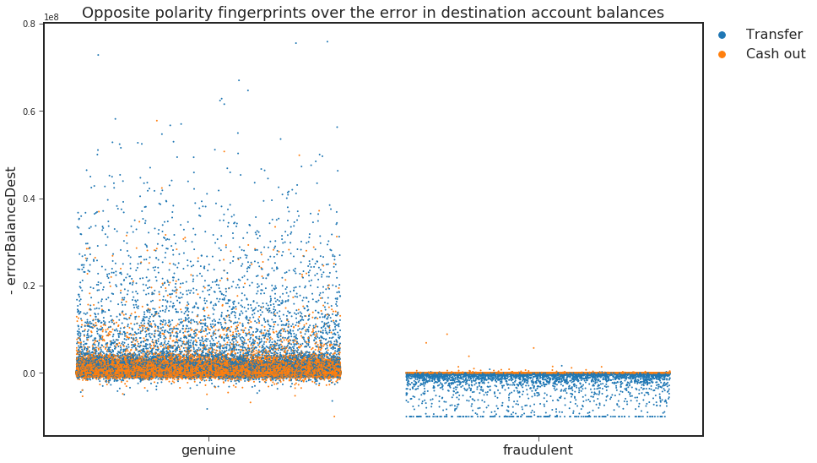
Data Visualization

Slide 8
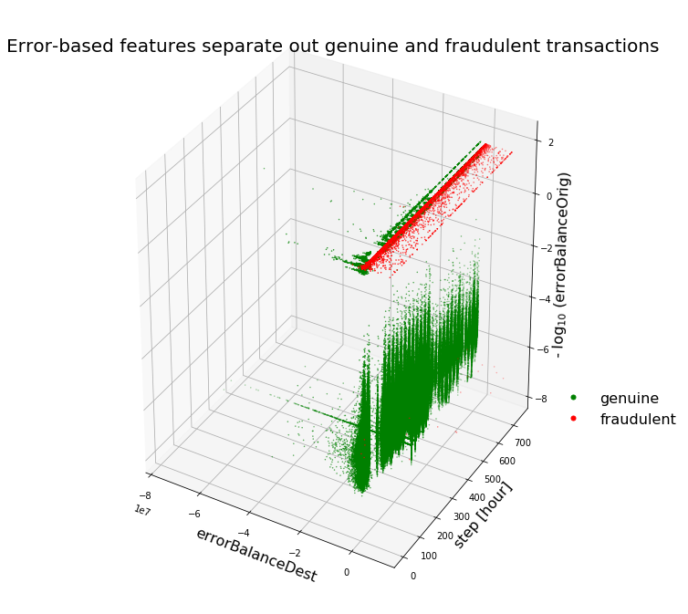
data visualization contd..

Slide 9
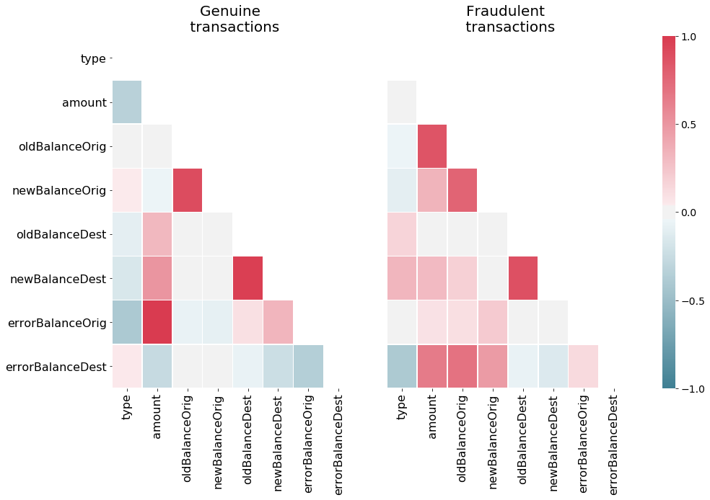
data visualization contd..

Slide 10
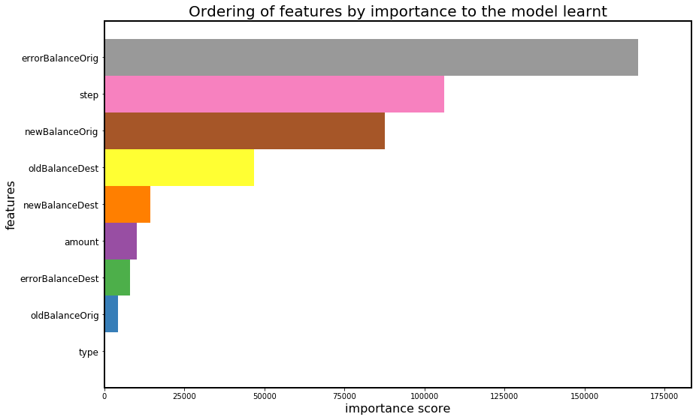
Feature Engineering

Slide 11
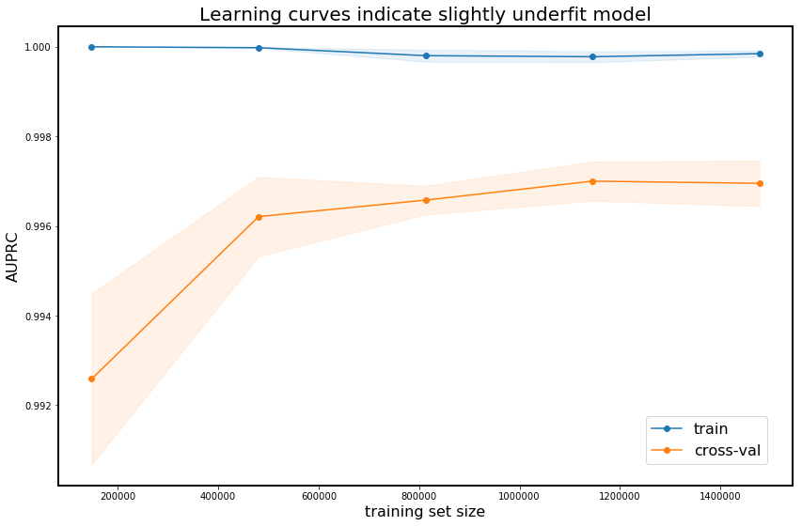
Predicting using Models

Slide 12
Predicting using models
Model | AUPRC Score | ROC_AUC_SCORE
Decision Tree | 0.9964451186024113 | 0.99950688490725992
Random Forest | 0.9975738174854184 | 0.99880210849742845
XGBoost | 0.9986361116985445

Slide 13
Thank You

