Slide 1
Basics of statistics

Slide 2
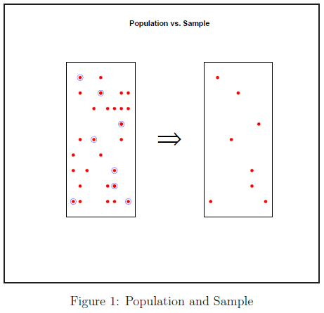
Statistics: Population & Sample
statistics is the methodology for collecting, analysing, interpreting and drawing conclusions from information.
Statistics consists of a body of methods for collecting and analysing data.
Statistics is the science of gaining information from numerical(quantitative) and categorical data(qualitative).
Categorical data (qualitative data) results from descriptions, e.g. the blood type of person, marital status or religious affiliation.
Population Vs Sample
  Population is the collection of all individuals
  or items under consideration in a statistical study.
  Population is the set of measurements (or
  record of some qualitative trait) corresponding to
  entire collection of units for which inferences
  are to be made.
  Sample is that part of the population from
  which information is collected.
  A sample from statistical population is the
  set of measurements that are actually collected
  in the course of an investigation.
The source of each measurement is defined
as sampling unit, or simply, a unit.
The population always represents the target of an
investigation. We learn about the population by
sampling from the collection.
Day-1

Slide 3
Descriptive & Inferential Statistics
Descriptive Statistics
  The branch of statistics devoted to the summarization and description of data is called descriptive statistics.
  Descriptive statistics consist of methods for organizing and summarizing information.
  Descriptive statistics includes the construction of graphs, charts, and tables, and the calculation of various
  descriptive measures such as averages, measures of variation, and percentiles.
Inferential Statistics
  The branch of statistics concerned with using sample data to make an inference about a population of data.
  Inferential statistics consist of methods for drawing and measuring the reliability of conclusions about
  population based on information obtained from a sample of the population.
  Inferential statistics includes methods like point estimation, interval estimation and hypothesis testing which
  are all based on probability theory.
It is almost always necessary to use methods of descriptive statistics to organize and summarize the information
obtained from a sample before methods of inferential statistics can be used to make more thorough analysis of the
subject under investigation.
The preliminary descriptive analysis of a sample often reveals features that lead to the choice of the appropriate
inferential method to be used later.
Only when an inference is made about the population based on information obtained from the sample(though it is
possible to obtain information from whole population) the study become inferential.
Day-2

Slide 4
Statistics
Day-3

Slide 5
Statistics
Day-4

Slide 6
Statistics
Day-5

Slide 7
It is my pleasure to address further Queries
Thank You
email:sadula.srikrishna@gmail.com
Mobile: +91 890 406 0096

