Slide 1

Invoice Classification
ATMECS Data Science Team

Slide 2
Contents
Data preparation
Analysis
Cleaning
Visualization
Feature Engineering
Modelling

Slide 3
Objective
Applying data science techniques such as data preparation to cleaning and then training and ML algorithms for classifying invoices into disputed and non-disputed categories.

Slide 4
Data preparation
Reading from .csv file
Data size is 2466 rows
Total variables are 12
'Disputed' is as label and other 11 are as features

Slide 5
Data Analysis
Are there any null values in the data?
Which fields determine if invoice is 'Disputed'?
Are date fields relevant ?
How different models compare against each other?

Slide 6
Data Cleaning
There are no missing values in the data set.
Mutating categorical variables from Yes/ No type of columns into 1/0 format for fitting the data into various algorithms.

Slide 7
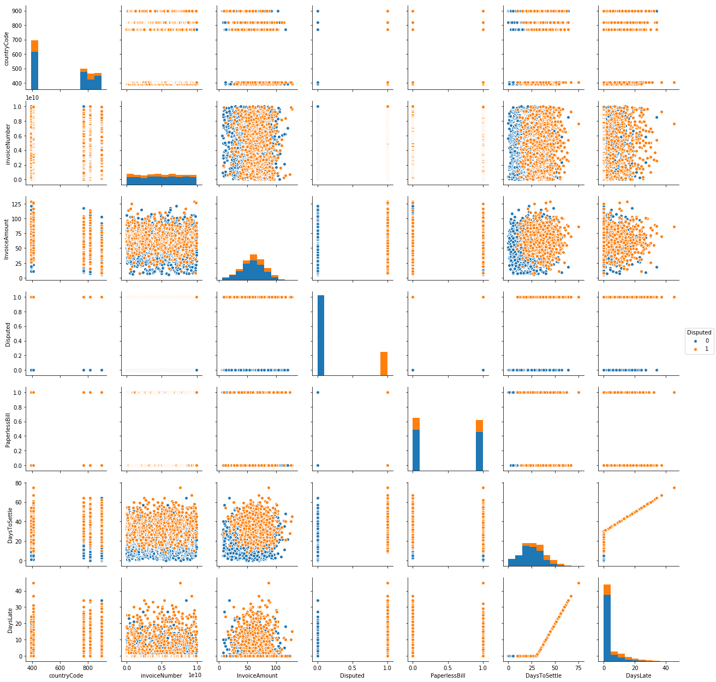
Data Visualization

Slide 8
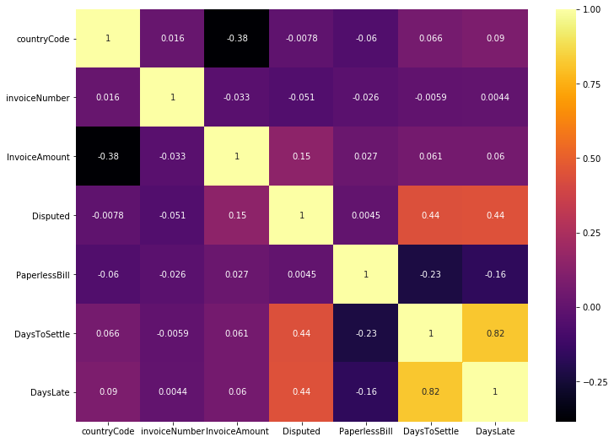
data visualization contd..

Slide 9
Predicting using models
Model | Test accuracy | ROC_AUC_SCORE
Decision Tree | 0.767206477733 | 0.77924351092896171
Random Forest | 0.767206477733 | 0.77924351092896171
Logistic Regression | 0.791497975709 | 0.79757940573770492

Slide 10
Future Scope
Can the models be more accurate? Yes.
By default the probability threshold is set as 0.5 for all classification models. We can change them according to our business requirements so tilt the favour of model's decision as suited.

Slide 11
Thank You

