Slide 1
TCS Technical Assessment
Prudential BMI Case Study
Krishna Hariramani
20/12/2021

Slide 2
Agenda
High Level Overview
Model Building and experimentation
Data Cleaning & Preparation
Training Model and Evaluation
Operational the Model

Slide 3
High Level Overview
Convert weight to kg
Convert height to m
Perform 5 fold cross validation and compute score
Inputs -: age, gender, weight, height,
Train model with train data
Load model
Prepare Inputs to model
Split data into train and test
Create ground truth using BMI formula
Compute model score on test data
Apply business logic to get quote
Predict BMI using ht and wt
Perform distribution analysis on features
Transform train data with scaler
Save model
Output -: Insurance quote
Fit scaler with train data
Transform test data with scaler
Run for a single input
Train and evaluate model
Run in Multiprocess for batch mode
Data Cleaning and prep
Jupyter Notebook
Python Script

Slide 4
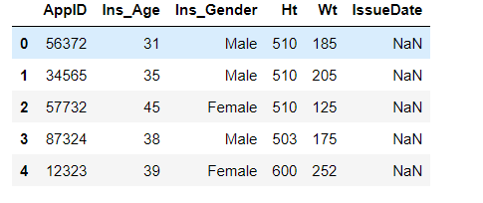
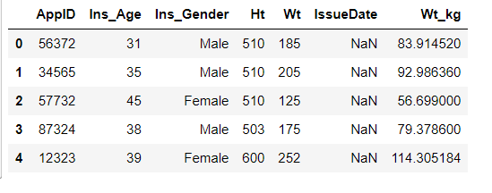
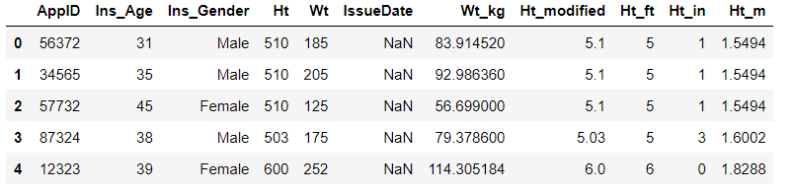
Data Cleaning and Preparation – Converting weight and height

Slide 5
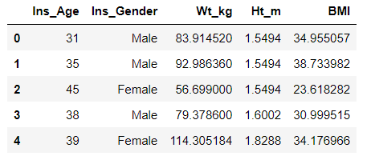
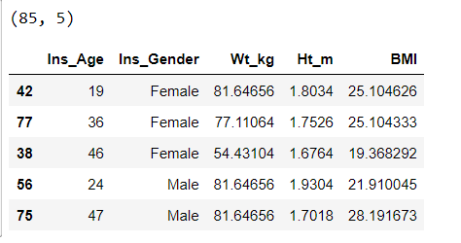
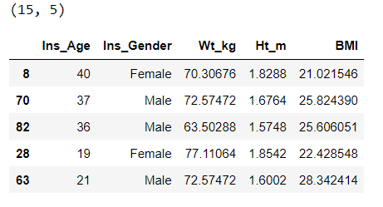
Data Cleaning and Preparation – Calculate ground truth and Split data

Slide 6
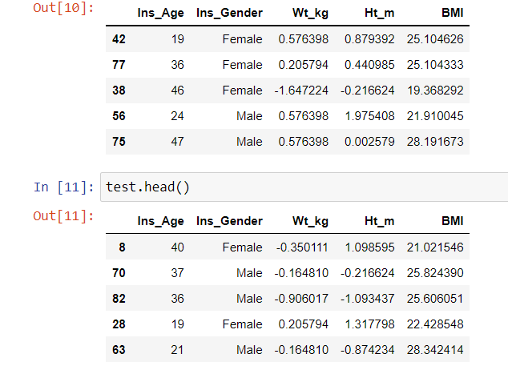
Data Cleaning and Preparation – Fit scaler on train and transform test

Slide 7
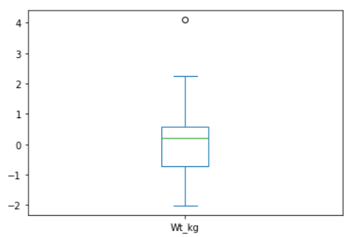
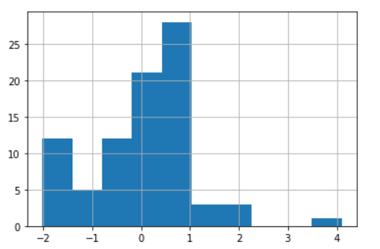
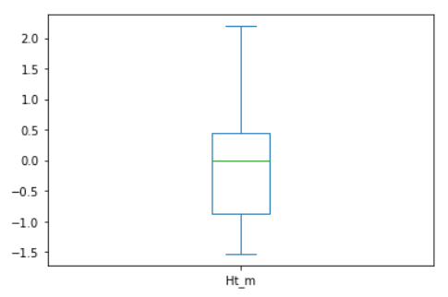
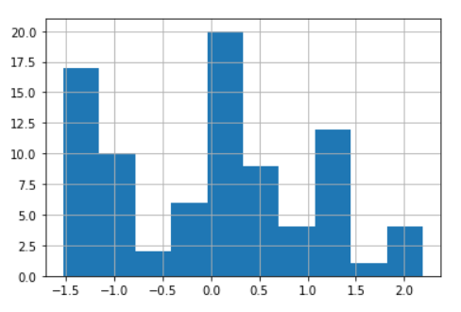
Data Cleaning and Preparation – Feature Distributions
Weight -:
Height -:

Slide 8
Train model and evaluation
Linear Regression -:
Support Vector Regressor -:

Slide 9
Operationalising the model
Web API takes multiple inputs from user
Airflow/K8 Split inputs in batches of 4, run 10 pods in parallel
Python Script running 4 inputs in parallel
Model
Web API displays output
Airflow/K8 Aggregate results from all pods

Slide 10


