Slide 1
LogBook
Jordan Atanasov
Kristiyana Stoyanova

Slide 2
What is LogBook?
LogBook is a desktop application. Its primary purpose is as a reminder, it can be used to remember important tasks that a person needs to do.

Slide 3





Technologies

Slide 4
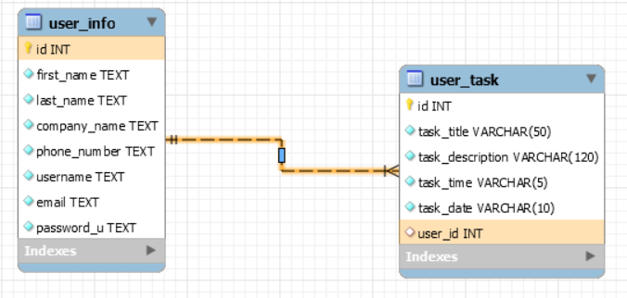
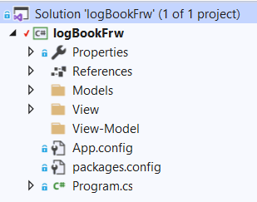
Database and Project structure

Slide 5
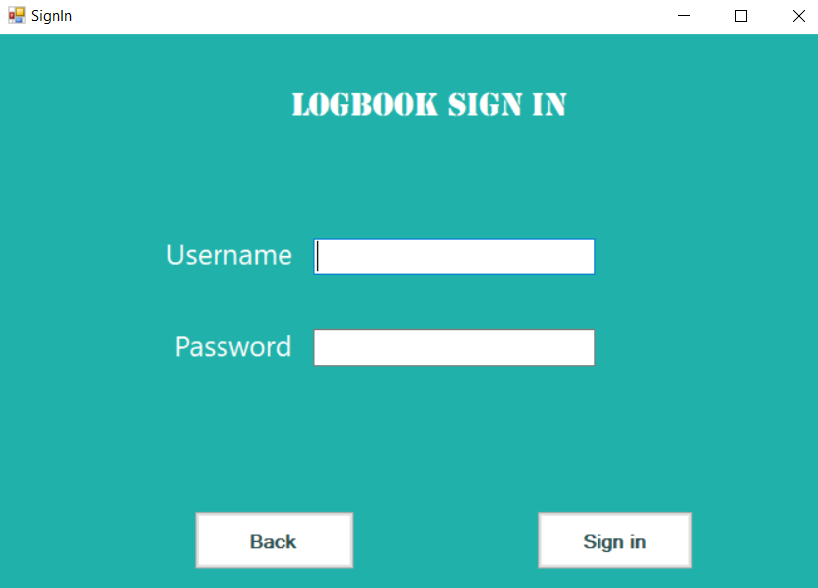
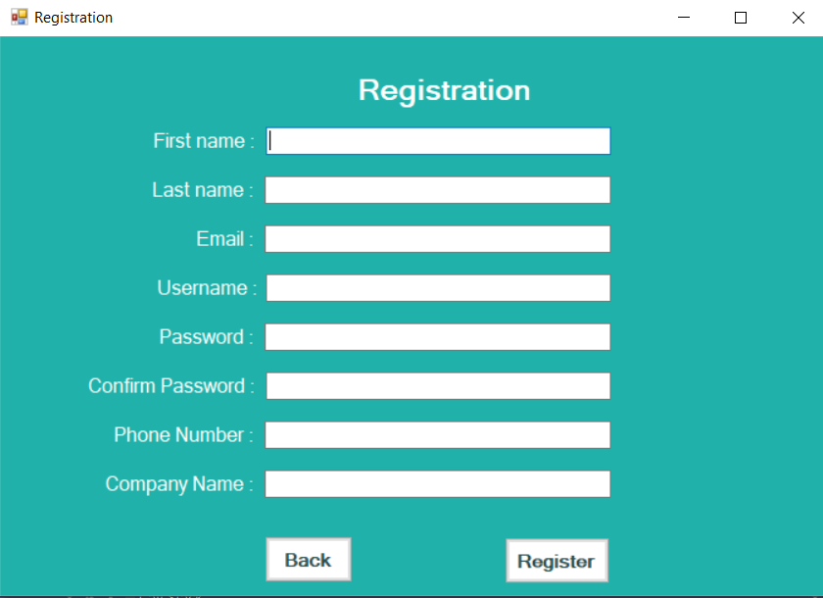
To secure our desktop application

Slide 6
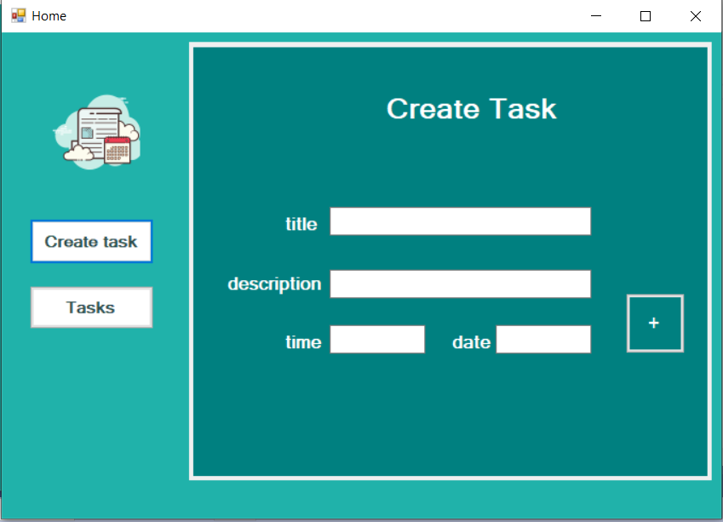
How can LogBook be expanded on?
LogBook can be integrated completely into companies, allowing them to monitor their employees progress. Deadlines can also be made optional to allow for more flexibility in making these tasks.

Slide 7

For more information check the link below:
https://docs.google.com/document/d/1F4xiFa5fe-mgkH1G2Xk3sjh5xaraYsNQGCIJlUg2csA

Slide 8


Slide 9
Thank you for your attention !

