Slide 1

Digital Environment Regulation Tool (DERT)
RP2040-based smart agriculture, equipped with four sensors and three plants to optimize conditions for agricultural crops.
Kris Keillor
Prof. Todd Morton
Prof. Junaid Khan
Prof. John Lund

Slide 2
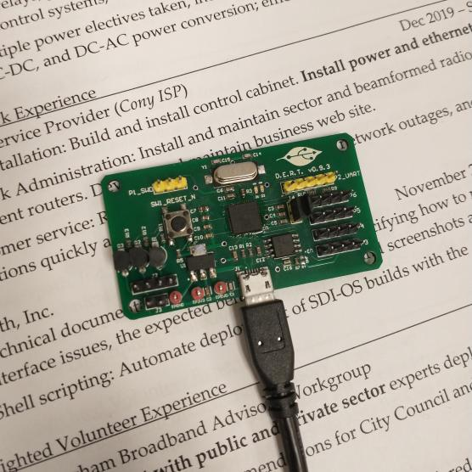
System Overview
Plants need light and water to grow full and healthy.
Solar insolation and manual watering can be inconsistent.
DERT-2040 measures soil moisture, lux, humidity, and temperature while controlling moisture and lux via LED panel and irrigation pump.
Software design include PID-based irrigation and UART-based reporting.

Slide 3
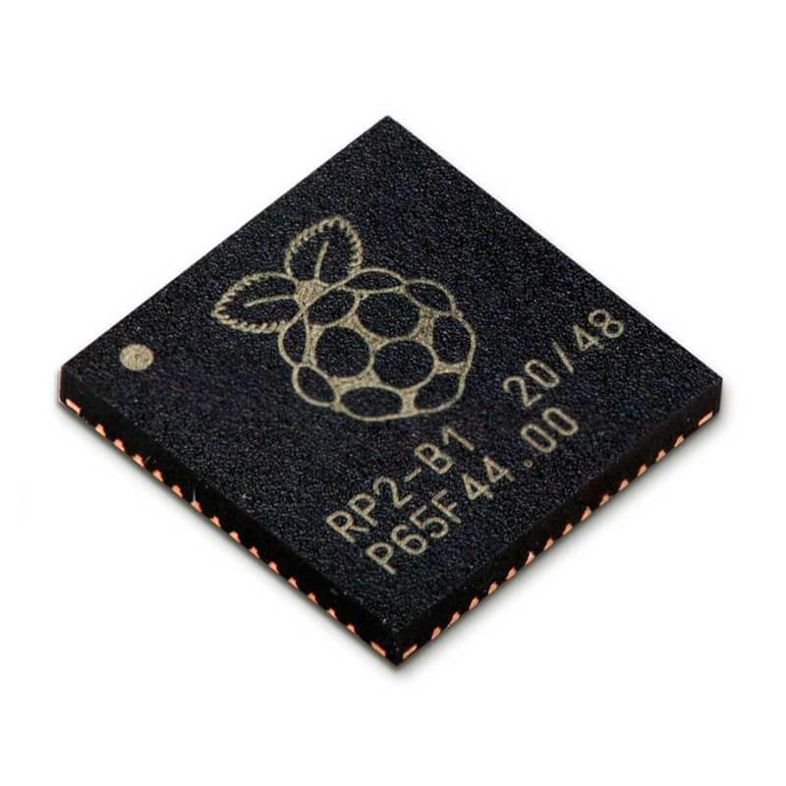
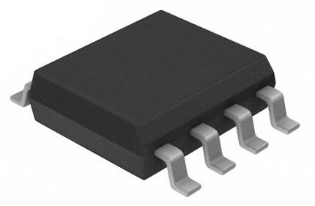
System Resources
v0.9.3:
Dual-core M0+ processor @ 12 MHz
128 Mb Flash
Four I²C ports on one bus
Three NPN transistors driven by GPIO
USB port/bootloader
SWD port
UART port
v1.0.0:
Three debug bit test points
Two indicator LEDs

Slide 4
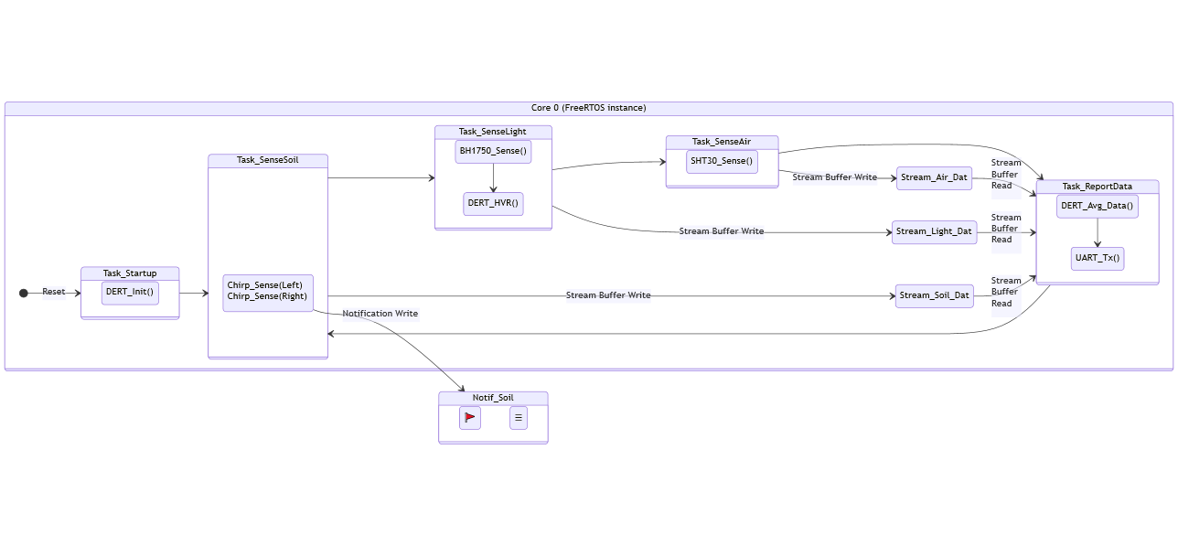
System Design – Core 0
Time-slice scheduler
Three message queues shared between tasks; one notification shared with Core 1

Slide 5
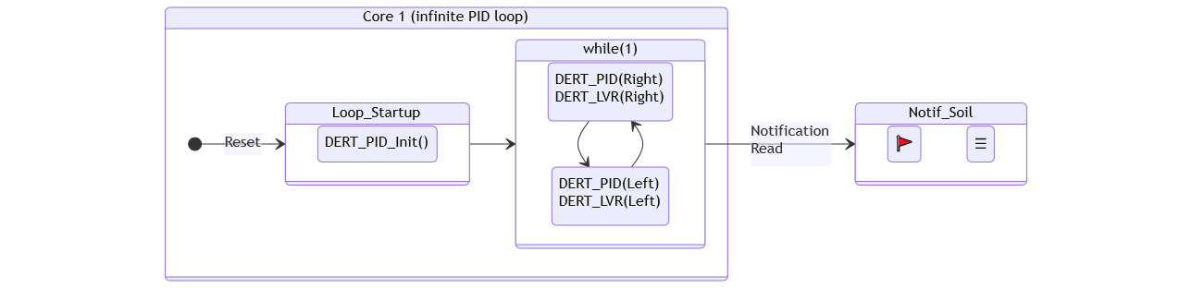
System Design – Core 1

Slide 6
Outstanding Challenges
Lack of a real-time clock:
Need for an RTC to track day-night cycles was overlooked during hardware design.
Workaround: Until next board rev (1.1.x), can use a clock divider in software, with the approximate time of day defined at build-and-flash time.
Soil sensor glitch:
Tests with the Chirp! capacitive soil sensor have been nuking the shared I²C bus. Hopefully, this can be fixed with a reset, or the 2nd/3rd sensors do not have the same issue.
/!\ If not, a new sensor will need to be procured.
Designing and programming the offboard SQL datalogger:
Only reporting data is a requirement; how to utilize that data is beyond DERT’s scope.
Minimum viable product will log output to a CSV file with minimal validation, visualization, or analytics – that is left as a “EECE 494” project.
Design of control cabinet:
High-voltage relay shall switch 120V, making this area safety-critical.

Slide 7
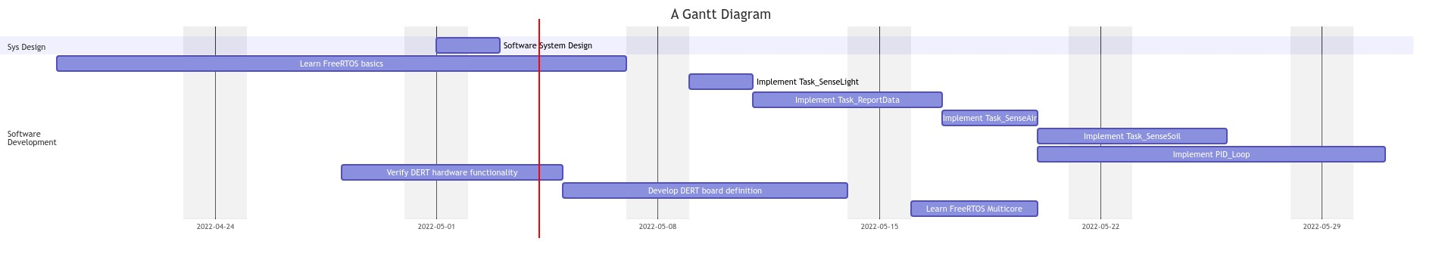
Project Timeline

Slide 8
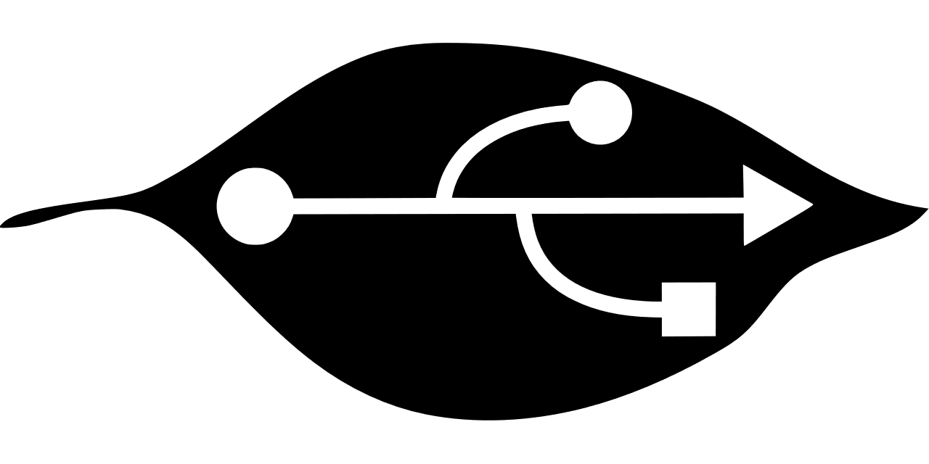
Questions?
Comments?
Job offers?

