Slide 1
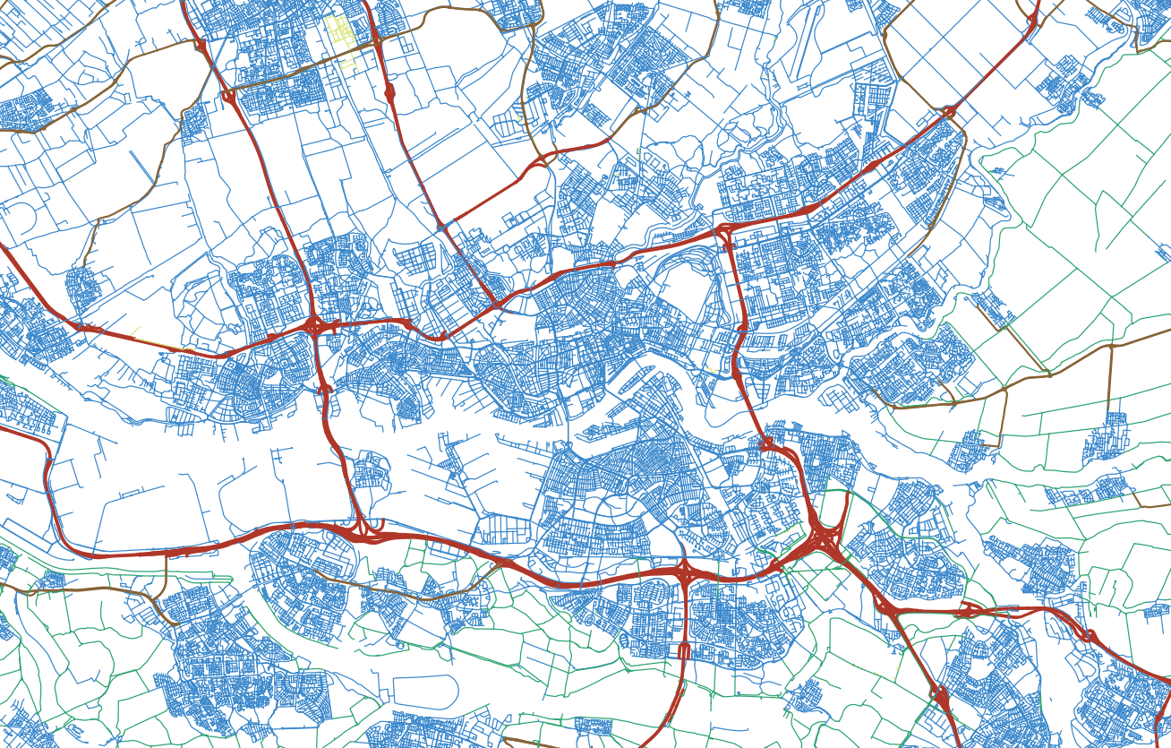

MSc Graduation Meeting P3 Constructing a digital 3D road network for The Netherlands
Kristof Kenesei Student 5142334 K.Kenesei@student.tudelft.nl
Supervisors: 1st – Ravi Peters 2nd – Jantien Stoter 2021-03-29
Notes:
Welcome to my P3 presentation about my graduation project, titled Constructing a digital 3D road network for The Netherlands
It is assumed that audience is familiar with Geomatics and with general aims of the project, so:
Introduction will be very short
Instead I will focus on the technical aspects

Slide 2
Constructing a digital 3D road network for The Netherlands Agenda
Motivation
Proposed workflow
Implementation and technical challenges
Summary and next steps
Notes:
Agenda of the presentation will be:
Short motivation section
Overview of proposed workflow
Details about pipeline steps and technical challenges
Short summary based on what has been completed already

Slide 3
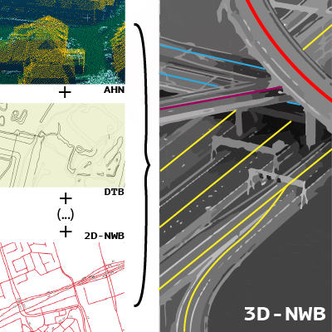
Motivation Top-level project plan
Take the Dutch 2D digital road network (NWB) (RWS’s open-data graph-like representation of road centrelines)
Create an accurate 3D version of it
Notes:
Main idea:
Take the Dutch 2D digital road network (NWB)
Create an accurate 3D version of it
RWS needs 3D-NWB for a noise modelling project, but it has various other applications too

Slide 4
Motivation Top-level project plan - constraints
Use open-data elevation measurements (AHN, DTB)
Explore academic aspects, not just fulfil a commission
Preserve topology, keep original 2D georeferencing
Compare with, and try to improve upon, the commercial implementation
Notes:
May seem like a straightforward commission, but we added some constraints…
Use open-data elevation measurements only (AHN, DTB)
Explore academic aspects, not only complete the commission
Preserve topology, keep the 2D georeferencing (commercial constraint)
Compare with, and try to improve upon, the commercial implementation developed in parallel with academic project

Slide 5
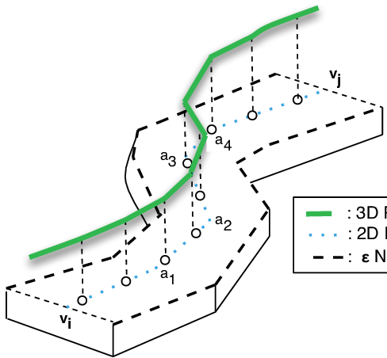
Motivation Essence of problem
https://www.researchgate.net/figure/A-2D-Road-Segment-With-its-Neighborhood-Definition-2-A-3D-spatial-network-is-also_fig2_236964742
How do we get from here…
…to here?
Notes:
So what we want to do in simple words is…
…to take a 2D georeferenced graph…
…and convert it to a 3D georeferenced graph based (mainly) on Lidar reflections from the road surface.

Slide 6
Motivation Research question
“How can we achieve a 3D conversion of the NWB dataset using Dutch open geospatial data and primarily 2.5D-based surface modelling methods, while guaranteeing optimal and quantifiable accuracy and completeness?”
Notes:
In the end we came up with the research question:
“How can we achieve a 3D conversion of the NWB dataset using Dutch open geospatial data and primarily 2.5D-based surface modelling methods, while guaranteeing optimal and quantifiable accuracy and completeness?”
2.5D-based surface modelling and accuracy assessment are mentioned specifically because these are the main added academic aspects

Slide 7
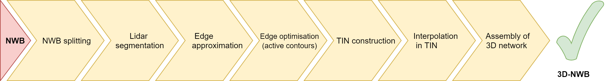
Proposed workflow Processing pipeline
Mosaicked together from methods found in literature, and own ideas
Made surface modelling a core stage of NWB’s 3D conversion
Notes:
This flowchart shows our planned processing pipeline
Result of a preparation process that spanned about two months
Reviewed relevant geomatics course materials and literature
Consulted with NDW, and their commercial partners
Mosaicked together the procedure based on knowledge, results of consultation, and my own ideas

Slide 8
Implementation and challenges NWB splitting
Issue: various workflow steps would work best with 1D profiles
Solution: split NWB into Non-Branching Road Segments (NBRS) in an ideal manner
When splitting at an intersection, what to prioritise?
Implemented two algorithms
Algorithm 1: uses only geometry
Algorithm 2: takes into account semantic data
Notes:
First step in pipeline: NWB splitting
We needed to subdivide NWB into well-behaved 1D profiles, a prerequisite for various subsequent steps
We call these Non-Branching Road Segments or NBRSs for short
How exactly do we generate NBRSs?
When splitting at an intersection, do we prioritise…
…the longest possible continuation?
…the smallest angle?
…the agreement of semantic attributes?
I call it splitting, but NBRS are actually assembled from wegvakken, the building blocks of NWB
Implemented two algorithms
Algorithm 1: uses only geometry, focuses on NBRS length maximisation, angle minimisation
Independent of NWB!
Algorithm 2: also uses semantic data to further optimise NBRS generation
Such as: road numbers, road types

Slide 9
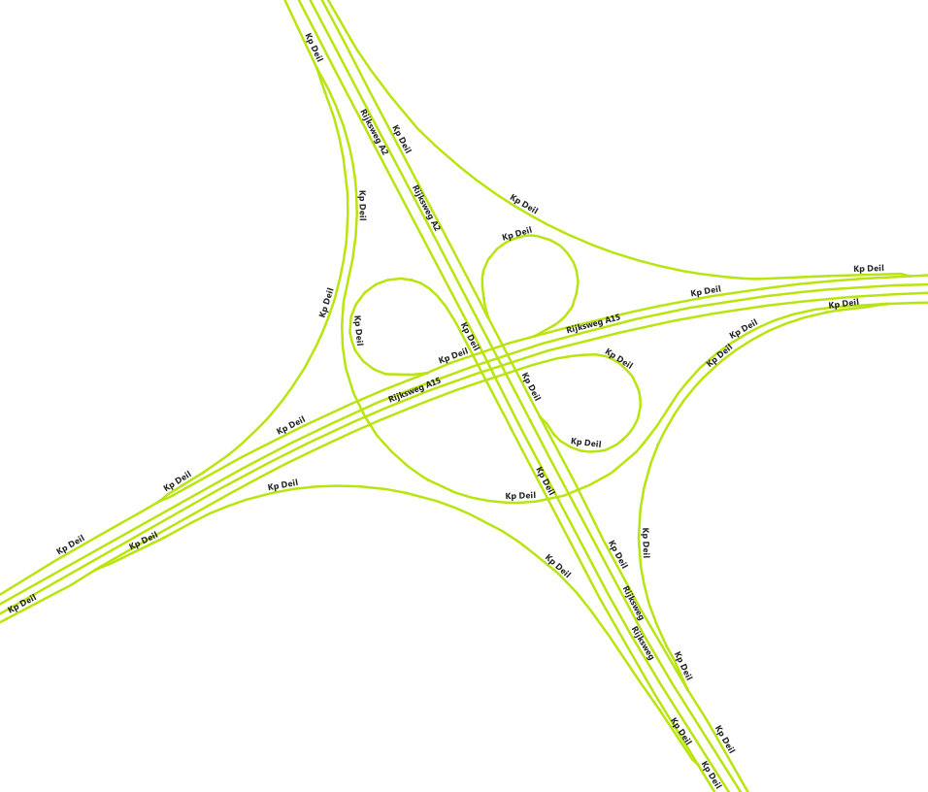
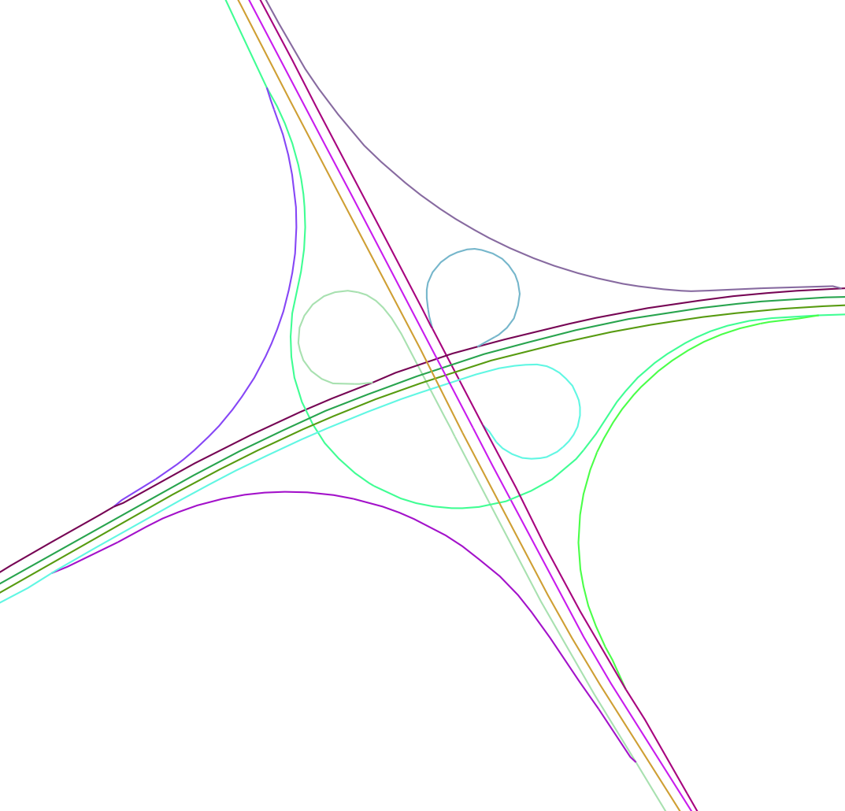
Implementation and challenges NWB splitting
Input NWB geometry
Generated NBRS geometries (each colour represents a different NBRS)
Notes:
The results shown here illustrate that NBRSs never overlap with themselves
They have ideal shapes for all the subsequent processing steps
The two algorithms produce similar results, so this is not shown separately here

Slide 10
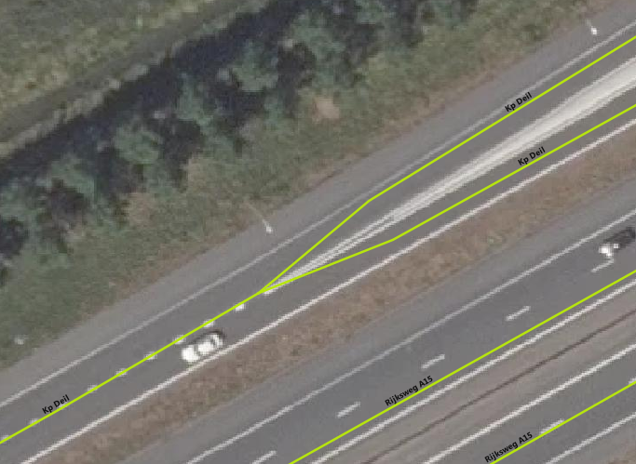
Implementation and challenges NWB splitting - challenges
Disjoint centrelines
Random reversals
Odd geometry at intersections
Notes:
In terms of challenges, both algorithms contain a large number of workaround solutions, because:
NWB has decimal precision problems, connected LineString objects do not always actually line up geometrically
NWB centrelines do not always face the same way, random reversals occur
In intersections, NWB geometry often does not accurately reflect real-life geometry
Makes it difficult for algorithm to recognise the continuations of roads

Slide 11
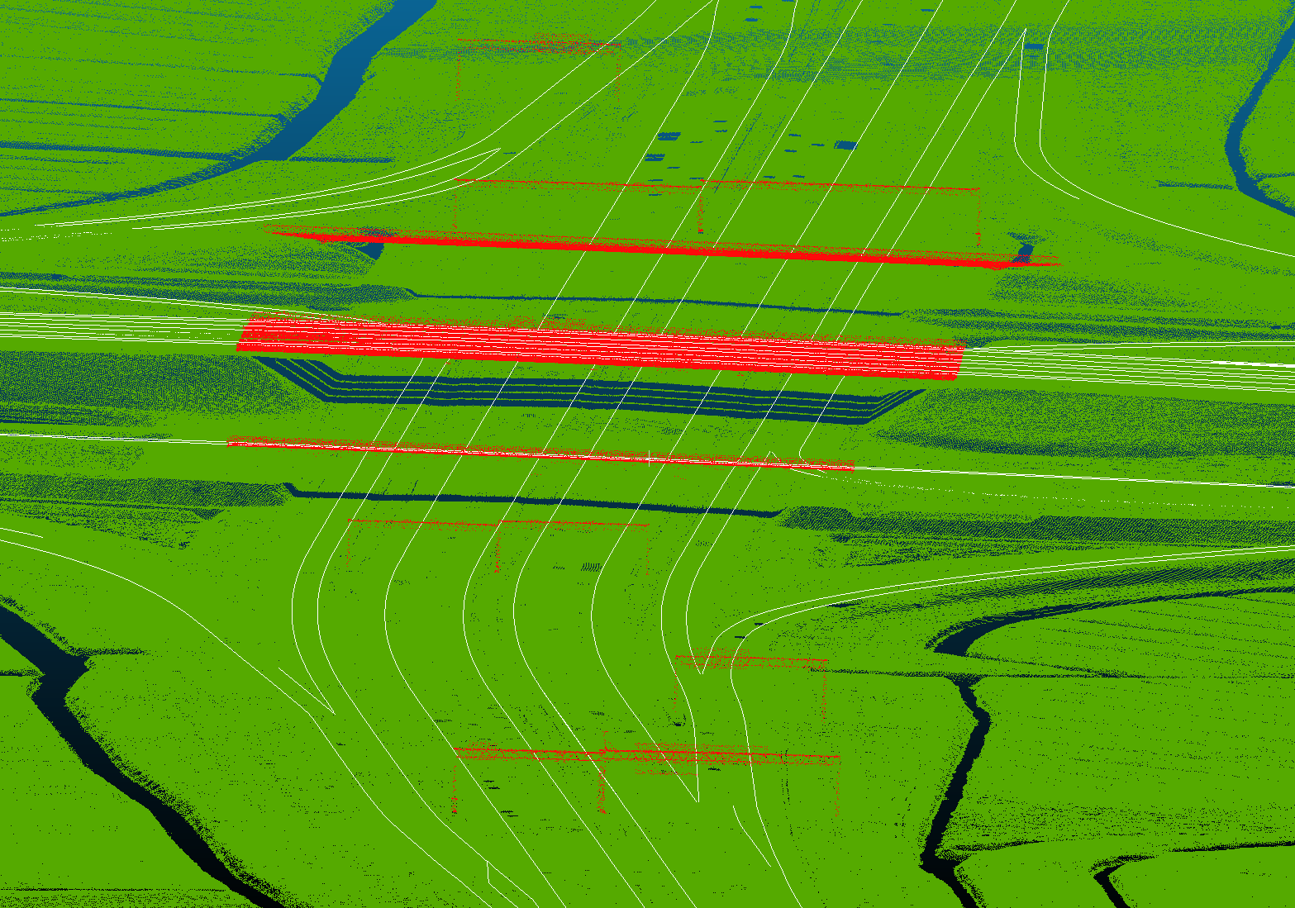
Implementation and challenges Lidar segmentation
AHN3 is the primary source of elevation data
DTB (Digitaal Topografisch Bestand) road surface lines also used where available
Green-red point cloud: AHN3 White lines: DTB’s 3D road markings
Notes:
Next step in pipeline: Lidar segmentation
We wish to associate NBRSs with those Lidar points, which are likely to be relevant to them
AHN3 is used primarily, but it has data gaps in key locations (see under the bridges in the image)
Same goes for tunnels, and all other kinds of occlusion
We use the national infrastructure management dataset DTB to assist us in such cases
However, DTB lines are only available for motorways, and even there coverage is imperfect
In certain cases, contains up to 15-20 years older elevation measurements than AHN3
→ Algorithm needs to work well also in the lack of DTB data

Slide 12
Implementation and challenges Lidar segmentation
Issue: handling entire point cloud at once is inefficient
Solution: segment point cloud into subclouds relevant to each NBRS
Densify NBRSs where needed
Transpose NBRSs to 3D by using elevation of point cloud point closest to each vertex and refine via polynomial fitting
Progressing along NBRS vertices, fit planes on point cloud points close to each vertex
For each vertex, pre-select close-by points that conform with local plane fit
Discard outlier planes by repeating steps 2, but sourcing elevations from pre-selected points
Construct subclouds by merging pre-selected points belonging to non-outlier planes
Perform basic outlier filtering on subcloud
Notes:
Why do we need Lidar segmentation?
In short: to improve performance and make subsequent steps more effective
Workflow:
Perform densification of NBRS vertices where needed
Transpose NBRSs to 3D by using the elevation of the point cloud point closest to each vertex and refine via polynomial fitting
[BRIEFLY SHOW VISUALISATION 1]
Progressing along NBRS vertices, fit planes on point cloud points close to each vertex
For each vertex, pre-select close-by points that conform with local plane fit
Discard outlier planes by repeating step 2, but sourcing elevations from pre-selected points
And then finally, construct subclouds by merging pre-selected points belonging to non-outlier planes
Perform basic outlier filtering on subcloud
Where DTB is available, the software detects occlusion automatically (avoiding the pre-selection of unrelated points). The algorithm benefits from DTB, but works without.

Slide 13
Implementation and challenges Lidar segmentation
[Demo of segmentation results]
Notes:
[SHOW VISUALISATION 2]
Each colour represents one NBRS’s subcloud
Small inaccuracies are possible due to ambiguous plane fits, but these do not influence the output in any way
This is not yet the stage where conservative thresholds are enforced

Slide 14
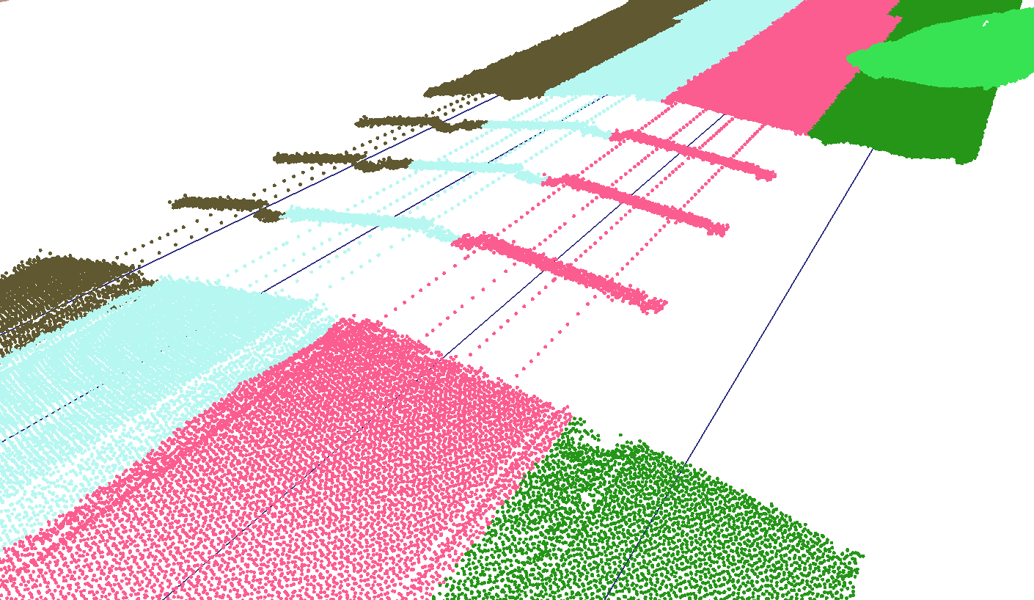
Implementation and challenges Lidar segmentation - challenges
DTB tracking
Handling of no-data parts of NBRS
Long tunnels with no DTB coverage
Ambiguous plane fits
DTB tracking unavailable
Notes:
Algorithm tracks road elevation across no-data zones using DTB
What to do where there is no DTB coverage?
The polynomial-fitting idea was re-used after much deliberation
Long tunnels with no DTB coverage may corrupt the polynomial fit
It is assumed that DTB exists or DTB-like data can be acquired in very long tunnels

Slide 15
Implementation and challenges Edge approximation
Issue: we need seed contours for active contour optimisation
Solution: assemble seed contours (preliminary edges) by inspecting cross-section trends
Construct cross-sections on NBRS vertices
Heavily densify cross-sections, compute elevations from nearby subcloud points
Fit them with lines, select first inlier vertex as the edge point (on both sides of NBRS)
Assemble preliminary edges from the discrete edge points of cross-sections
Notes:
Next step in pipeline: edge approximation
We are looking for 3D lines that delineate the smooth, traffic-occupied parts of roads, which we can then use as seeds for active contour optimisation
Workflow:
Construct cross-sections on NBRS vertices and densify them
Compute elevations for them from nearby part of relevant subcloud
Fit them with lines, select optimal inlier vertices as the edge points on both sides of centreline
Assemble preliminary edges of NBRS from these discrete edge points
Like in the Lidar segmentation algorithm, this algorithm also progresses along the length of each NBRS centreline and performs sanity checks to optimise edge shape and avoid generating artefacts.

Slide 16
Implementation and challenges Edge approximation
[Demo of edge approximation results]
Notes:
[SHOW VISUALISATION 3]
Both the preliminary edges, and the underlying cross-sections are shown
Where a cross-section is missing, the algorithm failed to obtain a sensible result and skipped a vertex as a result
Improvement over preliminary elevation estimates is already apparent, especially for roads with high curvature
This visualisation shows that at large data gaps where DTB is also missing, the NBRS is broken into discrete parts

Slide 17
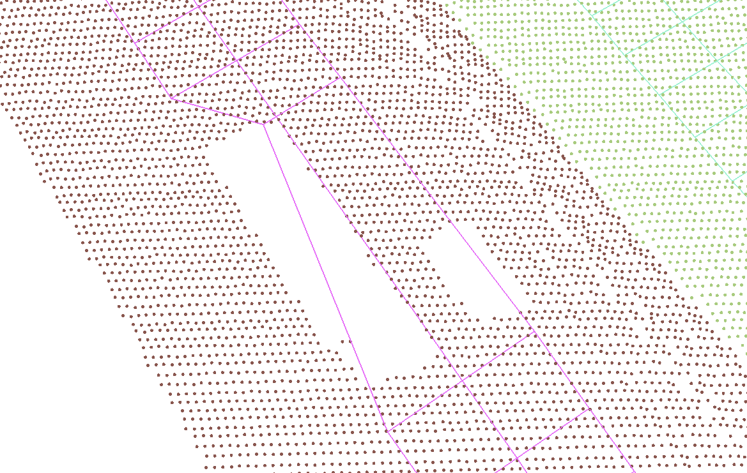
Implementation and challenges Edge approximation - challenges
Large vehicles may leave big data gaps
Sudden width changes need to be penalised by the workflow, but are possible in reality
Problems due to poor georeferencing of NWB
Lorry
Car
Edge is drawn inwards
Notes:
Large vehicles (especially stationary ones) sometimes leave big data gaps, which in some cases artificially shrinks road extents if real-life edges are occluded as a result
Width-related thresholds need to be enforced to avoid generating artefacts
Commonly, for wide roads this means that not their entire surface will fall between the edges
Most importantly, NWB centrelines are sometimes very close to road edges, or even off-road
Due to poor georeferencing of NWB
Difficult to visualise this problem, so no illustration is shown – but I will show it in the context of active contour optimisation
Edges constructed in such places will inevitably also be incorrect
This can go on for tens of meters depending on NWB
It almost always happens in very sharp bends
RWS is already working on fixing this

Slide 18
Implementation and challenges Active contour optimisation
Issue: preliminary edges are angular, often do not cover the whole road surface
Solution: iteratively improve edge locations using active contour optimisation
Construct an attractor map for each NBRS
Find an active contour optimisation parametrisation that works well with the whole dataset
Run active contour optimisation for each NBRS, inputting the attractor maps and preliminary edges
Notes:
Next step in pipeline: active contour optimisation
With it, we wanted to make the edges better adapt to the real-life road edges based on detecting large-scale breaks in surface smoothness
Workflow:
Construct an attractor map for each NBRS
Currently, my attractor map pixels contain median pairwise normal vector inner products of pixels falling into a moving window
Pixel normal vectors (of each pixel), in turn, are based on the subcloud points close to pixel centres
Find an active contour optimisation parametrisation that works well with all of the data (meaning the entire Netherlands)
The type of attractor map was selected in parallel with optimising the parametrisation
In the final configuration, the edge-detection component of active contour optimisation dominates
Run active contour optimisation for each NBRS, inputting their attractor maps and preliminary edges

Slide 19
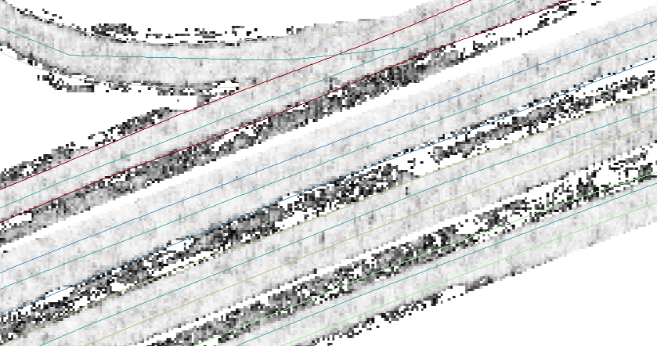
Implementation and challenges Active contour optimisation
Works ideally
Road too wide
NWB too close to edge
Notes:
The maps look convincing, suitable for edge detection in the general sense
In the technical sense, the implementation is stable and produces usable results
In the practical sense, I was unable to find a configuration that would significantly and reliably improve the quality of the edges
Issue related to NWB position relative to road edge is shown here

Slide 20
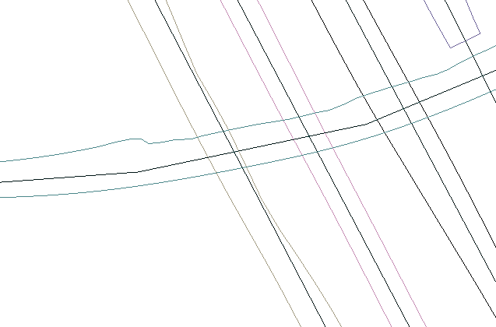
Implementation and challenges Active contour optimisation - challenges
Too close to centreline
Often produces unpredictable results (artefacts)
Susceptible to imperfect Lidar coverage
Works well only at high resolution and using all available Lidar points (slow)
Optimisation algorithm itself is rather slow
→ Implemented a bypass procedure
Artefact
Notes:
Extremely susceptible to changes in Lidar coverage, frequently fails where only DTB is available
Scikit algorithm I use is itself rather slow, especially at the high resolution required to obtain useful results
The severity of the produced artefacts is not negligible
Overall, the usefulness and reliability of the procedure is questionable
Implemented a bypass, TINs can also be constructed directly from preliminary edges without a degradation in quality

Slide 21
Implementation and challenges TIN construction
Issue: create efficient interpolation structure through which accuracy can be propagated
Also: academic desire to model surface
Solution: build TIN of road surface points procedurally
Seed the TIN using points close to the skeleton of road surface contours
Grow the TIN within the contours using an algorithm inspired by ground filtering workflows
Extend the TIN beyond the contours using very conservative insertion thresholds
Notes:
Next step in pipeline: TIN construction
Need to create an interpolation structure from where elevations for NWB can be extracted effectively
Also want to model the road surface – why not do both in a single step?
Workflow:
Seed the TIN using points close to the skeleton of road surface contours
Grow the TIN within the contours using an algorithm inspired by TIN-based ground filtering workflows
Extend the TIN beyond the contours using very conservative insertion thresholds

Slide 22
Implementation and challenges TIN construction
[Demo of TIN construction results]
Notes:
[SHOW VISUALISATION 6]
TINs are certainly accurate enough for NWB interpolation
In certain cases, they may include off-road points or not extend all the way to the edge
However, overall quality is good, and if NWB georeferencing is refined over time, it will become even better

Slide 23
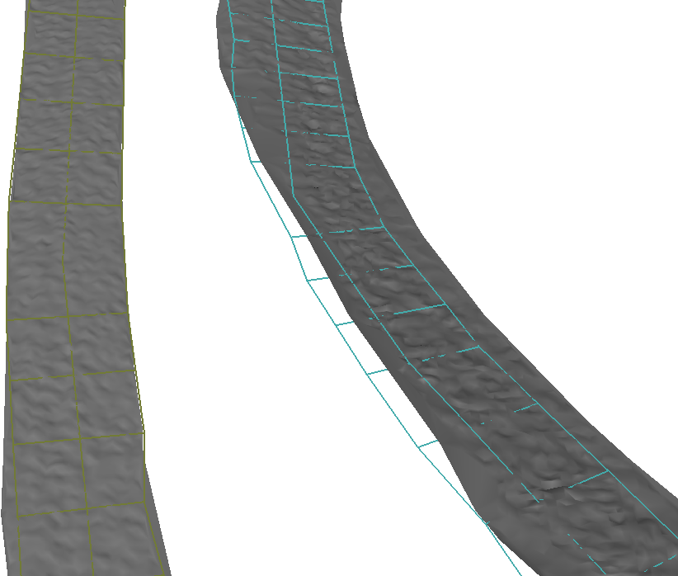
Implementation and challenges TIN construction - challenges
Developing a solution that works with optimised contours and preliminary edges
Key was to start with a handful of seed points halfway between the edges or contours, then carefully grow the surface from there
Biggest bottleneck remains that NWB centrelines are far from the real centres of roads in many places
NWB leaves road surface
NWB is well-behaved
Notes:
Biggest challenge was the difficulty in developing a solution that works with…
…the (not always so great) optimised contours…
…and the preliminary edges as well
It was also difficult to handle conditional insertions outside the TIN’s convex hull, which is not needed in normal ground filtering
Ultimately, the key was to start with a handful of seed points halfway between the edges or contours…
…which in almost all cases will be true road surface points…
…and then carefully grow the surface from there
Biggest bottleneck remains that where NWB centrelines are far from the real centres of roads, both preliminary edges and optimised contours tend to be inaccurate
Most commonly this results in the inclusion of off-road points in the TIN

Slide 24
Implementation and challenges Interpolation and 3D-NWB assembly
Issue: need to convert NWB to 3D based on the surface models
Solution: interpolate NWB vertices in the TINs of each NBRS
Interpolate at NBRS vertices in the TIN
Take care to only interpolate once at each location, to ensure continuity across intersections
Perform high-degree polynomial fitting to interpolate in zones of missing data
Notes:
Next step in pipeline: interpolation and assembly of 3D-NWB
We wish to export a file almost identical to the input in every sense other than the added Z coordinates
Workflow:
Interpolate in the TIN to produce 3D-NWB
Take care to only interpolate once at each location, to ensure continuity across intersections
Perform high-degree polynomial fitting to interpolate in zones of missing data
Each output vertex possesses an attribute indicating whether its elevation is based on AHN, DTB or polynomial-based interpolation.

Slide 25
Implementation and challenges Interpolation and 3D-NWB assembly
[Demo of interpolation results]
Notes:
[SHOW VISUALISATION 7]
The procedure has improved the quality of the 3D conversion significantly
Comparison is with the initial elevation estimates used in the first part of point cloud segmentation
Slight angularity at 5-times vertical exaggeration is due to Lidar noise!
Also, occasional bumps are the result of DTB-based interpolation where DTB is not in good agreement with AHN3 (suspect subsidence as the culprit)

Slide 26

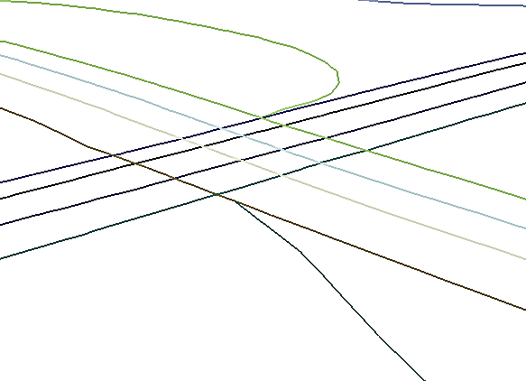
Implementation and challenges Interpolation and 3D-NWB assembly - challenges
Production of 3D-NWB from the TIN was the least challenging step
Keeping track of which output point’s elevation comes from where was tricky
Enforcing continuity across intersections was easy
Continuity is enforced
Notes:
Ironically, the production of 3D-NWB from the TIN was the least challenging step
Keeping track of which output point’s elevation comes from where was possibly the only tricky part
Enforcing continuity across intersections was easy, because in practice the same, or almost the same points are inserted in intersections into the TINs of each NBRS concerned

Slide 27
Summary and next steps Summary and next steps
Original goals related to 3D conversion of NWB fulfilled
Academic topics related to surface modelling explored in-depth
Active contour optimisation works, but was found to be ineffective
Proof-of-concept software nearing completion, is in working order
Next (and last) steps:
Accuracy assessment
Comparison with commercial results
Notes:
Original goals related to 3D conversion of NWB have been fulfilled
Academic topics related to surface modelling were explored in-depth
Active contour optimisation was found to be ineffective, perhaps even unnecessary
It was a core part of the original workflow, so a key conclusion will be that simpler in this particular case is better – especially considering the geographical scale and computational complexity
Proof-of-concept software nearing completion, is in working order
Next (and last) steps:
Accuracy assessment
Comparison with commercial results

Slide 28
Constructing a digital 3D road network for The Netherlands T
Thank you for your attention!

Slide 29
Constructing a digital 3D road network for The Netherlands T
Questions

