Slide 1
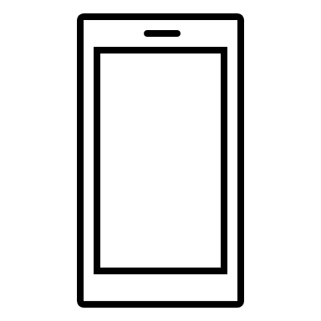
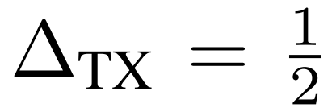
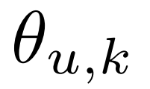
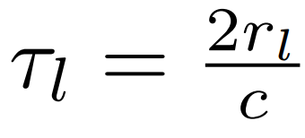
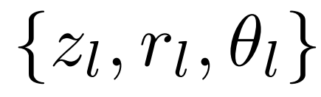

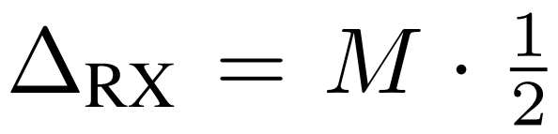







$M$ antenna BS
$u$-th user at $k$-th subcarrier
$N$ antenna receiver
$$F_{k}$$
…
$$r_{l}$$
…
$$θ_{l}$$
$$z_{l}$$

Slide 2





$M$ antenna BS
$N$ antenna receiver
$$F_{k}$$
$u$-th user assigned to
k-th subcarrier
…
$$r_{l}$$
…
$$θ_{l}$$
$$z_{l}$$
$l$-th scatterer
$N$ antenna receiver

Slide 3






$U$users per physical resource block
$M$ antenna BS
$$r_{l}$$
…
$$θ_{l}$$
$$z_{l}$$
$l$-th scatterer
$N$ antenna receiver

