Slide 2
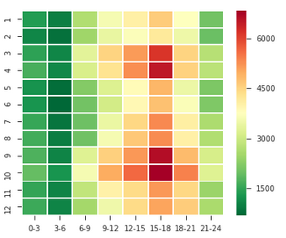
事故数のHeatmap：月と時間帯
ピークは午後の３時から６時の秋と春に分かれている．

Slide 3
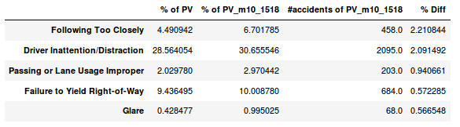
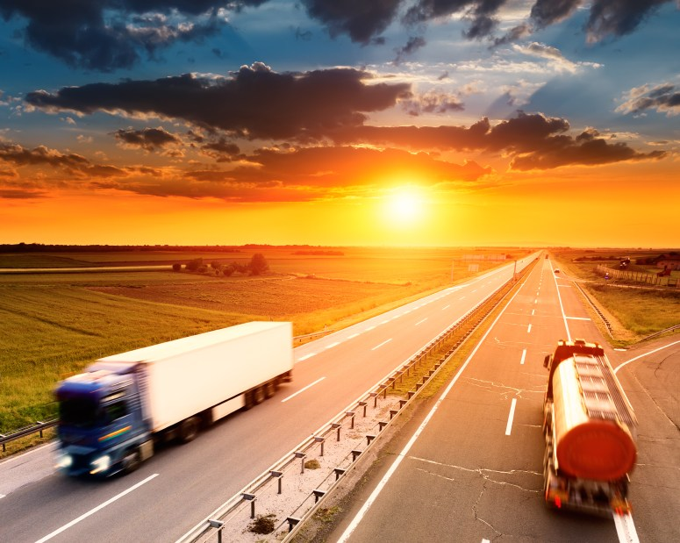
秋の事故原因の分析
Reasoning for these contributing factors:
Days getting shorter means more darkness
School zones reset speed limit
New Teen Drivers are on the streets

Slide 4
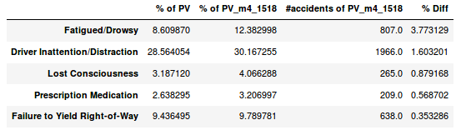
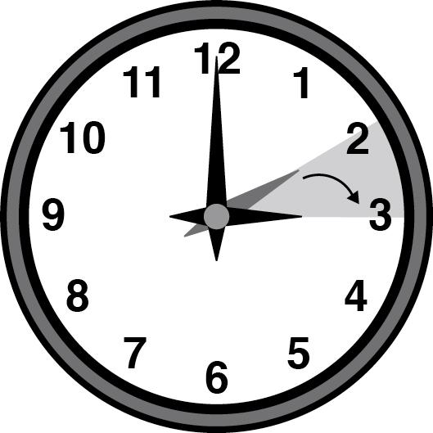
春の事故原因の分析
Reasoning for these contributing factors:
Daylight savings time links to sleep problems and drowsy driving accidents

Slide 5
改善する提案
Automatic Braking System
Keep distance sign

