Slide 1
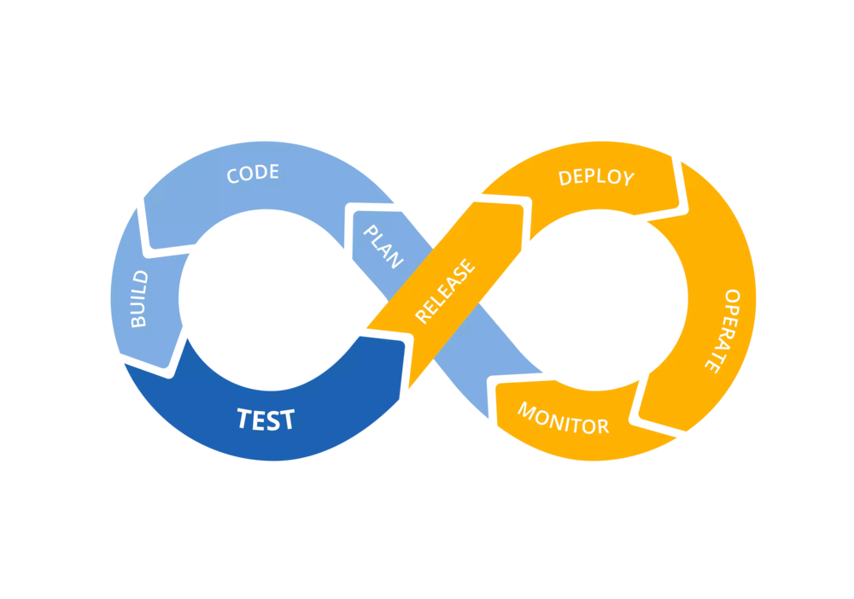
Continuous Integration and Delivery (CI/CD)

Slide 2

WHAT IS CI/CD ?
The practice of automating the integration of code changes from multiple contributors into a single software project
Continuous integration leads to continuous deployment allowing us to deliver software more rapidly
Notes:
This is the Jenkins Dashboard.

Slide 3
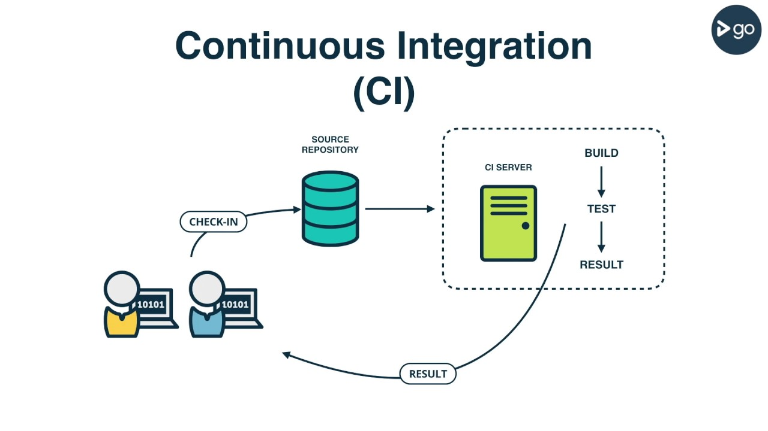

Slide 4

Open Source Continuous Integration Server

Slide 5
WHAT IS JENKINS?
Monitors executions of repeated jobs
Used primarily for continuously building and testing software projects, i.e. “Continuous Integration” or “CI”
Previously known as “Hudson”
http://jenkins-ci.org

Slide 6





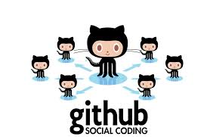







WHO USES JENKINS?

Slide 7
WHY USE JENKINS?
Immediate feedback on broken builds
No building from dev machines and manually copying files
Automated deployment
Automated test execution and feedback

Slide 8
PLUG-INS
Over 600 plug-ins available for customization
Examples:
  JIRA
  Ant
  Maven
  JUnit
  Javadoc
  SSH
  MSBuild
  NUnit
  PowerShell
  Email Notifications
https://wiki.jenkins-ci.org/display/JENKINS/Plugins

Slide 9
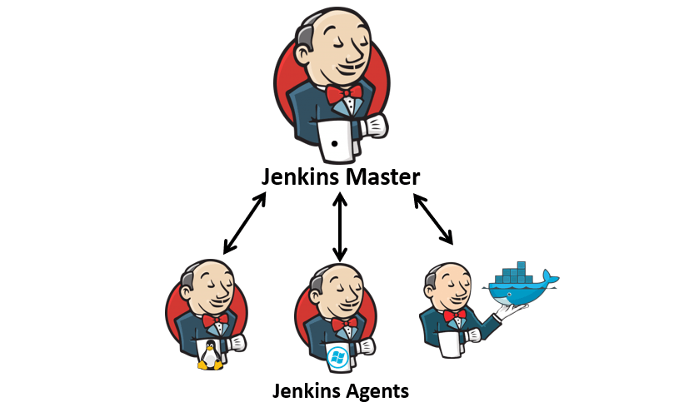
DISTRIBUTED BUILDS
Jenkins architecture is fundamentally "Master+Agent“
The master is designed to do co-ordination and provide the GUI and API endpoints, and the Agents are designed to perform the work

Slide 10
QUESTIONS?

Slide 11
INSTALLATION
Prerequisites :
Create a VM with Vmware/Virtualbox using image centos
Logged to your machine as root (or user with sudo privileges)
Installing Jenkins :
1. Java is a java application, so you need to install java
$ sudo yum install java-1.8.0-openjdk-devel
2. Enable Jenkins repository
$ curl --silent --location http://pkg.jenkins-ci.org/redhat-stable/jenkins.repo | sudo tee /etc/yum.repos.d/jenkins.repo
$ sudo rpm --import https://jenkins-ci.org/redhat/jenkins-ci.org.key

Slide 12
INSTALLATION
3. Install and start Jenkins
$ sudo yum install jenkins
$ sudo systemctl start jenkins
$ sudo systemctl status jenkins
$ sudo systemctl enable jenkins
4. Allow Jenkins port to be accessible from outsite the VM
$ sudo firewall-cmd --permanent --zone=public --add-port=8080/tcp
$ sudo firewall-cmd –reload
5. Open http://your_ip_or_domain:8080 and setup your jenkins
You can find more at link below :
https://linuxize.com/post/how-to-install-jenkins-on-centos-7/

Slide 13
JENKINS PIPELINE
A continuous delivery pipeline is an automated expression of your process for getting software from version control right through to your users and customers

Slide 14
Jenkinsfile (Declarative Pipeline)
pipeline {
agent any
stages {
stage('Build') {
steps {
sh 'makemvn -B -DskipTests clean package'
}
}
stage('Test'){
steps {
sh 'mvn test'
}
post {
always {
junit 'target/surefire-reports/*.xml'
}
}
}
stage(‘Deliver') {
steps {
sh './jenkins/scripts/deliver.sh'
}
}
}
}

Slide 15
QUESTIONS?

Slide 16
EXAMPLE 1
Build a java app with maven
1. Clone https://github.com/ericsonrumuy7/Jenkins-future.git to your local machine
2. Open your jenkins and create pipeline job
3. Setup post-commit git to trigger Jenkins pipeline job
More info :
http://www.andyfrench.info/2015/03/automatically-triggering-jenkins-build.html
https://jenkins.io/doc/tutorials/build-a-java-app-with-maven/

Slide 17
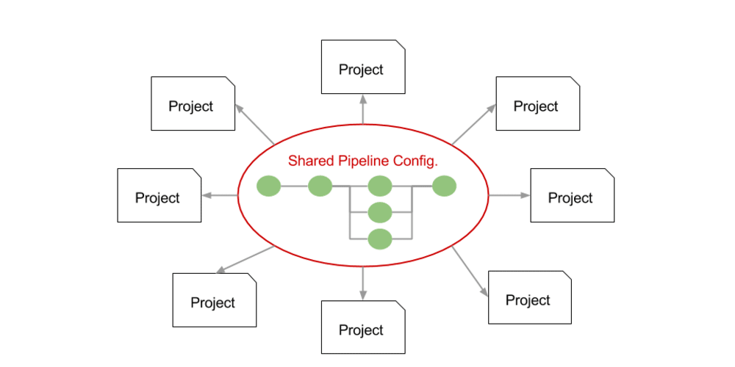
CENTRALIZED PIPELINE
As Pipeline is adopted for more and more projects in an organization, common patterns are likely to emerge. Oftentimes it is useful to share parts of Pipelines between various projects to reduce redundancies and keep code "DRY"

Slide 18
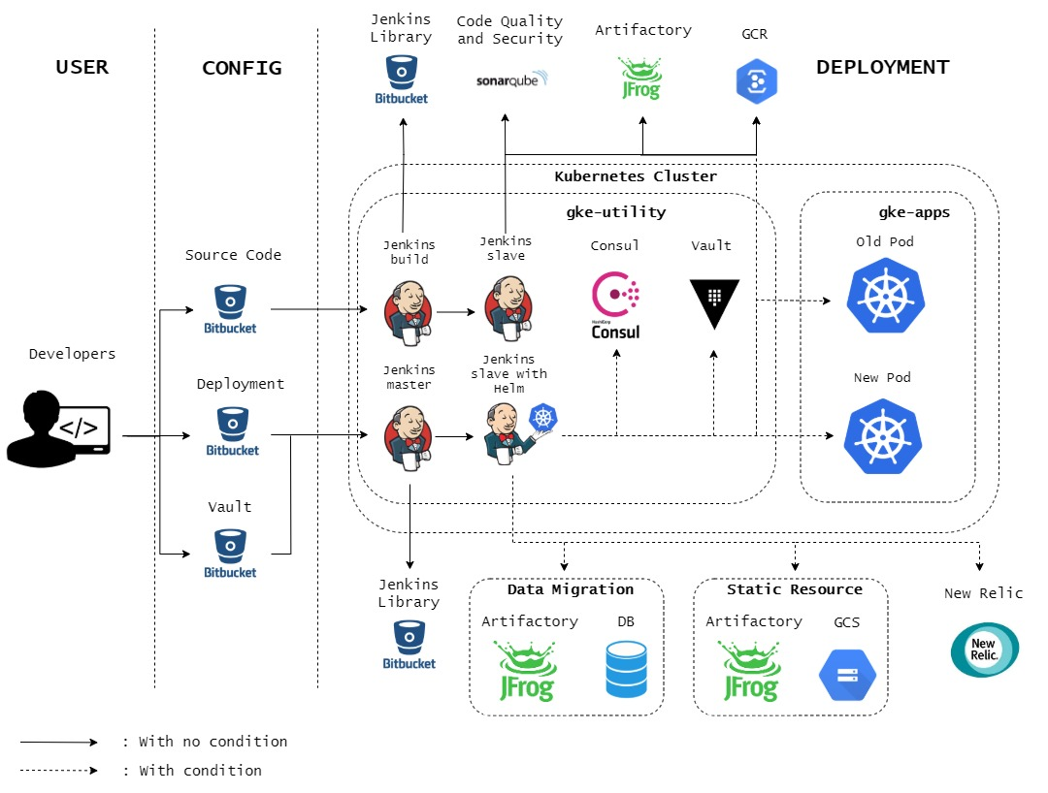
CI/CD AT BLIBLI.COM

Slide 19
EXAMPLE 2
Implement Jenkins shared library
1. Clone https://github.com/ericsonrumuy7/Jenkins-future.git to your local machine
2. Configure global library pipeline from Jenkins UI
3. Update your Jenkinsfile in maven repo (example 1) to use library
More info :
https://jenkins.io/doc/book/pipeline/shared-libraries/

Slide 20
QUESTIONS?

Slide 21
TAKS 1
Deploy java maven application (example 1) to targeted VM using shared library

Slide 22
TAKS 2
Deploy using agent Jenkins

Slide 23
QUESTIONS?

