Slide 1






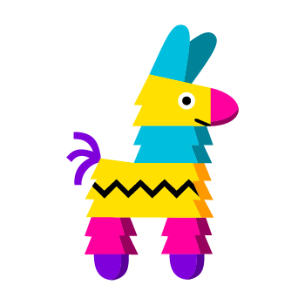



(DApp) Secret Storage Decentralized Application
Krisna Mughni - 49253
Decentralize Storage
UI & Web Server
Blockchain Dev Tools

