Slide 1
Zestimates
Kaggle Zillow Competition

Slide 2
Background
- Kaggle competition with $1,000,000 prize!!
- Predicting logerror of Zillow’s home estimate vs actual sale price
- Very real world - finding what an existing model might not be capturing

Slide 3
Data
- Provided by Zillow
- Home sales for LA, Orange, and Ventura counties from Jan-Dec ’16
- 59 features!
Hard to visualize!
So much cleaning

Slide 4
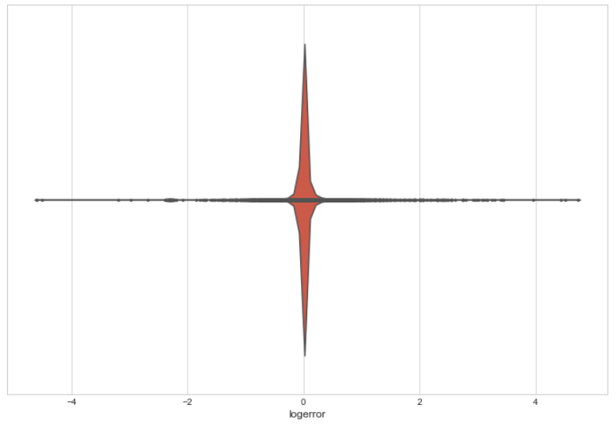
Logerrors
Logerror = log(zestimate) – log(sale price)
The log difference between Zillow’s price prediction and the actual sale
Gonna be hard to improve on that!

Slide 5
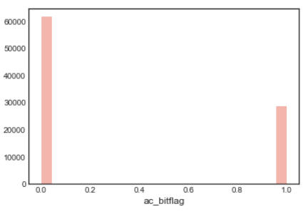
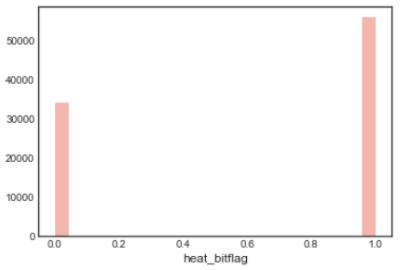
AC Vs heating
The majority of homes sold in southern California don’t have any air conditioning!
‘06 LA Times article somewhat corroborates: “In Orange County, 61% have some kind of air conditioning”
But they do have heating!

Slide 6
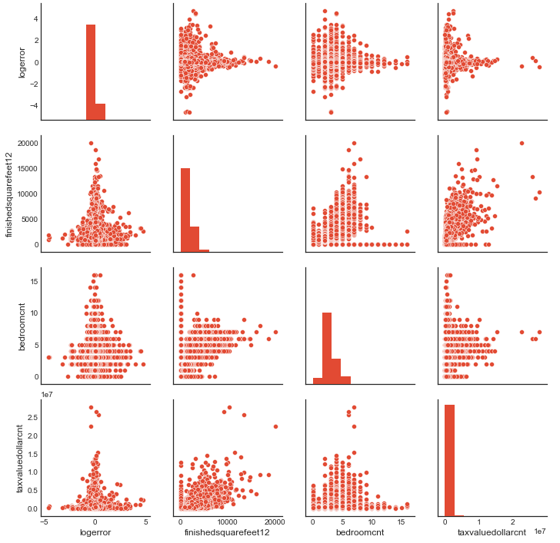
Pairplots
Zestimates fairly accurate for high value homes – large square footage and large tax value
Accuracy loss for 2-5 bedrooms, 0-5000 sq. ft., and 0-5mm tax value

Slide 7
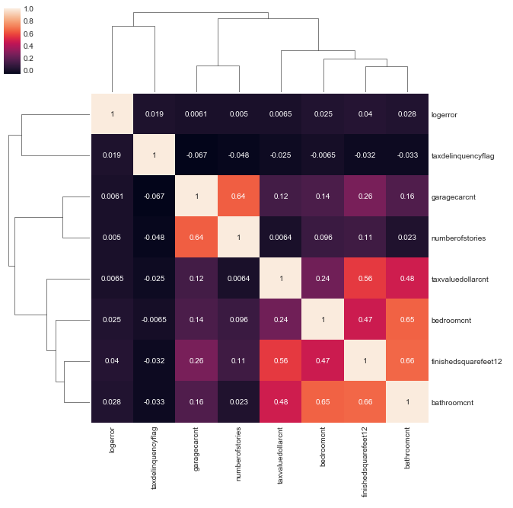
Correlations
Logerror has low correlations everywhere
Uh Oh
Sanity check – bedrooms, bathrooms, taxes, and square footage correlated

Slide 8
Model - Linear regression
Chasing a continuous variable with access to many independent features so using linear regression
Independent features possibly have multicollinearity
- Started with OLS
- Then used Ridge, 5 fold cross validation, grid search

Slide 9
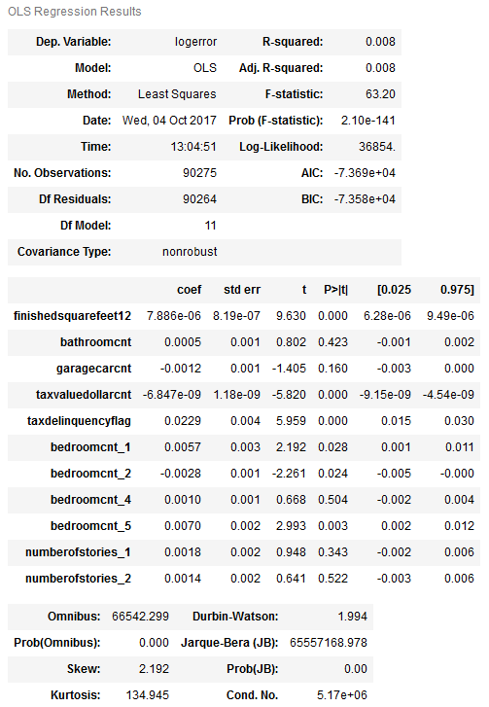
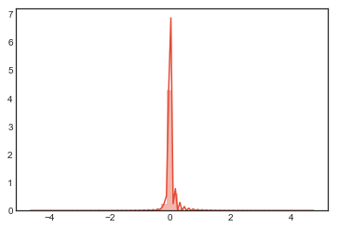
Model - OLS
- Coefficients practically 0
- R-squared miniscule
- pvalues significant for sq.ft., taxes
- Residuals similar to original logerror plot itself, because model basically predicts a zero
- RMSE basically identical to logerror standard deviation: .16

Slide 10
Cross validation And Grid Search
Var | coefficient
square feet | 0.00001
bathroom count | 0.00051
garage car cnt | -0.00116
tax value | 0.00000
tax delinquency flag | 0.02170
bedroomcnt_1 | 0.00558
bedroomcnt_1 | -0.00281
bedroomcnt_1 | 0.00096
bedroomcnt_1 | 0.00689
number of stories 1 | 0.00181
number of stories 2 | 0.00139
- 5 folds
- Grid search best estimator alpha = 100
- Coefficients even closer to 0:

Slide 11
Conclusion
- Not going to win the million dollars ☹
- The more features, the more time spent cleaning!
- Predicting real data scientist’s errors is fairly difficult
- Most correlations have been mined

Slide 12
Next steps
- Could run a classifier first to account for different property types, then linear regression
- PhD in Data Science

