Slide 1
Student Satisfaction with R vs. Excel in Data Mining and Business Analytics:
A Herzberg’s Motivation-Hygiene Theory Perspective
Siva Sankaran
Department of Systems and Operations Management
California State University, Northridge, siva.sankaran@csun.edu
Kris Sankaran
Department of Statistics
University of Wisconsin - Madison, ksankaran@wisc.edu
Tung Bui
Department of Information Technology Management
University of Hawaii at Manoa, tungb@hawaii.edu

Slide 2


Context
How do students respond to a change in data science interfaces?
Natural Experiment: California State University at Northridge recently transitioned its Decision Support Systems course from Excel to R
This course is required for Information Systems / Operations Management majors
All students had a minimum of 3-year Excel experience but no prior exposure to R
The course textbook was Data Mining for Business Analytics: Concepts, Techniques, and Applications with XLMiner, 3rd Edition by Shmueli, Bruce & Patel (Wiley)
?

Slide 3
Research Objectives
How did this transition influence student satisfaction in the course?
We followed Herzberg’s Motivation-Hygiene theory.
Hygiene Factors
Compulsory requirement to learn R, a new and challenging language for students in this study
Perceived effort in learning R for the first time
Motivating Factors
Intrinsic interest in Data Mining and Business Analytics (DMBA)
Perception that R is a better tool for DMBA than Excel
View that R is a facilitator of career advancement

Slide 4

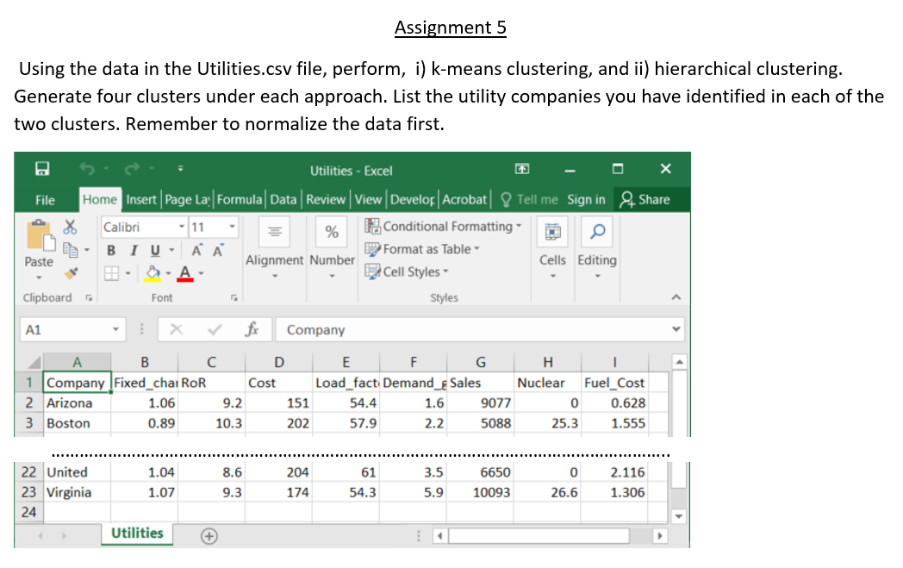
Study Design
120 undergraduate students participated. All were in their final semesters and had previously taken at least one Excel course during their undergraduate degrees.
The same instructor taught all three courses using the same syllabus.
Topics covered: R basics, functions, data manipulation and using packages
Homework assignments: i) R basics, ii) Classification, iii) Logistic Regression, iv) Neural Networks, and v) Clustering

Slide 5
Statement # |  | Excerpts of Statements in Survey | Mean | Std Dev.
 | 1 | Like to solve quantitative and analytical problems | 3.52 | 1.18
 | 2 | Interested in DMBA | 3.40 | 1.27
 | 3 | Like to learn quantitative and analytical skills | 3.66 | 1.03
 | 4 | Don't want a job as data scientist | 2.90 | 1.42
 | 5 | Course gave good DMBA experience | 4.14 | 0.87
 | 6 | Hands-on experience realistic | 4.34 | 0.78
 | 7 | R is useful in learning DMBA | 4.48 | 0.80
 | 8 | DMBA skills taught were relevant | 4.27 | 0.90
 | 9 | Learning R was easy | 2.26 | 1.08
 | 10 | Compared to Excel, Learning R takes more time and effort | 4.42 | 0.86
 | 11 | R requires writing program code | 4.33 | 0.84
 | 12 | R assignments were difficult to do | 3.32 | 1.21
 | 13 | R enhances job prospects | 4.21 | 0.93
 | 14 | Job prospects with R better than Excel | 3.78 | 1.11
 | 15 | R should be continued to be taught in the course | 4.06 | 0.91
 | 16 | Learning R has long term benefit | 4.07 | 0.94
 | 17 | Don't plan to use R in future | 2.83 | 1.36
 | 18 | Experience level with Excel | 3.96 | 1.37
 | 19 | Level of class preparations in using Excel | 3.59 | 1.32
 | 20 | Knowledge and ability to use Excel | 3.93 | 1.09
 | 21 | Level of experience using macros in Excel | 1.79 | 1.23
 | 22 | Level of experience in VBA coding | 1.78 | 1.34
 | 23 | Writing VBA code takes longer than using R | 3.51 | 0.98
 | 24 | R packages helps to write programs quickly | 3.43 | 0.99
 | 25 | Excel can do data mining faster and easier than R | 2.53 | 1.26
Survey
Instrument
Responses were measured on a Likert scale of 1-5.

Slide 6
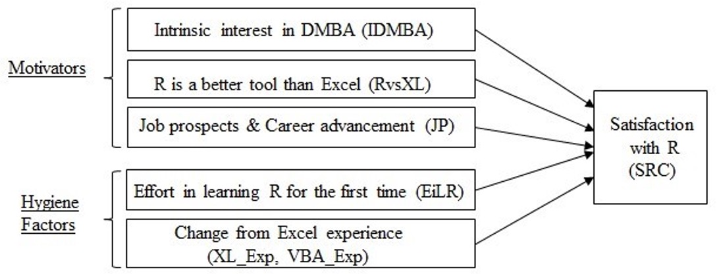
Research Model
This instrument allows us to formalize the relationship between motivators, hygiene factors, and satisfaction.

Slide 7
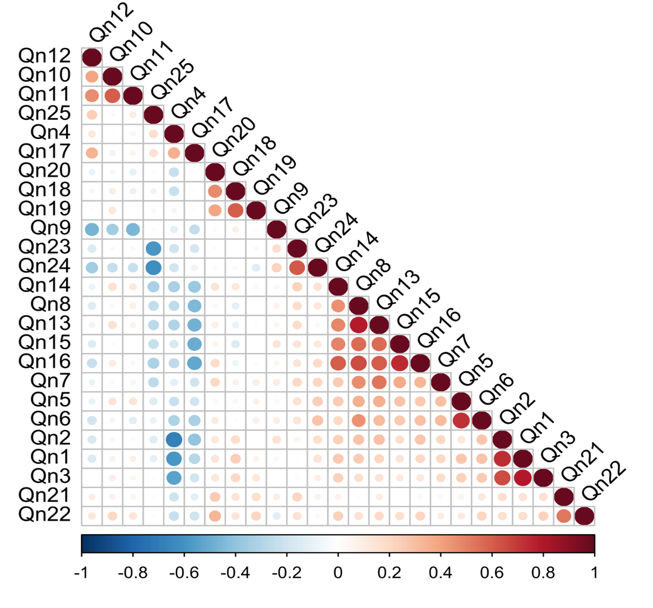
Correlations Among Survey Question Responses

Slide 8
Principal Components Analysis
Descriptive names & abbreviations
Scree Plot
Survey statement | Names of PCA-extracted Factors | Abbreviations | Cronbach 𝛼
1 - 4 | Intrinsic interest in Data Mining & Business Analytics | IDMBA | 0.88
5 - 7 | Satisfaction with R in the Course | SRC | 0.75
9 – 12 | Effort in Learning R for the first time | EiLR | 0.76
8, 13 – 17 | Job Prospects & Career advancement | JP | 0.83
18 – 20 21 – 22 | Change from Excel experience: i. Interactive ii. Programming | XL_Exp VBA_Exp | 0.74 0.68
23 – 25 | R is a better tool than Excel for DMBA | RvsXL | 0.82
Scree Plot:

Slide 9
Principal Components Analysis
Loadings
Descriptive names & abbreviations
Factor=Value (Survey question #)
JP = 0.78 (Qn 8) + 0.81 (Qn13) + 0.66 (Qn14) + 0.82 (Qn15) + 0.86 (Qn16) - 0.64(Qn17)
IDMBA = 0.89(Qn1) + 0.86(Qn2) + 0.85(Qn3) - 0.74(Qn4)
EiLR = -0.74(Qn9) + 0.75(Qn10) + 0.83(Qn11) + 0.71(Qn12)
R_vs_XL = 0.83(Qn23) + 0.81(Qn24) - 0.85(Qn25)
XL_Exp = 0.85(Qn18) + 0.81(Qn19) + 0.71(Qn20)
VBA_Exp = 0.85(Qn21) + 0.77(Qn22)
SRC = 0.85(Qn5) + 0.84(Qn6) + 0.37(Qn7)
Survey statement | Names of PCA-extracted Factors | Abbreviations | Cronbach 𝛼
1 - 4 | Intrinsic interest in Data Mining & Business Analytics | IDMBA | 0.88
5 - 7 | Satisfaction with R in the Course | SRC | 0.75
9 – 12 | Effort in Learning R for the first time | EiLR | 0.76
8, 13 – 17 | Job Prospects & Career advancement | JP | 0.83
18 – 20 21 – 22 | Change from Excel experience: i. Interactive ii. Programming | XL_Exp VBA_Exp | 0.74 0.68
23 – 25 | R is a better tool than Excel for DMBA | RvsXL | 0.82
Scree Plot:

Slide 10
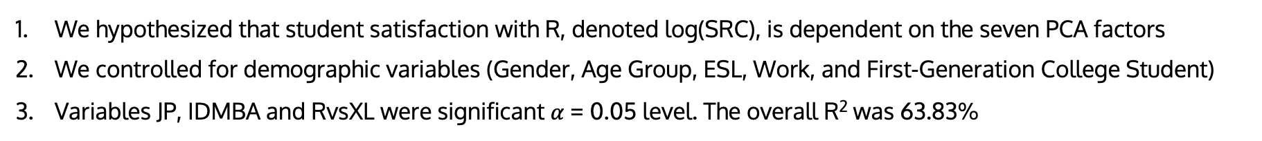
Generalized Additive Modeling (GAM)
We hypothesized that student satisfaction with R, denoted log(SRC), is dependent on the seven PCA factors
We controlled for demographic variables (Gender, Age Group, ESL, Work, and First-Generation College Student)
Variables JP, IDMBA and RvsXL were significant $α$= 0.05 level. The overall R² was 63.83%
 | Degrees of freedom | Sum of Squares | Mean Squares | F statistic | p-value
s(JP) | 1 | 1.20 | 1.20 | 96.49 | 1.04E-15 | ***
s(IDMBA) | 1 | 0.07 | 0.07 | 5.84 | 0.02 | *
s(EiLR) | 1 | 0.00 | 0.00 | 0.00 | 0.98
s(RvsXL) | 1 | 0.06 | 0.06 | 4.62 | 0.03 | *
s(XL_Exp) | 1 | 0.02 | 0.02 | 1.42 | 0.24
s(VBA_Exp) | 1 | 0.01 | 0.01 | 0.64 | 0.43
ESL | 1 | 0.00 | 0.00 | 0.08 | 0.78
AgeGp | 4 | 0.08 | 0.02 | 1.54 | 0.20
Work | 2 | 0.00 | 0.00 | 0.01 | 0.99
Gender | 1 | 0.00 | 0.00 | 0.00 | 0.99
FGC | 1 | 0.00 | 0.00 | 0.08 | 0.78
Residuals | 86 | 1.07 | 0.01

Slide 11
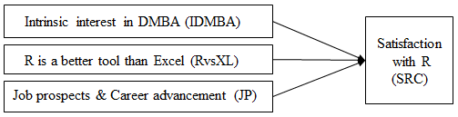
Revised Model
We repeated the GAM procedure using only the three significant variables, JP, IDMBA and RvsXL
Our estimates were:
Motivation factors: JP (F =97.81, p < 0.001) & IDMBA (F = 6.04, p = 0.02)
Hygiene factor: RvsXL (F = 4.57, p = 0.08)
3. This reduced model has an R² of 57.6%. The factors can be interpreted as
IDMBA: Genuine interest in DMBA
JP: Perception that knowing R would enhance job prospects
RvsXL: Perception that R is better than Excel for data analytics
4. The hygiene factors EiLR, XL_Exp and VBA_Exp were not statistically significant

Slide 12
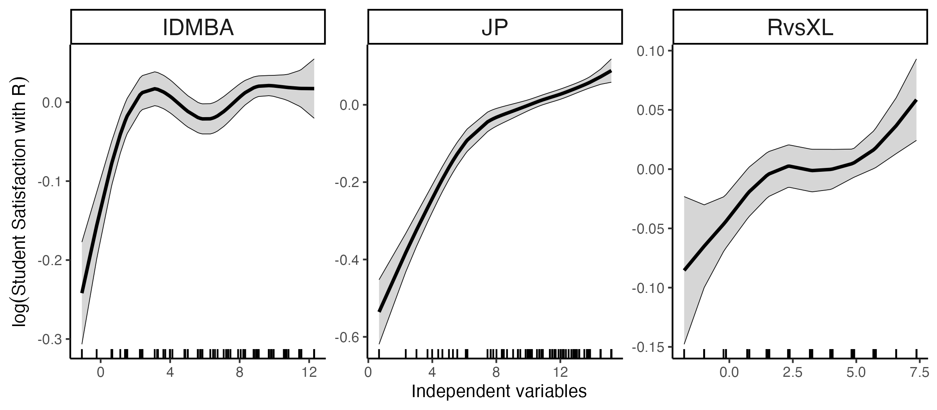
Visualization of GAM Results
The marginal relationships between JP (job prospects), IDMBA (intrinsic interests), and RvsXL (software perception) with log(SRC) (satisfaction with R).

Slide 13
Demographic Analysis
Variable | Category |  | Category ID | Counts
Gender | Men Women | 1 0 |  | 82 38
Age group | <18 years 18-20 years 21-23 years 24-26 years 27-29 years >29 years |  | 1 2 3 4 5 6 | 0 4 59 29 13 15
ESL | Yes No |  | 1 0 | 59 61
Employed or not | Full time |  | 1 | 51
 | Part-time |  | 2 | 39
 | NA |  | 3 | 30
First to go to College | Yes |  | 1 | 47
 | No |  | 0 | 73

Slide 14
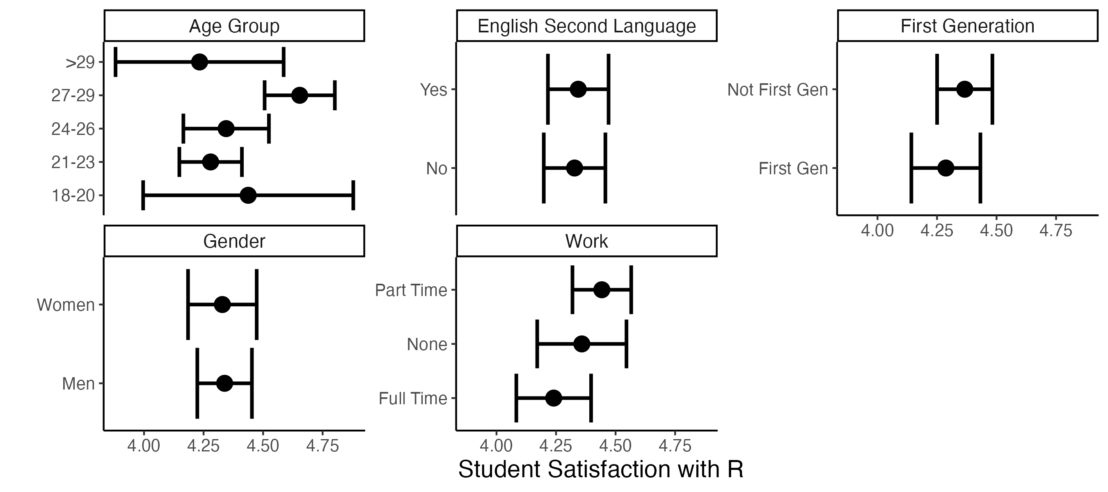
Demographic Analysis
90% confidence intervals of SRC by Age Group, ESL, First-Generation College Student, Gender, and Work.

Slide 15
Demographic Analysis
 | Gender | Age Group | ESL | Employed or not | First to go to College
 | Male = 1 Female = 0 |  | ESL = 1 Not ESL = 0 | Full-time: 1 Part-time: 2 NA: 3 | FGC = 1 Not FGC = 0
Difference in SRCs between groups, p-values | 0.015, p=0.23 | 3-2: -0.16, p=0.98 4-2: -0.09, p=0.99 5-2: 0.22, p=0.96 6-2: -0.20, p=0.97 4-3: 0.07, p=0.98 5-3: 0.37, p=0.24 6-3: -0.05, p=0.99 5-4: 0.31, p=0.52 6-4: -0.11, p=0.97 6-5: -0.42, p=0.33 | 1-0: 0.15, p=0.88 | 2-1: 0.20, p=0.24 3-1: 0.12, p=0.66 3-2: -0.83, p=0.82 | 1-0: -0.79 p=0.47

Slide 16

Implications for Course Design
Instructors teaching Data Mining / Business Analytics still debate whether to use Excel with add-ins, or use a programming language like R.
Hygiene Factors: Our study shows neither the effort to learn R for the first time nor the denial of existing Excel skillsets appear to be strong hygienic factors.
Motivation: The effort required to learn R was not a deterrent to satisfaction. In our study, students perceived R as a vehicle in finding jobs that provide intrinsically satisfying careers.
Fairness: We did not detect any associations between demographic characteristics (ESL, AgeGp, Work, Gender, FGC) and overall satisfaction.

Slide 17
Limitations and Future Research
Missing Factors: There are also other potential independent factors that we did not consider; for example: student ability, engagement, teaching and study methods, skill in code reading / writing / debugging and pedagogy
Context Specificity: We study the students’ perception of learning R not as a standalone course, but as an accompanying tool in a DMBA course. The students’ survey may be biased as the satisfaction of using R depends on the quality of the statistical theories and concepts taught in the course.
No Interactions: The GAM analysis used in this study is superior to linear regression, but it does not account for possible interactions among the predictors used in the model.

Slide 18

Conclusion
Our findings suggest that students are willing to study a harder technology in exchange for potential long-term benefits. This may be an especially strong factor among students who are close to graduation.
Informally, we found that the richness of the R package ecosystem sparked students’ curiosity to learn more.

